Slide 1
Workplace health promotion through
lifestyle interventions
Prof. dr Jelena Helen Cvejić
Assist. MPharm Darija Sazdanić
Department of Pharmacy, Faculty of Medicine, University of Novi Sad, Serbia

Slide 2
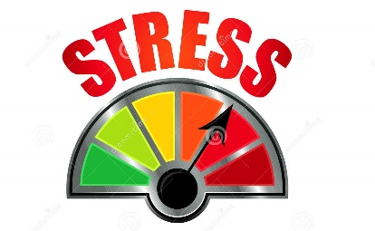
risk factors
Global epidemic
2018 report
NCD - the leading causes of
death & disability worldwide
41 million of the 55 million global deaths
in 2019 – due to NCDs
Unhealthy diet & physical inactivity
leading global risks to health
among the main NCD risk factors
Physical inactivity - 4th risk factor for global mortality
Lifestyle
The modern lifestyle working population
NCD
output

Slide 3
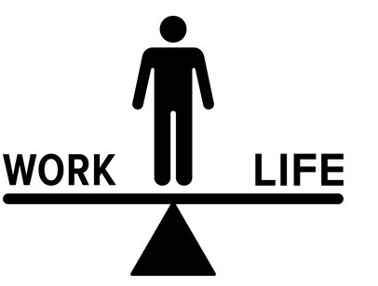
office-work
computer
‘office syndrome’
back-neck-muscles pain
headaches, lethargy
chronic fatigue, burnout
not defined working hours
"online" work, home-office
contributes to the "burnout" syndrome
disturbed life balance & healthy habits
disrupted circadian rhythm
Lifestyle – working population
health risks increase
short intervals of a sedentary lifestyle can cause
muscle loss
reduced aerobic capacity
fat deposition
low-level systemic inflammation
NCD development
sedentary time
111 min 2 years
Haß U, Herpich C, Norman K: Anti-inflammatory diets and fatigue. Nutrients 11(10): 2315, 2019.

Slide 4
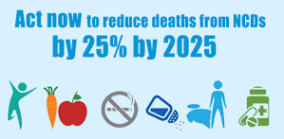
Lifestyle interventions
85% of chronic diseases caused by
unhealthy lifestyle choices
80% of
heart disease
stroke
T2 diabetes
40% of cancer
could be prevented
with
improvements to
DIET & LIFESTYLE
Lifestyle Medicine
Chronic diseases don’t develop overnight
No sharp borders between health and chronic disease

Slide 5
DFLY – Years lived without major chronic diseases
type 2 diabetes, coronary heart disease, stroke, cancer, asthma, chronic obstructive pulmonary disease COPD, heart failure, dementia
up to
+6 DFLY 0
+9 DFLY 0
16 lifestyle profiles studies
4 associated with the longest DFLY
BMI < 25 + min 2 : physical activity
never smoking, moderate alcohol cons.
0
risk factors
min.2
max.
Lifestyle & Disease-free Life years
risk factors
Study results suggest
a consistent association
both in men & women
Healthy lifestyle factors
DFLY
2020 JAMA Intern Med. Nyberg IF18.65 https://pubmed.ncbi.nlm.nih.gov/32250383/

Slide 6
WORK ENVIRONMENT
physical, mental and social health of employees
DIRECT IMPACT
Why workplaces ?
most adults spend a great part of their time
everyday behavior - becoming a pattern
ideal setting to provide healthy lifestyle strategies & programs
WHO strategy for the 21st century prioritizes health promotion programs using social environments such as the WORKPLACE.
Workplace health promotion
The Luxembourg Declaration defines workplace health promotion as
"the combined efforts of employers, employees and society to improve the health and well-being of people at work".
“Well-implemented workplace health promotion can lead to an improved working environment and reduced absenteeism.“ EU Agency for Safety and Health at Work
https://op.europa.eu/en/publication-detail/-/publication/ebba16aa-b224-4042-90e9-593fbf363200/language-en.
https://www.enwhp.org/resources/toolip/doc/2018/05/04/luxembourg_declaration.pdf
https://osha.europa.eu/sites/default/files/motivation-employers.pdf

Slide 7
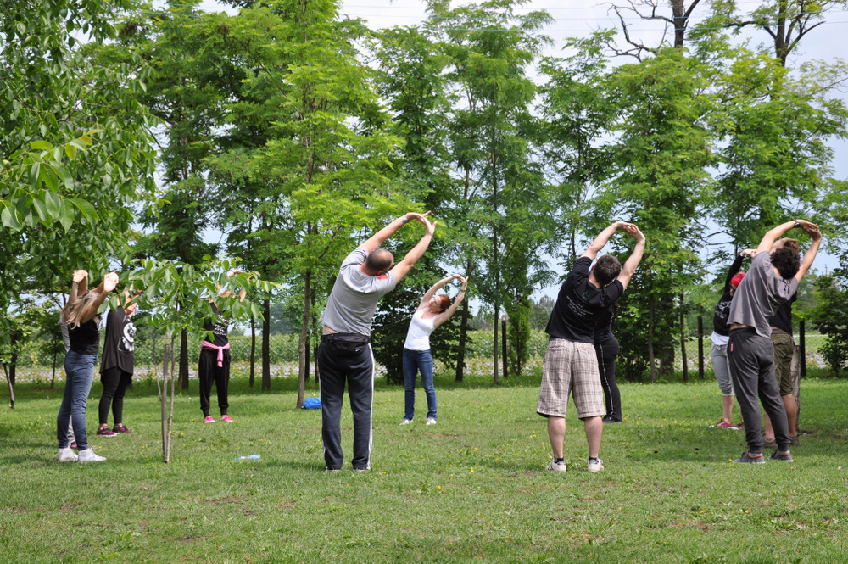
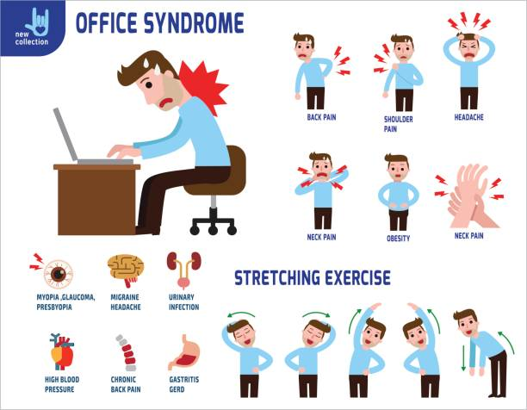
health & productivity employees
nutrition
exercise
IMPACT
worldwide recognized
workplace health promotion interventions
company economy
reported to
EU Commission
WHP ASPECTS to be included
Workplace health promotion - WHP
EXERCISES - short intervals physical exercises during the working day improve overall psycho-physical status.
NUTRITION - adequate workplace nutrition improves cognitive performance and employee’s well-being
BREATHING - breathing techniques interventions enhance mental balance and general health
SLEEPING – proper sleep schedule improves immune system function, improves productivity, presenteeism while reducing sick leave, and work-related burnout
https://www.apfisio.pt/wp-content/uploads/2018/08/Physical-Activity-at-the-Workplace.pdf

Slide 8
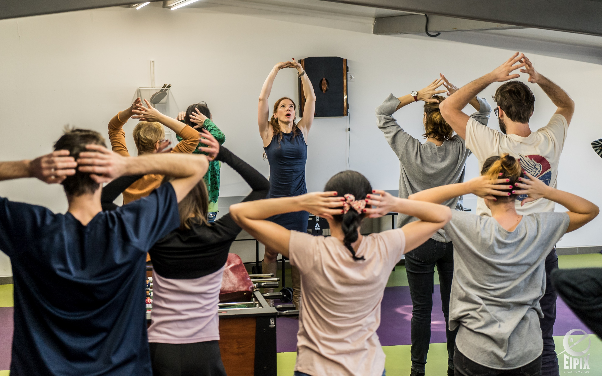
Added value for companies
Scientific principle
Interventions of proven effectiveness
care for employee
productivity and efficiency
the image of the company
Healthy food
Physical activity
Breathing exercises
Stress & sleep management
employee absenteeism
costs related to employee turnover and health
WHP - Results
incorporating world trends into its business
Added value for employees
Lifestyle changes
general psycho-physical condition
motivation and satisfaction for work
daily stress
improved health at the workplace
prevention of "burnout" syndrome and chronic fatigue
Hawkins, O'Garro, & Wimsett, 2009
https://pubsonline.informs.org/doi/abs/10.1287/mnsc.2017.2883
Song, Zirui, and Katherine Baicker. "Effect of a workplace wellness program on employee health and economic outcomes: a randomized clinical trial." Jama 321.15 (2019): 1491-1501.

Slide 9
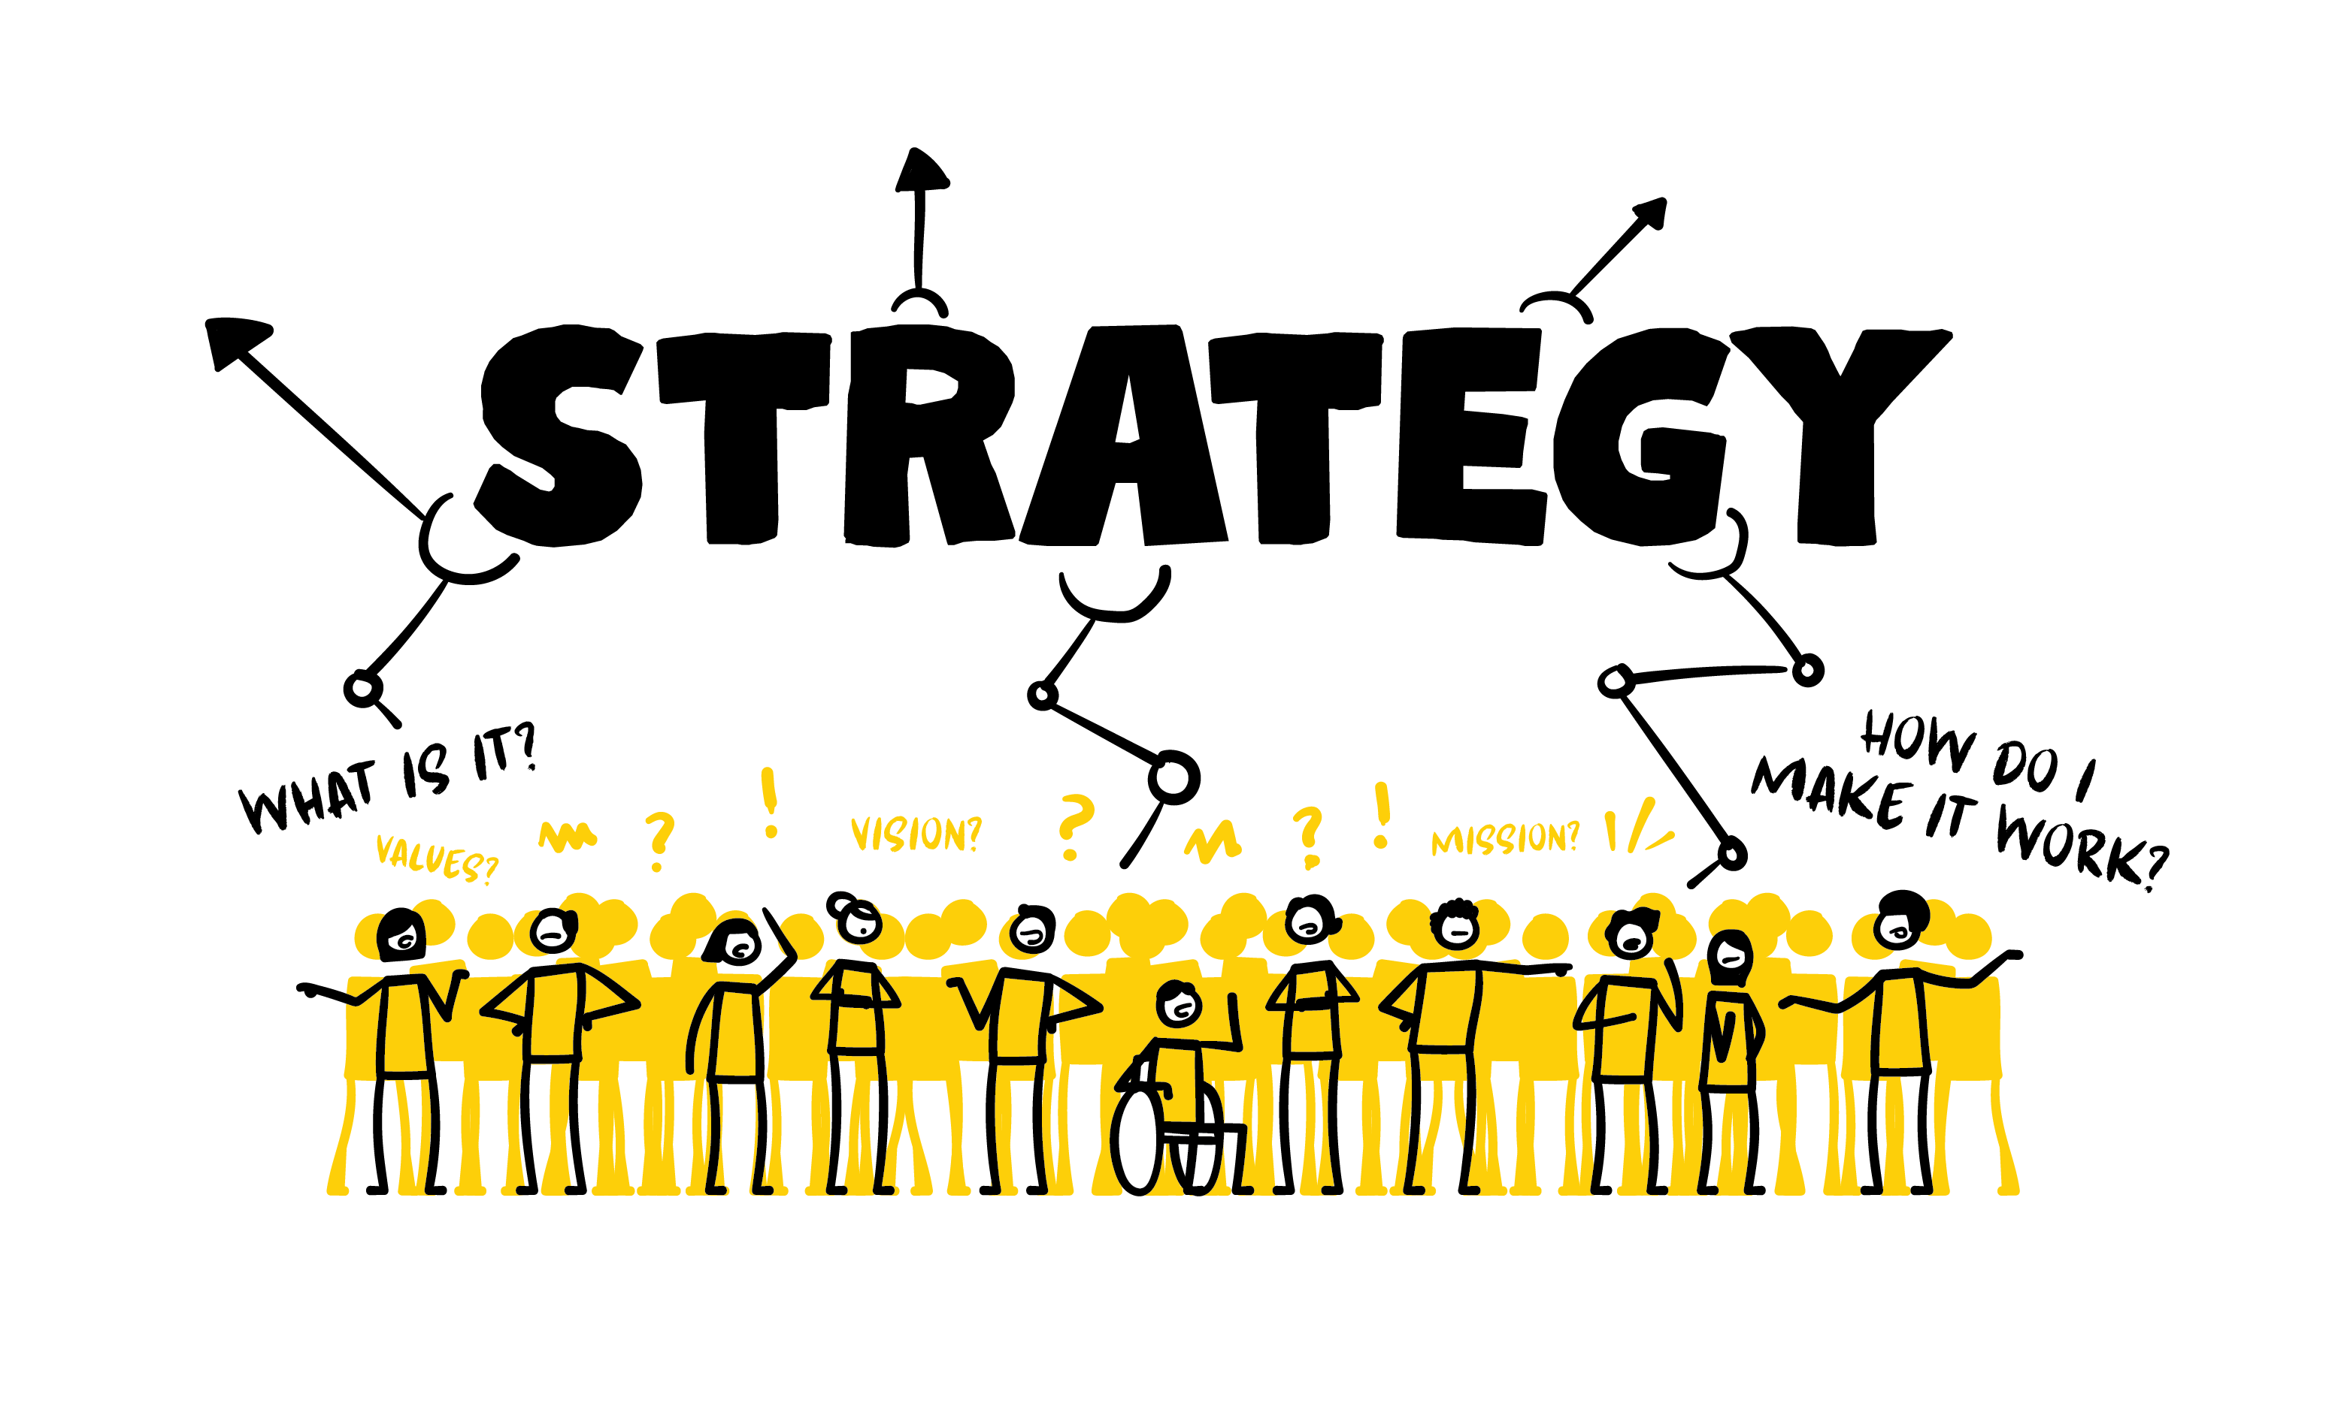
Current situation
Simple concept application
Successful
implementation strategies
participation rates often < 50%
attracted mostly employees adhering to
healthier lifestyle
Easy access to content
flexible approach
various communication channels
increasing motivation
stakeholders' involvement
education
WHP - Implementation
program benefits
effects on lifestyle changes
health policies
workplace environment
improve employee well-being
increase operational productivity
improve economic value
Interventions success depends on
Companies
stakeholders
program structure
management employee organization …
Employee with good health:
more likely to be at work
perform well
remain with an employer
Quality of
mental & physical form
productivity
providers
*

Slide 10
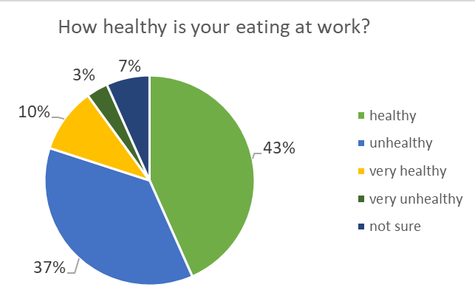
30 highly educated employees:
53% Healthy & very healthy eating
40% Unhealthy + very unhealthy eating
Not sure about eating habits at work - 7%
Workplace nutrition

Slide 11
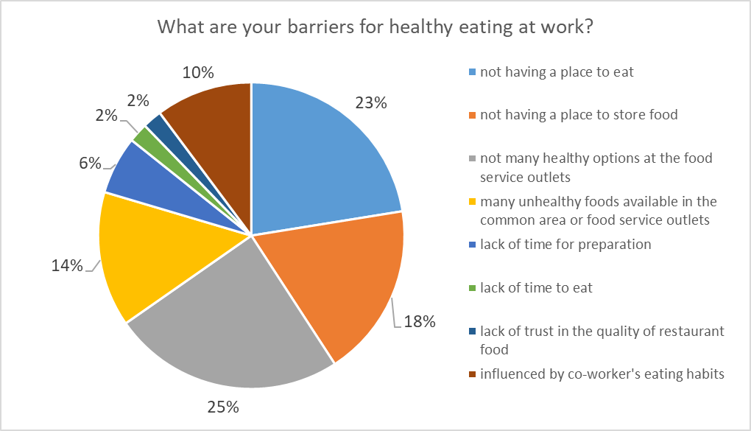
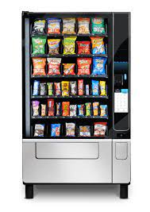
41% Lack of suitable PLACE
39% Availability healthy/unhealthy options
10 % Environment / co-workers
8% Lack of time
Workplace nutrition

Slide 12
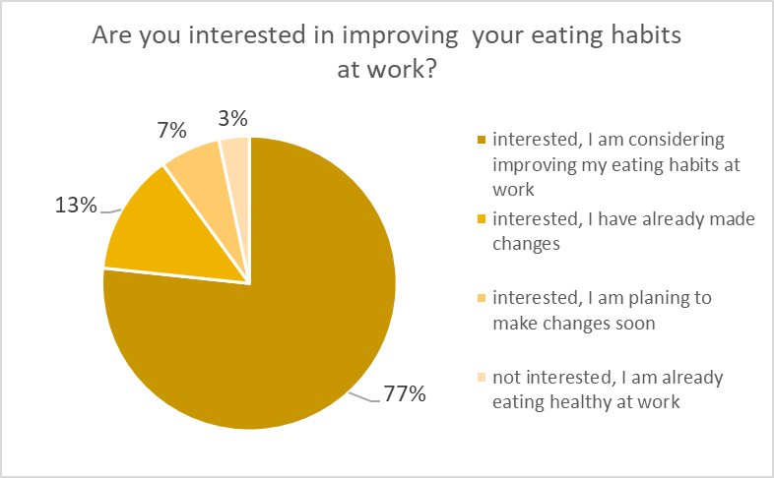
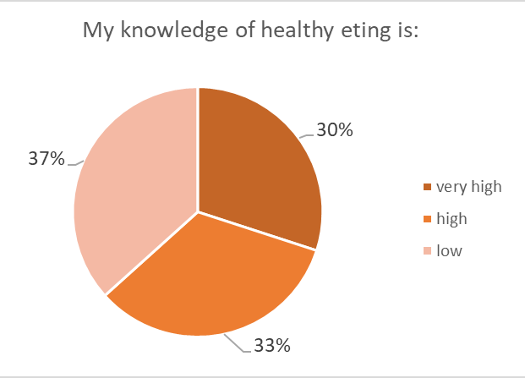
Workplace nutrition
ALL respondents are interested to improve habits
Interventions are HIGHLY recommended
Need for EDUCATION
Education will improve habits

Slide 13
Create physical spaces that support lifestyle interventions
Lead by example
WHP - Implementation
Develop workplace guidelines
Promote activities

Slide 14
Make ONE healthy choice.
Then, make ANOTHER..
Contact – Questions
Prof. Jelena Hélène Cvejić
jelena.cvejic@mf.uns.ac.rs
Thank you
Salseth - EU Horizon 2020 Marie Skłodowska-Curie grant agreement No. 872370.

