Slide 1
Caloric restriction in the management of cancer: lessons from in vivo studies and clinical trials
This research is co-financed by Greece and the European Union (European Social Fund-ESF) through the Operational Programme «Human Resources Development, Education and Lifelong Learning» in the context of the project “Strengthening Human Resources Research Potential via Doctorate Research” (MIS-5000432), implemented by the State Scholarships Foundation (ΙΚΥ)»
Aggelos T Margetis, MD
Internal Medicine-Oncology Residency Program, Athens Naval and Veterans Hospital
European Society for Clinical Nutrition and Metabolism
Mediterranean Lifestyle Medicine Institute

Slide 2
MD, Faculty of Medicine, National Kapodistrian University of Athens 2011-2017
Research Fellow, Department of Histology, Molecular Carcinogenesis Group, Faculty of Medicine, National Kapodistrian University of Athens 2017-2021
Internal Medicine-Oncology Residency Program, Athens Naval and Veterans Hospital 2020-today
Fundamentals of Integrative Oncology, certificated by Memorial Sloan Kettering Cancer Center 2022
Integrative Health and Medicine Certificated, online training, Minnesota University 2021
Nutrition and Disease Certificated, online training, Wageningen University and Research 2021
Cancer Survivorship Certificated, online training program, Washington Cancer Centre 2021
Geriatric Assessment and Geriatric Oncology Certificated, online training program, University of Rochester Medical Center 2021

Slide 3
Overview
Dietary restriction protocols ameliorate aging-related pathologies and carcinogenesis
Caloric restriction mechanisms of action
Preclinical data for CR in cancer management
Clinical data for CR in cancer management
Issues to be addressed and future perspectives

Slide 4
Overview
Dietary restriction protocols ameliorate aging-related pathologies and carcinogenesis
Caloric restriction mechanisms of action
Preclinical data for CR in cancer management
Clinical data for CR in cancer management
Issues to be addressed and future perspectives

Slide 5
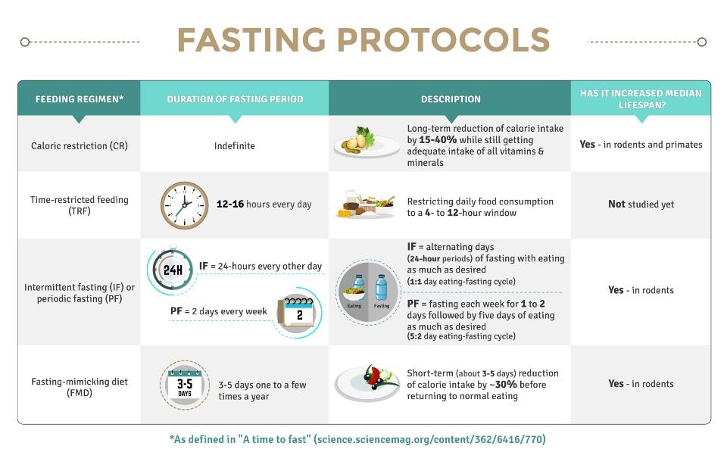

Slide 6
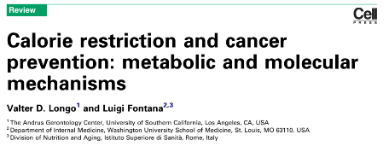
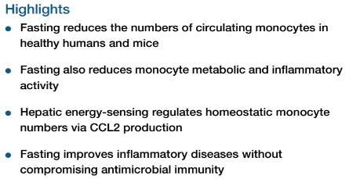
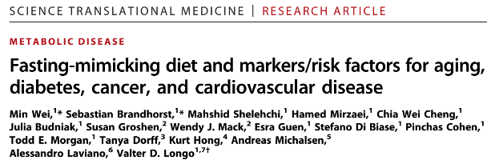
Dietary restriction protocols ameliorate aging-related pathologies and carcinogenesis

Slide 7
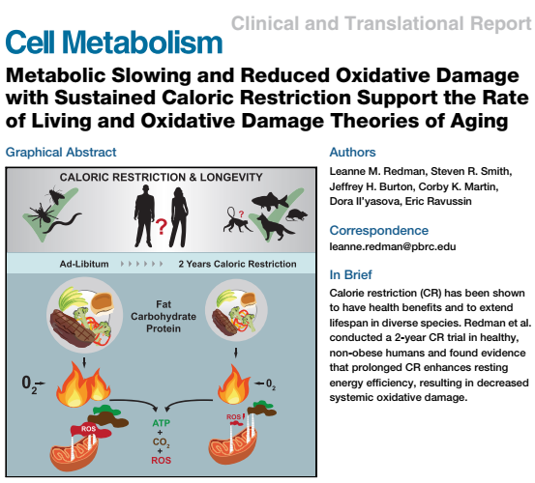
Dietary restriction protocols ameliorate aging-related pathologies and carcinogenesis

Slide 8
Overview
Dietary restriction protocols ameliorate aging-related pathologies and carcinogenesis
Caloric restriction mechanisms of action
Preclinical data for CR in cancer management
Clinical data for CR in cancer management
Issues to be addressed and future perspectives

Slide 9
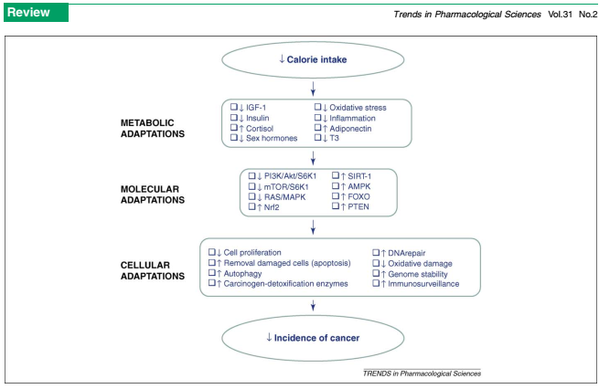
Caloric restriction: mechanisms of action

Slide 10
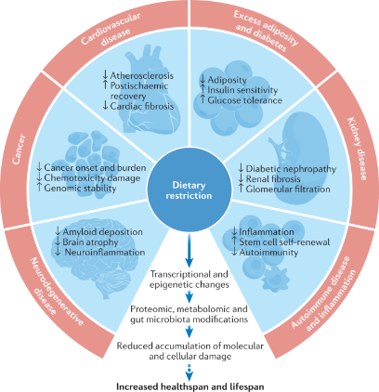
Caloric restriction: mechanisms of action
Molecular mechanisms of dietary restriction promoting health and longevity.
Green CL, Lamming DW, Fontana L. Nat Rev Mol Cell Biol. 2022 Jan;23(1):56-73.

Slide 11
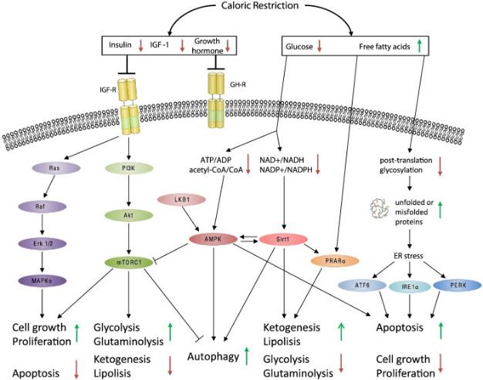
Caloric restriction: mechanisms of action
Caloric restriction - A promising anti-cancer approach: From molecular mechanisms to clinical trials. Kopeina GS, Senichkin VV, Zhivotovsky B. Biochim Biophys Acta Rev Cancer. 2017 Jan;1867(1):29-41

Slide 12
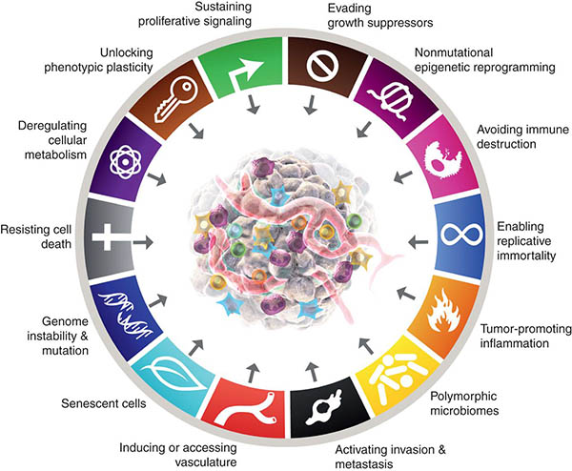
Caloric restriction: mechanisms of action
Insulin/IGF axis down-regulation
Metabolism rewiring
Angiogenesis disruption
Promoting apoptosis/cell death
Immune reprogramming
Metastasis amelioration

Slide 13
Overview
Dietary restriction protocols ameliorate aging-related pathologies and carcinogenesis
Caloric restriction mechanisms of action
Preclinical data for CR in cancer management
Clinical data for CR in cancer management
Issues to be addressed and future perspectives

Slide 14
Preclinical data for CR in cancer management
(Giovanella et al, 1982)
25-75% caloric restriction in Swiss nude mice
Tumor-inhibiting effects (lung, breast, colon)
Unfortunately all mice in 50% and 25% CR groups experienced severe weight loss and mortality; 75% CR group had a marginal weight loss
(Bunk et al 1992, Zhu et al 1991)
MUN-induced breast cancer in rats
70-75% CR showed anti-tumor effect
No side effects

Slide 15
Preclinical data for CR in cancer management
Brain cancer
Hybrid ketogenic-60% CR diet or 70% CR diet
Impressive results in variety of brain tumor models
Rare side effects, mainly weight loss <10%; some
mice subjected to 60% CR lost >20% of their body weight
Professor Thomas Seyfried.
Biology Department, Boston College,
Chestnut Hill, Massachusetts

Slide 16
Preclinical data for CR in cancer management
Breast cancer
70% CR along with chemotherapy exhibited synergistic anti-tumor effects and CR reversed chemotherapy-induced inflammation
70% CR along with irradiation synergistically inhibited tumor progression and metastasis
60-80% CR decreased breast cancer spread via remodeling
of systemic immune microenvironment ( Tregs, MDSCs,
CD8+ in peripheral tissues
60% CR protocol was accompanied by
significant weight loss (>20%) in two studies
Nicole Simone
Professor of Radiation Oncology and Integrative Medicine and Nutrition Sciences
SKCC Program Leader, Cancer Risk and Control Program
Radiation Lead of the Jefferson Breast Care Center

Slide 17
Preclinical data for CR in cancer management
Prostate cancer
60-70% CR alone or in combination with other agents showed promising results; 60% CR scheme was accompanied by 27% weight loss
Colon cancer
4 studies showed benefit of 70% CR; 10-25% weight loss

Slide 18
Preclinical data for CR in cancer management
Other cancer subtypes
Few data for lymphoma, ovarian, lung, liver, cervical cancer, lymphoma (60-75% CR regimens)
In pancreatic adenocarcinoma, weight loss >20% in mice treated with 60% and 70% CR schemes; somewhat problematic

Slide 19
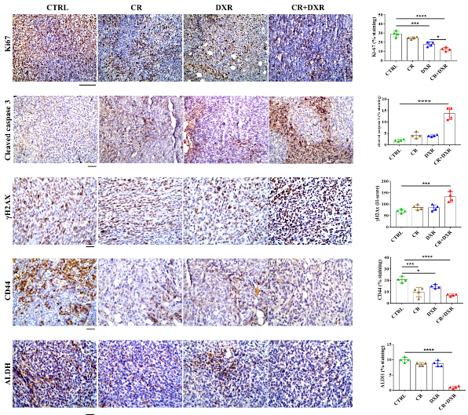
Preclinical data for CR in cancer management
70% CR plus DXR in 4T1 breast cancer model :
Synergistically promote apoptosis
Synergistically promote DNA damage
Synergistically decrease proliferation
Decrease markers of stemness which
are features of highly aggressive potential
(unpublished data from our group)

Slide 20
Overview
Dietary restriction protocols ameliorate aging-related pathologies and carcinogenesis
Caloric restriction mechanisms of action
Preclinical data for CR in cancer management
Clinical data for CR in cancer management
Issues to be addressed and future perspectives

Slide 21
Clinical data for CR in cancer management
Pilot study in overweight and obese prostate cancer patients
6-week 50-80% CR on personalized basis
CR induced slight weight loss (2%) and changes in serum biomarkers which may be related to better prognosis

Slide 22
Clinical data for CR in cancer management
NCT00444054
Pilot study in stage IV cancer patients
28-day 59-71% CR on personalized basis; ketogenic composition
Safe and feasible
Ketosis and decreased insulin were associated with stable disease or remission
Notes:
No major side effects

Slide 23
Clinical data for CR in cancer management
NL5624
Randomized controlled trial
Stage IV cancer patients receiving irinotecan
70% CR (+ 70% protein restriction) for 5days during 1st or 2nd cycle of chemo
Safe and feasible
Dietary regimen dramatically enhanced the bioavailability of the active metabolite of irinotecan, hence it may improve the therapeutic window
Notes:
No major side effects

Slide 24
Clinical data for CR in cancer management
NCT01754350
Randomized, controlled study in patients with recurrent glioma
Hybrid ketogenic-fasting diet (KD-FD) combined with irradiation versus standard diet plus irradiation
3days of KD (73% CR) followed by 3days of near-total fasting and again 3days KD (totally 9days)
No difference in progression-free survival or overall survival; but, patients on KD-FD with glucose<83.5mg/dl on day 6 had significantly longer PFS and OS
Notes:
Short-term fasting actually

Slide 25
Clinical data for CR in cancer management
DRKS00011610
controlled cross-over pilot study in patients with gynecological cancer
25% CR scheme for 96hr during half of chemotherapy cycles; half patients consumed a KD for 6days before CR
CR reduced the incidence of side effects and increased the tolerance of chemotherapy; KD subgroup had no substantial differences
Notes:
Short-term fasting actually

Slide 26
Clinical data for CR in cancer management
IDEAL trial NCT02708108
Combined CR scheme (60-80%) and exercise program
B-acute lymphoblastic leukemia
Safe and feasible
Intervention decreased fat mass in obese or overweight patients, ameliorated insulin resistance and decreased minimal residual disease
Notes:
Short-term fasting actually

Slide 27
Clinical data for CR in cancer management
Ongoing
NCT03162289
Breast and ovarian cancer patients
Randomized, controlled, two-armed interventional study
2 arms: 1) plant-based diet 350-700kcal daily from 48hr before until 24hr after chemotherapy infusion; 2) normocaloric wholefood plant-based diet with restriction of sugar and refined carbohydrates from 48hr before until 24hr after chemo
Outcomes: chemotherapy toxicity, QoL
Notes:
Short-term fasting actually

Slide 28
Clinical data for CR in cancer management
Ongoing
CREATE study NCT03131024
Breast cancer patients
Phase II randomized controlled trial
3 arms: 1) single, 30-min, vigorous-intensity, aerobic exercise session 24 h prior to each anthracycline treatment; 2) 50% CR for 48hr prior to each anthracycline treatment; 3) receive usual cancer care
Outcomes: chemotherapy toxicity in the terms of cardiovascular and skeletal muscle systems, fatigue, QoL, oxidative stress markers

Slide 29
Clinical data for CR in cancer management
Ongoing
DREAM study NCT03795493
Breast cancer patients
Phase II randomized controlled trial
2 arms: 1) 50% CR (ketogenic composition) for 48-72hr prior to each chemotherapy treatment and 30-60 min of moderate-intensity cycle ergometer exercise during each infusion, 2) receive usual cancer care
Outcomes: tumor burden (primary), chemotherapy toxicity in the terms of cardiovascular and skeletal muscle systems, QoL (tertiary)

Slide 30
Clinical data for CR in cancer management
Ongoing
NCT01886677
Overweight and obese prostate cancer patients
Randomized, controlled, two-armed study
1) Presurgical weight loss program via combination of personalized caloric restriction scheme (50-70% CR) and aerobic exercise, 2) wait-listed control arm
Outcomes: measures of feasibility, tumor and circulating biomarkers, gut microbiota changes

Slide 31
Overview
Dietary restriction protocols ameliorate aging-related pathologies and carcinogenesis
Caloric restriction mechanisms of action
Preclinical data for CR in cancer management
Clinical data for CR in cancer management
Issues to be addressed and future perspectives

Slide 32
Issues to be addressed and future perspectives
Diet adherence
Dietary and caloric monitoring
Micronutrients adequacy
Personalized dietary restriction may be essential
Dietary regimen duration
Inappropriate for patients with cancer cachexia
Inter-professional collaboration (nurses, fitness instructors, specialized dieticians, physicians)
Maintenance diet

Slide 33
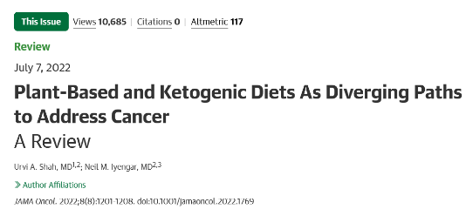
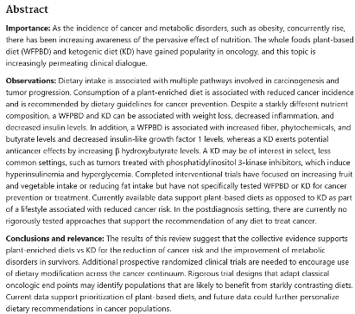
Plant-based diet
KD and CR diets
Cancer survivorship…

Slide 34
Issues to be addressed and future perspectives
Fasting and CR mimetics impact systemic and tumor immune microenvironment; concurrent immune-targeting therapies remain to be tested
PI3K inhibitors – induced hyperglycemia and hyperinsulinemia may be counteracted by CR schemes
TKIs along with restricted diets have shown synergistic anti-cancer effects in vitro and in vivo

Slide 35
Issues to be addressed and future perspectives
More clinical trials needed

Slide 36
Issues to be addressed and future perspectives
More clinical trials needed
More educational opportunities

Slide 37
Issues to be addressed and future perspectives
More clinical trials needed
More educational opportunities
More awareness of the general public about
nutritional and other lifestyle medicine
interventions in the management of cancer

