Slide 1
Supportive tools of Lifestyle medicine in rehabilitation and treatment protocol after traumas and chronic pain
Elena Gopchuk
MD PHD
Athens, 2022

Slide 2
Pain — has an Element of Blank — It cannot recollect When it begun — or if there were A time when it was not …
Emily Dickinson,
American poet 1930-1986

Slide 3
Pain takes away our ability to enjoy the small moments, but through science, we can help relieve pain and get back to doing what we love.

Slide 4
Lifestyle medicine strategies, such as incorporating whole foods and a plant-based diet, sustainable physical activity and mind-body exercises, restorative sleep, stress resiliency, awareness and mitigation of substance abuse and addiction, and establishing meaningful social networks and self-care strategies, is a part of managing chronic pain.

Slide 5
Pain Neuroscience Education for People With Chronic Pain
Pain neuroscience education (PNE) and motivational interviewing (MI) widely implemented and tested in the field of chronic pain management, and both strategies have been shown to be effective in the short term for the management of chronic pain.
The goal of PNE is to optimize patients pain beliefs/perceptions to facilitate the acquisition of adaptive pain-coping strategies.
MI is a patient-centered communication style for eliciting and enhancing motivation for behavior change by shifting the patient away from a state of indecision or uncertainty.
Clinicians can integrate PNE and MI in the treatment of patients experiencing chronic pain.

Slide 6
Pain Neuroscience Education for People With Chronic Pain
Jo Nijs @JoNijsBE Phys Ther
2020 May 18;100(5):846-859. doi: 10.1093/ptj/pzaa021.
Integrating Motivational Interviewing in Pain Neuroscience Education for People With Chronic Pain: A Practical Guide for Clinicians
paininmotion.be

Slide 7
Pain Neuroscience Education for People With Chronic Pain
Jo Nijs @JoNijsBE Phys Ther 2020 May 18;100(5):846-859. doi: 10.1093/ptj/pzaa021.
Integrating Motivational Interviewing in Pain Neuroscience Education for People With Chronic Pain: A Practical Guide for Clinicians
paininmotion.be

Slide 8
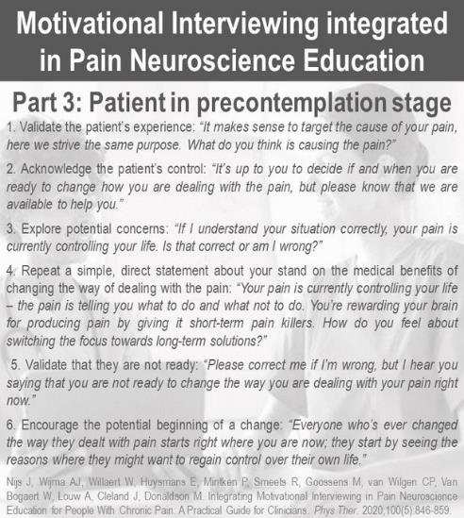
Pain Neuroscience Education for People With Chronic Pain
Jo Nijs @JoNijsBE Phys Ther 2020 May 18;100(5):846-859. doi: 10.1093/ptj/pzaa021.
Integrating Motivational Interviewing in Pain Neuroscience Education for People With Chronic Pain: A Practical Guide for Clinicians

Slide 9
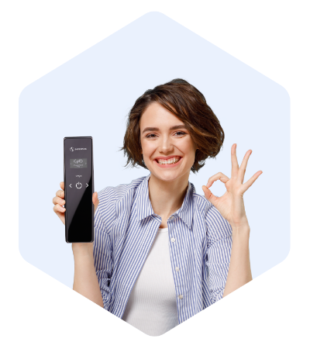
SENSONICA – visualizing the invisible.
Sensonica is an international company, established in 2017 by the group of scientists and engineers.
Wellness Devices That Rely on Science
detectors and generators of non-ionized radiation.
Application of our detectors and generators in various areas of human life & activity, getting & giving the ability to control & conduct connection between cosmic non-ionizing radiation and biological life on Earth.
Nowadays, our interests include human health, wellbeing, agriculture, astronomy and metallurgy, chemistry, space weather and seismic activity detection.
With our new technologies, we want to help people live better quality lives in the endlessly fast changing conditions all over the globe.

Slide 10
For a technological development task, we made random number generator hardware, based on luminescence, but instead of a random process, certain patterns were found in the phosphor’s brightness fluctuations, which we began to study. We proved the link of these fluctuations with cosmic processes, in particular, solar activity and non-ionizing radiation.
https://sensonica.com

Slide 11
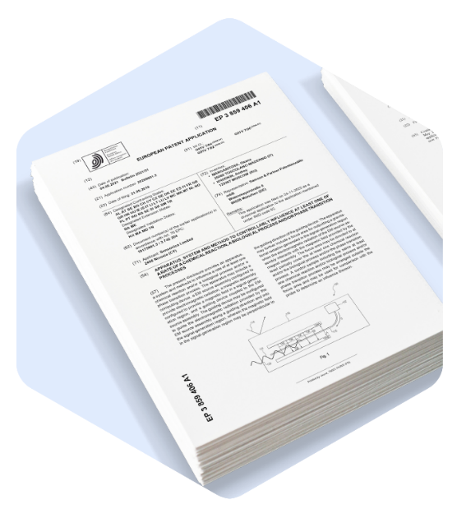
17 patents and applications US and EU
US20190154844 05/23/2019
DETECTION APPARATUS AND METHOD FOR MEASURING THE EFFECT OF RADIATION ON BIOLOGICAL OBJECTS Radiation detection arrangement and method for measuring the effect of radiation on a biological object using (thermally activated delayed fluorescence) TADF material-based detection of radiation.
US20200371269 11/26/2020 INFORMATION EXCHANGE USING GRAVITATIONAL WAVES Radiation detection arrangement and method for detection of external radiation using TADF material.
https://sensonica.com/patents

Slide 12
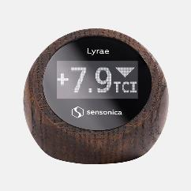
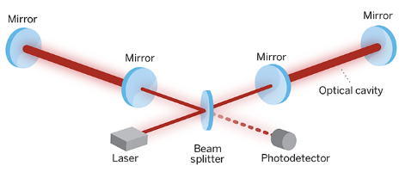
Herzenstein effect
Gravitational waves are perturbations of the gravitational field that propagate like ripples on water. They can travel great distances without interacting with matter, so they are a valuable source of information about the various events and can do various biological influences.
These could be mergers of neutron stars and black holes, the last stages of the collapse of stellar cores. For the first time, gravitational waves were detected by the LIGO detector in 2015, and the reason for their creation was precisely the merger of two black holes.
First time use an optical interferometer ( Michelson interferometer) as a detector of gravitational waves was proposed by Soviet scientists M.E. Herzenstein and V.I. Pustovoit in 1962 .
American professor Rainer Weiss proposed increasing the effective length of the arms of the interferometer due to multiple reflections of the optical beam from the mirrors located in each arm. That is, having run a shoulder 3 km back and forth a hundred times, the beam will make a run of 300 km. As a result, the Weiss-proposed detector is able to measure the change in length of one of the shoulders by 10 ⁻¹⁸ m.
https://sudonull.com/post/56898-Updated-gravitational-wave-detector-will-work-this-year
Detector LIGO USA

Slide 13
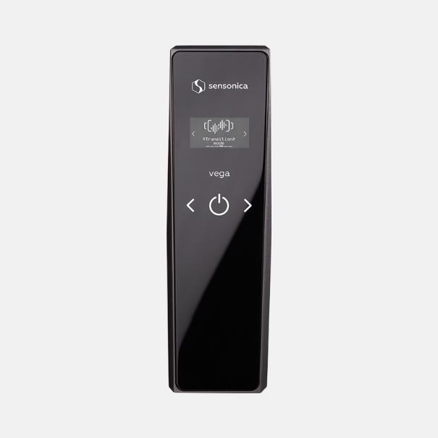
Vega
Sensonica Vega is a portable, non-invasive, directional non-ionizing radiation device based on the Herzenstein effect which allows you to fight chronic pain.
Vega affects the processes occurring in the connective tissue, which stops both acute and chronic inflammatory reactions, leading to a therapeutic effect and elimination of inflammatory symptoms (pain, swelling, hyperemia, dysfunction, etc.).

Slide 14
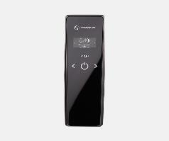
https://youtu.be/QzjfVIylu8c
Sensonica Vega is a fully autonomous device designed for personal use in session mode.
Vega is equipped with a rechargeable battery, display and keyboard and makes it possible to choose pre-programmed application modes, as well as the power and duration of treatment.
Vega dimensions: 221 x 65 x 55 mm.
Case dimensions: 275 x 225 x 120 mm.
Weight: 2 kg.
Power consumption in charging/operating mode: up to 40/30W.
Battery life at maximum power: 15 minutes.
Power source – supports PD3.0 charging technology, 45 watts of power, Type-C connector.
Comfortable handle for holding in your hand.
Operating conditions: ambient temperature: +10 – +35 degrees and 10-90% humidity.
Warranty period of device operation (daily use, 30 minutes) – 1 year.
Assigned service life – 3 years.

Slide 15
Inside Vega’s compact body is a broadband Gertsenshtein generator consisting of a resonator, an extremely powerful magnetic system and a coherent radiation source based on a pair of powerful laser emitters. Since our device’s non-ionizing radiation power is about 100 times lower than the average level of natural cosmic radiation, the device is not able to dramatically affect the living organism in a negative way.
The therapeutic effect is achieved by fine-tuning the characteristics of the radiation, and the shape and frequency of the generated signal. The device has a narrow directional pattern, which allows you to affect individual parts of the body in isolation, without affecting the entire body.

Slide 16
One of the device’s uses is to improve blood and lymph circulation after an injury and reduce symptoms of inflammation, especially joint pain. Thanks to Gertsenshtein waves’ action on the human body, blood circulation is activated, inflammation is reduced, and metabolism in cells and tissues is improved.
Vega affects the processes occurring in the connective tissue, which stops both acute and chronic inflammatory reactions, leading to a therapeutic effect and elimination of inflammatory symptoms (pain, swelling, hyperemia, dysfunction, etc.).
Vega is recommended after trauma, including recovery from sports injuries (sprains, contusions, rehabilitation after fractures), rehabilitation of muscle and ligament structure disorders, bone and cartilage tissue lesions, periosteum and blood and lymph plexus of treated areas of the body.

Slide 17
Nonrandomized volunteering study
Objectives: The aim of this study was to observe the medium-term effects on joint pain with the use of Vega
Methods: 30 patients were nonrandomly selected in Riga University Hospital. The primary outcome was legs joints pain. 15 min Vega ionization daily within 2 weeks. Questioner (q) of complains and symptoms was filled up at 1 month and 3 months after treatment.
Conclusion: effective at reducing chronic non-specific pain and disability according to q at 3-month follow-up was detected improvements in reduce of pain complains, kinesiophobia, pain anxiety, and pain-related beliefs.

Slide 18
WE ARE LOOKING FOR THE PARTNERS TO COLLABORATE
research laboratories, universities, clinics, doctors, physiotherapist to continue discover effects of patented technology
Research
Sales B2B B2C
Education - Sensonica school of healthy lifestyle

Slide 19
info@sensonica.com
Dr Elena Gopchuk
gopchuk@gmail.com
@Elena.Gopchuk

