Slide 1
MEASURES THAT IMPLEMENT LIFESTYLE MEDICINE IN THE COMMUNITY
Presentation by Roxanne Mihaela Marinescu-Wellness Alliance
CHRISTIANA NURSING SCHOOL ROMANIA – NURSING UNC CHARLOTTE
NURSING WINSTON SALEM STATE
Attending JOHN PATRICK INTEGRATIVE AND LIFESTYLE MEDICINE UNIV
MEMBER OF AMERICAN COLLEGE OF LIFESTYLE MEDICINE, EUROPEAN LIFESTYLE MEDICINE ORGANIZATION, AND ROMANIAN SOCIETY OF LIFESTYLE MEDICINE
Notes:
Hello, I'm Roxana Marinescu. I'm a nurse with initial studies in Romania continuing with bachelor's and master studies in the USA with a focus on well-being and lifestyle medicine. I will present here the Leadership Competence that includes the Community Implementation and Leadership Advocacy . In Romania, I have a wellness consulting startup and health counseling (so far I have offered health counseling to patients with chronic conditions and social cases), I have also been active alongside political and local authorities, as an influencer. I invite you to watch my YouTube channel Wellness Alliance and my FB page with the same name.

Slide 2
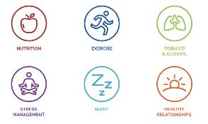
MEASURES THAT IMPLEMENT LIFESTYLE MEDICINE IN THE COMMUNITY LIFESTYLE MEDICINE 6 PILLARS
LIFESTYLE MEDICINE IS A MEDICINE THAT PREVENTS AND TREATS BY RECOMMENDING HEALTHY LIFESTYLE ROUTINES INTEGRATING BODY-MIND-SOUL AND SPIRIT DIMENSIONS. ITS 6 PILLARS INCLUDE: HEALTHY NUTRITION, REGULAR PHYSICAL ACTIVITY, HEALTHY SLEEP, EMOTIONAL WELLNESS AND RELAXATION PRACTICES, POSITIVE PSYCHOLOGY PRACTICES, POSITIVE CONNECTEDNESS AND MEANINGFUL SOCIAL RELATIONS, STAYING AWAY FROM ADDICTIVE HABITS AND TOXIC SUBSTANCES

Slide 3
MEASURES THAT IMPLEMENT LIFESTYLE MEDICINE IN THE COMMUNITY
I. LEGISLATION AND FINANCIAL SUPPORT
II. COMMUNITY HEALTH PROGRAMS
III. COMMUNITY HEALTH EDUCATION AND AWARENESS
IV. COMMUNITY HEALTHY SPACES
V. COMMUNITY HEALTH CENTERS
Notes:
Legislation and community implementation have a huge role. If we do not have a Culture for healthy living we can not obtain health in our population. At this time, I do not visibly see that the young generation has acquired the righ education in schools to care for themselves against illness .

Slide 4
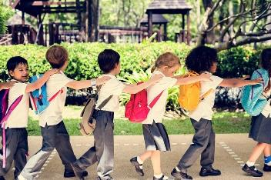
MEASURES THAT IMPLEMENT LIFESTYLE MEDICINE IN THE COMMUNITY I. LEGISLATION AND FINANCIAL SUPPORT
LEGISLATION THAT REFORMS THE EDUCATION SYSTEM AND PROVIDES MORE TIME FOR PRACTICAL WELLNESS AND HEALTHY LIVING ACTIVITIES INTO THE CURRICULA
( EQUAL TIME DEVOTED TO PRACTICAL /ACADEMIC, EXPERIENTIAL/ THEORETICAL ACTIVITIES )
MINISTRY OF EDUCATION TO PROVIDE THE OPPORTUNITY OF COLLABORATION WITH ALLIED HEALTH BUSINESSES AND NGOS TO INCLUDE IN THE SCHOOL /COLLEGE
CURRICULA HEALTH EDUCATION 1-12 /A ND TO PROVIDE EXPERT INSTRUCTORS COME TO TEACH CLASSES ON WELLBEING AND FITNESS
Notes:
Equal time for students to exercise, be active, connect, and relax as for academic work ; we know that children after 6 yo benefit from cardio, as well as resistance exercises to build cognition, bone, muscles

Slide 5
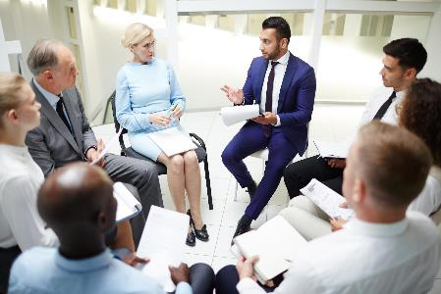
MEASURES THAT IMPLEMENT LIFESTYLE MEDICINE IN THE COMMUNITY I. LEGISLATION AND FINANCIAL SUPPORT
- MINISTRY OF HEALTH TO CREATE A
PREVENTION /HEALTHY LIVING DEPARTMENT
THAT WILL ASSIST WITH HEALTHY LIVING EDUCATION
AND COACHING ALL CLINICAL VISITS FOR CHRONIC
PATIENTS AND PREGNANT WOMEN , AND SERVICES
WILL BE COVERED BY ALL INSURANCES-
-HEALTH EDUCATION AND COACHING TO BE CREATED
AS A NEW PROFESSION IN THE CODE OF LABOR
THIS NEW PROFESSIONAL ( BELONGING TO MULTIPLE BACKGROUNDS) WILL EDUCATE AND MOTIVATE THE CHRONIC PATIENT OR PREGNANT WOMAN INTO HEALTHY LIVING AND OFFER CUSTOMIZED RECOMMENDATIONS BASED ON THEIR CONDITION FOR ALL PILLARS OF HEALTH

Slide 6
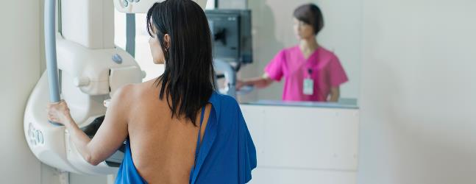
MEASURES THAT IMPLEMENT LIFESTYLE MEDICINE IN THE COMMUNITY I. LEGISLATION AND FINANCIAL SUPPORT
-A DATABASE WITH PROTOCOLS OF HEALTHY LIFESTYLE FOR EACH HEALTH CONDITION TO BE CREATED AND USED IN CLINICAL VISITS AND OFFERED TO THE PATIENTS ( DIGITAL APPS WOULD REPRESENT A HUGE PLUS FOR INDIVIDUAL USE AS
WELL AS GROUP VISITS ) INCLUSION AND COVERAGE OF ALL PREVENTIVE SCREENINGS IN THE MEDICAL MODEL BASED ON STATISTICAL DATA FOR THAT COUNTRY /REGION( SUCH AS MAMMOGRAMS, DEXA SCANS, COLONOSCOPY, …) BASED ON RISK , CONDITIONS AND AGE

Slide 7
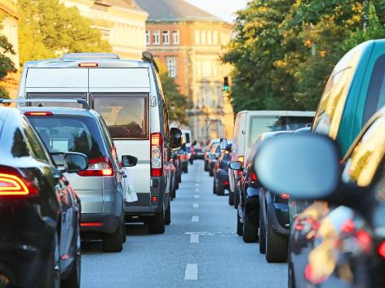
MEASURES THAT IMPLEMENT LIFESTYLE MEDICINE IN THE COMMUNITY I. LEGISLATION AND FINANCIAL SUPPORT
-LEGISLATION THAT CREATES NEW ENVIRONMENTAL STANDARDS SUCH AS FOR NOISES IN THE URBAN AREAS AND AIR POLLUTION
PRESERVATION ( SUCH AS FORBIDDING SMOKING OR
REQUIRING THE SEPARATION OF SMOKING ZONES
IN PUBLIC SPACES-TERRACES, BEACHES )
NOISE RADARS THACT AUTOMATICALLY ISSUE
FINES TO LOUD VEHICLES TO COMBAT NOISE
POLLUTION
-LEGISLATION THAT PROMOTES COMPANIES THAT
SUPPORT HEALTHY LIVING
-LEGISLATION THAT REQUIRES COMPANIES LEADERSHIP
TO TAKE HEALTHY LIVING CONTINUING EDUCATION ABOUT THEIR EMPLOYEES, PRODUCTS/INDUSTRY AND CLIENTS IN ORDER TO PROTECT HEALTH AND PREVENT OCCUPATIONAL ILLNESS, FURTHER INJURIES AND REDUCE HEALTH EXPENSES

Slide 8
MEASURES THAT IMPLEMENT LIFESTYLE MEDICINE IN THE COMMUNITY I. LEGISLATION AND FINANCIAL SUPPORT
FINANCIAL INCENTIVES TO BE GIVEN FOR PERMANENT COMMUNITY PROGRAMS
THAT PROMOTE HEALTHY LIVING EACH MAYOR’S
OFFICE TO ESTABLISH AND FUND A PERMANENT
DEPARTMENT FOR HEALTHY LIVING FOR ALL,
INCLUDING PERSONS WITH DISABILITY
( PREVENTION IS MUCH ECONOMIC THAN ILLNESS
AND COSTS THE GOVERNMENT MUCH LESS MONEY )

Slide 9
MEASURES THAT IMPLEMENT LIFESTYLE MEDICINE IN THE COMMUNITY II. COMMUNITY HEALTH PROGRAMS
COMMUNITY HEALTH CLASSES SHAPE A CULTURE OF WELLNESS AT THE LOWEST LEVEL OF INCOME, DIFFICULTY, EXPERIENCE AND STRENGTH
COMMUNITY MENTAL HEALTH AND RELAXATION
CLASSES ASSIST WITH STRESS, ANXIETY
HEALTH CLASSES FOR PREGNANT WOMEN:
PRENATAL YOGA AND
HEALTHY LIVING EDUCATION
COMMUNITY GROUPS FOR SENIORS AND WIDOWS
FOR SOCIALIZING ( MENTAL HEALTH)
SENIORS AVAILABLE ACCESS TO FITNESS CLASSES ( OF ALL AGES )

Slide 10
MEASURES THAT IMPLEMENT LIFESTYLE MEDICINE IN THE COMMUNITY II. COMMUNITY HEALTH PROGRAMS
COMMUNITY PROGRAMS DESIGNED BY STATE INSTITUTIONS IN COLLABORATION WITH NGOS TO SUPPORT ACTIVE LIFESTYLE AND SOCIAL CONNECTEDNESS, INCLUDING VULNERABLE CATEGORIES ( BUT NOT SEPRATIMG
THEM FROM THE REST) - SENIORS, WIDOWERS,
PERSONS TEMPORARILY UNEMPLOYED, CITIZENS
WITH A HEALTH CONDITION, PREGNANT WOMEN
COMMUNITY FITNESS CLASSES TO SUPPORT WELLNESS
IN ALL 4 AREAS: BALANCE, STRETCHING, RESISTANCE ,
AND CARDIOVASCULAR

Slide 11
MEASURES THAT IMPLEMENT LIFESTYLE MEDICINE IN THE COMMUNITY II. COMMUNITY HEALTH PROGRAMS
COMMUNITY OUTDOOR ACTIVITIES AT THE BEGINNER LEVEL, SUCH AS WALKS, RUNS, HIKES AND KAYAKING AVAILABLE FOR ALL AGES, FOR FREE OR AT A LOW COST
SWIMMING POOLS ACCESSIBLE FOR CHILDREN IN ALL AREAS AT A LOW COST
COMMUNITY MENTAL HEALTH CLASSES THAT OFFER NEURO PROGRAMMING, POSITIVE AFFIRMATIONS, GUIDED HYPNOTHERAPY, GOALS SETTING PRACTICE, AND JOURNALING TO BE ACCESSIBLE IN SCHOOLS AS WELL AS AFTER
COMMUNITY TRADITIONAL CLASSES FOR
HEALTH SUCH AS QI GONG AND TAI CHI ,
YOGA TO BE AVAILABLE IN ALL RURAL AND
TOWN LOCATIONS AT LOW COST
Notes:
CURRENT COMMUNITY PROGRAMS FOR HEALTH THAT ARE OFFERED THROUGH NGO’S ARE NOT PERMANENT WITH A PERMANENT AND SPECIALIZED STAFF, SCHEDULE AND LOCATION

Slide 12
MEASURES THAT IMPLEMENT LIFESTYLE MEDICINE IN THE COMMUNITY III. COMMUNITY HEALTH EDUCATION AND AWARENESS
COMMUNITY HEALTH EDUCATION NEEDS TO START
WHEN VERY YOUNG AND TO BE HOLISTIC,
BUILDING THE BELIEF THAT WE EMPOWER
OURSELVES THROUGH OUR LIFESTYLE
CHILDREN NEED TO START TO LEARN ABOUT
HEALTHY LIVING IN SCHOOL – AND THE
IMPORTANCE OF ALL 6 PILLARS OF HEALTH – THEIR EDUCATION NEEDS TO BE PROGRESSIVE 1-12 , ACCORDING TO THEIR UNDERSTANDING AND FOCUSED ON PRACTICE
PHYSICAL ACTIVITY OPTIONS IN SCHOOLS TO BE DIVERSE AND CHILDREN TO HAVE THE CHOICE TO SELECT THE LEVEL OF DIFFICULTY AND THE TYPE OF PHYSICAL ACTIVITY THEY ENJOY AND NOT BE FORCED INTO A SPORT THEY DO NOT FEEL FIT FOR ( FOR EX YOGA VS LONG-DISTANCE RUNNING OR OTHER COMPETITIVE STRENUOUS SPORTS)

Slide 13
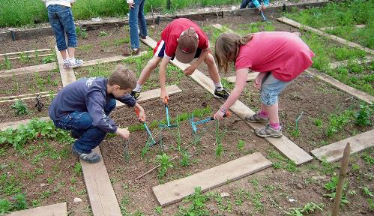
MEASURES THAT IMPLEMENT LIFESTYLE MEDICINE IN THE COMMUNITY III. COMMUNITY HEALTH EDUCATION AND AWARENESS
STUDENTS WITH DISABILITY OR A HEALTH CONDITION NOT BE WAIVED OF PHYSICAL ACTIVITY BUT OFFERED VARIOUS EASY OPTIONS
STUDENTS TO BE EXPOSED TO HEALTHY COOKING,, GARDENING, MENTAL RELAXATION PRACTICES, SELF-HYGIENE, AND SELF ESTHETICAL CARE
STUDENTS TO LEARN THAT FOODS CAN BE MEDICINES
AND WHAT FOODS TO ACCESS FOR WHAT SYSTEMS
AND PROBLEMS, AND WHAT PRACTICAL ACTIVITIES
TO DO FOR MENTAL STRESS CHILDREN TO BE TAUGHT
EMOTIONAL AND RELATIONAL SKILLS TO POSITIVELY
AND PROACTIVELY RELATE TO OTHERS AND AVOID
PREVENT HATE / AGGRESSIVENESS
- STUDENTS IN MEDICAL, NURSING, AND ALLIED PROFESSIONS TO BE TRAINED THEORETICALLY AND PRACTICALLY IN A HEALTHY LIFESTYLE FOR ALL PILLARS

Slide 14
MEASURES THAT IMPLEMENT LIFESTYLE MEDICINE IN THE COMMUNITY III. COMMUNITY HEALTH EDUCATION AND AWARENESS
--IN SCHOOLS, HEALTHY HABITS TO BE TAUGHT AS CENTRAL WAYS FOR OBTAINING A GOOD HEALTH
-QUESTIONNAIRES AND DISCUSSIONS ABOUT WELLNESS
AND HEALTHY ROUTINES TO BE THE FIRST LEVEL
OF PREVENTIVE HEALTH CARE- AND OFFERED
IN SCHOOLS, COLLEGES AND CLINICS
-WELLNESS QUESTIONNAIRES ABOUT HEALTHY ROUTINES TO BE OFFERED IN ALL CLINICAL SETTINGS FOR CHRONIC PATIENTS AND PREGNANT WOMEN

Slide 15
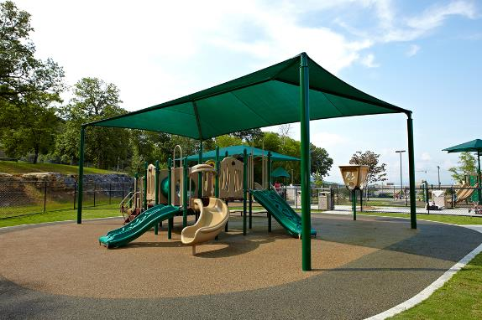
MEASURES THAT IMPLEMENT LIFESTYLE MEDICINE IN THE COMMUNITY IV. COMMUNITY HEALTHY SPACES
FILTERED DRINKING WATER TO BE AVAILABLE IN AREAS THAT ARE EXPOSED TO SUN AND WHERE PEOPLE HAVE TO WAIT, AND PLAY FOR LONG TERM
COMMUNITY PARKS TO PROVIDE SHADED AREAS FOR RELAXATION AND TABLES FOR PICNIC
PLAYGROUNDS AND SPORTS GROUNDS (BASKET, VOLLEYBALL) TO BE COVERED AGAINST UV RADIATION

Slide 16
MEASURES THAT IMPLEMENT LIFESTYLE MEDICINE IN THE COMMUNITY IV. COMMUNITY HEALTHY SPACES
PLAYGROUNDS AND PARKS TO BE LIT DURING
EVENINGS TO PROLONG THE PLAYTIME
PUBLIC LIBRARIES AND INSTITUTIONS
HAVE A DESIGN THAT SUPPORTS
COMMUNICATION ( WITH ROUND TABLES
AND LARGER SITTING AREAS )

Slide 17
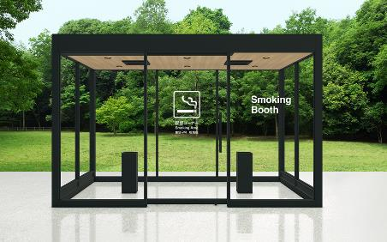
MEASURES THAT IMPLEMENT LIFESTYLE MEDICINE IN THE COMMUNITY IV. COMMUNITY HEALTHY SPACES
SMOKING AREAS TO BE DELIMITED FROM NONSMOKING ONES, INCLUDING AT BEACHES, AND PUBLIC TERRACES ( IN ORDER TO PROTECT BABIES, PREGNANT WOMEN, SENIORS, AND NONSMOKERS) OR TO BE FORBIDDEN
NOXES FROM CARS AND TRUCKS TO BE FINED FOR POLLUTION, AS FOR SPEEDING, TO PREVENT AND PROTECT AGAINST CANCER, ASTHMA AND VULNERABLE CATEGORIES: BABIES, CHILDREN, ELDERS
NOISE FROM CARS, AMBULANCES, AIRPLANES TRAFFIC TO BE REDUCED /REDIRECTED TO PROTECT AGAINST STRESS / MENTAL ILLNESS

Slide 18
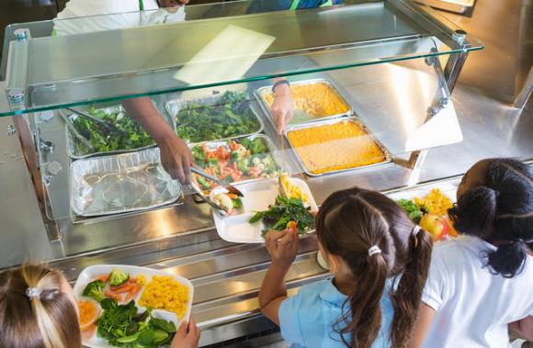
MEASURES THAT IMPLEMENT LIFESTYLE MEDICINE IN THE COMMUNITY IV. COMMUNITY HEALTHY SPACES
RESTAURANTS AND CAFETERIAS TO BE GIVEN INCENTIVES TO SELL HEALTHY FOODS AND MENUS –FOR OVERWEIGHT, DIABETES, HYPERTENSION, IMMUNITY AND BRAIN ( AND EVALUATED BY A STARS’ SYSTEM THAT PROMOTES HEALTH)
FITNESS-RELATED BUSINESSES TO RECEIVE INCENTIVES TO OFFER CLASSES WITH A LOW LEVEL OF DIFFICULTY FOR DIVERSE CONDITIONS OF HEALTH / DISABLED

Slide 19
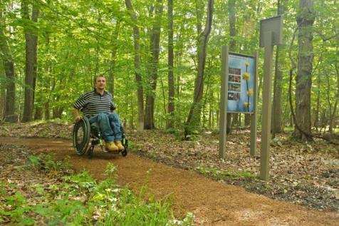
MEASURES THAT IMPLEMENT LIFESTYLE MEDICINE IN THE COMMUNITY IV. COMMUNITY HEALTHY SPACES (RURAL, TOWNS)
BUILD NEW SAFE, GREEN, QUIET TRAILS FOR WALKING, RUNNING, STROLLERS, BENCHES THAT CAN BE ACCESSED BY SENIORS, PEOPLE WITH A HEALTH CONDITION /DISABILITY
LOCAL AND NATIONAL PARKS TO OFFER HIKING TRAILS OF EASY DIFFICULTY, WITH TRAIL INDICATORS, TO INCLUDE ACCESS FOR PEOPLE WITH A HEALTH CONDITION /DISABILITY AND GET FUNDING FOR THIS/FUND THEMSELVES THROUGH TICKETS
PARKS AND PUBLIC SPACES TO PROVIDE CLEAN BATHROOMS WITH SOAP AND PAPER, TOILET SPACE FOR HANDICAPPED, DAILY MAINTAINED, INCLUDING BABY CHANGE EQUIPMENT

Slide 20
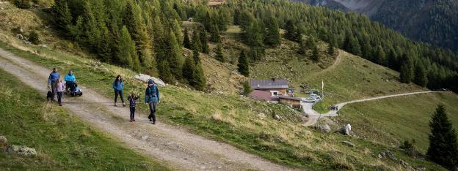
LIFESTYLE MEDICINE-BASED COMMUNITY MEASURES V. COMMUNITY HEALTH CENTERS
EACH SCHOOL, LOCAL UNIVERSITY, AND CHURCH TO BE ENCOURAGED TO HOST A SPACE FOR FITNESS ACTIVITIES, INDOOR AND OUTDOOR
SMALL GYMS WITH EQUIPMENT AND FITNESS AND RELAXATION CLASSES TO BE AVAILABLE IN SCHOOLS, COMMUNITY CENTERS AND RURAL AREAS
FUNDS TO BE GIVEN FOR SUCH COMMUNITY HEALTH INITIATIVES
PEOPLE OF LOW INCOME AND IN RURAL AREAS DO NOT HAVE ACCESS TO GYMS AND WELLNESS CENTERS AND HEALTHY ACTIVITIES SUCH AS GROUP HIKES AND SOCIALIZATIONS AWAY FROM ALCOHOL

Slide 21
THANK YOU
ROXANA MARINESCU BSN, BSM, ACLM, ELMO, RSLM
roxannemikaela@gmail.com
Wellnessalliance.us@gmail.com

