Slide 1
Management of the stress-related disorders of reproductive and sexual health for women
Elena Gopchuk
Cyprus
MD, PHD
Athens - 2022

Slide 2
Are You stressed?

Slide 3
Unswer the questions
1. Do you have trouble staying focused on the present moment?
Never
Sometimes
Often
Almost Always
2. Do you struggle to fall asleep at night?
Never
Sometimes
Often
Almost Always
3.On average, do you get less than 7-8 hours of sleep a night?
Never
Sometimes
Often
Almost Always

Slide 4
4 Do you experience headaches or muscle tension?
Never
Sometimes
Often
Almost Always
5 During work hours, do you have a hard time staying focused and concentrating on the task-at-hand?
Never
Sometimes
Often
Almost Always
6 Do you feel pain or tension in your stomach, muscles, chest, or head?
Never
Sometimes
Often
Almost Always
7 Have you noticed any increase or decrease in your sex drive? (Sex drive in this context refers to sexual release such as having the need to orgasm or ejaculate.)
Never
Sometimes
Often
Almost Always
3 and more often refers that you experience chronic stress

Slide 5
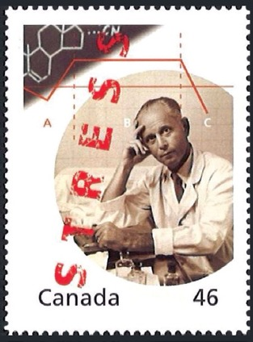
“syndrome of just being sick”
The relationship between stress and disease is obvious.
The word ‘stress’ is used in physics to refer to the interaction between a force and the resistance to counter that force, and it was Hans Selye who first incorporated this term into the medical lexicon to describe the “nonspecific response of the body to any demand “.
Selye, who is known as the ‘father of stress research’,

Slide 6
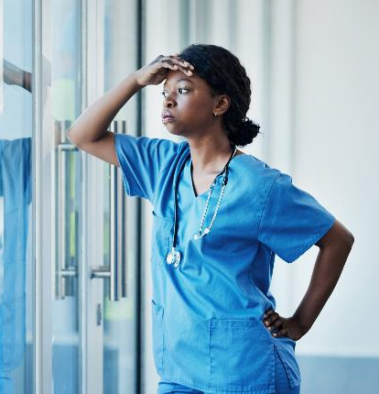
Types of stress
Stress is an emotional response to an external or conceived threat.
It usually arises when the demands of a situation exceed our ability to manage and overcome it.
Physical stress: the result of an environmental or physical challenge, such as an illness, injury, or a tough workout.
Emotional stress: the result of challenging life events, such as the
death of a loved one, a divorce, or moving to a new city.
Situational Stress: the result of a specific and fleeting situation,
such as an interview or nerve-wracking encounters.
Anticipatory stress: the uncertainty of future events.

Slide 7
Acute stress is a short-lived emotional response to perceived threats. It often comes with feelings of irritability, anger, and anxiety.
If acute stress happens frequently, it turns into episodic stress. This type of stress recurs frequently in someone’s life like waves.
If stress doesn’t fade in intensity, it then gets classified as chronic stress - more concerning physical and mental health effects on the body.

Slide 8
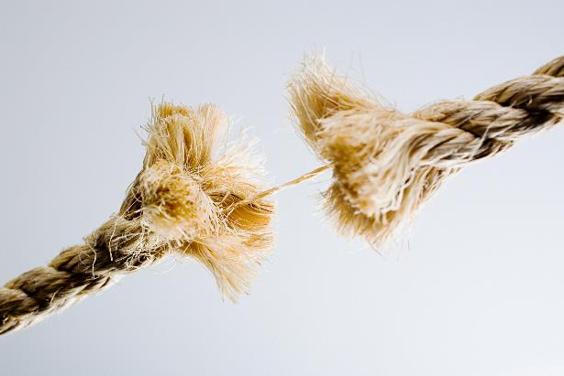
Inner stress -trauma of development -psychologically-determined self abuse -lie -manipulations -fears, -guilt -suppressed aggression -shame, -fake self-image -neglecting help -neglecting chronic diseases
Do we realize?

Slide 10
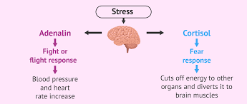
Stress hormones
From a psychological point of view, stress can alter emotional and cognitive states, preventing the individual from focusing on sexual stimuli during sexual activity. The presence of chronic stress seems therefore to produce harmful effects on sexual desire and genital arousal.
Breen KM, Karsch FJ. Does cortisol inhibit pulsatile luteinizing hormone secretion at the hypothalamic or pituitary level? Endocrinology. 2004;145:692–8.

Slide 11
Vicious circle in which sexual dysfunction, chronic stress, anxiety and depression compromise the quality of life of an individual
Study: a sample of women with average to high stress levels was recruited and subjected to the viewing of an erotic movie. Women with high stress levels had lower levels of genital, but not psychological arousal, higher levels of cortisol, and reported more distraction during the erotic film than women in the average stress group. high levels of chronic stress were related to lower levels of genital sexual arousal. Both psychological and hormonal factors were related to the lower levels of sexual arousal seen in women with high chronic stress levels. Hamilton LD, Meston CM. Chronic stress and sexual function in women. J Sex Med. 2013;10:2443–54.

Slide 12
Effects of stress
Chronic inflamation – cell-membraine damage
Natural barreires damage – epithelium -intestines, all cavities
Immune system disfunction – autoimune syndromes
dna damage
Ferment systems damage
Chronic inflamation – domination of pathological estrogens

Slide 13
Stress and Sexual health disorders
affects the sexual response cycle.
affects sexual arousal
affects libido

Slide 14
women experiencing high levels of chronic stress would show lower levels of genital arousal & DHEAS and higher levels of cortisol and cognitive distraction compared to women with average levels of stress. Lisa Dawn Hamilton, PhD^{1,2} and Cindy M. Meston, J
Main outcome measures were vaginal pulse amplitude, psychological arousal, salivary cortisol, salivary DHEAS, and heart rate and compared them between women with high and average levels of chronic stress. Sex Me
High levels of chronic stress were related to lower levels of genital sexual arousal. Both psychological (distraction) and hormonal (increased cortisol) factors were related to the lower levels of sexual arousal seen in women high in chronic stress, but distraction was the only significant predictor when controlling for other variables. d. 2013 Oct; 10(10): 2443–2454.

Slide 15
Reproductive health disorders: Infertility, pregnancy loss
anovulation – insulin cortisol, dehydrotestosterone, testosterone sickness of tissues, reduction receprors – cells membraine damage
polycyst ovarian sypdrome
endometriosis
epithelium damage – dysbacteriosis,
infections causing Fallopean tubes disfunction
autoimune sperm cell reaction
mammal glands adenomas
surrogate estrogens domination

Slide 16
Inner stress
Addiction to adrenalin brings pathological circle -self-created sttess-l situations:
postponding things to the last moment, doing thing on the run, doing simultaneously numerouse things,
neglecting inner basic needs, need for intimacy, help and acceptance
getting into dangerous situation,
communicational stress -
relationships,
”victim-aggressor-saivior situations”

Slide 17
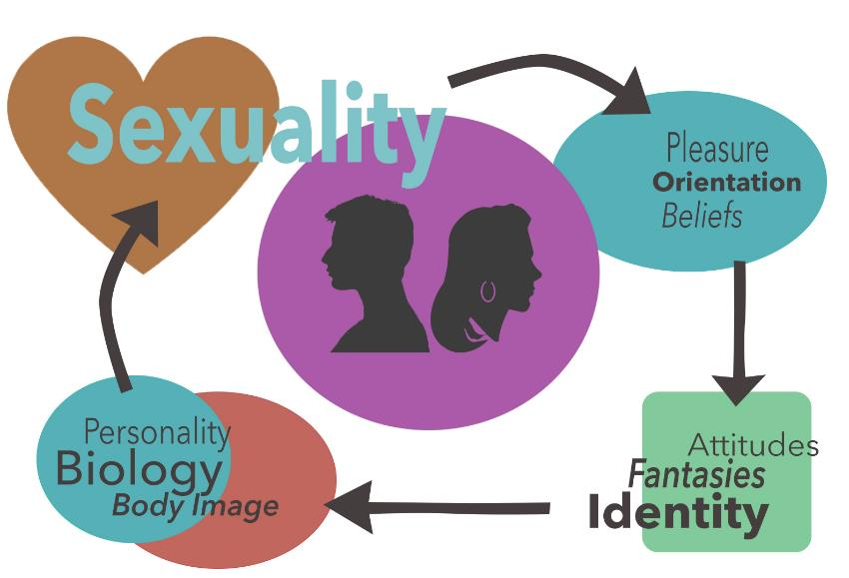

Slide 18
FINAL WORDS
The simplest things can bring the most happiness.
IZABELLA SCORUPCO
IZABELLA SCORUPCO

Slide 19
Programs that may be incorporated in stress management programs include:
Breathing exercises
Journaling
Guided meditation
Aromatherapy
Practices body-mind connecting

Slide 20
Mend Relationship Problems
What are your relationships with yourself?
If you have strained relationships with your loved ones, it can add to your stress levels..
Talk with your partner regarding your stress and work together to find healthy coping mechanisms.
Scheduling regular date nights, weekend getaways, or even initiating sexual contact can help alleviate some of the tension and anxiety surrounding romance.
If you find that you can’t mend the relationship on your own, consider seeking out professional help.

Slide 21
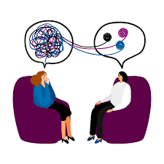
Psychotheraphy

Slide 22
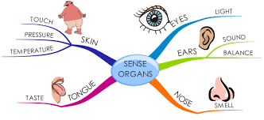
Activate your senses
Touch
cloth from natural material silk textile
Bathtub with essential oils
Self massage with body butter
Skin care
Body care
Smell
what pleases you
Taste food that makes you feel eroused
Listen erotic music sexy voices
Watch movies pictures naked body

Slide 23
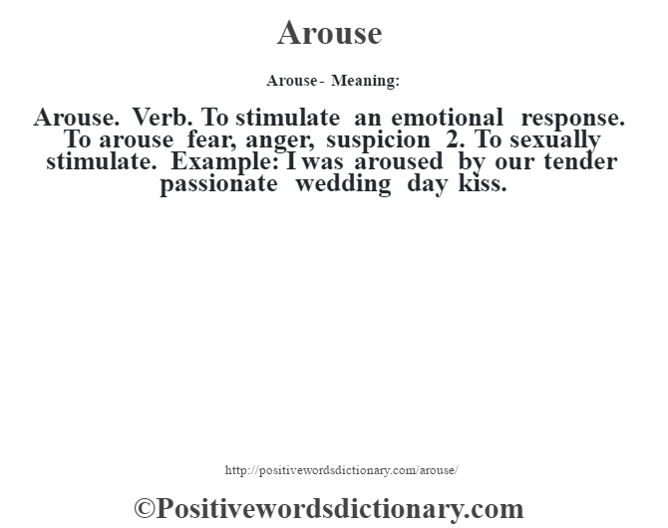
It is about relationships with yourself

Slide 24
EVERYDAY FOR A HEALTHY SEXUALITY
Keep focused on yourself
Express
Learn
Sing
Say
Shout
Sound
Before bringing your partner, a blame find out if you are all OK
Tips and tricks of sexuality, sex-related goods, movies, books, youtube speakers,

Slide 25
Copability
Lubrication
Masturbation
Food Supplements- Macca root, Agnus castus
Exercising – Kegel, Pilates, yoga, walking, swimming, running,
Erotic movies
Regular skin-body care
Massage on regular base
Short-term tattoo
Aromas, candles,
Cyber-sex
Sex-shop
Toys and games
Tricks with underwear – being naked or dressed unusually

Slide 26
Returning responsibility

Slide 27
Help the mind - Help the body
Liquids – drinking water protocol 30 ml per kg, diuretic drinks
Sweating – sauna, trainings
Lymphatic gymnastic 5-7 min 3 times per day
Tears – crying up to 15 min
Alarm for breaks
Sense activation protocol- “realize your body”
Hormones of happines – small goals - as higher serotonin as lover cortisol
Sleep
Quriosity
Sun – walking
Massage hugs trees, animals
Watching the sky)

Slide 28
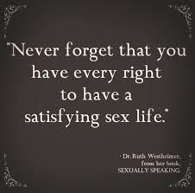
gopchuk@gmail.com
Facebook/Instagram/LinkedIn
Elena.Gopchuk
www.gopchuk.com

