Slide 1

Lifestyle Medicine:
is there a beneficial impact of nutrition on the prevention and regression of heart failure?
Georgeta Vaidean, MD, MPH, PhD
ELMO Congress, November 6, 2021

Slide 2
Overview
Synthesize the evidence for HF prevention & management at various stages
Describe ultra-processed foods and the evidence for their harmful effects
Enumerate 4 roles clinicians can play in promoting a healthy nutrition
Provide practical tips and principles for clinical implementation

Slide 3

What is the evidence for the role of nutrition in HF prevention/ management ?
Alberto
Bianca
Charlie
Dimitrios

Slide 4

Nutrition in the Guidelines ?
“Healthy diet”
“Appropriate diet”

Slide 5


Traditional nutrition focus
Sodium and fluid restriction
Antioxidants
  Vit C, E, beta-carotene, lycopene, lutein, zeaxanthin, anthocyanins
Zinc, Selenium
Coenzyme Q10
L-carnitine, taurine
Vitamins: B1, D
Calcium
Other beneficial bioactives
  Inorganic nitrates
  Etc.

Slide 6

Current focus: dietary patterns
Plant-based
MedDiet
DASH
Minimally processed foods

Slide 7

Preventing New Onset Heart Failure
Optimal LS7
  60% lower HF risk (MESA Study)¹
  lifetime risk 14% vs. 50% poor LS7 (ARIC study)²
  55% lower HF risk (EPIC-NL)³
1. J Am Heart Assoc. 2017;6:e005180.; 2.JACC Heart Fail. 2019;7:637–47; 3. JACC Heart Fail. 2019;7:637–47

Slide 8
Dietary patterns & HF risk: the evidence
No established CHD at baseline
Observational
RCT ~ PREDIMED
Plant based
Risk of HF
41% lower/plant-based
72% higher risk
REGARDS Study ¹
Pre-specified analysis
Southern
Risk of HF
Risk of HF
DASH/sodium → 20–40% lower
Swedish Study ²
DASH
LV function
  Optimized, MESA study ³
MedDiet
No effect on HF events^{5.}
  Underpowered
Some effect on biomarkers⁶
NT-proBNP,oxLDL, Lp(a)
Overall lifestyle
No relation with dietary patterns.
Overall Lifestyle - yes.
CHS- elderly ⁴
Risk of HF
1.J Am Coll Cardiol. 2019 April 30; 73(16): 2036–2045; 2. Arch Intern Med. 2009;169:851–7.; Am J Cardiol. 2009;104:1416–20; 3. Am Coll Nutr. 2012;31:401–7
4. JACC Heart Fail. 2015;3:520–8. 5. European Journal of Heart Failure (2017) 19, 1179–1185. 6. Eur J Heart Fail. 2014;16(5):543-50

Slide 9
Obesity & HF risk:
Strong Evidence, Strong Challenges
HFpEF
HFpEF
BMI
WC
VAT on CT
Dose–response relationship
Regional adiposity
HFrEF
JACC Heart Fail. 2018 Dec; 6(12): 999–1007
J Am Coll Cardiol. 2017 Mar 7; 69(9): 1129–1142
Eur J Heart Fail. 2020 Sep;22(9):1540-1550

Slide 10
Obesity & HF risk: Strong Evidence, Strong Challenges
Keeping BMI <30.0 kg/m2 for ~ 21.5 years → 30% lower risk for HF development.
No specific dietary pattern was associated with incident HF
≥4 healthy lifestyle factors→ 45% lower HF risk
Loss ≥ 10% body weight necessary
Long term adherence needed
Whole Lifestyle
Bariatric surgery-
  Can LM mimic it?
N Engl J Med 2013;369: 145–54; JACC Heart Fail . 2015 Jul;3(7):520-528

Slide 11
Dietary patterns & HF risk: the Evidence
Had established CHD at baseline
No HF at baseline
HF at baseline
Lyon Diet Heart Study / RCT
MedDiet→ composite endpoint, incl. HF lowered by 67% (RR 0.33; 95% CI 0.21–0.52)¹
Women’s Health Initiative ³
MedDiet
DASH
No benefit
MEDIT-AHF Study-Spanish ER ⁴
MedDiet
REGARDS study
DASH diet quartiles and incident HF ²
Same benefit HFpEF, HFrEF
No benefit on mortality
Benefit 14% reduction HF rehospitalizations
1. Circulation 1999;99:779–785;
2. J Card Fail. 2021 May;27(5):512-521
3. Circ Hear Fail. 2013;6(6):1116–1123; 4. JACC Heart Fail. 2018;6(1):52–62

Slide 12
Patient with edema & HF
Case report*:
54-year-old female
DM2 – HbA1c 8.1%
Cc: edema
LBBB
LV EF 25%
CAC score: 458
Causality cannot be determined in a case report
Can nutrition reverse HF?
*Front Nutr. 2019; 6: 82

Slide 13
Which diet?
Healthful vs. non-healthful nutrition
Dose-Response Relationship of Plant-Based Diet Indices and
Animal, Healthy Plant, and Less Healthy Plant Foods With CHD Incidence
73,710 women in Nurses' Health Study, 92,329 women in NHS2, 43,259 men in Health Professionals Follow-up Study. 4,833,042 person-years of follow-up. 8,631 incident CHD cases.
J Am Coll Cardiol. 2017;70(4):411–22.

Slide 14
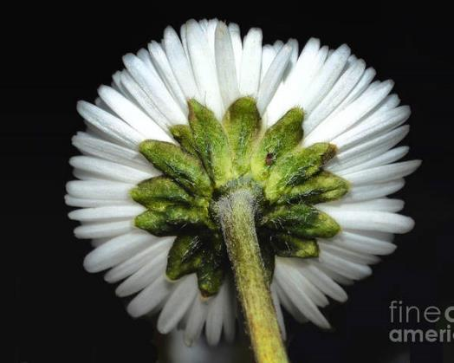

Healthful vs. non-healthful nutrition ?

Slide 15
What are Ultra- Processed Foods ?
Juul F, Vaidean G, Lin Y, Deierlein AL, Parekh N. J Am Coll Cardiol. 2021 Mar 30;77(12):1520-1531

Slide 16
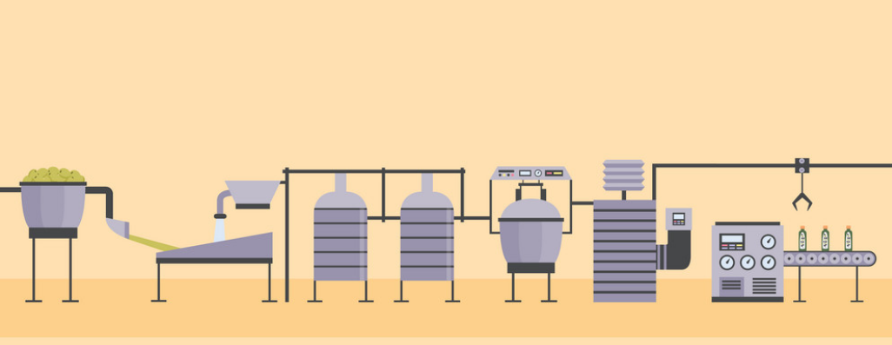
How are ultra-processed foods made?
Food derivatives
Oils
Fats- hydrogenated
Sugar
Salt
Starches
Proteins – hydrolyzed
Industrial compounds
Dyes, artificial flavors, artificial sweeteners,
anti-caking agents, antioxidants, stabilizers,
emulsifiers, solvents, hydrogenated oils, hydrolyzed proteins, bulkers, defoaming agents,
glazing agents, packaging contaminants,
sensory enhancers (to imitate or disguise)
Processing:
hydrogenation
hydrolysis
extruding
molding
reshaping
pre-processing

Slide 17
The spectrum of food processing
Unprocessed & minimally processed foods ---- Processed foods ---- Ultra-processed foods
Picture credit: Dr. Niyati Parekh, NYU

Slide 18
% Caloric intake coming from Ultra processed foods in the US
?

Slide 19
% Caloric intake coming from Ultra processed foods in the US
Culinary ingredients
Processed
Ultra Processed Foods
57.5%
Unprocessed/
minimally processed
NHANES data (nationally representative)
Popul Health Met . 2017 Feb 14;15(1):6

Slide 20
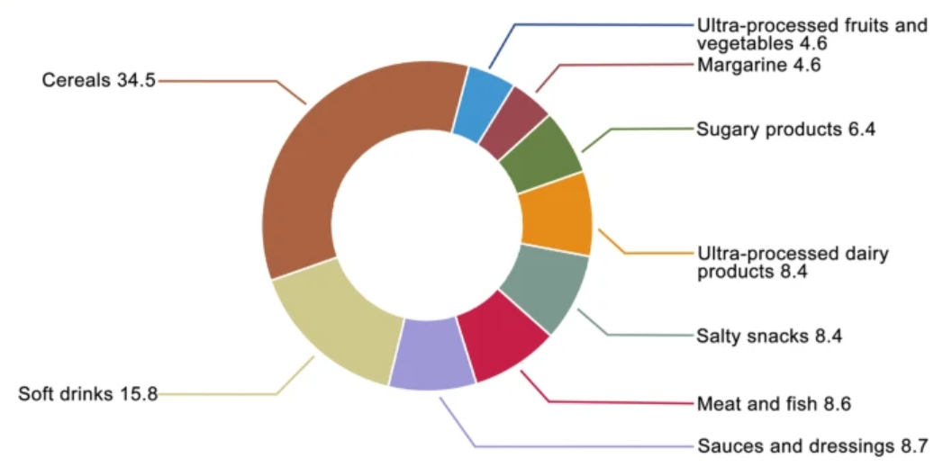
Proportion (%) of each food group in total energy from ultra-processed foods
PLCO Study, N= 91,891, age 55-74. Based on NOVA food classification.
Int J Behav Nutr Phys Act 18, 21 (2021)

Slide 21
Saturated fat
Carbohydrates
Added sugar
Salt
Energy density
Protein
Fiber
vitamins A, C, D, and E,
Minerals: Zn, K, P, Mg, Ca
Processing
Quality
NHANES: An inverse dose–response association between ultra-processed food quintiles and overall dietary quality
Popul Health Metr . 2017 Feb 14;15(1):6.

Slide 22
Ultra-processed Foods & CVD Risk – Putative mechanisms of action
Juul F, Vaidean G, Parekh N. Adv Nutr. 2021. 2021 Oct 1;12(5):1673-1680

Slide 23
Ultra-processed foods & CVD – The Framingham Offspring Study
5% 7% 9% 9%
Each additional daily serving of UPF → Increase in risk
adjusted for age, sex, education, alcohol consumption, smoking, and physical activity.
Juul F, Vaidean G, Lin Y, Deierlein AL, Parekh N. J Am Coll Cardiol. 2021 Mar 30;77(12):1520-1531

Slide 24
USA: NHANES
FU ~ 19 years
All-cause mortality: highest quartile UPF vs. lowest: 31% higher risk
HR = 1.31; 95% CI 1.09, 1.58, adjusted for demographic and socio-economic factors, health behaviors
CVD mortality- no association
USA: ARIC
FU ~ 27 years
CAD, highest vs. lowest UPF quartile: IR/10,000 py: 70.8 vs 59.3
HR: 1.19; 95% CI: 1.05, 1.35, adjusted for sociodemographic factors and health behaviors
Linear relation UPF- CAD
Public Health Nutr. 2019 Jul;22(10):1777-1785
J Nutr . 2021 Sep 7

Slide 25
France
The NutriNet-Santé Cohort
Greece
The ATTICA study
With each 10% increment in amount of UPF:
12% increase CVD
13% increase CHD
11% increase CVA
With each additional weekly serving:
10% higher CVD likelihood (HR=1.10, 95% CI 1.02–1.21)
19% higher CVD likelihood (HR = 1.19 (95%CI 1.12-1.25) if low MedDiet*
* low MedDiet (<27 on 0-55 scale)
BMJ 2019;365:l1451
ESC Congress , August 28, 2021

Slide 26
Evidence linking ultra-processed foods to obesity, hypertension, metabolic syndrome and type 2 diabetes
20 studies
334,114 participants
Increased risk of
Hypertension
Metabolic syndrome
Overweight and obesity
+
National Health and Nutrition Examination Survey. 15 977 adults (20–64 years)
Br J Nutr . 2018 Jul;120(1):90-100
Nutr J 2020;19:86.

Slide 27
Ultra-processed foods and the risk of obesity
Highest vs. lowest quartile UPF UK Biobank Study 40-69 yr, 947 incident cases overall -, 1900 abdominal obesity,
5-yr Risk of developing
Overall obesity | HR 1.79 95% CI 1.06─3.03
Abdominal obesity | HR 1.30 95% CI 1.14─1.48
5-yr Risk of experiencing a ≥ 5% increase
BMI | HR 1.31 95% CI 1.20─1.43),
WC | HR 1.35 95% CI 1.25─1.45)
%BF | HR 1.14 95% CI 1.03─1.25)
Data from Eur J Nutr. 2021; 60(4): 2169–2180

Slide 28
Greater age-related visceral and overall adiposity accumulation
PREDIMED-Plus trial ¹
Visceral fat
Android-to-gynoid fat ratio
Total fat
10% daily increment UPF intake
1·61 units higher BMI
4·07 cm greater WC
NHANES Study ²
Odds of
  BMI≥25 kg/m2: 48% higher
  BMI≥30 kg/m2: 53% higher
  Abdominal obesity: 62% higher
High vs. low UPF intake
1-Clin Nutr 2021; 40(6):4290-4300
2. Data from Juul et.al. Br J Nutr . 2018 Jul;120(1):90-100

Slide 29
The association between ultra-processed foods intake & other health outcomes
-cohort studies-
British Journal of Nutrition (2021), 125, 308–318

Slide 30
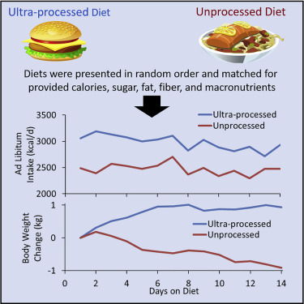
RCT: Ultra-Processed Diets Cause Excess Calorie Intake and Weight Gain
Inpatient RCT of ad libitum food intake: UPF vs. unprocessed diet
Matched for calories, sugar, fat, Na+, fiber, macros
→ Mechanisms beyond nutrient content might be responsible?
Hall et al., 2019, Cell Metabolism 30, 67–77

Slide 31
Other dietary aspects
Conflicted data
Controversy
Sodium
Dietary supplements
ACC/AHA
CMP at > 4 g alcohol/day > 5d/wk
Light-to-moderate –J curve?
Limit/refrain
2 units/ day –M, 1 unit/day –W (ESC, Self-care 2021)
Alcohol

Slide 32
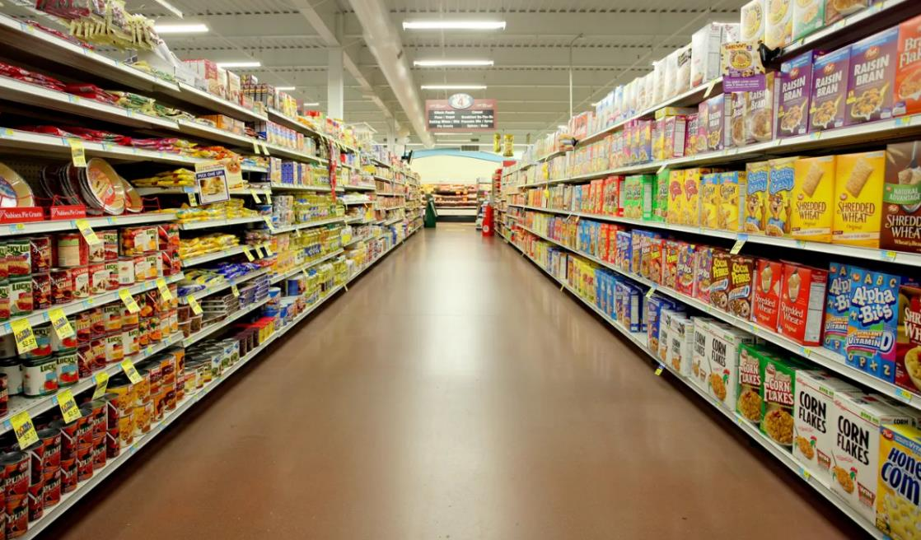
Where
do we
go
from
here
?
Photo credit: https://www.theguardian.com/food/2020/feb/13/how-ultra-processed-food-took-over-your-shopping-basket-brazil-carlos-monteiro

Slide 33
Practice Implementation
Whole Food
Whole Lifestyle
Whole Patient

Slide 34

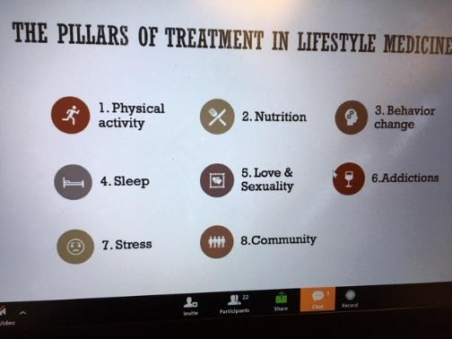
Heart-healthy nutrition works in tandem with all aspects of a healthy lifestyle
Photo credit: Dr. Ioan Hanes, ELMO,2020
European Journal of Heart Failure (2021) 23, 157–174

Slide 35
Nutrition and the heart- What can clinicians do?
Advise
Refer
Champion
Advocate
Team work
RDs
Certified coaches
Healthy Cooking classes
Discuss ultra-processed foods & ‘hidden’ sources
SDM - achievable goals
Explore financially sustainable options
Advocate for policy changes (taxation, industry reformulations, labeling)
Champion changes toward healthier foods in hospitals, schools, workplaces

Slide 36
Dietary advice provided by a doctor or a health professional
Euroaspire V
Reduce salt intake Reduce sugar intake.
8261 participants
27 countries
6 -24 months after hospitalization
for a CHD event
Int J Cardiol. 2020 Mar 1;302:5-14

Slide 37
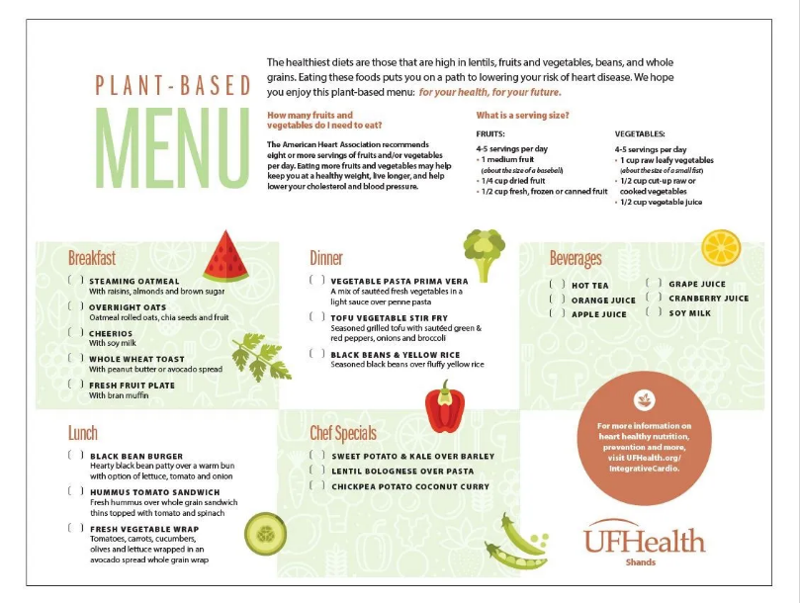
Successful Implementation of Healthful Nutrition Initiatives Into Hospitals
Am J Med. 2020 Jan;133(1):19-25; American Journal Of Lifestyle Medicine October 18, 2021 doi.org/10.1177/15598276211048788

Slide 38


Slide 39

Multi-prong approach for practice implementation
Patient-centered counseling→ Empowering the patient
Multidisciplinary team
Home telemonitoring (HTM)
COVID-19 times
Wearable technologies

Slide 40
Practical tips for Implementation
What
Fruits-Vegetables-Whole Grains-Legumes
Limit/avoid ultra-processed foods
How
Focus on patterns
Plant-based and variations on this theme
DASH
MedDiet
Photo credit: Prog Cardiovasc Dis. 2020 ; 63(5): 538–551.

Slide 41
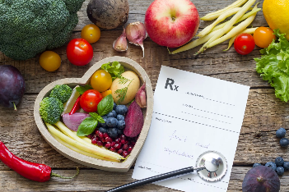
Principles of Dietary Counseling
•Meet your patient where they are
• Strive for progress, not perfection
• Negotiate goals
• Deploy positive psychology
• Be mindful of patient’s environment, SES for sustainable change
•Follow-up visits → improved outcomes (dietician/nutritionist, certified coaches)
• Arrange for self-efficacy edu./skills- culinary medicine
• Encourage social support

Slide 42
A call for a whole’hearted nutrition
Thank you

Slide 43
Supplemental slides
Directions for future

Slide 44
Directions for future
Old unsolved
Novel
Obesity
Implementation
Systemic changes
Microbiome
Personalized nutrition Nutrigenomics
Immuno-nutrition

Slide 45
The Microbiome & HF
Changes in bacterial composition → Etiologic? Prognosis factor?
Metabolites levels → may influence HF pathogenesis
Bidirectionality: HF→ microbial dysbiosis

Slide 46
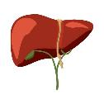
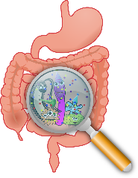
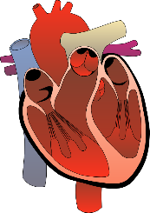

Unhealthy diet
Low fiber
High fat
UPF
Trimethylamine (TMA)
Trimethylamine N-oxide (TMAO)
Bacterial cell wall products, LPS, peptidoglycans
Systemic inflammation
TNF-alpha, IL-2, etc.
Platelet hyper-activity
Endothelial cells
Cardiomyocites
Remodeling
HF progression
Gut Inflammation
Dysbiosis
Reduced SCFA production
Loss of colonic tight junction
Gut derived toxins
Sedentary
Stress
Medication
Metabolic endotexemia
IL6, FFA
Bowel wall edema + splanchnic ischemia

Slide 47
Potential factors in the link microbiome dysbiosis & heart failure
BA, bile acids; HF, heart failure; LPS, lipopolysaccharide; SCFA, short-chain fatty acids; TMAO, trimethylamine-N-oxide
Eur Heart J . 2017 Mar 14;38(11):814-824

Slide 48
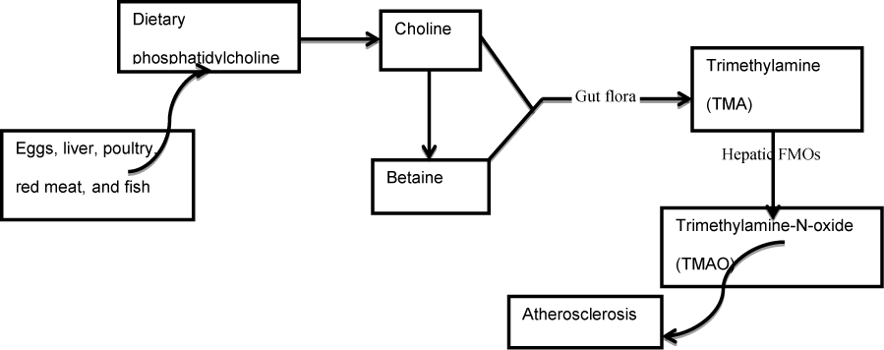
TMAO - causal or marker?
TMAO
High in NYHA III, IV, ischemic etiology
High in HFrEF
Inhibits reverse Chol transp. → foam cell
Pro-inflammatory
Platelet hyper-reactivity
Promoted myocardial hypertrophy and fibrosis
Mitochondrial dysfunction
JSM Clin Case Rep, 2014, 2(5): 1055. Translational Research 2021; 228:109125

Slide 49
TMAO in the setting of acute coronary syndromes (ACS)
TMAO is a prognostic marker in predicting
both near- and long-term adverse cardiovascular events beyond multiple CVDRFs
Eur Heart J . 2017 Mar 14;38(11):814-824

Slide 50
Risk of MACE in patients with a high vs. low baseline TMAO plasma level
major adverse cardiovascular events: RR = 2.05; 95% CI 1.61–2.61
all-cause mortality:(RR = 3.42; 95% CI 2.27–5.15
Intern Emerg Med. 2021 Jan;16(1):201-207

Slide 51
Maturity of the gut microbiome as a precision medicine tool
Are we ready for RCTs ?
Nat Rev Gastroenterol Hepatol. 2021 Aug 27

Slide 52
Potential strategies
SN Comprehensive Clinical Medicine (2020) 2:1614–1627

Slide 53
Microbiome & Diet- a bi-directional relation
Diversity and function of gut microbiota
Digestion and absorption of nutrients
Bio-transform food
metabolites
  influence host metabolism and immune system
Diet

Slide 54
Med Diet, high-fiber diets
Specific bacterial families
  Reduction in MI events
  Linked to adherence to Med Diet
  May modify response to Med Diet?
DASH
  Reduction in HF incidence
  WHI- lower mortality in HF
  RCT(n=24)- endothelial fct.
Ultra-processed foods
Harsh processing, binding agents, food matrix → change protein digestibility & supply to colon – substrate, nutrients for bacteria

Slide 55
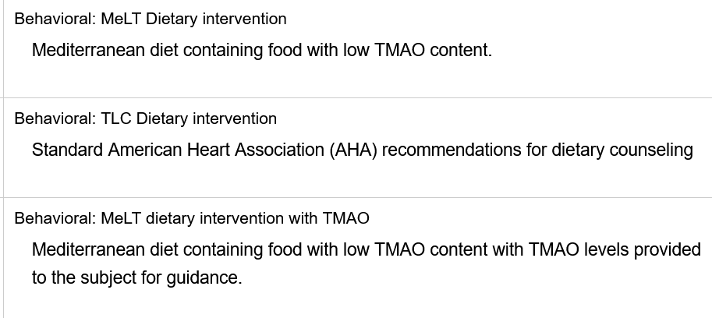
RCTs are ongoing
Gut Flora Metabolite Reduction After Dietary Intervention (GRADY)
Open Label RCT - NCT02016430

Slide 56



Slide 57
Strength of association
Temporality
Dose-Response
Experiment- RCTs
Biological plausibility
Consistency
Quality studies Biomarkers vs. hard endpoints
Lab vs. Animal vs. Human
Intuitive
exciting ideas
Evidence-based
Lifestyle Medicine practice

Slide 58
Which diet is best ?

Slide 59
Mortality rate attributable to dietary factors
Main contributors
• High sodium
• Low whole grains
• Low fruits
• Low nuts and seeds
• Low vegetables
GBD 2017 Diet Collaborators. Lancet. April 2019

Slide 60
EUROASPIRE IV
ESC survey on the lifestyle, risk factor and therapeutic management of coronary patients from 24 European countries
Among coronary patients:
4 in 10 achieved a physical activity level of vigorous intensity for ≥ 20 minutes, ≥ 1 times/ week
Among coronary patients with obesity
48 % followed dietary recommendations since their coronary event
48 % increased their regular physical activity levels to lose weight
Eur J Prev Cardiol. 2016 Apr;23(6):636-48

Slide 61
Benefits of Vegan/Vegetarian Diets
• Weight loss
• Reduced development of diabetes
• Reduced development of cancer
• Reduced cardiovascular events
• Reduced mortality
• Decreased ischemia
• Plaque regression

Slide 62
Mediterranean Diet
• Lowered LDL and triglycerides, increased HDL
• Reduced CRP, IL-6, IL-7, IL-8
• Reduced adiponectin and leptin
• Improved insulin resistance in diabetics
• Provides anti-thrombotic benefits
• Improved endothelial function
• Reduction in IMT and plaque
Circulation. 2001;103:1823-1825, (Lyon Heart Study)
ATVB. 2014;34:439-445 (PREDIMED)

Slide 63
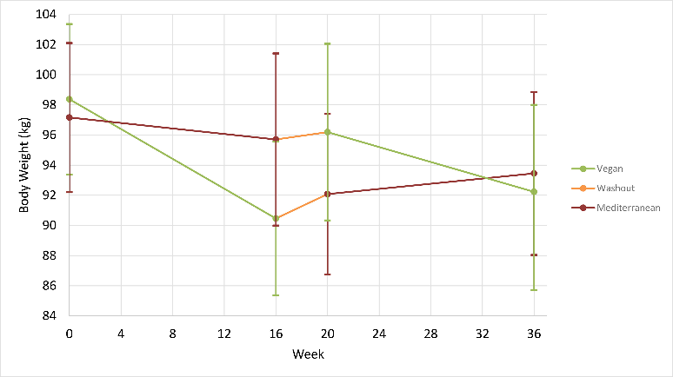
Weight Loss
Mediterranean Diet vs. Low-Fat Vegan Diet
J Am Coll Nutr . 2021 Feb 5;1-13

Slide 64
Weight Loss
Low-Fat vs Low-Carbohydrate Diet- DIETFITS trial
Healthy low fat and low carbohydrate diets work for weight loss
• Impressive ~5 kg weight loss at 12 months with both dietary interventions
• No evidence that recommendations should be guided by insulin levels or genotype
• As long as diet is healthy, allow patient to choose based on preference
• When patients are eating whole foods with mindful eating, no need for caloric restriction
The Diet Intervention Examining The Factors Interacting with Treatment Success
Gardner CD et al. JAMA. 2018;319 (7):667-679

Slide 65
70% of the diets are identical!
All reduce DM, HTN, HLD
Courtesy Dr. Gianos, Lenox Hill, NYC, 2021

