Slide 1
Vilma Kriaučionienė, Inga Sribikienė Lithuanian University of Health Sciences. Faculty of Public Health e-mail: vilma.kriaucioniene@lsmu.lt 2023
Lifestyle habits of medical students and residents and their intentions to apply lifestyle medicine knowledge while consulting patients

Slide 2
Disclosure
Speaker Vilma Kriaučionienė and all others involved in the planning, development, and presentation of this study provide the following Disclosure information:
no actual or potential conflict of interest with this study and presentation;
no current or past relationships with commercial entities.

Slide 3
Introduction
Lifestyle changes are essential for the prevention and treatment of many common diseases such as high blood pressure, overweight, diabetes, and substance abuse. The doctor's healthy lifestyle sets a powerful example that inspires patients to enjoy health.
Our study aims to analyze the lifestyle habits of medical students and residents and their intentions to apply lifestyle medicine knowledge while consulting patients.

Slide 4
Methods
The online cross-sectional survey at the Lithuanian University of Health Sciences
in 2022-2023 study years
Residents (N 304)
372 females
101 males
6-year students (N 161)

Slide 5
Results
Characteristic of respondents;
Lifestyle habits of residents and students;
The intention to counsel patients on healthy lifestyles.

Slide 6
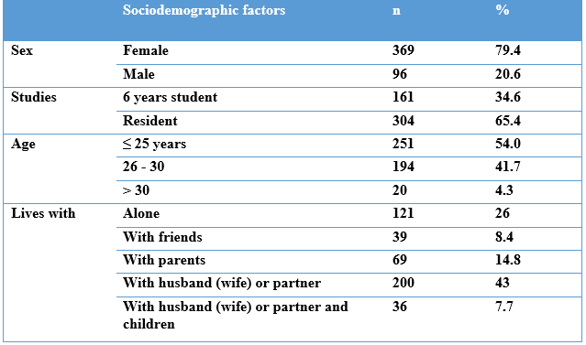
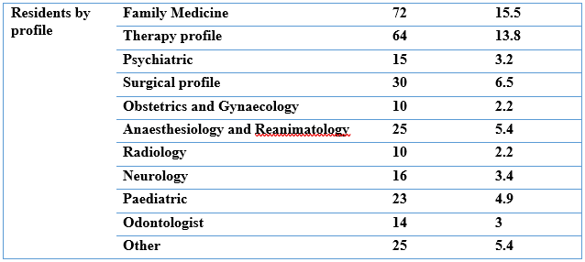
Characteristic of respondents

Slide 7
Distribution of respondents according to following a healthy lifestyle

Slide 8
Distribution of respondents according to the frequency of main meals per day by gender
χ2=7.46; lls=3; p=0.059; p<0.05 compared with males

Slide 9
Distribution of respondents according to the frequency of consumption of certain food products by gender
Food products | Total | Females | Males | p
Daily
Meat | 12.3 | 7.9 | 29.2 | p<0.001
Poultry | 21.3 | 16.5 | 39.6 | p<0.001
Meat products | 3.9 | 3.0 | 7.3 | p=0.051
Cereal products | 19.4 | 18.7 | 21.9 | p=0.483
Fresh vegetables | 63.7 | 67.2 | 50.0 | p=0.002
Fresh fruits | 33.5 | 36.6 | 21.9 | p=0.036

Slide 10
Distribution of respondents according to the frequency of consumption of certain food products by gender
Food products | Total | Females | Males | p
At least several time per week
Legumes (peas, beans, lentils etc.) | 44.7 | 45.8 | 40.6 | p=0.364
Bread (whole grain, rye, enriched with seeds) | 80.2 | 80.2 | 80.2 | p=0.999
Confectionery | 57.0 | 58.8 | 50.0 | p=0.120
Sweets | 70.3 | 72.1 | 63.5 | p=0.103
Soft drinks | 35.5 | 33.1 | 44.8 | p=0.006
Energy drinks | 9.2 | 7.9 | 14.6 | p=0.03
Fast food | 29.2 | 27.9 | 34.4 | p=0.001
Unhealthy snacks | 8.8 | 7.9 | 12.5 | p=0.153

Slide 11
Distribution of respondents according to the frequency of alcohol consumption
χ²=2.700; lls=5; p=0.745

Slide 12
Distribution of respondents according to BMI
χ²=34,8; lls=2; p<0,001; p<0.05 compared with males.

Slide 13
Health complaints reported by students and residents
Complaints | Never | Not very often | Quite often | Very often
Headache* | 5.8 | 49 | 32.5 | 12.7
Nervousness, restlessness* | 3.9 | 26.2 | 46.2 | 23.7
Depression, depressed mood* | 13.5 | 41.9 | 32.7 | 11.8
Sleep disorders, insomnia | 20.6 | 52.9 | 19.4 | 7.1
Stomach ailments, heartburn | 22.2 | 42.2 | 24.7 | 11.0
Back and neck pain | 12.3 | 35.1 | 39.6 | 13.1
Constipation* | 35.9 | 47.1 | 14.4 | 2.6
* - women more often compared with men
Notes:
Moterims dažniau:
Galvos skausmas
Nervingumas
Depresija
Vidurių užkietėjimas

Slide 14
Distribution of respondents according to the reported sufficient knowledge on lifestyle counseling issues

Slide 15
Distribution of respondents according to the reported knowledge of lifestyle counseling issues according to job profile
%

Slide 16
Distribution of respondents according to intentions to counsel patients on lifestyle issues
%

Slide 17
Reported factors influencing doctors‘ counseling on patients‘ lifestyle issues
%
*p<0.05 compared with students

Slide 18
Distribution of respondents according to their opinions on who should teach/advise patients about a healthy lifestyle
%

Slide 19
Distribution of respondents according to their opinions on some tips of lifestyle counseling
%

Slide 20
Distribution of respondents by following healthy lifestyle and their intention to counsel patients on healthy lifestyle
%
*p<0.05, compared with those who don‘t follow a healthy lifestyle

Slide 21
Summary
Part of students and residents don‘t follow healthy lifestyles, and experience different health complaints;
Those who participated in the study have a favorable attitude towards counseling patients on healthy lifestyles;
Students and residents following healthy lifestyles have a higher intention to provide lifestyle medicine counseling.

Slide 22
Vilma Kriaučionienė Lithuanian University of Health Sciences, Faculty of Public Health e-mail: vilma.kriaucioniene@lsmu.lt
Questions?

