Slide 1
Physico-chemical properties of natural mineral water suitable for frequent hydration as a healthy lifestyle choice
Dušan Avramović
Department for water City Institute of Public Health of Belgrade, Serbia

Slide 2
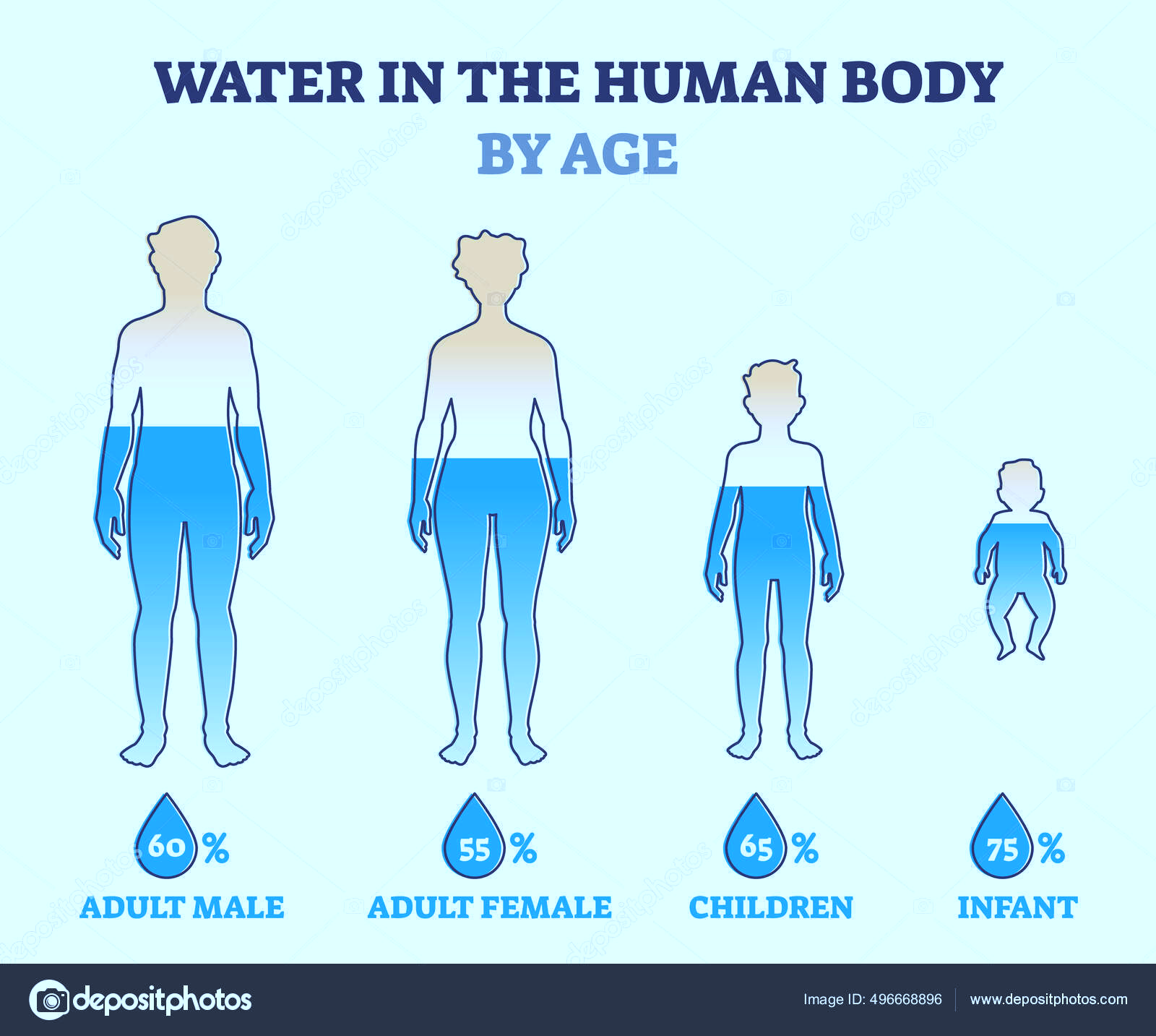
The water in the human body
all metabolic processes,
all cells, organs and systems,
helps maintain normal body temperature (thermoregulation) as core component of physiological homeostasis and survival.[1]
in newborn babies, the percentage of water in the body is up to 75%
in the adult male to about 60% and in women to 50-55%.[2]
The first sign of apoptosis (cellular death) is loss of water
Notes:
The water in the human body has a complex role, participates in almost all metabolic processes, ensures proper functioning of all cells, organs and systems, and above all helps maintain normal body temperature (thermoregulation) as core component of physiological homeostasis and survival.[1]
As a key factor in the human body, in newborn babies, the percentage of water in the body is up to 75% and continually throughout life, the proportion of water is reduced, in the adult male declining to about 60% and in women to 50-55%.[2]

Slide 3
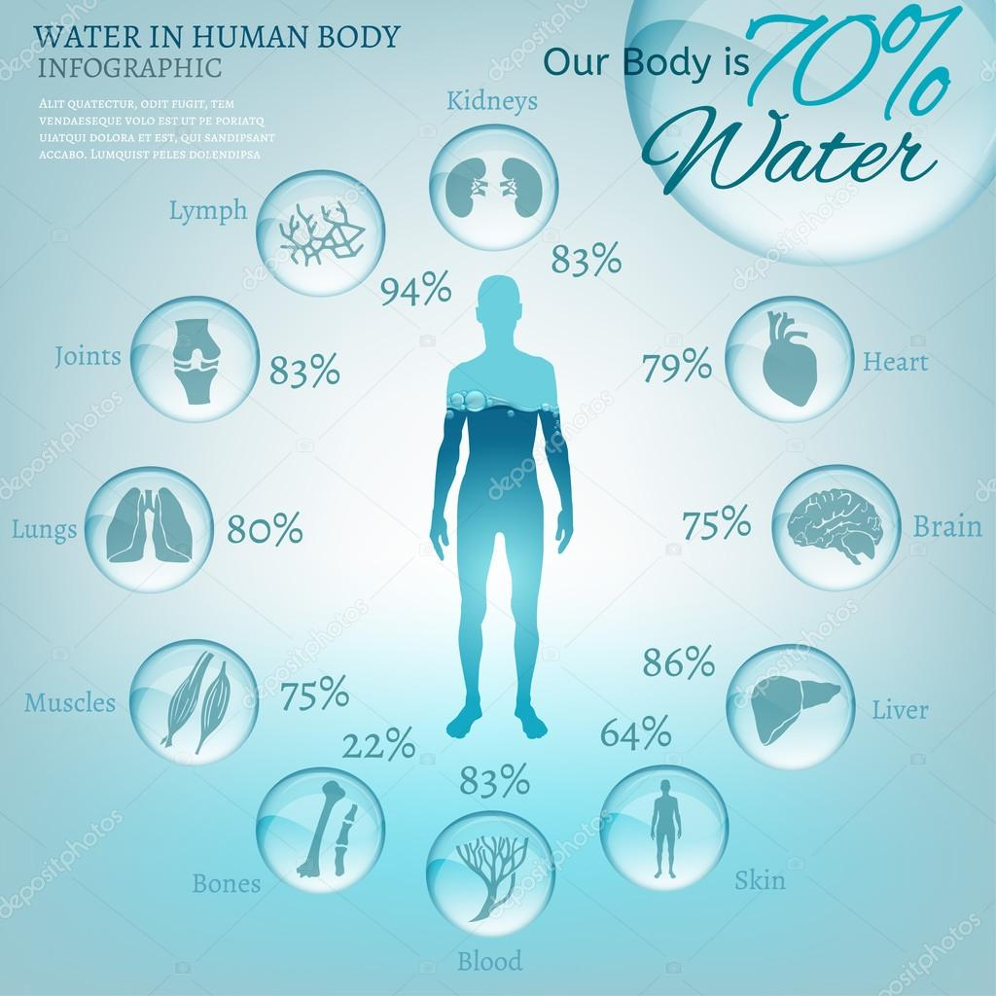
vast majority of organs and tissues in human body contain 60-90% of water
MUSCLE MASS = „THE ONLY COGNITIVE VARIABLE BODY WATER STORAGE“
red marrow, water 40%:
yellow marrow, water 15%
*percentages on infographic are for presentataion illustrative purposes only, may vary in human

Slide 4
Water from the body is lost !!
Water is lost through urine, stool, sweat, during breathing and through the skin.
These processes are under very precise control of the internal organs, especially the kidneys which the corresponding response time is caused by changes in the concentration of the body fluids of some 1-2%. (avg. 75 kg person 400 – 800 ml) 2-4 glasses of water
greatly influenced by:
climate and microclimate conditions, age, the adequacy of clothes, the type of activities performed, as well as the general health of the body, including the proper functioning of each system and organ in our body.
Grandjean, A. Water requirements: Impinging factors and recommended intakes. In World Health Organization (Ed.), Nutrients in drinking water. Geneva, Switzerland: World Health Organization 2005
Notes:
Water from the body is lost through urine, stool, sweat, during breathing and through the skin.
These processes are under very precise control of the internal organs, especially the kidneys which the corresponding response time is caused by changes in the concentration of the body fluids of some 1-2%. (avg. 75 kg person 400 – 800 ml) 2-4 glasses of water
all of the above is greatly influenced by climate and microclimate conditions in the environment in which we find ourselves, age, the adequacy of clothes in which one person is, the type of activities performed, as well as the general health of the body, including the proper functioning of each system and organ in our body.

Slide 5
Woulnerable groups – young, old, athletes, pregnant....
In infants and children at an early age there is a significant water loss through the skin, because at that age the ratio of skin surface area and volume of the body is two to three times higher than in adults, reflecting lower water reserves and a larger area for the loss of water that are characteristic of the early stages of life
as well, the adult and senior age individuals frequently expose themselves to a high risk of dehydration due to insufficient daily intake of fluids (especially water) while on chronic blood pressure-lowering therapy, often with diuretic component
Avramović DD et al. Daily fluid intake habit among adult and senior visitors of Belgrade Health Fairs. 13th International Congress of Nutrition, Belgrade.2016
European Food Safety Authority (EFSA). Scientific Opinion on Dietary Reference Values for water. EFSA Journal;8(3):1459.2010
Notes:
In infants and children at an early age there is a significant water loss through the skin, because at that age the ratio of skin surface area and volume of the body is two to three times higher than in adults, reflecting lower water reserves and a larger area for the loss of water that are characteristic of the early stages of life
infants up to 6 months of age should intake 100 to 190 ml of fluid per kilogram of body weight (BW) per day; from 6 to 12 months of age 0.8 to 1.0 l / day. During the second year of life1.1 to 1.2 liters of fluid every day. Values appropriate for water intake for boys and girls aged 2 to 3 years are estimated to be 1.3 l per day.
as well, the adult and senior age individuals frequently expose themselves to a high risk of dehydration due to insufficient daily intake of fluids (especially water) while on chronic blood pressure-lowering therapy, often with diuretic component

Slide 6
Material and Methods
The tap water and natural mineral water samples were collected according to applicable standards (SRPS ISO 5667-5, SRPS ISO 5667-11).
We compared the results of analysis of physical and chemical properties of water samples performed in the ISO 17025 accredited laboratory of City Institute of Public Health (Belgrade, Serbia) following standards and methods stated for every parameter listed.
All compared parameters are listed according to national regulations: Regulation on Hygienic Standards of Drinking Water (“Official Gazette FRY, nº 42/98 and 44/99”, and „ Official Gazette RS“, nº 28/2019) and Regulation on quality and other demands for natural mineral waters, natural spring waters and still waters („Official Gazette SCG, nº 53/05 and 43/13“).
Notes:
The natural mineral water and tap water samples were collected according to applicable standards (SRPS ISO 5667-5, SRPS ISO 5667-11).
We compared the results of analysis of chemical and physical properties of water samples performed in the ISO 17025 accredited laboratory of City Institute of Public Health (Belgrade, Serbia) following standards and methods stated for every parameter listed.
All compared parameters are listed according to national regulations : Regulation on Hygienic Standards of Drinking Water (“Official Gazette FRY, nº 42/98 and 44/99”, and „ Official Gazette RS“, nº 28/2019) and Regulation on quality and other demands for natural mineral waters, natural spring waters and still waters („Official Gazette SCG, nº 53/05 and 43/13“).

Slide 7
Results and Discussion
On the basis of the reports of the results of the laboratory analysis of water samples, in terms of the studied physico-chemical parameters, we found that the analyzed sample of natural mineral water, compared to drinking water from public water supply system, contains a moderate levels of mineral substances with a slightly increased content of calcium and bicarbonates
Notes:
On the basis of the reports of the results of the laboratory analysis of water samples, in terms of the studied physico-chemical parameters, we found that the analyzed sample of natural mineral water, compared to drinking water from public water supply system, contains a moderate levels of mineral substances with a slightly increased content of calcium and bicarbonates

Slide 8
Tap water – public drinking water
NMW – natural mineral water
TDS - total dissolved solids at 105ºC, in mg/l
EC – electroconductivity at 20ºC, in μS/cm
Hardness – total hardness, in ºdH
Calcium – Ca2+, in mg/l
Bicarbonates - as HCO3, in mg/l

Slide 9
Total Dissolved Solids (TDS) - mineralisation
Concentrations of TDS from natural sources have been found to vary from less than 30 mg/litre to as much as 6000 mg/litre (5), depending on the solubilities of minerals in different geological regions.
an optimum level for total dissolved salts (250-500 mg/L for bicarbonate water);
Kozisek F.: WHO: HEALTH RISKS FROM DRINKING DEMINERALISED WATER at https://www.who.int/water_sanitation_health/dwq/nutrientschap12.pdf
Notes:
Concentrations of TDS from natural sources have been found to vary from less than 30 mg/litre to as much as 6000 mg/litre (5), depending on the solubilities of minerals in different geological regions.
an optimum level for total dissolved salts (250-500 mg/L for bicarbonate water);

Slide 10
Electrical Conductivity of water
EC or Electrical Conductivity of water is its ability to conduct an electric current.
Salts or other chemicals that dissolve in water can break down into positively and negatively charged ions.
These free ions in the water conduct electricity, so the water electrical conductivity depends on the concentration of ions.
Salinity and total dissolved solids (TDS) are used to calculate the EC of water, which helps to indicate the water’s purity.
The purer the water the lower the conductivity.- but taste and potential health effects?
Notes:
EC or Electrical Conductivity of water is its ability to conduct an electric current.
Salts or other chemicals that dissolve in water can break down into positively and negatively charged ions.
These free ions in the water conduct electricity, so the water electrical conductivity depends on the concentration of ions.
Salinity and total dissolved solids (TDS) are used to calculate the EC of water, which helps to indicate the water’s purity.
The purer the water the lower the conductivity.- but taste and potential health effects?

Slide 11
EC and TDS effects of „purer“ water low in TDS (e.g. < 100 mg/L) on water and mineral homeostasis in human body
Low-mineral water markedly:
increased diuresis (almost by 20%, on average), body water volume, and serum sodium concentrations,
decreased serum potassium concentration, and
increased the elimination of sodium, potassium, chloride, calcium and magnesium ions from the body.
due to osmotic changes in the blood plasma
Kozisek F.: WHO: HEALTH RISKS FROM DRINKING DEMINERALISED WATER at https://www.who.int/water_sanitation_health/dwq/nutrientschap12.pdf
Notes:
Low-mineral water markedly:
1.) increased diuresis (almost by 20%, on average), body water volume, and serum sodium concentrations,
2.) decreased serum potassium concentration, and
3.) increased the elimination of sodium, potassium, chloride, calcium and magnesium ions from the body.
due to osmotic changes in the blood plasma

Slide 12
Hardness in Drinking-water
Calculated according to presence of Ca, Mg ions
Although hardness is caused by cations, it may also be discussed in terms of carbonate (temporary) and non-carbonate (permanent) hardness.
Not considered a health hazard.
potentially improves some of the gastrointestinal functions allowing better digestibility.
Pohl, U., Auinger, A., Bothe, G., Uebelhack, R. Pilot Trial on the Efficacy and Safety of a Natural Mineral Water Rich in Hydrogen Carbonate on Functional Dyspepsia and Heartburn. Open Journal of Gastroenterology, 6, 88-96. http://dx.doi.org/10.4236/ojgas.2016.63012.2016
Notes:
Calculated according to presence of Ca, Mg ions
Although hardness is caused by cations, it may also be discussed in terms of carbonate (temporary) and non-carbonate (permanent) hardness.
Not considered a health hazard.
potentially improves some of the gastrointestinal functions allowing better digestibility.

Slide 13
Calcium in Drinking-water
Water containing calcium carbonate at concentrations below 60 mg/l is generally considered as soft; 60–120 mg/l, moderately hard; 120–180 mg/l, hard; and more than 180 mg/l, very hard (McGowan, 2000).
micronutrient important for proper development and functioning of the musculoskeletal system
improves prefered taste of water*
Notes:
Water containing calcium carbonate at concentrations below 60 mg/l is generally considered as soft; 60–120 mg/l, moderately hard; 120–180 mg/l, hard; and more than 180 mg/l, very hard (McGowan, 2000).
micronutrient important for proper development and functioning of the musculoskeletal system
improves prefered taste of water*

Slide 14
Bicarbonates (HCO3-) in Drinking-water
in mineral water, bicarbonates are present due to natural processes
there is no maximum or minimum defined by the quantity,
maintenance of acid-base balance in the body, and,
form part of the bicarbonate buffer system in the body, (important in prevention of metabolic acidosis)
Notes:
in mineral water, bicarbonates are present due to natural processes - water passing through several layers of limestone which filters the water and partly dissolves in it, thus elevating levels of bicarbonates
Although there is no maximum or minimum defined by the quantity, bicarbonates play a significant role in the maintenance of acid-base balance in the body, and, as being the negatively charged ions, form part of one of the most important buffer systems in the body, to which all other buffering systems in human body adjust to.
in emergence situations when primary disease is accompanied by a high body temperature, vomiting or diarrhea

Slide 15
Liquids consumption - Taste is a vital
Taste is a vital sensory process that facilitates the ingestion of nutritive substances and the avoidance of toxins.
It is not surprising, then, that the perception of taste stimuli is highly informed by the homeostatic state of the organism, as well as
prior experiences
88% of those surveyed stated taste as their primary reason for buying a product
taste is central to the second moment of truth - the most important re-purchase driver
Jacobs et al., 1988; Morton et al., 2006
Chang and Scott, 1984; McCaughey et al., 1997
https://www.taste-institute.com/en/resources/blog/importance-of-taste-in-product-development 2021, Oct
Notes:
Taste is a vital sensory process that facilitates the ingestion of nutritive substances and the avoidance of toxins.
It is not surprising, then, that the perception of taste stimuli is highly informed by the homeostatic state of the organism, as well as prior experiences with appetitive and aversive stimuli.
When consumers decide whether they like a product, taste is the most important factor. Every survey that the International Food Information Council Foundation has carried out to date has confirmed this, and in 2020 88% of those surveyed stated taste as their primary reason for buying a product. With statistics like this, it’s clear that taste should be a key focus during product development and a key criteria in the decision to launch the product commercially.
In terms of food and drink products, taste is central to the second moment of truth and is the most important re-purchase driver

Slide 16
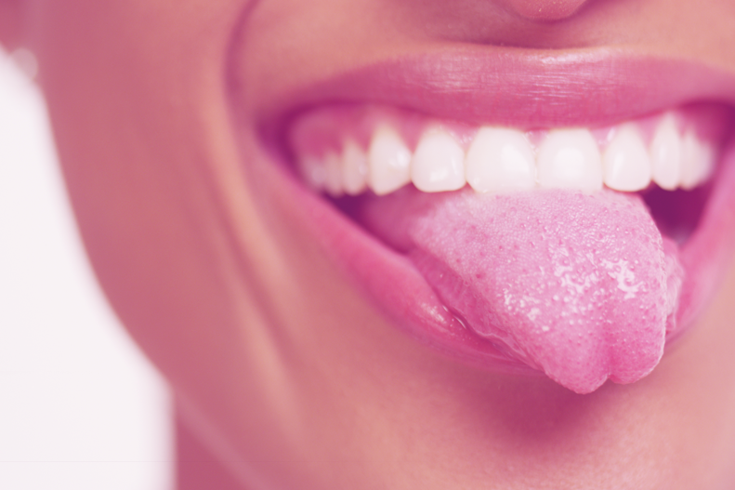
Taste is the effect
Taste is the effect of chemical reaction between substances in mouth with the taste receptor cells.
Humans detect taste with taste receptor cells. Taste can be of various forms like sweet, salty, bitter, sour, etc.
We cannot identify taste of sample or solution unless and until it is tasted by human tongue.
The dissolved molecules and ions of a solution will decide the pH and conductivity of that solution.
Joshi, Kushal & Satpute, Suresh & Khutale, Abhitab & Mudhalwadkar, R.. (2016). pH and conductivity based taste identification. 1963-1967. 10.1109/ICEEOT.2016.7755032.
Notes:
Taste is the effect of chemical reaction between substances in mouth with the taste receptor cells. Humans detect taste with taste receptor cells. Taste can be of various forms like sweet, salty, bitter, sour, etc.
We cannot identify taste of sample or solution unless and until it is tasted by human tongue.
The dissolved molecules and ions of a solution will decide the pH and conductivity of that solution.

Slide 17
The preferred bottled and tap water
six important micronutrients (Ca2+, Mg2+, Na+, K+, HCO−3, Cl−)
The preferred bottled and tap water samples were associated with moderate (relatively to the parameters mean values) contents of total dissolved solids and with relatively high concentrations of HCO₃⁻, SO₄²⁻, Ca²⁺ and Mg²⁺ as well as with relatively high pH values.
High concentrations of Na⁺, K⁺ and Cl⁻ were scored low by many of the panelists,
while residual chlorine did not affect the ratings, but did enable the panel to distinguish between bottled mineral water and tap water samples
Platikanov S, Garcia V, Fonseca I, Rullán E, Devesa R, Tauler R. Influence of minerals on the taste of bottled and tap water: a chemometric approach. Water Res. 2013 Feb 1;47(2):693-704. doi: 10.1016/j.watres.2012.10.040. Epub 2012 Nov 9. PMID: 23200507.
Notes:
six important nutrients (Ca2+, Mg2+, Na+, K+, HCO−3, Cl−)
The preferred bottled and tap water samples were associated with moderate (relatively to the parameters mean values) contents of total dissolved solids and with relatively high concentrations of HCO₃⁻, SO₄²⁻, Ca²⁺ and Mg²⁺ as well as with relatively high pH values.
High concentrations of Na⁺, K⁺ and Cl⁻ were scored low by many of the panelists,
while residual chlorine did not affect the ratings, but did enable the panel to distinguish between bottled mineral water and tap water samples

Slide 18
Conclusions
For fluid replacement in healthy humans of all age groups and throughout expected lifespan, through the drinks and foods taken daily, the best choice is to provide sufficient quantities of safe drinking water with a moderate mineral content of the abovementioned properties, such as:
TDS, EC, moderatly elevated calcium (Ca) and bicarbonates (HCO3-)
natural mineral water, with similar mineralisation (as local tap water), could be suitable for regular daily intake and oral rehydration in all healthy individuals
in the daily amounts recommended for each age group.
Notes:
For fluid replacement in infants and children through the drinks and foods taken daily, the best choice is to provide sufficient quantities of safe drinking water with a moderate mineral content of the abovementioned properties, such as:
TDS, EC, moderatly elevated calcium (Ca) and bicarbonates (HCO3-),
natural mineral water, with similar mineralisation (as local tap water), could be suitable for regular daily intake and oral rehydration in all healthy individuals including children, in the daily amounts according to the EFSA document, stated for each age group.

Slide 19
Keep hydrated – water is medicine!
Conflict of Interests
The authors declare no competing interests regarding this presentation.
Acknowledgements
Author would like to thank to all colleagues involved in field water sampling and laboratory team members who performed water samples analysis. All opinions and statements expressed by author in this presentation are solely individual and do not neccessarily represent affiliated institutions’ official positions.
„BIG THANK YOU“ to 5th ELMO organizers and all participants!

