Slide 1


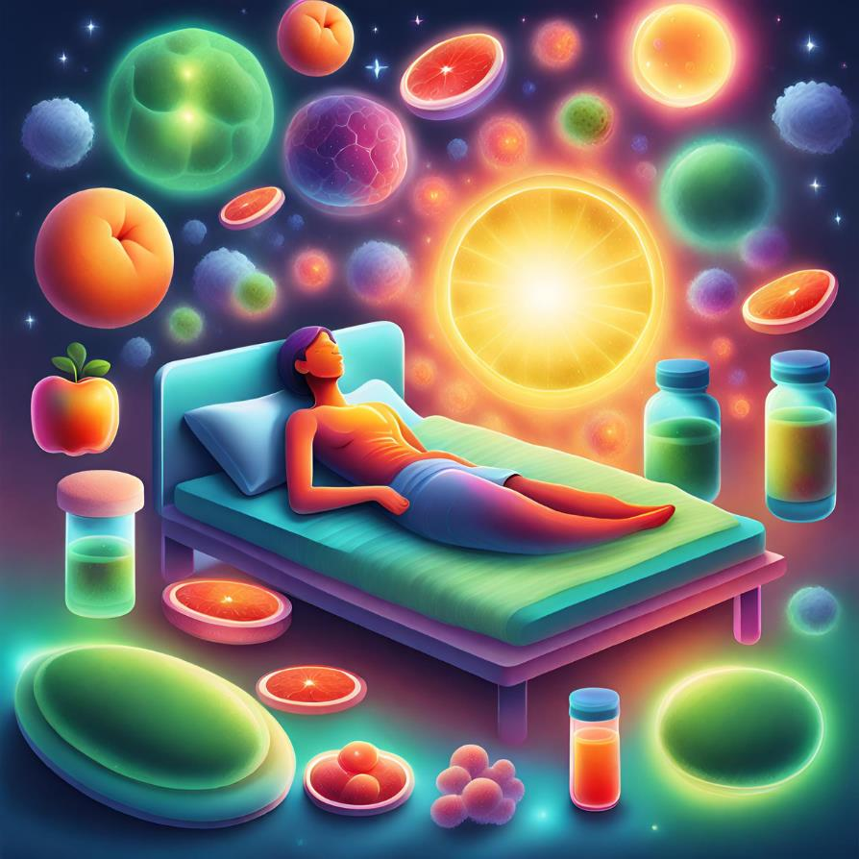


PROMOTING IMMUNITY IN OLDER ADULTS
The Interplay of Physical Activity and Sleep in Antibody Maintenance
LEN DE NYS, MSC., PHD CANDIDATE
UNIVERSITY OF STIRLING, SCOTLAND, UK
LifeMe vzw, Belgium
Host of the LifeMe podcast (Dutch)

Slide 2

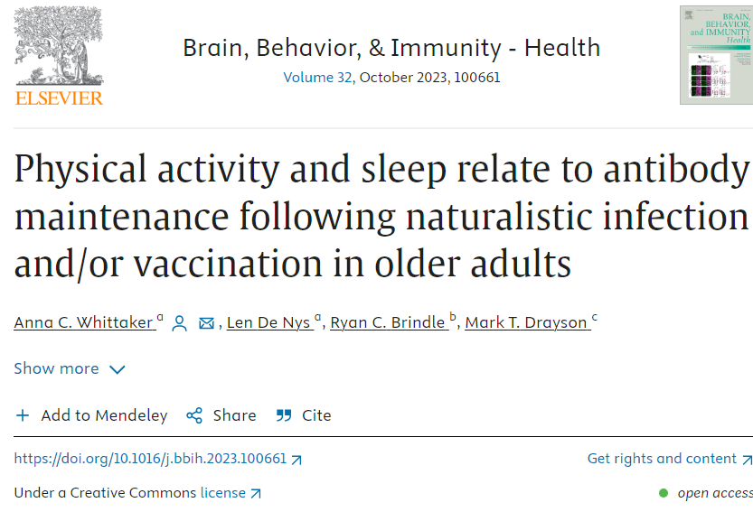


University of Stirling, Scotland, UK

Slide 3

Importance: as we age, our immune system deteriorates.
But, if older adults stay active and sleep well, their guards seem to stay sharper for longer.

Slide 4

What is new? There’s not much research on how PA and sleep might influence the maintenance of immunity following naturalistic infection or prior vaccination in older adults.

Slide 5

We performed a secondary analysis of a larger longitudinal study.
Participants & design
  104 older adults (65+), UK, 2003
  mostly female
  no acute illnesses or immunosuppressant indications
Measurements
  PA at baseline and one month (Q from Whitehall II study)
  Sleep (adapted version of PSQI)
  Blood: antibody assays (IgG) against a range of common infectious diseases (pneumonia, meningitis, diphtheria and tetanus)

Slide 6

1. Positive impact of Physical Activity
Higher Physical Activity
Higher Level of Antibodies
Bohn-Goldbaum et al., 2022, Chastin et al., 2021, Felismino et al., 2021; Kohut et al., 2004, 2005, Schuler et al., 2003, Woods et al., 2009,, Zheng et al., 2015

Slide 7
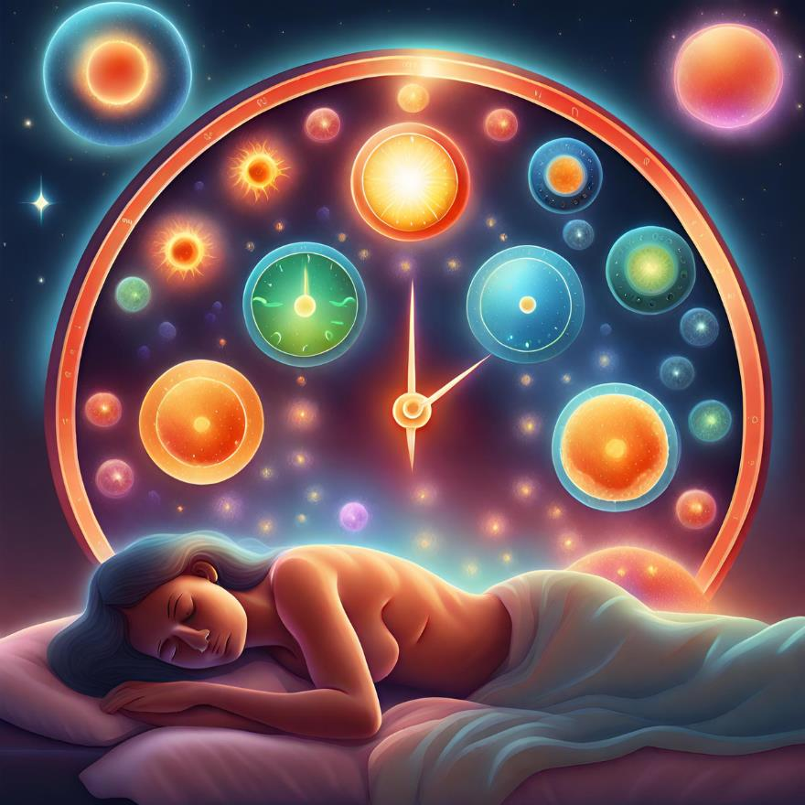
Sleep and immunity: Circadian rhythms
  Glucocorticoids and pro-inflammatory cytokines peak during active phase (‘emergency sirens during the day’)
  Immune cell numbers in blood peak during rest phase (‘healthcare workers active at night’)
  Disbalance: Chronic inflammation and health issues
Scheiemann et al., 2014

Slide 8
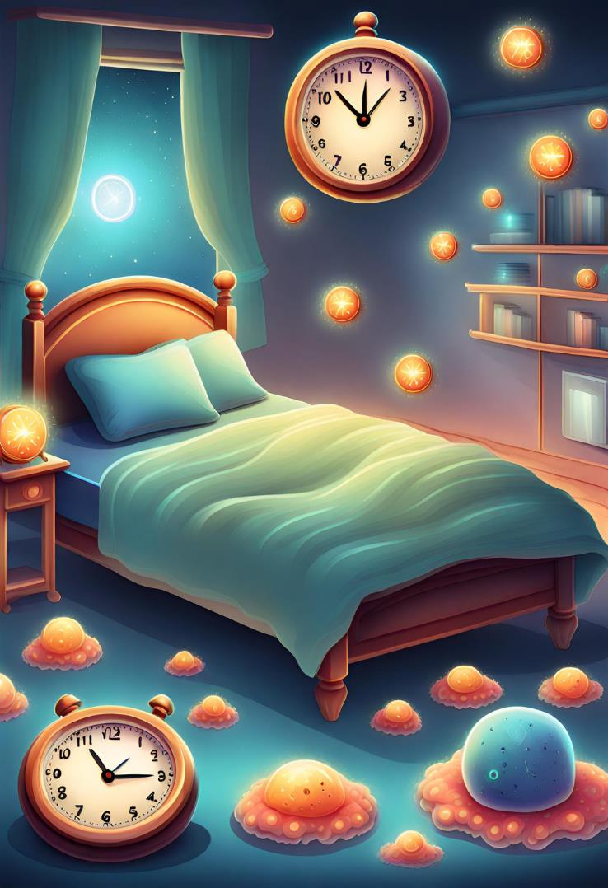
2. Sufficient time in bed (7-9 hr) and less daytime napping
~ higher antibody levels

Slide 9
2. Sufficient time in bed (7-9 hr) and less daytime napping ~ higher antibody levels
  Sleep duration and sleep quality ~ antibody responses and immune system (Bryant et al., 2004, Taylor et al., 2016; Prather et al., 2012, 2021)
  <7hr and >8-9hr (time in bed) ~ greater systemic inflammation (Dowd et al., 2011; Grandner et al., 2013; Patel et al., 2012)
  Napping during the day (being tired during the day!)~ inflammation in older adults (Leng et al., 2014; Mantua and Spencer, 2015)

Slide 10

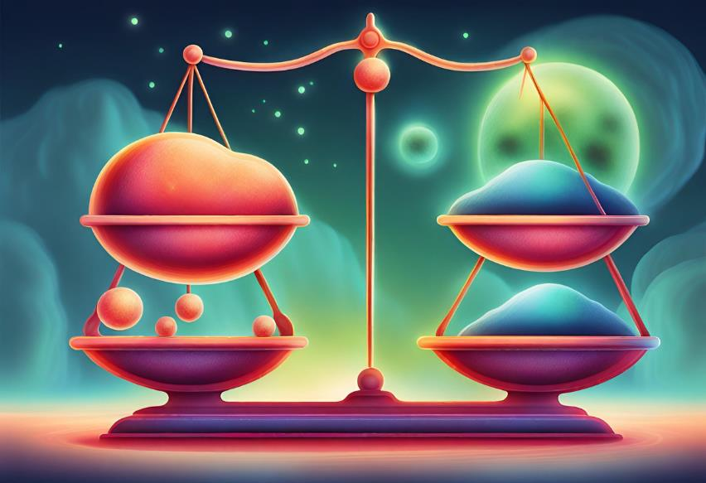
Powernaps have their health benefits,
but frequent and prolonged naps may be associated with higher morbidity and mortality in older adults.
Dhand and Sohal, 2006

Slide 11

3. Lower sleep quality related to higher antibody titres (Pn19f)
  A little bit of tossing and turning at night might not be as bad for your immune system as previously thought?
  There were 83% ‘bad sleepers’ in our demographic, thus confounding the results (difficult to differentiate between good and bad sleepers)?
  Did the respondents have short-term low sleep quality at time of completing the questionnaires, but overall good sleep quality? (cross-sectional study)
  Research artifact – not reproducable?

Slide 12
This displays that the relationship between sleep and immune function can be complex. More personalized sleep assessments and interventions are welcome.

Slide 13
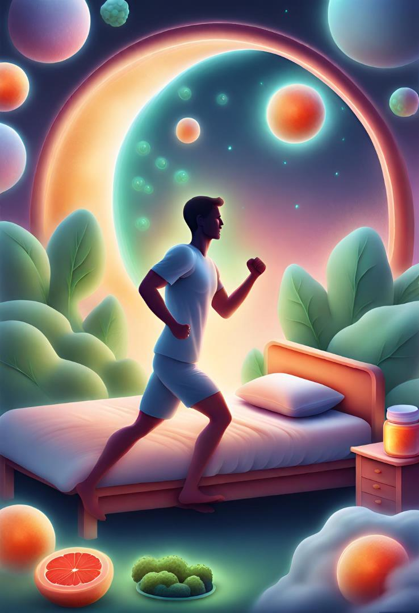
  1. Higher PA ~ Higher Antibodies
  2. Sufficient Sleep and Sleep Quality ~ Better Immune System
  3. Sleep and Immunity interaction is Complex ~ Personalized Medicine

Slide 14
Importance: Sufficient physical activity and quality sleep are variables that could be adjusted to enhance vaccine efficacy and promote antibody longevity in older adults.

Slide 15
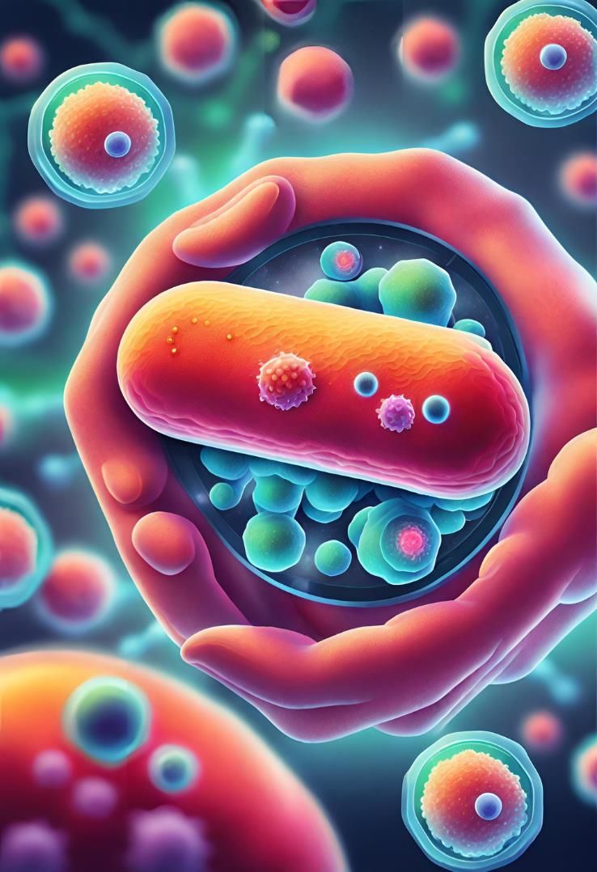
Future perspectives
Research
  Longitudinal research
    Immediate effects post-vaccination vs long-lasting benefits of PA and sleep -> exercise boost?
    Diet, stress levels and other lifestyle factors?
  Sleep measurements: ECG, sleep phases?
Clinical practice
  Promotion of PA
  Patient educations of PA and sleep
  Tailored sleep recommendations
  Vaccine scheduling

Slide 16


Thank you!
Len De Nys
PhD Candidate Sport and Health Sciences, University of Stirling, Scotland, UK
Website : www.lendenys.eu
Email : len.de.nys@stir.ac.uk

