Slide 1
Physical health predicts weight loss in lifestyle intervention
- a retrospective cohort study
Martin Nilsson, med. stud., Umeå University
2023-11-12

Slide 2
An intensive multimodal lifestyle intervention for high-risk patients
Metabolic syndrome
Department of Behavioural Medicine, Umeå University Hospital
Referral by physician or patient's own request
12 months program based on social learning to increase patients' self-efficacy for sustainable lifestyle changes

Slide 3
Why predictors?
Patient selection
Additional support in intervention
Development of new treatment strategies
Outcomes:
5% weight loss
5 kg weight loss
20% excess body weight loss
6 cm waist circumference reduction
Modest, but significant!

Slide 4
Study data
Quality register of 2467 completed interventions 2006-2016
Sociodemographic factors
Age
Gender
Tobacco use
Out-patient/residential
Anthropometrics
Weight
BMI
Waist circumference
Clinical factors
Blood pressure
fP-glucose
Serum lipid profile
HRQoL* (RAND-36 scores)
*HRQoL = Health-Related Quality of Life

Slide 5
Methods
Stepwise logistic regression
Q4 vs Q1 (for continuous variables)
Based on baseline variables
Baseline and 50% most improved vs 50% least improved

Slide 6
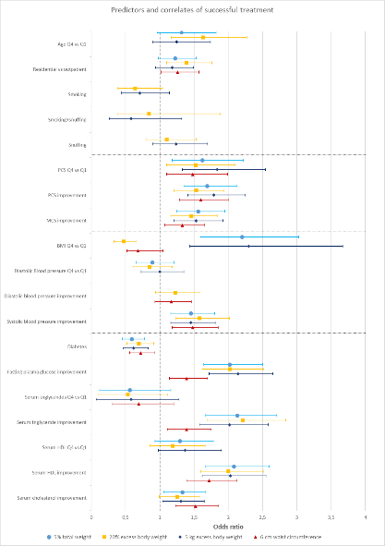
Results
High physical HRQoL predicts weight loss
Diabetes negative predictor
Outcomes correlated to improved HRQoL and metabolic status
HRQoL from clearly below average to normalised!
Physical HRQoL Q4 vs Q1
Most vs least improved physical HRQoL
Most vs least improved mental HRQoL
Diabetes mellitus
Most vs least improved fasting plasma glucose
Most vs least improved serum triglycerides
Most vs least improved serum HDL
Most vs least improved total serum cholesterol

Slide 7
In conclusion:
Better health predicts successful outcomes
Additional support or alterantive treatment options for patients with diabetes and/or low baseline physical health
Successful treatment correlated to improved/normalised HRQoL
Note:
One-center study = limited external validity.

Slide 8
Thank you for your attention!
Contact: erik.martin.nilsson@outlook.com

