Slide 1
Attribution of modifiable risk factors to the total burden of chronic respiratory diseases
Zorica Terzic Supic, Milena Santric Milicevic, Aleksandar Stevanovic, Zeljka Stamenkovic, Jovana Todorovic
University of Belgrade, Faculty of Medicine, Institute of Social Medicine, Belgrade, Serbia

Slide 2
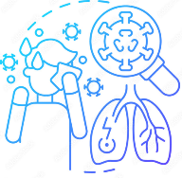
Chronic respiratory diseases
Chronic respiratory diseases are diseases of the airways and other structures of the lung
Chronic respiratory diseases:
chronic obstructive pulmonary disease (COPD), asthma, pneumoconiosis, interstitial lung disease (ILD), and occupational lung diseases.
Notes:
Chronic respiratory diseases are diseases of the airways and other structures of the lung.
They are among the leading causes of morbidity and mortality worldwide
CRDs mainly include chronic obstructive pulmonary disease (COPD), asthma, pneumoconiosis, interstitial lung disease (cause fibrosis of the lungs) and occupational lung diseases.
These diseases contribute to the rising burden of non-communicable diseases (NCDs) globally.
These four types of chronic respiratory disease are associated with demographic trends, socioeconomic development, and risk exposures.

Slide 3
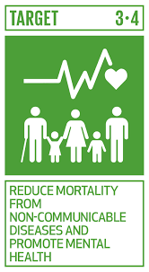
Sustainable development goal target 3.4
The sustainable development goal (SDG) target 3.4, defined by the United Nations (UN), is a one-third reduction of premature mortality from non-communicable diseases (NCDs), including CRDs, by 2030.
Notes:
Chronic respiratory diseases are part of the sustainable development goals of the United Nations. United Nations defined as a target, reduction of premature mortality from non-communicable diseases (NCDs), including CRDs, for one-third by 2030

Slide 4
Modifiable risk factors of CRD
Modifiable risk factors
Tobacco smoking habits
Indoor air pollution from biofuels
Urban outdoor air pollution
Occupational factors
Exposure to respiratory allergens and or ambient particulate matter
Second-hand smoking
Notes:
Several common modifiable risk factors have been identified for CRDs, such as tobacco smoking, second-hand smoking, indoor and outdoor pollution, allergens, and occupational factors.
It is known that there is a relationship between lung cancer and tobacco smoking.
According to the World Health Organization, modifiable risk factors are strongly associated with increased mortality in asthma and chronic obstructive pulmonary disease.

Slide 5
Chronic respiratory diseases as public health issues
In 2019, costs of about €380 billion annually were attributable to the care of patients with CRDs
3rd leading cause of mortality globally in 2019
3.91 million deaths in 2017, accounting for 7% of all deaths worldwide
Costs of lost productivity at least €42 billion
Asthma and allergic rhinitis are reason in more than 100 million lost workdays and missed school days in Europe every year.
Disability-adjusted life-years (DALYs) lost at least €280 billion
By 2025 more than 50% of all Europeans will suffer from at least one type of allergy
Notes:
Chronic respiratory diseases are a major public health problem.
This slide shows the reasons: premature mortality worldwide, the third leading cause of mortality, and very high health care costs which include costs of direct primary and inpatient health care. The cost of disability-adjusted life years lost is at least 280 billion euros, while the costs of lost productivity are at least 42 billion euros.
The next reason is the estimation that 50% of all Europeans will suffer from at least one type of allergy, with no age, social, or geographical distinction (differences) by 2025.
Asthma and allergic rhinitis alone lead to lost workdays and missed school days. Together, they increase presenteeism but with low productivity.

Slide 6
Aim
To examine the burden attributable to modifiable risk factors in the ten countries with the highest burden of chronic respiratory diseases in the European region of the World Health Organization.
Notes:
The aim of this study was to examine the burden attributable to modifiable risk factors in the ten countries with the highest burden of chronic respiratory diseases in the European region of the World Health Organization.

Slide 7
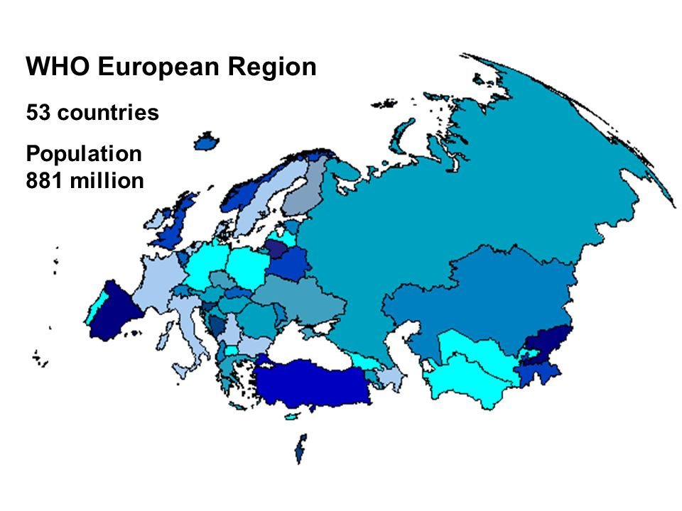
Notes:
I would like to stress that this analysis included all WHO European Region with not only EU countries but also countries of the former Soviet Union

Slide 8
Methods
Data from the 2019 Global Burden of Disease (GBD) study that is being conducted by the Institute of Health Metrics and Evaluation (IHME) (www.healthdata.org)
Disability-Adjusted Life-Years (DALY) rates of chronic respiratory diseases per 100,000 among general population (95% uncertainty interval)
Notes:
Estimates were taken from the Global Burden of Disease Study 2019, which is being conducted by the Institute of Health Metrics and Evaluation
We used the data on the total Disability- adjusted-life years (DALY) rate for chronic respiratory diseases (95% uncertainty interval)
analysis

Slide 9
Five modifiable risk factors examined
Tobacco smoking
Second hand smoking
Particulate matter air pollution
Ambient ozone pollution
Occupational risks
Notes:
We analyzed five modifiable risk factors: tobacco smoking, second hand smoking, particulate matter air pollution, ambient ozone pollution, and occupational risks.

Slide 10
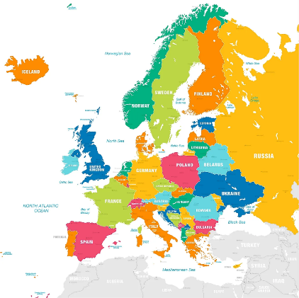
Estimates for ten countries
The United Kingdom, Denmark, The Netherlands, Hungary, Portugal, Belgium, Spain, Greece, Germany and Monaco.
Notes:
Estimates were obtained for ten countries with the highest DALY rates of chronic respiratory diseases: the United Kingdom, Denmark, Netherlands, Portugal, Belgium, Spain, Greece, Germany and Monaco.

Slide 11
Burden of chronic respiratory diseases in the 2019, countries with the highest burden in WHO European region
Country | DALY rate (95% uncertainty interval)
Monaco | 1398.33 (1197.93 – 1603.38)
Germany | 1433.48 (1275.93 – 1588.48)
Greece | 1463.59 (121.27 - 1636.07)
Spain | 1472.97 (1291.40 – 1646.63)
Belgium | 1559.41 (1383.50 – 1736.63)
Portugal | 1574.16 (1361.65 – 1828.64)
Hungary | 1644.24 (1420.15 – 1882.86)
Netherlands | 1698.98 (1451.95 – 1923.27)
Denmark | 1860.91 (1569.67 – 2072.82)
United Kingdom | 1912.73 (1657.06 – 2148.88)
Notes:
The highest DALY rate per 100,000 for chronic respiratory diseases in 2019 was in the United Kingdom followed by Denmark

Slide 12
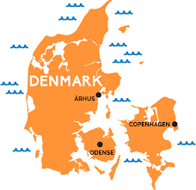
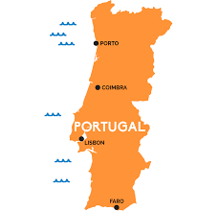
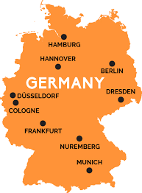
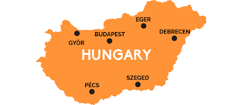
Attribution of modifiable risk factors to the total DALY rate of CRDs
%
DALY
%
DALY
Notes:
The next few slides present the attribution of different risk factors to the total DALY of CRDs in percentages.
The total attribution of smoking to the DALY rate was between 29% in Portugal to 55% in Denmark.
The total attribution of second hand smoking to the DALY rate was between 3.5% in Germany to 8.7% in Hungary.
Hungary smoking rate for 2020 was 31.80%
Denmark smoking rate for 2020 was 17.50%

Slide 13
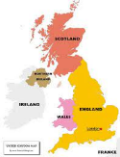
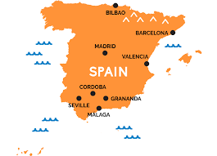
Attribution of modifiable risk factors to the total DALY rate of CRD
%
DALY
%
DALY
Notes:
The total attribution of particulate matter pollution to the DALY rate varies between 2.7% in Portugal and 11.4 % in Hungary.
The total attribution of ambient ozone pollution to the DALY rate varies between 0.6 % in the United Kingdom and 4.7% in Spain.

Slide 14
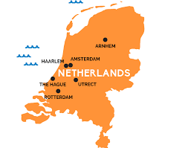
Attribution of modifiable risk factors to the total DALY rate of CRD
%
Notes:
The total attribution of occupational risks to the DALY rate varies between 7.3% in the Netherlands and 10.3% in Portugal.

Slide 15
Conclusion
The burden of chronic respiratory diseases in 2019 is the highest in the United Kingdom among all the countries in the WHO European region
The highest attribution of smoking, second-hand smoking, and particulate matter pollution was in Hungary
The high attribution of modifiable risk factors to the total burden of chronic respiratory diseases seems to be a wake-up call for the officials in environmental and occupational health.
Notes:
According to the results
All these results, seem to be a wake-up call for public health and professionals in the fields of environmental and occupational health
The percentages of attribution of individual risk factors cannot be simply summed up, because of the common joint existence and their interaction.

