Slide 1


THE INFLUENCE OF PHYSICAL ACTIVITY ON DIGESTIVE HEALTH AND GUT MICROBIOTA
Thiago Guimarães Osório

Slide 2

(B)ELMO-ALL RIGHTS RESERVED
POTENTIAL CONFLICTS OF INTEREST:
  PASSIONATE ABOUT
LIFE

Slide 3
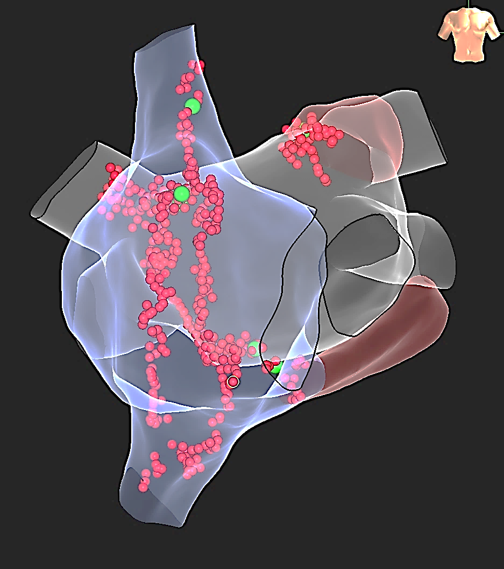
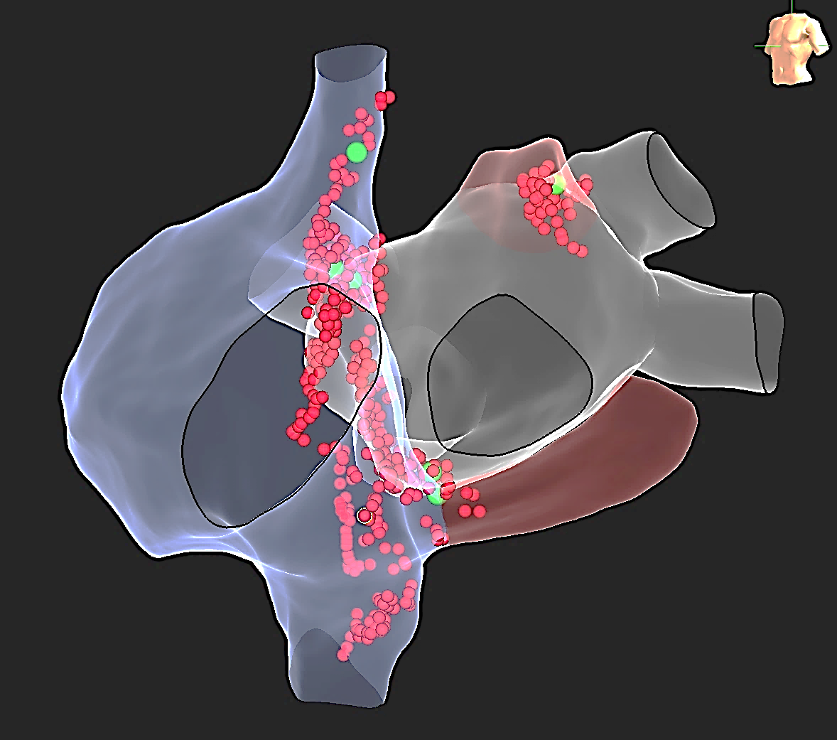
1
1
4
4
2
2
P Point
P Point
3
3

Slide 4
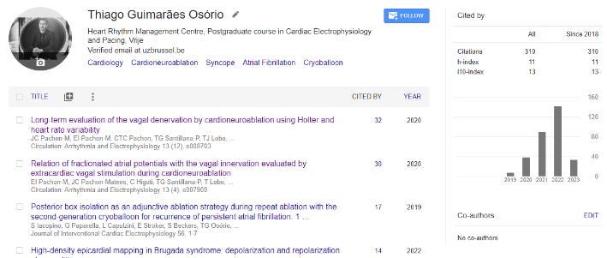
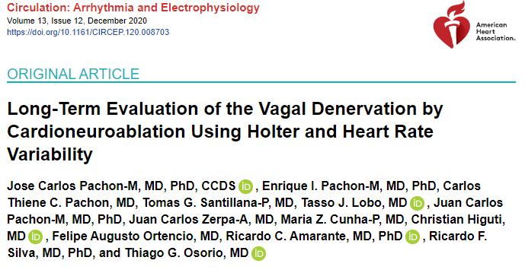

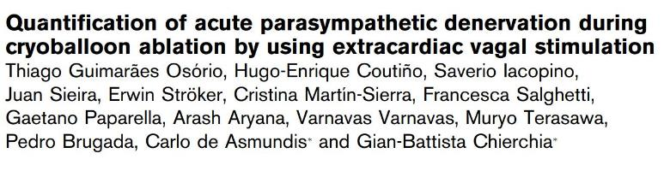
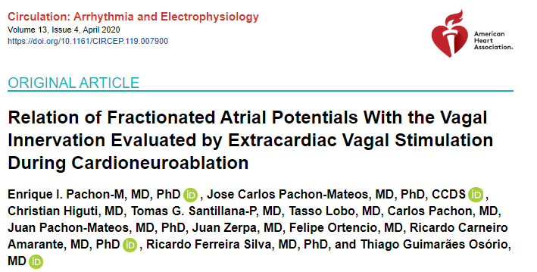
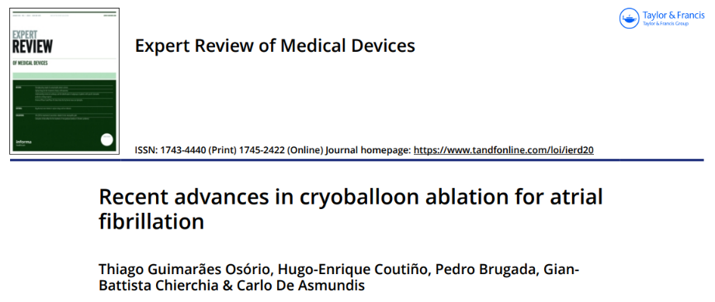

Slide 5

Is Physical Activity GOOD ?

Slide 6
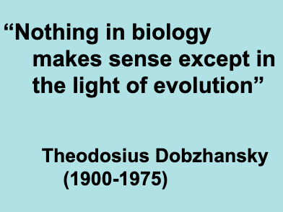
Is regular exercise good for us?

Slide 7
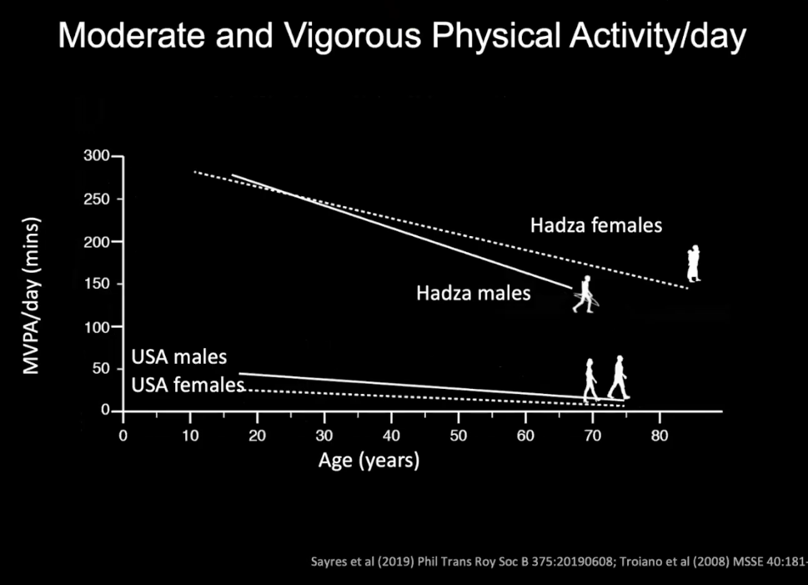
Evolution
Notes:
if they

Slide 8
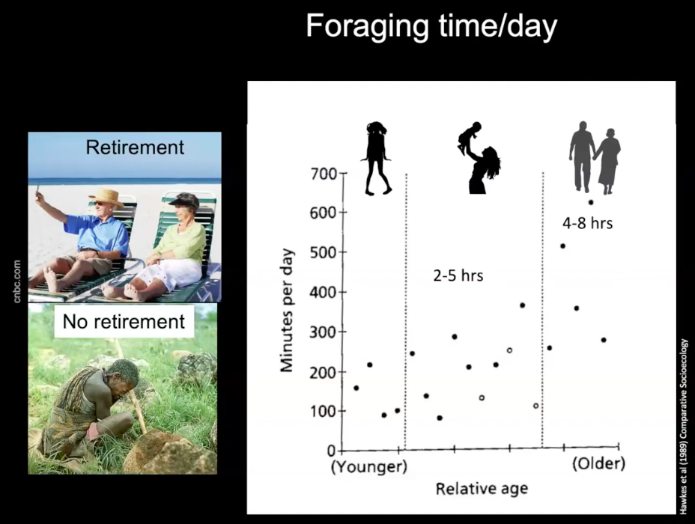
Evolution

Slide 9
Feelings of anxiety, whether chronically present or momentarily, are reduced with physical activity.
Perceived quality of life is improved with physical activity.
Physical function is improved for both young (as young as 3–5 years of age) and old.
In older adults, physical activity allows for greater physical independence, improved bone health, reduced risk of falls or injuries from falls in elderly, and the ability to more easily complete tasks of daily living.
Physical activity reduces the risk of several diseases and improves health.

Slide 10
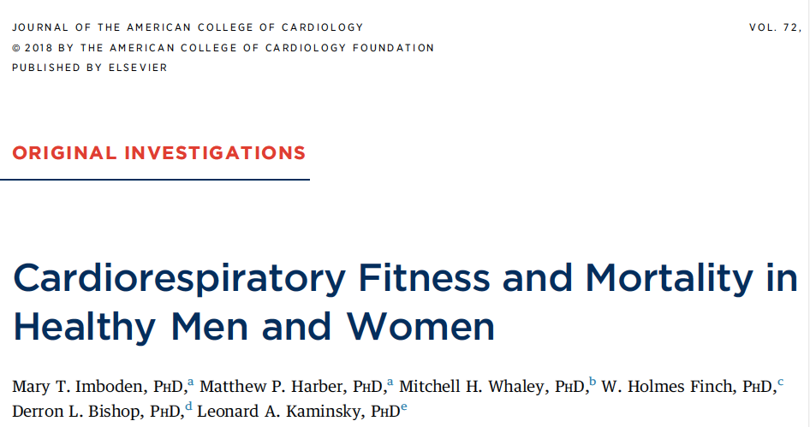
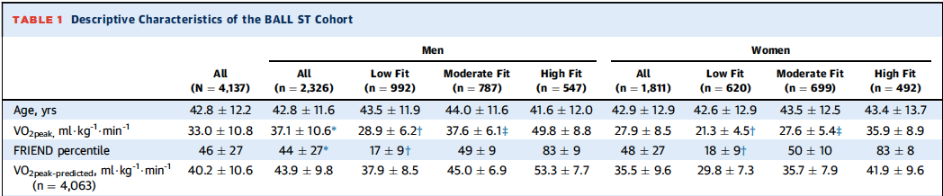
IS REGULAR EXERCISE GOOD FOR US?
4,137Participants
Mean age:42.8
Followed for 24 years for mortality.
Notes:
METHODS Participants included 4,137 apparently healthy adults
mean age:42.8
followed for 24 years for mortality.
CRF level (low, moderate, and high) with mortality outcomes.
RESULTS During follow-up, 727 participants died (524 men, 203 women). CPX-derived CRF was inversely related to allcause,
CVD, and cancer mortality. Low CRF was associated with higher risk for all-cause (hazard ratio [HR]: 1.73; 95%
confidence interval [CI]: 1.20 to 3.50), CVD (HR: 2.27; 95% CI: 1.20 to 3.49), and cancer (HR: 2.07; 95% CI: 1.18 to 3.36)
mortality compared with high CRF. Further, each metabolic equivalent increment increase in CRF was associated with a
11.6%, 16.1%, and 14.0% reductions in all-cause, CVD, and cancer mortality, respectively.
CONCLUSIONS Given the prognostic ability of CPX-derived CRF for all-cause and disease-specific mortality outcomes,
its use should be highly considered for apparently healthy populations as it may help to improve the efficacy
of the individualized patient risk assessment and guide clinical decisions. (J Am Coll Cardiol 2018;72:2283–92)
© 2018 by the American College of Cardiology Foundation.
60

Slide 11
INVERSE RELATIONSHIP BETWEEN CRF AND MORTALITY OUTCOMES;
IS REGULAR EXERCISE GOOD FOR US?
MEN CATEGORIZED AS LOW-FIT HAD A 54%, 49%, AND 46% GREATER LIKELIHOOD OF DYING FROM ALL-CAUSES, CVD, AND CANCER THAN HIGH-FIT MEN (P < 0.001) AFTER ADJUSTING FOR AGE;
AT ANY POINT IN TIME, LOW-FIT WOMEN HAD A 28%,34% AND 34% INCREASED RISK OF DYING FROM ALL-CAUSES, CVD, AND CANCER COMPARED WITH HIGH-FIT WOMEN
THIS STUDY HAD A MEAN FOLLOW-UP OF 24.2 YEARS

Slide 12
IS REGULAR EXERCISE GOOD FOR US?
  AFTER ADJUSTING FOR EXAMINATION YEAR AND TRADITIONAL RISK FACTORS, THE LOW-FIT GROUP WAS ASSOCIATED WITH 73% INCREASED RISK OF ALL-CAUSE MORTALITY, AND A MORE THAN 2-FOLD INCREASED HAZARD FOR BOTH CVD AND CANCER MORTALITY (P < 0.01).

Slide 13
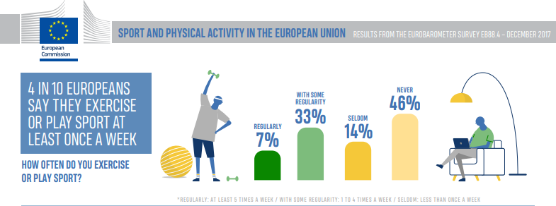


PARADOX
  LESS THAN 1/3 OF THE EU CITIZENS DECLARED SPENDING AT LEAST 150 MINUTES/WEEK
  46% OF THE EUROPEANS NEVER EXERCISE OR PLAY SPORT (EUROBAROMETER 2018)

Slide 14
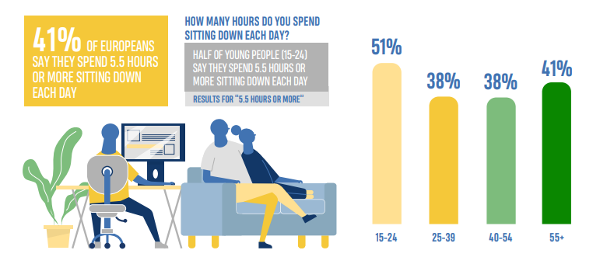


Slide 15
Exercise is possibly the single most important
and accessible lifestyle component that offers
protection from a large range of diseases.
Neufer, P. D. et al. Understanding the cellular and molecular mechanisms of physical activity-induced health benefits. Cell Metab. 22, 4–11 (2015).

Slide 16
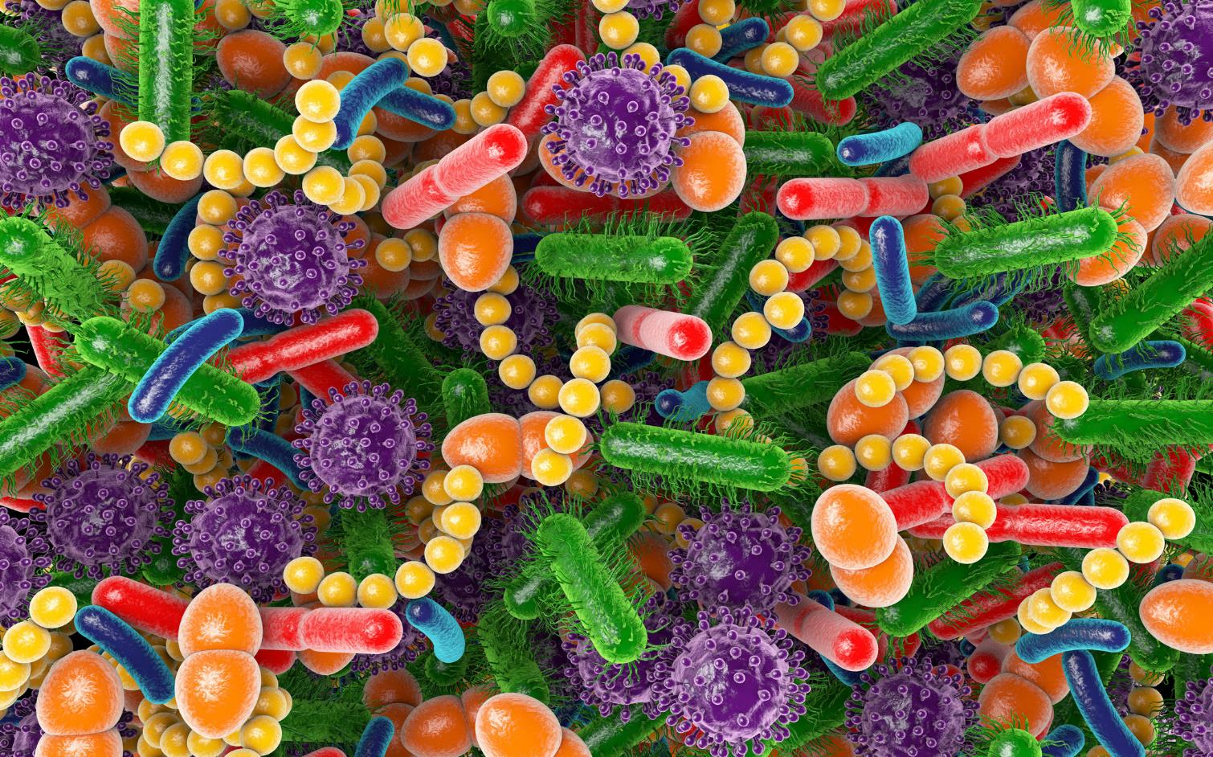
Gut microbiota
The human gut microbiota has been defined as the entire collection of microbes (bacteria, archaea, eukarya, and viruses)
Several important biological functions such as digestion, absorption, stimulating
immune responses, and protection against enteropathogens.

Slide 17
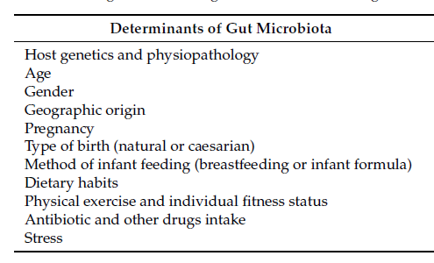

Slide 18
Benefits of Physical Activity on Digestive Health
Enhanced Digestive Efficiency
Lower Risk of Gastrointestinal Disorders
Improved Nutrient Absorption
Stress Reduction and Digestive Health
Weight Management and Digestive Disorders
Enhanced Insulin Sensitivity

Slide 19
Dysbiosis or imbalance in gut microbiota has been associated
  Ulcerative colitis
  Crohn’s disease
  Colon cancer
  Metabolic syndrome
  Type I and type II diabetes
  Cardiovascular disease
  Allergy
  Asthma
  Eczema
  Autism
  Depression
  …….?

Slide 20
Short Chain Fatty Acids
They are metabolites produced by the bacterial fermentation of indigestible carbohydrates and dietary fibers in the colon.
Production and absorption occurs mainly in the proximal large intestine
Functions?
Substrates for energy metabolism;
Increase ATP production and improve metabolic efficiency of myofibers;
Contribute to regulate immune and inflammatory responses;
Lipid accumulation and inhibition;
Regulation of food intake, appetite and glucose homeostasis;
In the Brain acting in cellular metabolism, and neurotransmitter synthesis.

Slide 21
The Gut-muscle Axis
SCFAs appear to increase after exercise and are positively associated with physical activity level and cardiorespiratory fitness;
Contraction of skeletal muscle during exercise has an anti-inflammatory effect because of the release of myokines;
Myokines mediate the secretion of GLP-1, a key involved in whole-body metabolism, in the gut during exercise;
Increase gut microbiota producing SCFAs—key mediators of energy metabolism in the mitochondria of skeletal muscles;
SCFAs enhance muscle fat oxidation. Thus, enhance metabolic flexibility;
Butyrate also protect against muscle protein catabolism and therefore preventing age-related muscle mass loss.

Slide 22
Neurotransmitters
Gut microbiota is itself a source of local neurotransmitters:
Nitric oxide
GABA
Noradrenaline
Dopamine
Serotonin
The concentrations of tryptophan, a precursor of serotonin, is controlled by the bacteria in the gut.
Affect mood, motivation, and sensation of exhaustion in both sedentary individuals and athletes
The gut-brain axis

Slide 23
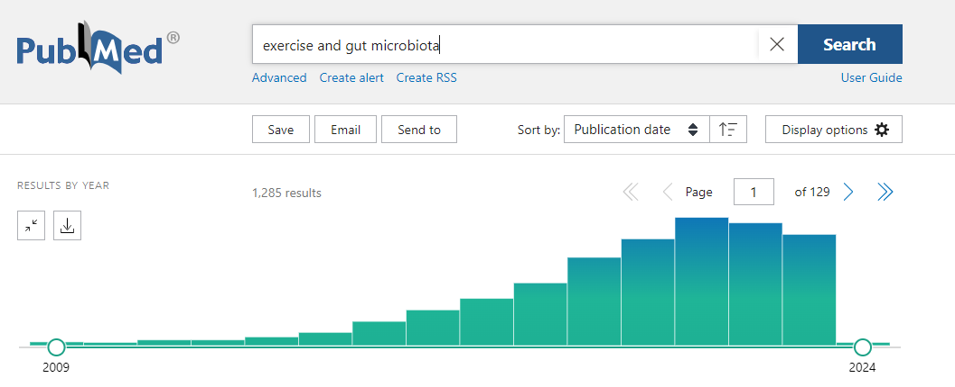
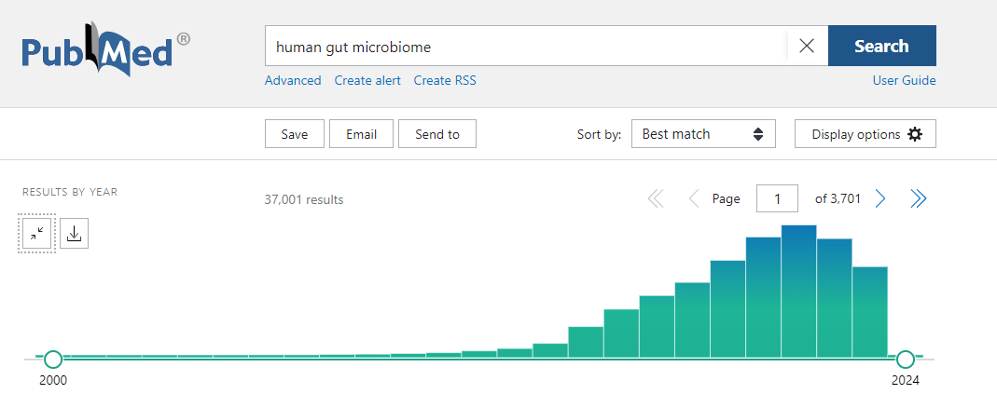
  Evidence for a role of exercise in shaping the human gut microbiota emerged only a few years ago.
Recently, interest has increased for moving beyond “who’s there?” to better understand the role of the gut microbiota in states of health and disease “what are they doing?”.

Slide 24
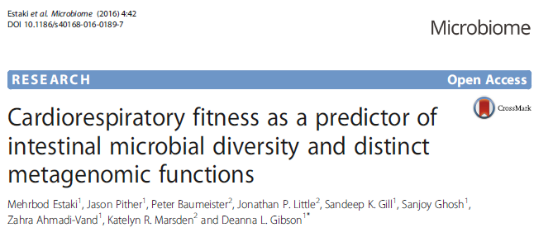
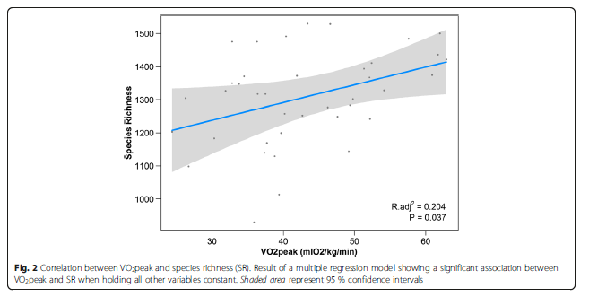
39 healthy participants with similar age, BMI, and diets but with varying cardiorespiratory fitness levels.
VO2peak, can account for more than 20 % of the variation in variety of microbial species , after accounting for all other factors, including diet.
Increases in production of fecal butyrate
Estaki et al. Microbiome (2016) 4:42 DOI 10.1186/s40168-016-0189-7

Slide 25
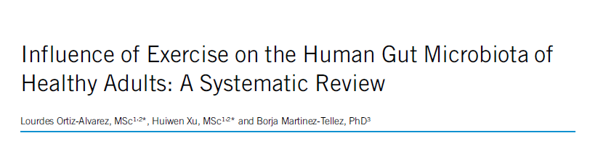
The initial search retrieved 619 articles of which 18 met the inclusion criteria;
Higher levels of physical activity and cardiorespiratory fitness are associated with higher fecal bacterial diversity and certain short-chain fatty acids.
Very short-term and medium/long-term exercise interventions seem to influence the fecal diversity.
Clinical and Translational Gastroenterology 2020;11:e00126. https://doi.org/10.14309/ctg.0000000000000126

Slide 26
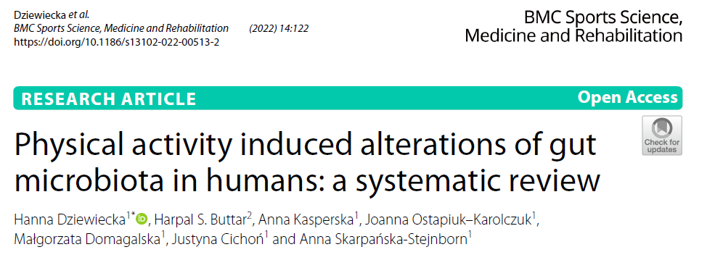
After excluding 2052 articles, 38 articles were selected.
Non-athletes rising physical activity markedly influenced the relative abundance of SCFA.
Aerobic training that lasted 60 min, and physical activity that characterized 60% HRmax or more also influenced the abundance of certain microbes and the overall diversity of the gut microbiota is also affected.
High intensity and volume of exercise may lead to gut dysbiosis.

Slide 27
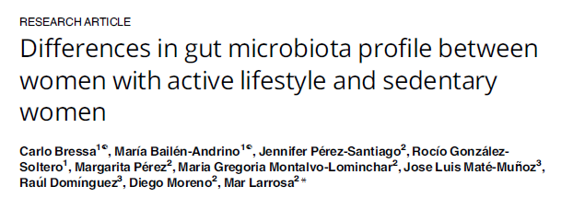
40 women age 18±40 years and body mass index (BMI) 20±25 kg/m2.
Sedentary - performed 3 days of exercise per week for 30 minutes at a moderate intensity
Active - performed at least 3 hours of physical exercise per week
Body fat percentage, muscular mass and physical activity significantly correlated with biodiversity.
Forced exercise showed more marked effects on microbiota diversity than voluntary exercise.
An inverse association between sedentary parameters and microbiota richness was observed, emphasizing the importance of active lifestyle patterns.
.

Slide 28
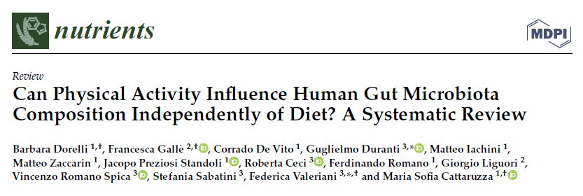
PA can increase the abundance of health-promoting bacteria and reduce ones in the intestinal microbiota.
However, it should be noted that the practice of sport can be associated with specific food/nutrient intakes, which can favor specific microbial populations.
Review. Nutrients 2021, 13, 1890. https://doi.org/10.3390/nu13061890

Slide 29
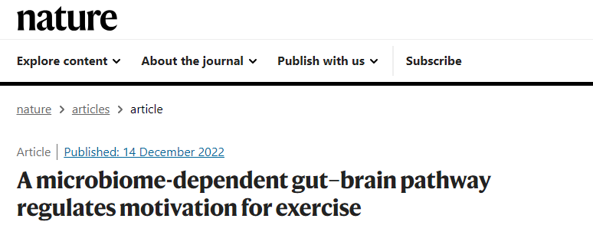
Identified a metabolite triggered gut–brain connection that regulates the motivation for exercise, linking the intestinal microbiome to midbrain dopamine signalling via afferent sensory neurons.

Slide 30
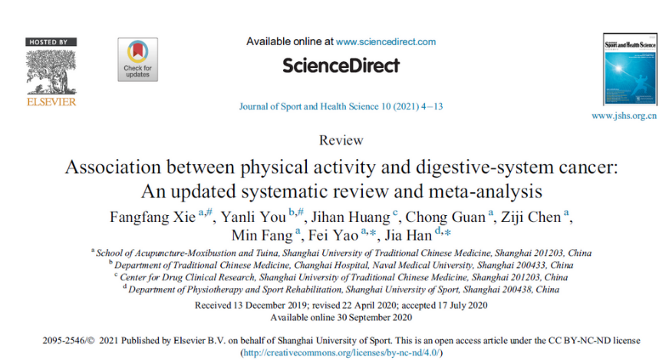
Digestive-system cancers (DSC), including colon, rectal, colorectal, gallbladder, gastric, liver, oropharyngeal, and pancreatic cancers.
  Data from 47 studies involving over 5.7 million participants and found that higher levels of PA are generally associated with a reduced risk of DSC.
  Adjusted for confounders such as smoking, BMI, and alcohol intake in the analysis.
  High PA levels were linked to an 18% reduction in DSC risk compared to low PA levels.
Limitation : Did not allow to identify the specific types and intensity of
PA that might affect its impact on DSC risk.

Slide 31
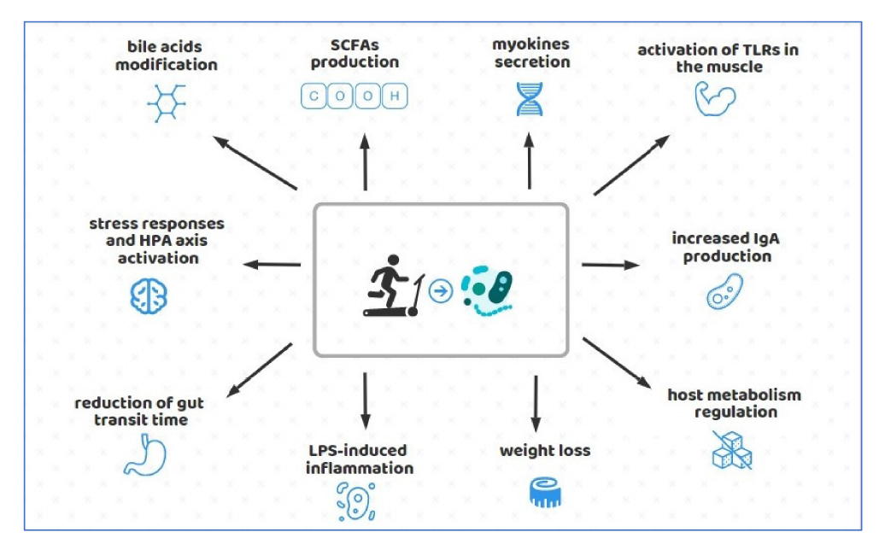
https://doi.org/10.3390/foods10123075

Slide 32
The science of the gut microbiome, particularly the interaction with exercise, is still in its early stages. While significant discoveries have been made, our understanding of the communication within the muscle-brain-gut axis is still far from complete.
What we know is that a clear relationship exists between physical activity, gut microbiota, and a healthy digestive system.

Slide 33

Future?
What frequency, mode, or intensity
of exercise is best?
How does exercise impact the gut
microbiome in children or the elderly?
In healthy or diseased
states?
How does exercise interact with diet in shaping the gut
microbiome?
Do probiotics or prebiotics influence gut responses
to an exercise intervention?
What about resistance exercise?

Slide 34

Prevention!

Slide 35
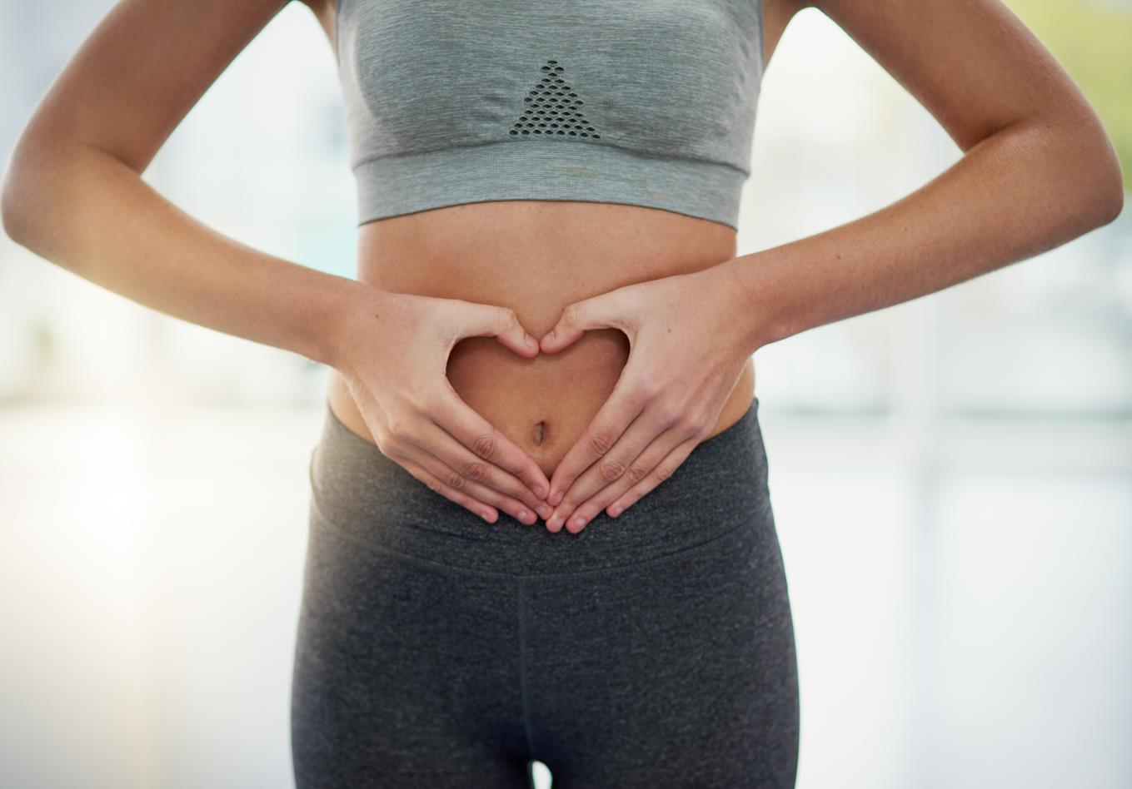

Thank you!
Keep moving and taking care of your gut!

