Slide 1

Exercise-Cardio-Oncology
Georgeta Vaidean, MD, MPH, PhD
Faculty, Herbert Wertheim College of Medicine, Florida International University, Miami, FL, USA
Senior Research Consultant, Lenox Hill Hospital, Cardiovascular Prevention Department, New York, NY.
gvaidean@fiu.edu X: @georgeta
ELMO Congress, November 2023

Slide 2
Exercise in
Breast Cancer patients treated with Cardiotoxic agents
A brief look at the evidence
and
the role of the Lifestyle Medicine practitioner

Slide 3
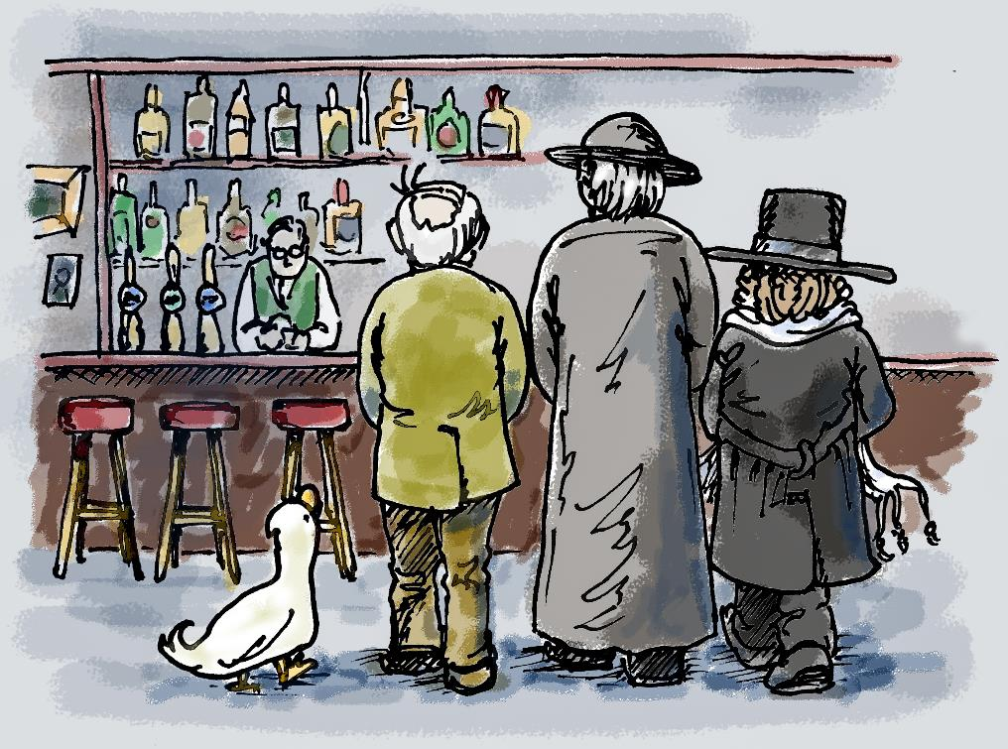
A cardiologist,
an oncologist and a
lifestyle medicine
specialist walk
into….

Slide 4
More drugs
6o+ recent years
New drugs
molecularly targeted
20 % reduction in cancer death rates
Life expectancy
Cancer survivors prevalence
Cancer – as chronic disease

Slide 5
Cancer therapy
Short- & long-term cardiovascular complications
40% deaths are CVD deaths

Slide 6
Shared Risk
Factors at baseline
Cardiovascular Risk Factors
Breast Cancer Risk Factors
High blood pressure
Insulin resistance
Diabetes
Dyslipidemia
Sleep Apnea
APOs: PE, HDP, GDM
Autoimmune diseases
Inflammatory diseases
Psycho-social
CVD Genetics
Inflammation
Dense breast
Carcinogens
Chest radiation
Diethylstibestrol
Oral contraceptives
Early Menses
Late/no pregnancy
Late menopause (>55)
BRCA Genetics
Metabolic syndrome
Oxidative stress
Adiposity
Low Physical Activity
Dietary factors
Low in fruits/vegetables, fiber-rich whole grains, high in SSB,
UPF, red meat
Smoking
Alcohol
Age
SES
Hormones, parity, menopause
Environment
Microbiome
Henry S, Vaidean G (co-primary authors), Rege R, Gianos E. Heart. 2023 Jun 26;109(14):1113-1121
Notes:
Henry S, Vaidean G (co-primary authors), Rege R, Gianos E. Heart. 2023 Jun 26;109(14):1113-1121

Slide 7
Cardio-oncology-lifestyle medicine
Throughout the entire spectrum
Pre-Cancer
Diagnosis

Slide 8
Cardio-oncology-lifestyle medicine
Throughout the entire spectrum
Pre-Cancer
Diagnosis

Slide 9

The Triple Threat
Baseline CVDRF
HTN, DM, Dyslipidemia, Obesity, Smoking, Sedentary life, Sleep, Stress
Direct injury
(Cardiotoxicity)
Indirect injury
Pulmonary, hema, MSK→O2 cascade
Poor nutrition, frailty, deconditioning low adherence, psycho-social factors

Slide 10
Direct injury
(Cardiotoxicity)
Anti cancer drugs
Anthracyclines
Others: Cyclophosphamide, Cisplatin, Ifosfamide, Taxanes
Immunotherapies, targeted therapies:
Trastuzumab
Drugs targeting HER2
Proteasome inhibitors
Radiotherapy
DNA damage
Apoptosis
Mitochondrial dysfunction
Oxidative stress
Endothelial dysfunction
HER2-human epidermal growth factor receptor 2

Slide 11
Cancer treatment –related cardiovascular toxicity
myocardial dysfunction and heart failure
coronary artery disease
valvular disease
arrhythmias, QT prolongation
arterial hypertension
thromboembolic disease
peripheral vascular disease
stroke
pulmonary hypertension
pericardial complications

Slide 12
Cancer treatment –related cardiovascular toxicity
myocardial dysfunction and heart failure
coronary artery disease
valvular disease
arrhythmias, QT prolongation
arterial hypertension
thromboembolic disease
peripheral vascular disease
stroke
pulmonary hypertension
pericardial complications
Risk factors
Prior asymptomatic LV dysfunction (EF < 50%)
Prior coronary /valvular/ hypertensive heart disease
prior cardiotoxicity
age < 18 or > 50
family history of CAD
traditional CVD Risk factors (HTN, DM, hyperlipidemia)

Slide 13
Incidence of Cancer treatment-induced cardiotoxicities
It depends
Definitions criteria
Diagnostic monitoring and methods
Study setting and design (eg, RCT vs. community cohort study)
Population
Cancer treatments used
Complex interactions, multimodal/multiagent TX regimens
Duration of follow-up
Variable impact of preexisting CVDRF

Slide 14
Therapies for preventing & mitigating cardiotoxicity

Slide 15
Therapies for preventing & mitigating cardiotoxicity
Dexrazoxane…
ACE inhibitors, ARBs, Beta-blockers…

Slide 16
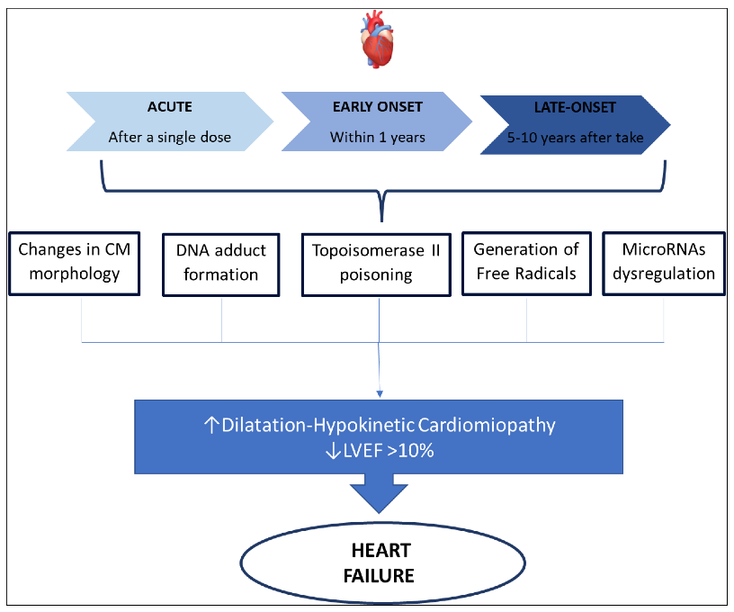
Anthracycline-induced cardiotoxicity mechanisms
Cardiotoxicity
- a continuous phenomenon
HF
- on a spectrum
- dose- and schedule-dependent
Cancers 2022, 14, 2288

Slide 17
Cardiotoxicity mechanisms potentially positively affected by physical activity & exercise
Life 2022, 12, 1006. https://doi.org/10.3390/life12071006

Slide 18
The Triple Threat
Baseline CVDRF
HTN, DM, Dyslipidemia, Obesity, Smoking, Sedentary life, Sleep, Stress
Direct injury
(Cardiotoxicity)
Indirect injury
Pulmonary, hema, MSK→O2 cascade
Poor nutrition, frailty, deconditioning low adherence, psycho-social factors
Cancer relapse risk
Pulmonary function
Weight control
Cognitive function
Lymphedema
Astenia
Nausea
QoL
Exercise Potential Protection

Slide 19
Evidence and Implementation
Exercise training in non-cancer settings
Exercise training in cancer settings
AHA- 1st exercise guidelines for cardiac exercise rehabilitation in 1975
Evidence - strong
Implementation – +/- OK
New +/-
Evidence – poor/emerging
Implementation – poor

Slide 20
Evidence and Implementation
Exercise training in non-cancer settings
Exercise training in cancer settings
AHA- 1st exercise guidelines for cardiac exercise rehabilitation in 1975
Evidence - strong
Implementation – +/- OK
New +/-
Evidence – poor/emerging
Implementation – poor

Slide 21
Cardio-Oncology Rehabilitation across the cancer care spectrum

Slide 22
Cardio-Oncology Rehabilitation across the cancer care spectrum
Cardiotoxicities
Acute
(~ within 2 weeks of TX)
Early
(~ 2 weeks -1 year of TX)
Late
(~ >1-year post TX)

Slide 23
Cardiotoxicity is a dynamic variable over the therapy continuum
Pre-existing CVRF, CVD, previous cancer TX may increase the magnitude of acute and long-term CV toxicity risk
CTR-CVT risk changes during and after treatment according
to type, dose, frequency, and duration of treatment
European Heart Journal (2022) 43, 4229–4361

Slide 24
Current evidence- Primary prevention: to prevent the development of treatment induced cardiotoxicities
Cardiorespiratory fitness #
aerobic exercise → 5.6 mL/kg/min increase in VO2peak
  MA, not all RCTs
attenuation of Tx- induced declines in VO2peak
Benefit in early Tx
attenuation of significant VO2peak decline may be related to exercise volume, irrespective of mode
# Support Care Cancer. 2022;30:10323–10334; Circulation. 2023;147:532–545. Med Sci Sports Exerc. 2019;51:1573–1581.; Ann Phys Rehabil Med. 2022;65:101485.; Eur Heart J . 2023 Feb 21:ehad085 ; J Am Coll Cardiol CardioOnc. 2022;4:491–503
* Support Care Cancer. 2022;30:10323–10334; Circulation. 2023;147:532–545.
## Cardiooncology. 2021;7:7.; J Am Coll Cardiol CardioOnc 2023;5:553–569

Slide 25
Current evidence- Primary prevention: to prevent the development of treatment induced cardiotoxicities
Cardiorespiratory fitness #
aerobic exercise → 5.6 mL/kg/min increase in VO2peak
  MA, not all RCTs
attenuation of Tx- induced declines in VO2peak
Benefit in early Tx
attenuation of significant VO2peak decline may be related to exercise volume, irrespective of mode
Cardiac function *
E/A ratio- improved
LVEF, global longit. strain (GLS)- no effect in most studies
  MA, not all RCTs
  Rest Echo
Stress echo- peak, but not rest cardiac function measures were the driving force for VO2peak changes after a combined aerobic and resistance exercise intervention
# Support Care Cancer. 2022;30:10323–10334; Circulation. 2023;147:532–545. Med Sci Sports Exerc. 2019;51:1573–1581.; Ann Phys Rehabil Med. 2022;65:101485.; Eur Heart J . 2023 Feb 21:ehad085 ; J Am Coll Cardiol CardioOnc. 2022;4:491–503
* Support Care Cancer. 2022;30:10323–10334; Circulation. 2023;147:532–545.
## Cardiooncology. 2021;7:7.; J Am Coll Cardiol CardioOnc 2023;5:553–569

Slide 26
Current evidence- Primary prevention: to prevent the development of treatment induced cardiotoxicities
Cardiorespiratory fitness #
aerobic exercise → 5.6 mL/kg/min increase in VO2peak
  MA, not all RCTs
attenuation of Tx- induced declines in VO2peak
Benefit in early Tx
attenuation of significant VO2peak decline may be related to exercise volume, irrespective of mode
Cardiac function *
E/A ratio- improved
LVEF, global longit. strain (GLS)- no effect in most studies
  MA, not all RCTs
  Rest Echo
Stress echo- peak, but not rest cardiac function measures were the driving force for VO2peak changes after a combined aerobic and resistance exercise intervention
Biomarkers of cardiac injury ##
natriuretic peptides –most studies→ no effect
treatment-induced increases in Troponin attenuated by combined training vs. non-exercising.
NT-ProBNP – lower at 1-year FU in those w/exercise for 16 wk vs. usual-care ( in patients on chemoTx)
# Support Care Cancer. 2022;30:10323–10334; Circulation. 2023;147:532–545. Med Sci Sports Exerc. 2019;51:1573–1581.; Ann Phys Rehabil Med. 2022;65:101485.; Eur Heart J . 2023 Feb 21:ehad085 ; J Am Coll Cardiol CardioOnc. 2022;4:491–503
* Support Care Cancer. 2022;30:10323–10334; Circulation. 2023;147:532–545.
## Cardiooncology. 2021;7:7.; J Am Coll Cardiol CardioOnc 2023;5:553–569

Slide 27
Current evidence- Primary prevention: to prevent the development of treatment induced cardiotoxicities
Cardiorespiratory fitness #
aerobic exercise → 5.6 mL/kg/min increase in VO2peak
  MA, not all RCTs
attenuation of Tx- induced declines in VO2peak
Benefit in early Tx
attenuation of significant VO2peak decline may be related to exercise volume, irrespective of mode
Cardiac function *
E/A ratio- improved
LVEF, global longit. strain (GLS)- no effect in most studies
  MA, not all RCTs
  Rest Echo
Stress echo- peak, but not rest cardiac function measures were the driving force for VO2peak changes after a combined aerobic and resistance exercise intervention
Biomarkers of cardiac injury ##
natriuretic peptides –most studies→ no effect
treatment-induced increases in Troponin attenuated by combined training vs. non-exercising.
NT-ProBNP – lower at 1-year FU in those w/exercise for 16 wk vs. usual-care ( in patients on chemoTx)
Exercise programs may prevent deterioration
# Support Care Cancer. 2022;30:10323–10334; Circulation. 2023;147:532–545. Med Sci Sports Exerc. 2019;51:1573–1581.; Ann Phys Rehabil Med. 2022;65:101485.; Eur Heart J . 2023 Feb 21:ehad085 ; J Am Coll Cardiol CardioOnc. 2022;4:491–503
* Support Care Cancer. 2022;30:10323–10334; Circulation. 2023;147:532–545.
## Cardiooncology. 2021;7:7.; J Am Coll Cardiol CardioOnc 2023;5:553–569

Slide 28
Current evidence- Secondary prevention: in patients w/cancer w/evidence of cardiac dysfunction or reduced CRF in absence of symptoms/clinically overt CVD
Cardiorespiratory fitness#
Only 2 RCTs
Other Cancers (not BC)
Clinically significant improvements in VO2peak (ie, >3.5 mL/kg/min or ~10%), which represents the reversal of a decade’s worth of cardiorespiratory aging within 12 weeks of HIIT or combined aerobic and resistance training
# . J Am Coll Cardiol CardioOnc 2023;5:553–569
* J Cardiopulm Rehabil Prev. 2023;43:129–134.
## . J Am Coll Cardiol CardioOnc 2023;5:553–569

Slide 29
Current evidence- Secondary prevention: in patients w/cancer w/evidence of cardiac dysfunction or reduced CRF in absence of symptoms/clinically overt CVD
Cardiorespiratory fitness#
Only 2 RCTs
Other Cancers (not BC)
Clinically significant improvements in VO2peak (ie, >3.5 mL/kg/min or ~10%), which represents the reversal of a decade’s worth of cardiorespiratory aging within 12 weeks of HIIT or combined aerobic and resistance training
Cardiac function *
LVEF, global longit. strain (GLS)- no effect in most studies
Conflicting results
# . J Am Coll Cardiol CardioOnc 2023;5:553–569
* J Cardiopulm Rehabil Prev. 2023;43:129–134.
## . J Am Coll Cardiol CardioOnc 2023;5:553–569

Slide 30
Structured Exercise Program Attenuates Cardiotoxicity of Anthracycline Chemotherapy Measured by Global Longitudinal Strain, N= 27
Exercise attenuates injury
Preservation
of myocardial function
Reduction in GLS
JACC CardioOncol. 2019 Dec; 1(2): 298–301

Slide 31
Current evidence- Secondary prevention: in patients w/cancer w/evidence of cardiac dysfunction or reduced CRF in absence of symptoms/clinically overt CVD
Cardiorespiratory fitness#
Only 2 RCTs
Other Cancers (not BC)
Clinically significant improvements in VO2peak (ie, >3.5 mL/kg/min or ~10%), which represents the reversal of a decade’s worth of cardiorespiratory aging within 12 weeks of HIIT or combined aerobic and resistance training
Cardiac function *
LVEF, global longit. strain (GLS)- no effect in most studies
Conflicting results
Biomarkers of cardiac injury ##
Other cancers
No changes/ conflicting results
# . J Am Coll Cardiol CardioOnc 2023;5:553–569
* J Cardiopulm Rehabil Prev. 2023;43:129–134.
## . J Am Coll Cardiol CardioOnc 2023;5:553–569

Slide 32
Current evidence- Secondary prevention: in patients w/cancer w/evidence of cardiac dysfunction or reduced CRF in absence of symptoms/clinically overt CVD
Cardiorespiratory fitness#
Only 2 RCTs
Other Cancers (not BC)
Clinically significant improvements in VO2peak (ie, >3.5 mL/kg/min or ~10%), which represents the reversal of a decade’s worth of cardiorespiratory aging within 12 weeks of HIIT or combined aerobic and resistance training
Cardiac function *
LVEF, global longit. strain (GLS)- no effect in most studies
Conflicting results
Biomarkers of cardiac injury ##
Other cancers
No changes/ conflicting results
Exercise programs may improve some measures
# . J Am Coll Cardiol CardioOnc 2023;5:553–569
* J Cardiopulm Rehabil Prev. 2023;43:129–134.
## . J Am Coll Cardiol CardioOnc 2023;5:553–569

Slide 33
Breaking away from physical inactivity after a cancer Dx is associated with a reduced CVD risk, whether or not postDx PA levels meet guideline recommendations
increased their PA in MET-min/week
  from 0 to 1–599 (not meeting guideline)
  from 0 to ≥600 (meeting guideline)
decreased PA from 1–599 or ≥600 to 0
20% risk reduction
24% risk increase
European Heart Journal (2023) 00, 1–4

Slide 34
Exercise Prescription Components for Cardio-Oncology REhabilitation CORE
Aerobic
Resistance
Flexibility/ROM
Mayo Clinic , Journal of Cardiopulmonary Rehabilitation and Prevention 2021;41:341-344

Slide 35
Guidelines
“Exercise is a potent multitargeted therapy that prevents and treats multiple competing mechanisms of Cancer treatment related CV Toxicity in cancer survivors, including CRF impairment, CV injury, and pre-existing and new CVRF.”
Prescribing exercise facilitates the delivery of therapeutic exercise that is individualized to a person’s fitness level and systematically progressed to optimize physiological adaptation.
European Heart Journal (2022) 43, 4229–4361

Slide 36
Recommendations for end-of-cancer therapy cardiovascular risk assessment
Guidelines
“Patient education and CVRF optimization”
European Heart Journal (2022) 43, 4229–4361

Slide 37
Critique of the evidence
Methodology issues
Exercise Prescription/program issues
Small sample size
Limited RCTs designs
Clinical outcomes – rare, often not primary
Surrogate/biomarkers outcomes
Program adherence - poor
Loss of follow up
Design quality
Low dose interventions
Unclear necessary exercise stimulus to improve or maintain baseline cardiovascular health (exercise volume?)
Unclear appropriate modes of exercise
Heterogeneous exercise prescriptions
(aerobic, resistance, Freq- Inten-Time )

Slide 38
Critique of the evidence
Methodology issues
Exercise Prescription/program issues
Small sample size
Limited RCTs designs
Clinical outcomes – rare, often not primary
Surrogate/biomarkers outcomes
Program adherence - poor
Loss of follow up
Intervention specifics - poor
Design quality
Low dose interventions
Unclear necessary exercise stimulus to improve or maintain baseline cardiovascular health (exercise volume?)
Unclear appropriate modes of exercise
Heterogeneous exercise prescriptions
(aerobic, resistance, Freq- Inten-Time )

Slide 39

Integrate Exercise interventions to :
Prevent - Monitor - Mitigate
Future Directions
acute & chronic CV effects of Cancer Tx
immediately after & long term in survivorship

Slide 40
Future research needs
Better Exercise intervention specification
Need for tailored Exercise programs
  tailored to Tx regimen, disease stage, patient needs
Need for out-of-hospital programs and Remote digital cardio-onc rehab programs
Incorporate patient perspectives
More RCTs
Efficacy and Effectiveness + Implementation studies
Optimize Teamwork

Slide 41
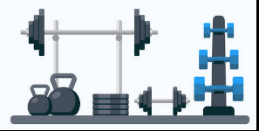
Implementation of Exercise and comprehensive monitoring of cardiac health in oncological patients
Hospital/Inpatient
Gym
Home/Ambulatory
Virtual care
Integrated with comprehensive all-pillars Lifestyle medicine

Slide 42
Case study
 | Exercise prescription 1 | Exercise prescription 2
Type | recumbent cycle/stepper, walk (outdoors, treadmill, indoors), mini-trampoline | add jogging, water exercise: swim, walk, aerobics.
Frequency | 5-7 sessions/wk | unchanged, at target level
Intensity | RPE 12-14/20 for continuous mod. intensity CMI, exercise, 15-17/20 for HIIT | unchanged; HIIT: introduce jogging, as tolerated
Time | warm-up 3-5 min, aerobic-gradually progress to 45-60 min, cool-down 3-5 min HIIT: 60 sec at RPE 15-17/20, 3-5 min CMI, 3-5 HIIT intervals/session, 2-3 exer. Sess /wk w/HIIT | increase upper range to 90 min
Flexibility | Flexibility: daily | add yoga one session/wk
Balance | Balance exercises: 2-3 times/wk
Strength | calisthenics, free weights, weight machines; 2-3 sessions/wk; mod. Int., RPE 12-14/20; 10-15 repetitions, 1-2 sets/exercise; | add wall push-ups, additional core exercise
Progression | Progression: use RPE targets to judge when to increase intensity and/or duration. | unchanged
General activity | avoid prolonged sitting, perform household chores / gardening /shopping, pedometer step/d goal of ≥10,000, take the stairs. | unchanged
66 yr woman, high-grade ductal in situ BC, HER-2(+), L mastectomy, deferred adjuvant therapy, HER-2-directed therapy.
6 mo later Dx large B-cell lymphoma.
ECG: HR 71, nonsp. T-wave abn.
Echo: LVEF 64%, LV strain 19% (normal is ≤ 18%).
TX: cyclophosphamide, doxorubicin, Oncovin (vincristine),prednisone (R-CHOP), pegfilgrastim
LVEF 44%, LV strain 15%; Carvedilol 12.5 mg 2x/d initiated.
5 mo later, Dx recurrent BC, left chest wall surgery.

Slide 43
Case study
 | Exercise prescription 1 | Exercise prescription 2
Type | recumbent cycle/stepper, walk (outdoors, treadmill, indoors), mini-trampoline | add jogging, water exercise: swim, walk, aerobics.
Frequency | 5-7 sessions/wk | unchanged, at target level
Intensity | RPE 12-14/20 for continuous mod. intensity CMI, exercise, 15-17/20 for HIIT | unchanged; HIIT: introduce jogging, as tolerated
Time | warm-up 3-5 min, aerobic-gradually progress to 45-60 min, cool-down 3-5 min HIIT: 60 sec at RPE 15-17/20, 3-5 min CMI, 3-5 HIIT intervals/session, 2-3 exer. Sess /wk w/HIIT | increase upper range to 90 min
Flexibility | Flexibility: daily | add yoga one session/wk
Balance | Balance exercises: 2-3 times/wk
Strength | calisthenics, free weights, weight machines; 2-3 sessions/wk; mod. Int., RPE 12-14/20; 10-15 repetitions, 1-2 sets/exercise; | add wall push-ups, additional core exercise
Progression | Progression: use RPE targets to judge when to increase intensity and/or duration. | unchanged
General activity | avoid prolonged sitting, perform household chores / gardening /shopping, pedometer step/d goal of ≥10,000, take the stairs. | unchanged
66 yr woman, high-grade ductal in situ BC, HER-2(+), L mastectomy, deferred adjuvant therapy, HER-2-directed therapy.
6 mo later Dx large B-cell lymphoma.
ECG: HR 71, nonsp. T-wave abn.
Echo: LVEF 64%, LV strain 19% (normal is ≤ 18%).
TX: cyclophosphamide, doxorubicin, Oncovin (vincristine),prednisone (R-CHOP), pegfilgrastim
LVEF 44%, LV strain 15%; Carvedilol 12.5 mg 2x/d initiated.
5 mo later, Dx recurrent BC, left chest wall surgery.

Slide 44
Case study
 | Exercise prescription 1 | Exercise prescription 2
Type | recumbent cycle/stepper, walk (outdoors, treadmill, indoors), mini-trampoline | add jogging, water exercise: swim, walk, aerobics.
Frequency | 5-7 sessions/wk | unchanged, at target level
Intensity | RPE 12-14/20 for continuous mod. intensity CMI, exercise, 15-17/20 for HIIT | unchanged; HIIT: introduce jogging, as tolerated
Time | warm-up 3-5 min, aerobic-gradually progress to 45-60 min, cool-down 3-5 min HIIT: 60 sec at RPE 15-17/20, 3-5 min CMI, 3-5 HIIT intervals/session, 2-3 exer. Sess /wk w/HIIT | increase upper range to 90 min
Flexibility | Flexibility: daily | add yoga one session/wk
Balance | Balance exercises: 2-3 times/wk
Strength | calisthenics, free weights, weight machines; 2-3 sessions/wk; mod. Int., RPE 12-14/20; 10-15 repetitions, 1-2 sets/exercise; | add wall push-ups, additional core exercise
Progression | Progression: use RPE targets to judge when to increase intensity and/or duration. | unchanged
General activity | avoid prolonged sitting, perform household chores / gardening /shopping, pedometer step/d goal of ≥10,000, take the stairs. | unchanged
66 yr woman, high-grade ductal in situ BC, HER-2(+), L mastectomy, deferred adjuvant therapy, HER-2-directed therapy.
6 mo later Dx large B-cell lymphoma.
ECG: HR 71, nonsp. T-wave abn.
Echo: LVEF 64%, LV strain 19% (normal is ≤ 18%).
TX: cyclophosphamide, doxorubicin, Oncovin (vincristine),prednisone (R-CHOP), pegfilgrastim
LVEF 44%, LV strain 15%; Carvedilol 12.5 mg 2x/d initiated.
5 mo later, Dx recurrent BC, left chest wall surgery.

Slide 45
Case study
 | Exercise prescription 1 | Exercise prescription 2
Type | recumbent cycle/stepper, walk (outdoors, treadmill, indoors), mini-trampoline | add jogging, water exercise: swim, walk, aerobics.
Frequency | 5-7 sessions/wk | unchanged, at target level
Intensity | RPE 12-14/20 for continuous mod. intensity CMI, exercise, 15-17/20 for HIIT | unchanged; HIIT: introduce jogging, as tolerated
Time | warm-up 3-5 min, aerobic-gradually progress to 45-60 min, cool-down 3-5 min HIIT: 60 sec at RPE 15-17/20, 3-5 min CMI, 3-5 HIIT intervals/session, 2-3 exer. Sess /wk w/HIIT | increase upper range to 90 min
Flexibility | Flexibility: daily | add yoga one session/wk
Balance | Balance exercises: 2-3 times/wk
Strength | calisthenics, free weights, weight machines; 2-3 sessions/wk; mod. Int., RPE 12-14/20; 10-15 repetitions, 1-2 sets/exercise; | add wall push-ups, additional core exercise
Progression | Progression: use RPE targets to judge when to increase intensity and/or duration. | unchanged
General activity | avoid prolonged sitting, perform household chores / gardening /shopping, pedometer step/d goal of ≥10,000, take the stairs. | unchanged
66 yr woman, high-grade ductal in situ BC, HER-2(+), L mastectomy, deferred adjuvant therapy, HER-2-directed therapy.
6 mo later Dx large B-cell lymphoma.
ECG: HR 71, nonsp. T-wave abn.
Echo: LVEF 64%, LV strain 19% (normal is ≤ 18%).
TX: cyclophosphamide, doxorubicin, Oncovin (vincristine),prednisone (R-CHOP), pegfilgrastim
LVEF 44%, LV strain 15%; Carvedilol 12.5 mg 2x/d initiated.
5 mo later, Dx recurrent BC, left chest wall surgery.
Patients are
the greatest source of inspiration
Mayo Clinic , Journal of Cardiopulmonary Rehabilitation and Prevention 2021;41:341-344

Slide 46
In Sum
Exercise-Cardio-Oncology during entire treatment continuum
Cardioprotective strategies & Cancer survivorship programmes
Exercise and Lifestyle Medicine support

Slide 47
A cardiologist,
an oncologist and a
lifestyle medicine
specialist walk
into….

Slide 48
A cardiologist,
an oncologist and a
lifestyle medicine
specialist walk
into….
…and they all order Exercise

Slide 49
A cardiologist,
an oncologist and a
lifestyle medicine
specialist walk
into….
…and they all order Exercise
Thank you

Slide 50
This work is licensed under a Creative Commons Attribution-NonCommercial-NoDerivatives 4.0 International License
You are free to:
Share — copy and redistribute the FULL material in any medium or format
The licensor cannot revoke these freedoms as long as you follow the license terms.
Under the following terms:
Attribution — You must give appropriate credit
NonCommercial — You may not use the material for commercial purposes
No Derivatives — If you remix, transform, or build upon the material you may NOT distribute the modified material

Slide 51

DISCUSSION

Slide 52
Exercise-Cardio-Oncology
Suppl slides
DISCUSSION

Slide 53
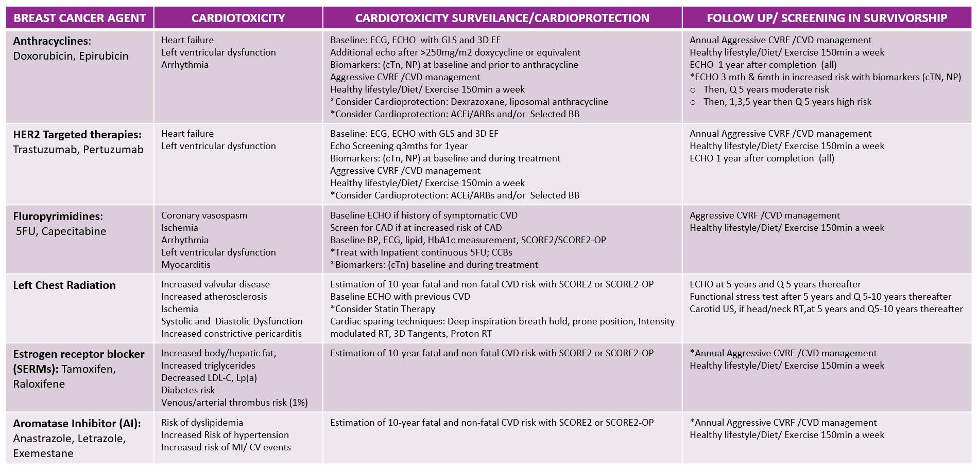
Henry S, Vaidean G (co-primary authors), Rege R, Gianos E. Heart. 2023 Jun 26;109(14):1113-1121
Notes:
Table 1- alternative format

Slide 54
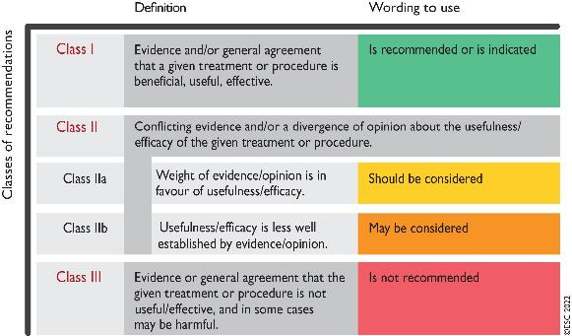
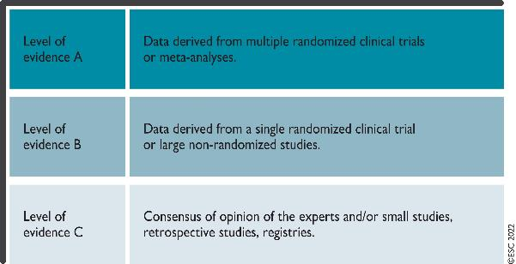
Class of recommendation and Levels of evidence
European Heart Journal (2022) 43, 4229–4361

Slide 55
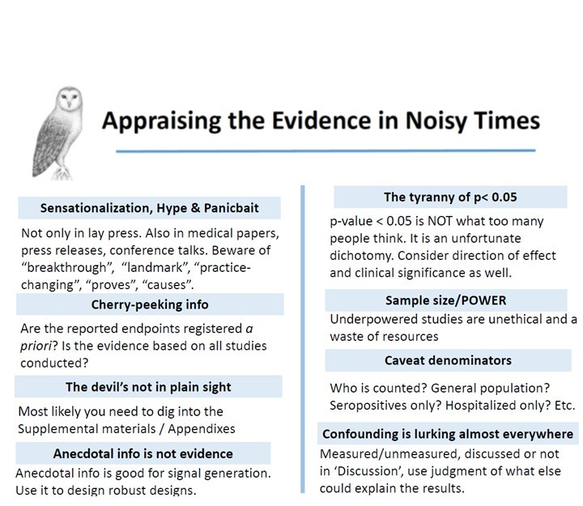
Appraising the Evidence during Noisy Times

Slide 56
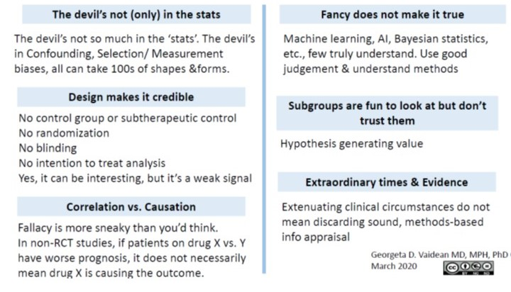
Appraising the Evidence during Noisy Times

