Slide 1

Effective
Physical Activity Prescription
Factors for consideration for inactive and sedentary patients
Sophia Franklin
Physiotherapist
ELMO Health and Fitness Lifestyle Advisor
Villar Saint Pancrace, France
BPhty, PGDipBusAdmin, MMgt (New Zealand)
OrdreMK (France), MCSP (UK), NZSP (NZ)
ELMO Congress 2023, Budapest, Hungary

Slide 2
Sophia Franklin
Physiotherapist
ELMO Health and Fitness Lifestyle Advisor
Villar Saint Pancrace, France
ELMO Congress 2023, Budapest, Hungary
NO CONFLICT OF INTEREST TO DECLARE

Slide 3
1 in 4 adults do not meet the recommended levels of physical activity 150 minutes of moderate intensity activity per week
Physical inactivity is the 4th leading risk factor for mortality.
Increased sedentary time associated with independent increased risk of all-cause and cardiovascular mortality
Women are less active than men
In France in 2021 only 41% of GP‘s had used prescription of adapted physical activity with their patients with chronic conditions.
Only 51% of boys and 33% of girls aged 6-17 met the WHO recommendations for physical activity in 2015.
Guthold et al., Lancet Glob Health 2018 Oct;6(10):e1077-e1086. doi: 10.1016/S2214-109X(18)30357-7.
Owen, Healy, Matthews et al., Exerc Sport Sci Rev. 2010 Jul;38(3):105-13. doi: 10.1097/JES.0b013e3181e373a2.
Ancellin, 2022, Santé Publique France
L‘Assurance Maladie, 2023.
Notes:
Hypertension (13%), smoking (9%) and diabetes (6%), physical activity (6%)
In 2016 France introduces PAP through law with modernization of the health system, however Investigation by France Institute National of Cancer in 2021 on 41%

Slide 4
Definitions
Physical Activity
Physical Inactivity
Sedentary Behaviour
Any bodily movement produced by skeletal muscles that requires energy expenditure
(WHO)
An absence of health-enhancing physical activity
(HSE 2012)
An insufficient physical activity level to meet present physical activity recommendations
(SBRN 2017)
Any waking behavior characterized by an energy expenditure ≤1.5 metabolic equivalents (METs), while in a sitting, reclining or lying posture
(SBRN 2017)
Notes:
WHO SB -Less than 150 minutes of moderate-intensity activity per week or equivalent
SBRN - Sedentary Behaviour Research Network
Behaviours characterised by little physical movement and low energy expenditure

Slide 5
Reduced Activity
Physiotherapists experienced in assessing, analysing, diagnosing and treating problems related to inactivity or movement dysfunction.
We see the effects of reduced physical activity on physical health such as loss of strength, muscle mass, aerobic fitness, flexibility and subsequent impact on joint range of motion, and how this impacts functional ability and mental health in a variety of clinical settings, daily.

Slide 6
Effects
Sedentary behaviour is associated with musculoskeletal pain conditions in adults
Non-occupational sedentary behaviour: LBP, knee pain, arthritis and general musculoskeletal pain
Occupational sedentary behaviour (workplace sitting): LBP, neck/shoulder pain (Dzakpasu, F.Q.S., Carver, A., Brakenridge, C.J. et al., 2021)
Age related changes in skeletal muscle mass and the prevalence of sarcopenia may be accelerated by periods of immobility or lifestyle changes – Catabolic Crisis Model (English & Paddon-Jones, 2010)
Step Reduction 75-1500 steps /day
Causes peripheral insulin resistance in skeletal muscle and adipose tissue in younger and older adults
Effects of short-term step reduction reversible in younger people, less so in older (Bowden Davies, Pickles et al, 2019)
Altered gait biomechanics found in healthy men with reduced PA during COVID-19
Changes in spatiotemporal parameters, of gait (knee angles, and knee moments) during walking, likely influenced by reduced physical activity levels and increased body weight. Reduced quadriceps strength.
(Brisson, Krahl, Krämer et al., 2023)
Notes:
Preferred Reporting Items for Systematic Reviews and Meta-Analyses (PRISMA) guidelines-based pre-designed protocol
Small study secondary analysis of data from an observational study

Slide 7
Physical Activity Prescription
CURRENT PHYSICAL ACTIVITY
Establish current activity level per week
PA Vital Sign, Single Item Question, GPPAQ, GPAQ, IPAQ, ONAPS-PAQ
SCREENING FOR CONTRAINDICAT﻿IONS
PAR-Q+ and ePARmed-X+
Medical assessment and clearance
Referral for supervised program
PHYSICAL ACTIVITY PRESCRIPTION and EDUCATION
Principles of FITT
ABC Approach (O’Regan, Pollock, D’Sa et al, BMJ Open Sport & Exercise Medicine 2021)
GOAL SETTING & FOLLOW UP
SMART Goals
Notes:
Assessment – Risk for participation, Motivation, self efficacy, personal preference
Brief Intervention – Written, FITT Progress, counselling
Continued support – collaboration from other health professionals

Slide 8
ADHERENCE
  Initial exploration of patient characteristics, barriers and facilitators
    Assessment of previous habits, and physical and mental health status
    Barriers and facilitators are explored prior to program delivery
  Design and characteristics of the physical exercise program
    Individualised and scientifically correct
  Integration into daily living and lifestyle
    Participants preferences and background are considered
    Accessible, flexible schedule
  Participant education, expectations and knowledge of the risks and benefits
  Multi-disciplinary program, goal-setting, supervision, feedback and social support
  Participants active role, self-efficacy, self management, enjoyment.
(Collado-Mateo, Lavín-Pérez, Peñacoba, et al, 2021)
Notes:
Systematic review carried out by:
Collado-Mateo, Lavín-Pérez, Peñacoba, et al, 2021

Slide 9
Identifying Barriers
Patients
Lack of time
Motivation
Fatigue/Energy
Social support
Poor health
Poor physical condition
Inactivity at baseline
Skill level
Fear of Injury
Access
Cost
Environment
Pollution
Notes:
As populations, culture, environment and socio-economic settings differ between countries, barriers to physical activity can also vary
NEED to assess with own unique environment in mind.
Study in Singapore - Lack of time, fatigue and pollution (Koh, Y.S., Asharani, P.V., Devi, F. et al., 2022)
In the US lack of time, fatigue; adequate exercise at work and low motivation (Brownson, Baker, Housemann et al, 2001).
Lack of motivation and time indepedently contributed to variations in LTPA
(Paper based on the PLACE study in Adelaide Australia)
Poor health and lack of facilities were positively independently related to the odds of nonparticipation in LTPA (Cerin, Leslie, Sugiyama, Owen, 2010) It needs to be fun!
Brownson, Baker, Housemann et al, 2001
CDC, 2022
Cerin, Leslie, Sugiyama, Owen, 2010
Koh, Y.S., Asharani, P.V., Devi, F. et al., 2022
O'Regan, Pollock; D'Sa et al, (2021)

Slide 10
Physical Activity Prescription
BARRIERS
Questioning, Assessment, Tools
Use of action plans combined with plans for how to cope with barriers
(Kwasnicka, Presseau, White et al, 2013, Health Psychology Review)
COM-B Model
Capability – Physical, Psychological
Opportunity – Physical, Social
Motivation – Reflective, Automatic
Behaviour (Webb, Baker, Palmer et al, 2022, Public Health in Practice)
Barriers to Being Active Quiz (CDC, 1999)
Exercise Benefits/Barriers Scale (Sechrist et al, 1987; Koehn & Amirabdollahian, 2021)
Inventory of Physical Activity and Barriers (Wingood, Jones, Gell et al, 2022, AMJ Phys Med Rehab)
Addressing motivational, health, and environmental barriers can help inactive adults initiate physical activity and active leisure pursuits.
(Cerin, Leslie, Sugiyama, Owen, 2010, J Physical Activity & Health)

Slide 11
Barriers
Physician / Clinician Barriers
Time required for consultation
Level of own physical activity
Training in prescription
Knowledge of PA prescription
Trust in providers – safety and quality
Conflicting priorities - acute patients
(Bélanger, Wolfe Phillips, O‘Reilly et al, 2017)
(West, Purcell, Haynes, et al, 2021)
Knowledge of Adapted Physical Activity
Not sufficiently informed or trained
Little time for consultations, training or for discussing APA
Knowledge of local sports for health facilities and system
Lack of trust in APA professionals
Required culture change
(Tchirkov, Didierjean, Schuft, 2023)
Lack of tools (Attalin, Romain, Avignon, 2012)
Notes:
Longitudinal qualitative study describing family physicians’ experiences with attempting to integrate physical activity prescriptions in their practice 2017 Canada
Uncertainty about the effectiveness of written PA prescription, and
Practical concerns (eg, changing well-established habits, time constraints, systemic institutional barriers).

Slide 12
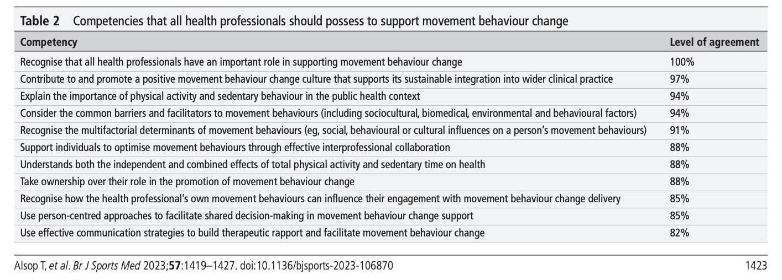
COMPETENCIES
for promoting movement behaviour change
Reproduced from [British Journal of Sports Medicine,
Alsop T, Lehman E, Brauer S et al, 57, 1419-1427, 2023] with permission from BMJ Publishing Group Ltd.
Notes:
Recent consensus statement published by Tahlia Alsop and team – study using Delphi method to collect opinions of a group of international healthcare professionals to identify competencies required by health professionals
RECOGNISE
Health professionals have an important role in supporting behaviour change
CONSIDER
Common barriers and facilitators to movement behaviours including Sociocultural; biomedical, environmental, and behavioural factors.
RECOGNISE
How our own movement behaviours can influence our engagement with movement behaviour change delivery
SUPPORT
Individuals to optimise movement behaviours through effective interprofessional collaboration
--
USE
Person-centred approaches to facilitate shared decision-making in movement behaviour change support
CONTRIBUTE TO & PROMOTE
A positive movement behaviour change culture that supports its sustainable integration into wider clinical practice
TAKE OWNERSHIP
Over our role in the promotion of movement behaviour change
USE
Effective communication strategies to build therapeutic rapport & facilitate movement behaviour change
UNDERSTAND
Independent and combined effects of total physical activity & sedentary time on health
EXPLAIN
Importance of physical activity and sedentary behaviour in the public health context
RECOGNISE
The multifactorial determinants of movement behaviour

Slide 13
The Role of the PHYSIOTHERAPIST
Physiotherapy is a science-based profession that takes a ‘whole person’ approach to health and wellbeing, which includes the patient’s general lifestyle.
(Chartered Society of Physiotherapists’, UK)
Consider referral to a physiotherapist for physical activity:
  Poor general health / comorbidities
  Current musculoskeletal conditions
  Poor physical function
  Chronic conditions with barriers
  Inactive patients with identifies barriers
  Patients who have been recently unwell, illness induced reduction in physical activity, especially older patients
Notes:
Physio’s have expressed interest in developing skills in the lifestyle medicine and physical activity prescription fields.
In particular behavioural strategies and information to overcome patient-focused barriers (O’Brien, Shields, Campbell. etal, 2020)

Slide 14

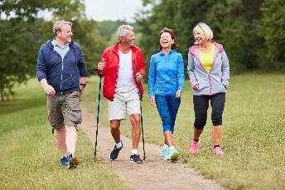
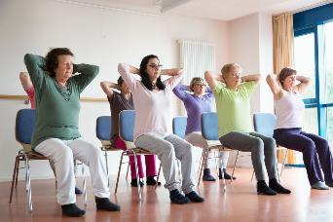
ACTIONS
Refer Patients
For physiotherapy assessment, intervention and customised activity programs
To physical activity program providers
Assess for Barriers
Patients
Barriers in own practice
Prescribe Physical Activity
Build Partnerships
Tools online for conversations
Range of activity types integrated into ADL’s
Personalised prescriptions
Measure outcomes
With physiotherapists local to you, MDT and physical activity providers
Training opportunities
Educate on Lifestyle Medicine
Seek training opportunities
Provide training for colleagues
Encourage Dr’s, physiotherapists, AHP’s and MDT towards opportunities to develop skills in Lifestyle Medicine

Slide 15
THANK YOU
Sophia Franklin
sophiallawson@gmail.com
Physiotherapist
ELMO Health and Fitness Lifestyle Advisor
Villar Saint Pancrace, France

