Slide 1
Exploring the Link Between Lifestyle and Breast Cancer
Francis Elena Escalante D. MD
Msc. Senology and Breast pathology.
ELMO Certified in Lifestyle Medicine
Notes:
Today, in this presentation We are “Exploring the Link Between Lifestyle and Breast Cancer”.
I want to begin by telling you that the etiology of Breast cancer is mostly unknown.
But there are numerous risk factors that increase the incidence of Breast Cancer. And
Some of these factors are related to lifestyle behaviors that can be modified and use as primary prevention to reduce the incidence of the disease and improve the prognóses.

Slide 2
Introduction
Breast cancer in the world
Women will develop breast cancer
Most cases are sporadic. Genetic predisposition is only 5-10%
Notes:
First, you have to know, why this topic is so important. Breast cancer is the most common tumor diagnosed in women in the world.
Now, one in eight women will develop Breast Cancer.
You must also know that most cases of breast cancer are sporadic, and only 5-10 per cént have a hereditary genetic cómponent.

Slide 3
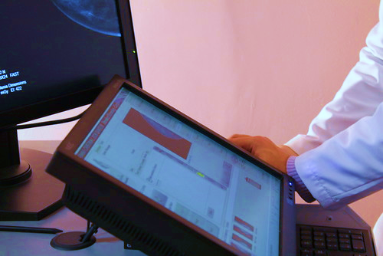
Decrease Mortality and
Global Disparities
Implementation of mammography screening has played a vital role.
Advances in treatment have reduced Breast Cancer mortality.
Incidence rates are higher in developed countries than in less developed ones.
Notes:
It is true that the incidence of breast cancer is high, but mortality from this cause has decreased.
The main reasons are the implementation of mammography screenings and new treatments.
However, incidence rates are higher in developed countries than in less developed ones. Maybe due to differences in opportunities for early diagnosis, but also because of differences in lifestyle.

Slide 4
Association between Lifestyle and Breast Cancer
Carcinogenesis: Genetic and Epigenetic alterations
Epigenetics is the activation or suppression of genes without changing DNA sequence
Lifestyle and environmental factors can affect the risk of Breast Cancer.
Epigenetic modifications are reversible
About 30% of Breast Cancer cases could be prevented by lifestyle changes.
Notes:
But, How is the association between lifestyle and breast cancer?
The Answer to this question is The Epigenetic
Carcinogenesis is a complex process which results from genetic and epigenetic alterations.
Epigenetics is the activation or suppression of genes without changing DNA sequence and this can cause the development of diseases.
So, lifestyle and environmental factors can affect the risk of breast cancer through epigenetic modifications.
The key point here is that epigenetic modifications are reversible, and we can change them through lifestyle.
About 30% of Breast Cancer cases could be prevented by lifestyle changes. wich is a significant percentage

Slide 5
Risk Factors for Breast Cancer
Is the largest and greatest scientific authority in the world on the prevention of cancer.
Third Expert Report. Diet, Nutrition, Physical Activity and Breast Cancer: A Global Perspective.
Available in: https://www.wcrf.org/wp-content/uploads/2021/02/Breast-cancer-report.pdf
Notes:
The World Cancer Research Fund is the top authority in the world for Cancer prevention.
In 2018, they published the Third Expert Report: Diet, Nutrition, Physical Activity and Breast Cancer: A Global Perspective.
This report contains all recent data on risk factors for Breast cancer.
The link is attached to the slide, and you may review it later.
Today, I will discuss the modifiable lifestyle factors mentioned in this report and a few additional ones not covered in it.

Slide 6
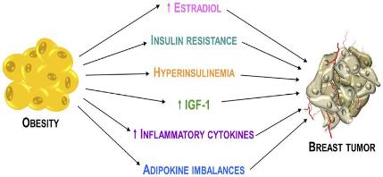
Unveiling Risk Factors and Empowering Prevention in Breast Cancer
Obesity
“Weight management across the lifespan is important to reduce the risk of breast cancer and other chronic conditions that can increase breast cancer risk and poor outcomes”
Enough evidence
Chronic inflammation
Excess of estrogen production
Insulin resistance
2019
Available in: https://pubmed.ncbi.nlm.nih.gov/31099634/
Notes:
Let´s begin with Obesity. There is enough evidence related to obesity and postmenopausal breast cancer. But not for premenopausal breast cancer.
Chronic inflammation,
excess of estrogen production, and
insulin resistance are some of the mechanisms associated with Breast Cancer development in postmenopausal women that are overweight or obese.
In this context, I'd like to mention that the doctor Jennifer Ligibel and collaborators published a review in 2019 about Weight management and physical activity for breast cancer, and they advice that “weight management across the lifespen is impórtant to reduce the risk of breast cancer and other chronic conditions that can increase breast cancer risk and poor outcomes”.

Slide 7
Unveiling Risk Factors and Empowering Prevention in Breast Cancer
Association of Healthy Diet and Physical Activity With Breast Cancer: Lifestyle Interventions and Oncology Education
Tiantian Jia Yufeng Liu Yuanyuan Fan Lintao Wang Enshe Jiang (2022)
Diet
Saturated Fats
Limited Evidence
Protective effect on Breast Cancer onset or progression
Red and processed Meat
Vitamin
C y E
Endogenous Estrogens, Insulin-Like Growth Factor
Pro-inflammatory cytokines
Fresh fruits and vegetables
Polyunsaturated Fatty Acids
Breast Cancer Development
Available in :https://www.frontiersin.org/articles/10.3389/fpubh.2022.797794/full
Notes:
In the third expert report, it is indicated that there is limited evidence about major food groups and breast cancer risk
However, in this update Association of Healthy Diet and Physical Activity with Breast Cancer, published in 2022 suggest an increased risk of Breast Cancer development with the consumption of specific nutrients,
such as:
saturated fats, red and processed meat that could increase:
endogenous estrogens, insulin like growth factors, and proinflammatory cytokines.
In contrast, consumption of polyunsaturated fatty acids, fresh fruits and vegetables rich on vitamins C and E, would have a protective effect on Breast Cancer.

Slide 8
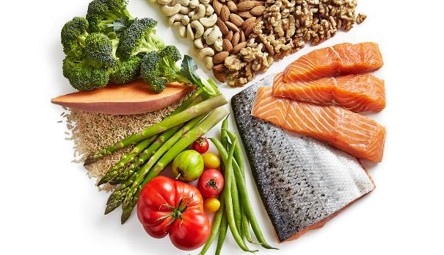
Diet
Fruit and vegetable consumption is associated with a reduced risk in postmenopausal BC and Fruit Juice consumption with an increased of BC risk.
Available: British Journal of Cancer (2021) 125:284–298; https://doi.org/10.1038/s41416-021-01373-2
Mediterranean Diet has a protective effect against Breast Cancer
Notes:
A recent meta-analysis of prospective studies, published in the British Journal of Cancer, about fruit and vegetable consumption and incident Breast Cancer found:
that fruit and vegetable consumption is associated with a reduce risk in post-menopausal breast cancer
and fruit juice consumption was associated to an increased risk of Breast Cancer.
But foods are normally combined in people’s diet.
The most studied food pattern is the Mediterranean diet according to those studies it has a protective effect against Breast Cancer.

Slide 9
Alcohol
Strong Evidence: Post-menopausal
Chen et. Al 2016: 10g of alcohol consumption in a single day increased risk for Breast Cancer:
9% for post-menopausal women
5% for pre-menopausal women
Mechanisms:
Elevated Acetaldehyde Production
Inflammation
Increased estradiol
Alteration of folate metabolism
Notes:
About álko jol, There is strong evidence that álko jol consumption causes postmenopausal Breast Cancer, and probably also pre-menopausal Breast Cancer.
10 grams of álko jol consumption in a single day increased the risk for Breast Cancer
The associated mechanisms are
elevated asitaldihyde production, inflammation, increase estradáyol and alteration of foleit metábelizem.

Slide 10
Physical Activity
Probably helps to protect against BC
Mechanisms of action include effects on:
Menstrual function
Body-fat reduction
Changes in sex hormone levels
Reduced inflammation
Reduces the risk of recurrence and improve survival rates, regardless:
Body Mass Index
Hormone receptor status
Changes in weight.
Notes:
Today we know that vigorous physical activity probably helps to protect against premenopausal and postmenopausal breast cancer.
The mechanisms of action include effects on menstrual function, body fat reduction, changes in sex hormone levels and reduce inflammation.
Moreover, It's known that reduces the risk of recurrence and improve survival rates regardless another factors like BMI, hormone receptor status or changes in weight.
So, Prescribing physical activity has many benefits

Slide 11
Smoking
The components of tobacco smoke can reach the mammary gland.
The risk associated for Breast Cancer with smoking :
Pre-menopausal women (17%)
Post-menopausal women (7%)
Number of years of smoking and cigarettes smoked per day are important
Passive smoking increases RR of Breast Cancer by 11-15%
Notes:
Another risk factor is Smoking. The components of tobacco smoke can reach the mammary gland.
The risk associated for Breast Cancer with smoking is higher in premenopausal women than in post-menopausal ones.
The number of years of smoking and the number of cigarettes smoked per day are important.
Passive smoking also increases the relative risk of breast cancer by 11-15 pér cent

Slide 12
Environmental Risks
Factors would influence the incidence of Breast cancer:
Environment
Occupation
Stress
Radiation
Endocrine disruptors
Most breast cancers are associated with exposure to estrogens
Xenoestrogens or endocrine disruptors are substances that mimic the effect of estrogen in the body.
Notes:
Factors like the environment, occupation, stress, radiation, and xenoestrogenes would influence the incidence of breast cancer.
We know that Most breast cancers are associated with exposure to estrogens, wherever they came from the body or the environment. The longer the exposure to estrogen, the higher the risk.
So, It is important to consider the Xenoestrogens, or endocrine disruptors, because they are substances that mimic the effects of estrogen in the body.
Everybody is exposed to xenoestrogens, because they are in almost everything, in soft drinks, canned foods, dental products, healthcare equipment, cosmetics, inhalation of dust, some clothes, and toys.

Slide 13
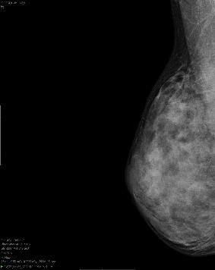
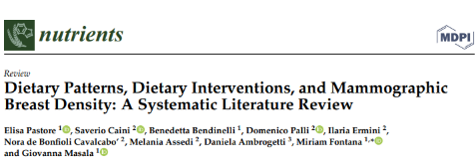
Mammographic Breast Density and Lifestyle
Alcohol consumption and menopausal hormone therapy
directly influence breast density and the development of breast cancer
Physical activity and diet do not seemingly have a direct influence
On breast density
Conclusions: Healthy diet, based primarily on vegetables, fruit, cereals, and legumes and low in animal-based foods, reduces MBD
Limited number of studies, most of which have a cross-sectional design
Notes:
Now, I'd like to make a brief comment about mammographic Breast density. It is a not modifiable risk factor for breast cancer.
however, a review published in The Oncologist in 2022 found that drinking alcohol increases it, while another study published the same year in Nutrients demonstrated that a healthy diet reduces it.
The fact is that more studies are necessary about breast density and its relationship with another risk factors.

Slide 14
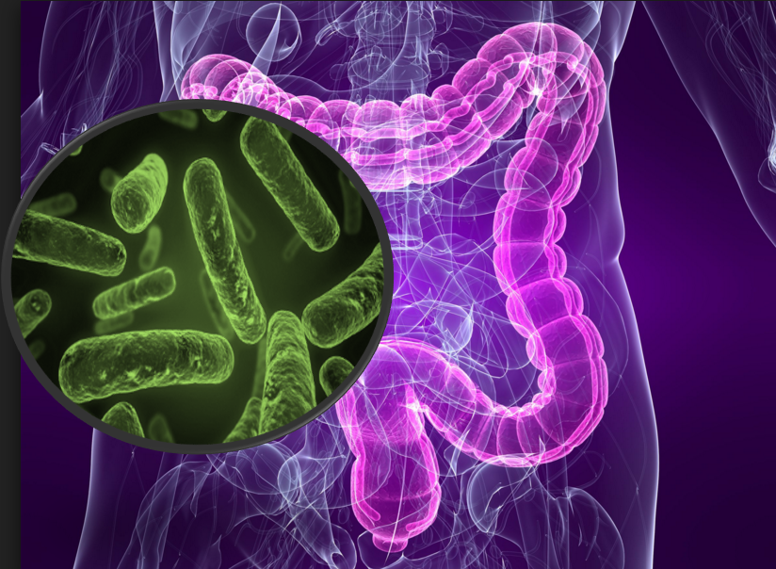
Microbiota and Breast Cancer
Estrobolome: Are a subgroup of microbiota that participates in estrogen metabolism.
Fiber is the primary energy source for Estrobolome
The microbiota composition depends on lifestyle.
Notes:
Another áspect to consider is the maicrobaiota. Today we know that there is a subgroup of the gut microbiota called Estrobolome, that participates in éstrogen metabolism,
Fiber is the primary energy source for that subgroup and Consuming a high fiber diet increases estrogen metabolism and helps remove it from the body.
In addition, the microbiota composition can be affected by lifestyle. So, we need to think about microbiota in cancer prevention and treatment stráteegis.

Slide 15
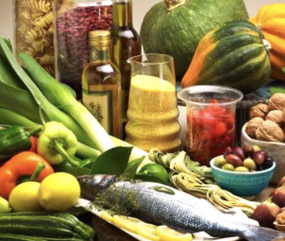
What are the Lifestyle changes we should recommend?
Physical activity (current guidelines):
150 min/week
2 strength training sessions per week
Mediterranean Diet
Sleep 7-8h a day
Avoid Alcohol and Smoking
Notes:
What are the lifestyle changes we should recommend?
Dr. Marie Savard makes an analogy that I love, she says that exercise is the King, diet is the Queen and sleep is the Princess.
The Physical activity recommendations are the same as the current activity guidelines: We must recommend to our patients to do at least 150 minutes of aerobic exercise each week and include two strength training sessions.
Follow a healthy Mediterranean diet and get 7-8 hours of good sleep.
Also patients should be advice about avoid alcohol and smoking

Slide 16
Exploring the Link Between Lifestyle and Breast Cancer
CONCLUSIONS:
There is an association between lifestyle behavior and sporadic Breast Cancer
Lifestyle modifications are a key factor for the prevention of Breast Cancer and improve the lives of survivors
Notes:
To conclude our exploration of the link between lifestyle and breast cancer, we can say that:
There is an association between lifestyle behavior and sporadic Breast Cancer and Lifestyle modifications are a key factor for the prevention of Breast Cancer and improve the lives of survivors.

Slide 17
THANK YOU
@dra.escalanted
draescalanted@gmail.com
https://draescalante.com
SPAIN
VENEZUELA
Notes:
Here, I share with you a beautiful beach from my home country, Venezuela and a wonderful view of the country that welcomed me Spain I invite you to know both. Thank you

