Slide 1
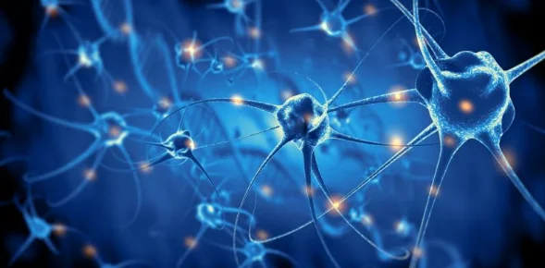
Meta-inflammation and anthropogenic factors in LM
José L. Palma-Gámiz
Cardiologist
President
Spanish Institute of Lifestyle Medicine

Slide 2
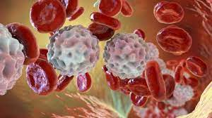
EPIDEMIOLOGY OF NCDs
In Europe and USA 86% of all deaths are related to NCDs (CVD, cancer, T2DM, neurodegenerative diseases, psychiatric disorders, arteriosclerosis..) affecting many organs and systems. most of them RELATED TO AN UNHEALTHY LFESTYLE (WHO 2017)
Since prehistoric times, hunger was the main cause of death.
Today it is superabundance that leads man to the grave

Slide 3
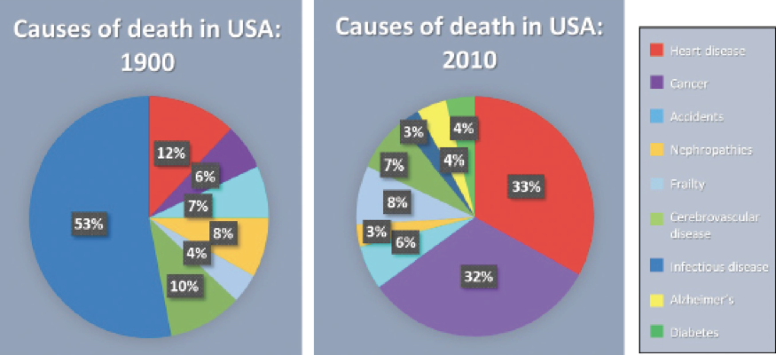
LEADING CAUSES OF DEATH IN USA (1900 – 2010)
CVD
Ca
CVD
Infections
Cancer
Source: Centers for Diseases and Infections Data

Slide 4
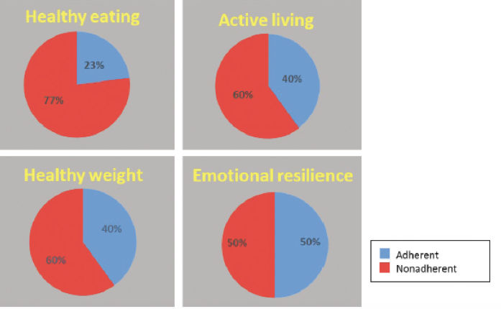
CURRENT LIFESTYLE IN USA
Source: Centers for Diseases and Infections Data

Slide 5
CVD MORTALITY: A SEEMINGLY UNSTOPPABLE TREND
More than 18 million deaths per year
First cause mortality in the world
Source: World Heart Organization
Cancer
SPAIN (NSI: 2015 data)
(NSI:2022 data)
Traffic accidents
Cardiovascular diseases
28,6%
Cancer
27,4%
Respiratory diseases
11%
Bronchopulmonary diseases

Cardiovascular diseases
Traffic accidents
<1%
Source: : National Statistic Institute
CVD morbidity & mortality: A seemingly unstoppable trend …
According to the WHO forecast, 25 million deaths are expecting in the whole world as a consequence of CVD.

Slide 6
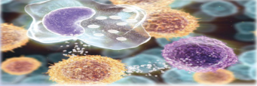
Meta-inflammation
Definition
Meta-inflammation is a low-profile inflammation as a chronic reaction of the inmunological system to fight against chronic diseases with the intervention of
all its components.
Main characteristics
* High plasma level of inflammatory cytokines (IL-1, IL4, IL-8, IL-10) as well as
an increase in macrophages infiltration in peripheral tissues.
* Close relationshiip with cardiometabolic diseases (overweight, obesity,
T2DM, CVDs, cancer, arthritis, neurological disorders…)

Slide 7
Six diferences between classic inflammation vs meta-inflammation
Aulio Cornelio Celsus (25 yrs B.C)
1.- Blushing: (Painful & redness)
2.- Tumor: Heat & swelling
3.- Lethargy: Loss of function
4.- Short-term response
5.- Total repair
6.- Full healing
Metainflammation (Hotamisligil 2006)
1.- Litle increase on: PCRs, IL-1, 4…TNF, …
2.- Long and underclinical activity
3.- No focalization but generalization
4.- Lower antigenic response
5.- Disease chronification without solving it
6.- Low metabolic rate
Celsus inflammation plays a healing role in the acute process.
Chronic meta-inflammation only exerts a mediating role that aggravates and perpetuates chronic diseases.

Slide 8
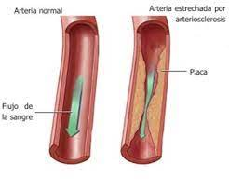
Diseases mediated by metainflammation
Arteriosclerosis (cronic inflammation + high colesterol: Rudolf Wirchow, 1821)
Insulin resistence (Stress of endoplasmic reticulum)
Metabolic syndrome (Microbiome changes)
Diabetes (I.R.. + chronic pancreas inflammation)
Obesity & overweight (Genétics & Epigenétics)
Neurological diseases (Az + Pk)
Acute & chronic joint proceses

Slide 9
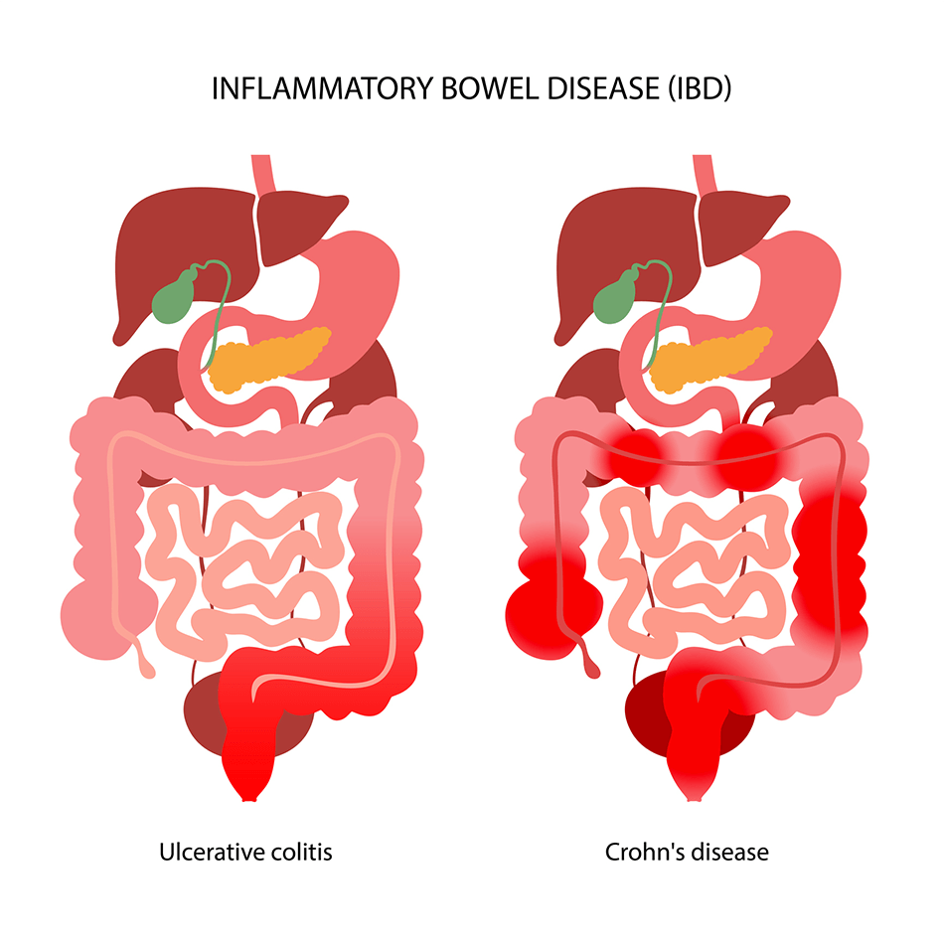
Metainflammation: Clinical diagnosis
Usually the signs and symptoms are not very expressive.
Chronic tireness Headaches and migraines
Loss of memory Inability to get relaxed
BP increase Chronic constipation
Lack of concentration Emotional stres
Insomnia GI inflammation
Compulsive obsessions
Bowel syndrome
Ulcerative colitis / Crohn Diease.

Slide 10
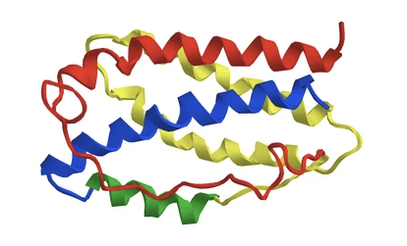
Meta-inflammation: Biochemical diagnosis
1.- Lipids:
Abnormal ApoA / ApoB ratio gives better risk definition of meta-inflammation than chol. and TG.
2.- Inflammatory factors:
CRPs, Interleukines (1,4,6,9…), homocysteine, TNF, insulin plasma level, procoagulatory factors…
To keep in mind:
Only 20% of risk factors explain 80% of NCDs.
The remainder 80% has been linked to an inadequate lifestyle.

Slide 11
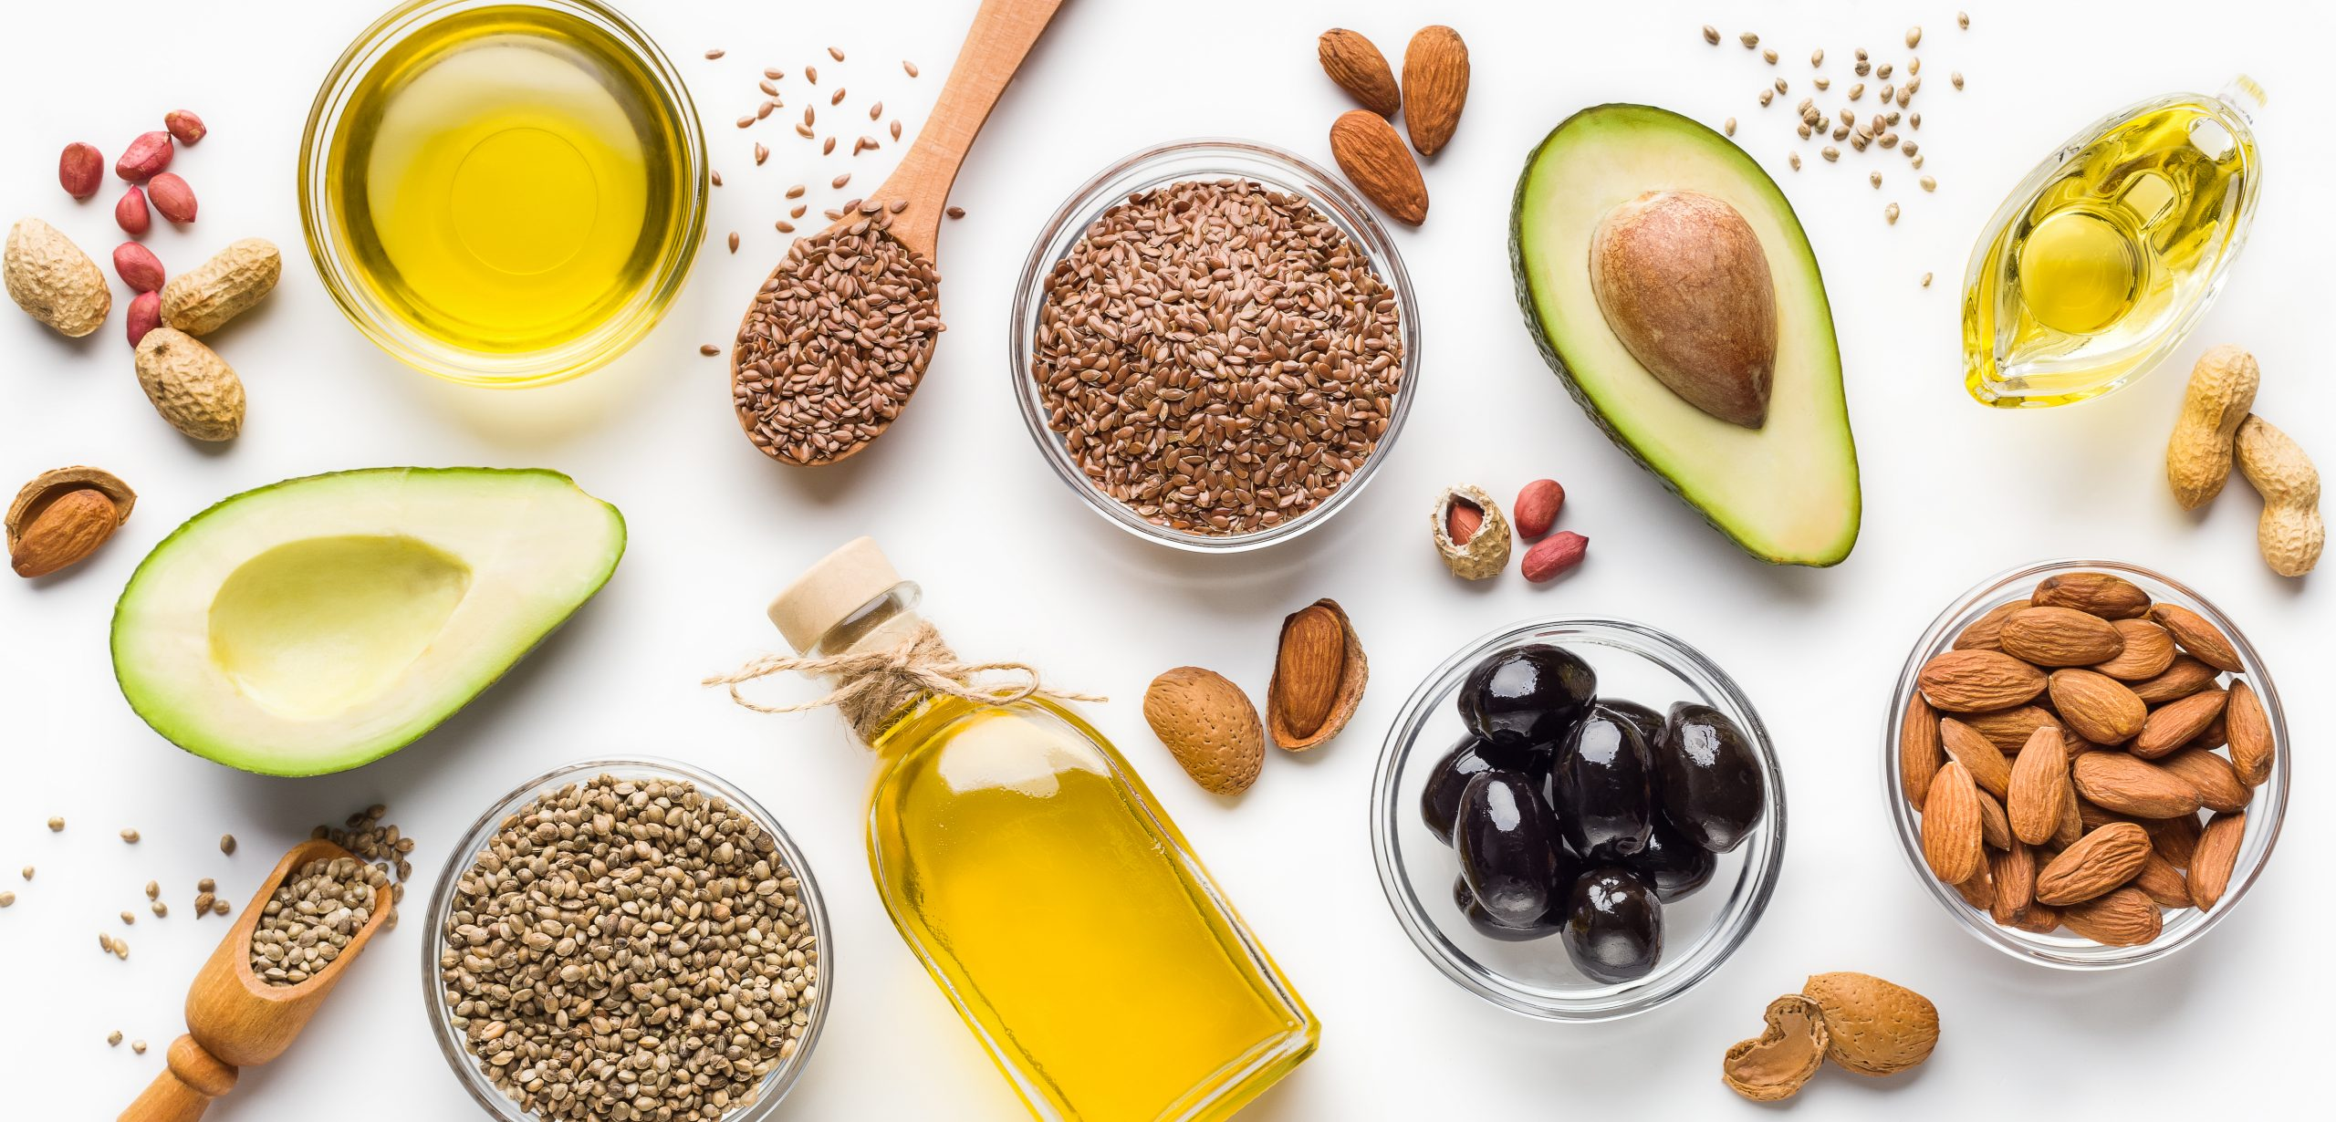
Antropogenic factors causing meta-inflammation
A.- Caused by lifestyle
Excercise (low or excesive)
Alcohol excess consumption
Fat (saturated and trans)
Fiber (low intake)
* Carbohydrates of high glycemic index
Red and processed meet
Low fish intake
Salt (high intake)
Smoking and vaping
Insomnia, stress, anxiety, depression
B.- Environment
Aging
Air pollution (Indoor/outdoor)
CO2, NO2, ozone
Particular matter
Sick building syndrome
Radon (Lung cancer)
Electromagnetism
Passive smoking
Poor literacy
Low economical level

Slide 12
Meta-inflammation causes DNA damage
Some epigenetic factors could modify genes structure in such a way that cells become unable to read their own DNA, starting chromosones alterations leading to cardiovascular, metabolic,
tumoral and cognitive chronic diseases

Slide 13
How prevent and treat meta-inflammation ?
Healthy diet Exercise Sleep hygiene Mental health
Toxics abuse Sexuality Social connection Pollution
This task is closely related to the 8 pillars of LM

Slide 14
Therapeutic approach to the causes
Inflammation approach
Basically in infective processes (Bacteria, viruses and fungi)
* Hygiene
* Profilaxis
* Vaccination
* Antibiotics
Meta-inflammation approach
Promoting changes in lifestyle as the main causes of meta-inflammation responsables of >80% of morbidity and mortality due to chronic NCDs

Slide 15
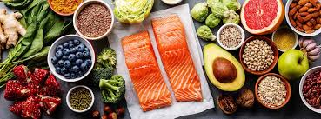
Actions against anthopogenic factors
A.- Lifestyle factors
Physical excercise
Avoiding alcohol
Normocaloric diet (reducing salt)
Rejecting fast food
Low carbohydrates intake
Avoid red & processed meat
Increasing fish consumption
Stop smoking and vaping
B.- Environment agents
To be avoid:
Air pollution (In / out)
CO2 / NO2 / O3
Sick building syndrome
Electromagnetism
Radon (lung cancer)
Passive smoking
High / low temperature

Slide 16
CONCLUSION If you want to have a longer and healthier life, free of chronic diseases, time has come to address all your attention to avoid meta-inflammation

