Slide 1
Mediterranean Diet and its role in weight management
Ioannis arkadianos M.D. Saturday 11.11.2023

Slide 2
IOANNIS ARKADIANOS M.D.
Certified Physician in General Medicine
President and co-founder " European Lifestyle Medicine Organization"
SCOPE Certified (Strategic Center for Obesity Professional Education)
Council of Directors at “True Health Initiative”
I have no conflict of interest to declare
The information which is being shared does not establish a patient-doctor relationship or privilege
All of the slides/pictures have copyright and must be credited to the original author

Slide 3
People who have overweight or obesity, compared to those with healthy weight, are at increased risk for many serious diseases and health conditions.

Slide 4
These include :
All-causes of death (mortality)
High blood pressure (hypertension)
High LDL cholesterol, low HDL cholesterol, or high levels of triglycerides (dyslipidaemia)
Type 2 diabetes
Coronary heart disease
Stroke
Gallbladder disease
Source

Slide 5
These include (cont.)
Osteoarthritis (a breakdown of cartilage and bone within a joint)
Sleep apnea and breathing problems
Many types of cancer
Low quality of life
Mental illness such as clinical depression, anxiety, and other mental disorders
Body pain and difficulty with physical functioning
Source

Slide 6
Obesity is a lifestyle related disease in the majority of cases

Slide 7
DEFINITION
“Obesity is a medical condition described as excess body weight in the form of fat. When accumulated, this fat can lead to severe health impairments”
Obesity is a disease
ICD -10 : Obesity Coded E66
*Source World Obesity Federation

Slide 8
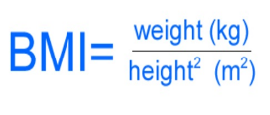
BMI is a person's weight in kilograms (kg) divided by his or her height in meters squared.
It’s important to recognize that BMI itself is not measuring “health” or a physiological state (such as resting blood pressure) that indicates the presence (or absence) of disease.
It is simply a measure of patient’s size.

Slide 9
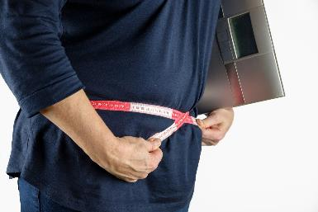
Overweight BMI is 25 to 29,9
Class 1 (low-risk) obesity BMI is 30.0 to 34.9
Class 2 (moderate-risk) obesity BMI is 35.0 to 39.9
Class 3 (high-risk) obesity BMI is > 40.0

Slide 11
Overweight and Obesity
Lifestyle Interventions for prevention and treatment
A
B
Physical activity
C
Limit screen time
D
Stress management (included sleep)
E
Social habits
f
Environment

Slide 12
Nutrition
Mediterranean diet

Slide 13
Nutrition
Nutrition is the intake of food, considered in relation to the body’s dietary needs. Good nutrition – an adequate, well-balanced diet combined with regular physical activity – is a cornerstone of good health
There are a lot of nutrition models for obesity management
Must choose the one that is easy for the patient to follow long term, according to his/her lifestyle

Slide 14
The Mediterranean Diet is defined as a traditional diet pattern found in the populations living in the Mediterranean basin (especially in Italy and Greece) during the 50s and 60s of the 20th century.
The Mediterranean diet (MedDiet) represents a more general dietary model in the nutritional epidemiology that has been extensively studied, especially over the last two decades.

Slide 15
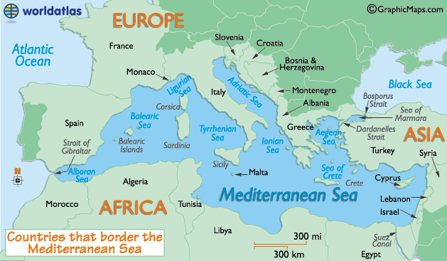

Slide 16
The nutritional value and health benefits of the Mediterranean diet were first documented in the Seven Countries Study, which investigated the relationship between diet and heart diseases among roughly 13,000 men from 1958 to 1999.
The seven countries that the participants hailed from included:
Greece.
Italy.
Japan.
Finland.
Croatia and Serbia (Former Yugoslavia).
The Netherlands.
U.S.
The study demonstrated that the type of fat – saturated, monounsaturated or polyunsaturated – affects cardiovascular health more than total fat intake does. Although standard nutrition advice calls for a 30% limit on total calories from fat, up to 40% may be heart-friendly, if most of the fats consumed are unsaturated.

Slide 17
Basic characteristics (MedDiet)
Low consumption of meat and meat products with very low consumption of red meat (beef, pork and lamb) consumed only in special cases)
Very low or zero consumption of processed meats, butter, ice cream or other full-fat dairy products (only fermented dairy products, cheese and yogurt are consumed in moderation)
An important source of protein is the moderate consumption of fish and shellfish, which was variable depending on the proximity to the sea.

Slide 18
Basic characteristics (MedDiet)
It has a relatively high fat profile due to the abundant consumption of olive oil, combined with the high consumption of slightly processed, locally grown vegetables, fruits, nuts, legumes and cereals (mainly raw)
The main sources of fat and alcohol among individuals in the traditional Mediterranean Diet are mainly extra virgin olive oil (EVOO) and red wine, respectively
The abundant use of olive oil, through salads, traditionally cooked vegetables and legumes, as well as the moderate consumption of red wine during meals, makes this diet extremely nutritious and enjoyable

Slide 19
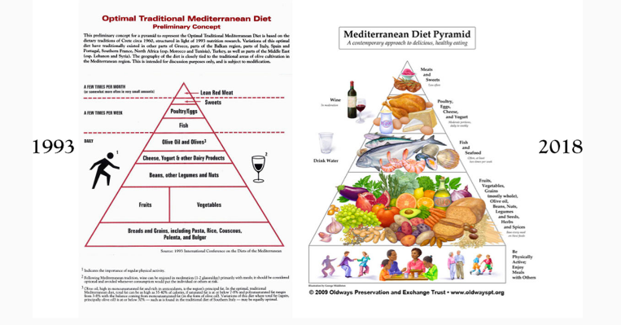
First and last version of the Mediterranean diet (MedDiet) pyramid developed by Oldways.

Slide 20
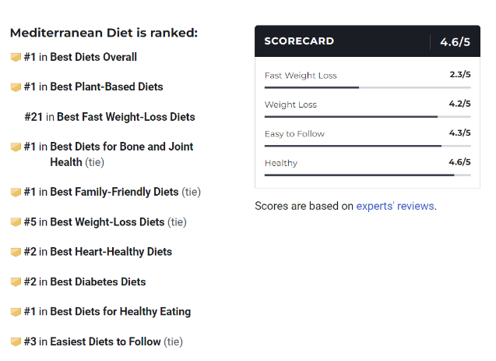
2023

Slide 21
2023
#1 Best Diet Overall
#1 Best Plant-Based Diets
#1 Best Diets for Healthy Eating
#1 Best Family Friendly Diets
#3 Easiest Diets to Follow
#5 Best Weight-Loss Diets

Slide 22
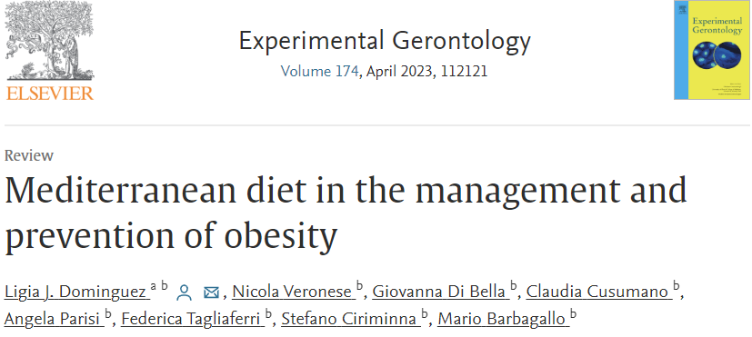

Slide 23
Highlights
Mediterranean diet has the largest body of evidence on the prevention and treatment of non-communicable diseases and mortality.
Mediterranean diet is mainly based on plant-based foods but also includes many non-dietary lifestyle components.
Four meta-analyses of RCTs (Randomized Control Trials) have shown a greater reduction of body weight and BMI with MedDiet compared to other diets.
A meta-analysis of cohort studies found a reduced risk of becoming obese over time.

Slide 24
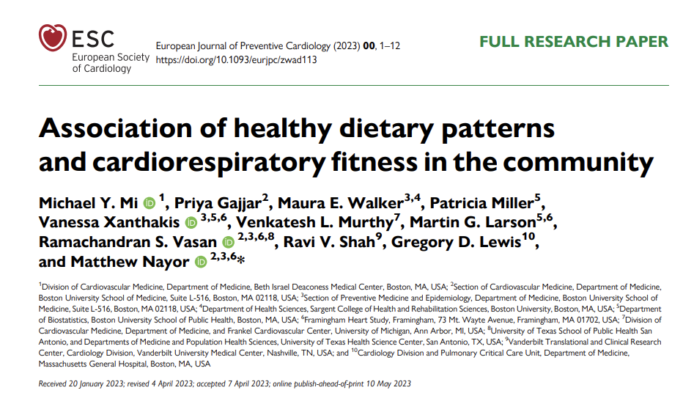
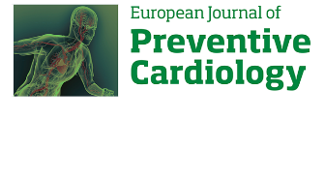

Slide 25
Highlights
Researchers say adopting a Mediterranean-style diet produces the same benefits as walking 4,000 extra steps per day.
Experts say you can adjust to this type of eating plan by eating more fruits and vegetables, consuming less red meat, and preparing your own meals from scratch.
They also note it’s still important to exercise regularly even if you are on a healthy diet plan.

Slide 27
Highlights
The study finds that higher devotion to the Mediterranean diet and lifestyle is associated with a 29% lower risk of all-cause mortality and a 28% lower risk of cancer compared to people who least follow the diet and lifestyle.
The study documents the health benefits of the Mediterranean diet, analyzing data from about 110.000 participants living in the United Kingdom.
A Mediterranean diet is not just a good idea for people living near the Mediterranean sea.
Besides following a Mediterranean diet, a ‘Mediterranean’ attitude toward food and eating was even more important.

Slide 28
Mediterranean Lifestyle

Slide 29
Med Diet it’s not only a Diet as it focus on:
physical activity in the context of daily family and community life
a sleep pattern that allows for adequate rest – including a short mid-day siesta as needed
social participation – social ties – conviviality – stress control
living in synch – promoting a way of life (diet, transportation, etc.) with low environmental impact
Source

Slide 30
Case study

Slide 31
Case
Man, Date of birth 28.2.1973
1st Visit in my Clinic: June 2015 (43 years old)
Height : 1.86cm Weight: 204 kg BMI 59 Fat 53,5% (109kg)
History :
Mild hypertension - Fatty liver infiltration -Smoker NO
Family History:
Parents : Both Obese
Father : Diabetes Τype 2 and Coronary heart disease
Medication: Nebivolol Hydrochlorothiazide (5/12,5-mg) *1

Slide 32
Blood exams (June 2015)
Glucose 78 SGOT 11
Hb1AC 5,5 SGPT 15
Insulin 24,7 γGt 36
TSH 4,9
CHOL 190 Folic Acid 3,1 (>5,4 ng/dl)
HDL 40
LDL 129
Tg 106

Slide 33
Treatment approach
Nutrition consulting Mediterranean Diet model
Recommendation for mild physical activity (at least 150min/week)
Physiological support
B Comblex supplement with Β12 50μg and Folic acid 400 μg (for 3 months)
A multi vitamin (for 2 months)
Weekly follow up

Slide 34
Process
DATE WEIGHT BMI Part FAT
29.6.2015 204 59 140/90 53,5% (109kg)
28.9.2015 187 54
27.6.2016 158 45
26.6.2017 129 37
2.7.2018 116 33
1.7.2019 110 32 125/78 33,8% (38kg)
15.6.2020 109 31 32,5% (35kg)
27.7.2021 110 32 34,7% (38kg)
7.2.2022 109 31
16.3.2023 110 32

Slide 35
Blood Exams (September 2016)
Insulin 5,2 from 24,7 (6.2015)
Hb1Ac 4,9 from 5,5 (6.2015)
Folic acid 13,3 from 3,1 (6.2015)
TSH 3,1 from 4,9 (6.2015)

Slide 37
Very important :
Patient Frequently follow up*
*Obesity is a chronic, relapsing, progressive disease process

Slide 39
Conclusions
Overweight and obesity are lifestyle-related in the vast majority of cases
Influence the health status in multiple levels and in a lot of systems

Slide 40
Conclusions (cont.)
There are a lot of Nutrition models for prevention and treatment
Health Professionals must choose an evidenced based nutrition model, combined with other lifestyle interventions
Mediterranean diet is a nutrition model easy to follow,
with a lot of bibliography which support it

