Slide 1

DIABETES REMISSION MYTH or REALITY?
Dr Anca Hâncu
Medical doctor, PhD nutrition
“ Better Me “ by MedLife, lifestyle medicine network coordinator
General secretary, Board, European Lifestyle Medicine Organisation
President, Medical Association for prevention through lifestylemedicine

Slide 2
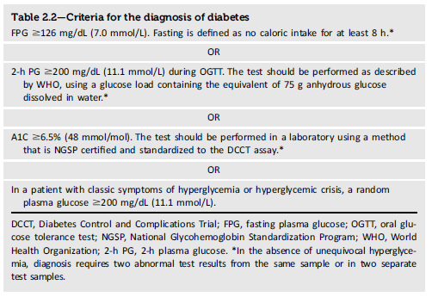
Classification and Diagnosis of Diabetes
Table 2.2
Classification and Diagnosis of Diabetes:
Standards of Care in Diabetes - 2023. Diabetes Care 2023;46(Suppl. 1):S19-S40
2
Introduction and Methodology:
ElSayed NA, Aleppo G, Aroda VR, et al., American Diabetes Association. Introduction and methodology: Standards of Care in Diabetes—2023. Diabetes Care 2023;46(Suppl. 1):S1–S4

Slide 3
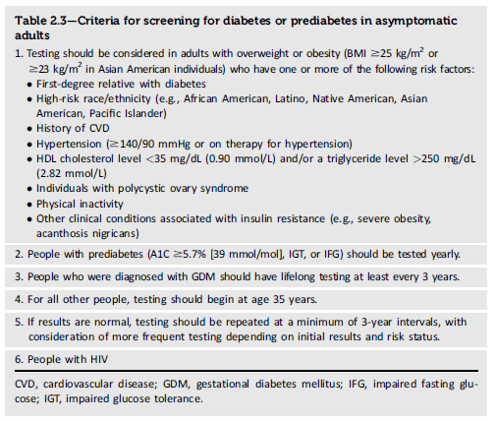
Classification and Diagnosis of Diabetes
Classification and Diagnosis of Diabetes:
Standards of Care in Diabetes - 2023. Diabetes Care 2023;46(Suppl. 1):S19-S40

Slide 4
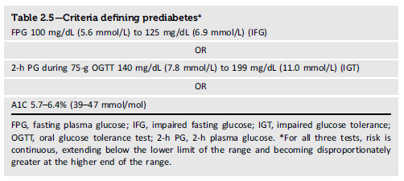
Classification and Diagnosis of Diabetes
Classification and Diagnosis of Diabetes:
Standards of Care in Diabetes - 2023. Diabetes Care 2023;46(Suppl. 1):S19-S40

Slide 6
Evaluation of non-glycaemic measures during remission
Circulating lipoprotein profile
Peripheral and visceral adiposity
Intracellular fat deposition in the liver
The role of changes in GLP1

Slide 7
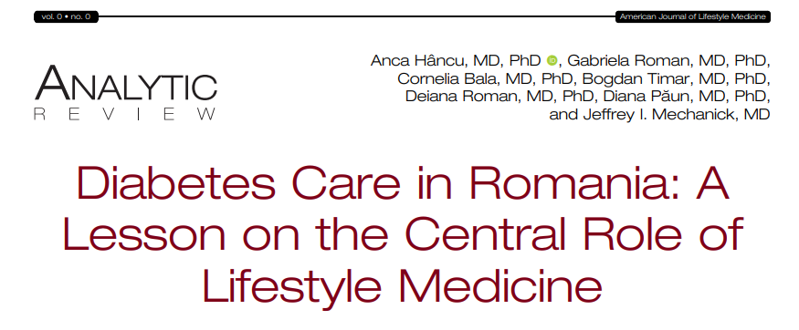

Slide 8

STUDIES
COUNTERPOINT
This Photo by Unknown Author is licensed under CC BY-ND

Slide 9
COUNTERPOINT STUDY
COUNTERacting the Pancreatic inhibition Of INsulin secretion by Triglyceride (Counterpoint) study.
It was powered to detect a significant fall in fasting plasma glucose levels in a small group size (n=11).
To test the underlying mechanisms, new methodology was developed to measure fat
within the substance of the pancreas using advanced magnetic resonance techniques.
The results were clear-cut: individuals with very ordinary type 2 diabetes (up to 4 years duration) regained absolutely normal fasting glucose levels within 7 days of commencing a very low calorie diet.
This was despite stopping metformin therapy on day one of the diet.
Liver fat levels dropped by 30% and liver insulin sensitivity returned to normal in the first 7 days, explaining the change in fasting plasma glucose.
However, the change in insulin secretion followed a different time course, gradually improving to normal over 8 weeks.
Calorie restriction for long-term remission of type 2 diabetes Author: Roy Taylor , A Clinical Medicine 2019 Vol 19, No 1: 37–42

Slide 10
Is remission of diabetes durable?
It was clearly necessary to determine whether the reversal of underlying pathophysiology and resulting normoglycaemia would persist in the longer term.
The basic requirement to achieve nondiabetic glucose control was weight loss of 15 kg.
Although this may seem unattainable, a pragmatic approach to permit success
during everyday life had been developed in order to carry out the Counterpoint study.
The pathophysiological basis of diabetes reversal
The hypothesis-driven design of the Counterpoint study revealed surprisingly high liver fat in people with type 2 diabetes and a dramatic fall to normal on weight loss.
This permitted a decrease in intra-pancreatic fat because of decreased export of very low density lipoprotein triglyceride from the liver and the return of normal first phase insulin response.
It was possible to describe the new understanding of the aetiology of type 2 diabetes on the basis of Counterpoint, and the response of people with diabetes simply provided with information on how to reverse their condition
Lim EL , Hollingsworth KG , Aribisala BS et al . Reversal of type 2 diabetes: normalisation of beta cell function in association with decreased pancreas and liver triacylglycerol . Diabetologia 2011 ; 54 : 2506 – 14 . Steven S Hollingsworth KG , Al-Mrabeh A et al . Very low calorie diet and 6 months of weight stability in type 2 diabetes: Pathophysiological changes in responders and nonresponders . Diabetes Care 2016 ; 39 : 158 – 65 .

Slide 11
Redifferentiation
Loss of specialized beta cell function due to dedifferentiation is now recognized as the most likely mechanism underlying type 2 diabetes
The old histology studies were certain to report apparently decreased numbers of beta cells as they relied upon insulin immunostaining, and the cells had stopped producing insulin although were still alive.
Redifferentiation is permitted by removal of fat from within the pancreas coupled with lower delivery from plasma triglyceride.
Calorie restriction for long-term remission of type 2 diabetes Author: Roy Taylor , A Clinical Medicine 2019 Vol 19, No 1: 37–42

Slide 12
TWIN CYCLE HYPOTHESIS
Research on liver insulin resistance in relation to liver fat content
offered a potential breakthrough in understanding; the higher
the liver fat, the greater the insulin resistance of the liver. Given
that insulin action regulates hepatic glucose output, excess fat in
the liver could explain fasting hyperglycaemia. But how about the
beta cell defect which was always associated with development of
type 2 diabetes? Surely a disease as common as type 2 diabetes
must have a single cause, and not separate disease processes in
different organs? What if excess fat also caused dysfunction of the
beta cell? The twin cycle hypothesis applied Occam’s razor
Calorie restriction for long-term remission of type 2 diabetes Author: Roy Taylor , A Clinical Medicine 2019 Vol 19, No 1: 37–42

Slide 13
STUDIES
DiRECT
This Photo by Unknown Author is licensed under CC BY-ND

Slide 14
Exclusion criteria were current insulin use, a glycated
haemoglobin (HbA1c) concentration of 12% or more (≥108
mmol/mol), weight loss of more than 5 kg within the past
6 months, a recent on-record estimated glomerular
filtration rate of less than 30 mL/min per 1・732 m2, severe
or unstable heart failure, participation in another clinical
research trial, substance abuse, known cancer, myocardial
infarction within the previous 6 months, learning
difficulties, current treatment with anti-obesity drugs,
presence of an eating disorder or purging behaviour,
pregnancy or consideration of pregnancy, and hospital
admission for depression or use of antipsychotic drugs.
DiRECT STUDY Methods
Study design and participants
Open-label, cluster-randomised trial at
49 primary care practices in Scotland and the Tyneside
region of England.
Inclusion criterias: participants were aged 20–65 years, had been diagnosed with type 2 diabetes within the previous 6 years, and had a body-mass index (BMI) of 27–45 kg/m2. The inclusion
criteria were revised to specify that the most recent HbA1c value should be greater than 6・0% (>43 mmol/mol) and, if less than 6・5% (<48 mmol/mol), individuals should still be receiving antidiabetic medication
Randomisation- assigned (1:1) by the Robertson Centre for
Biostatistics (University of Glasgow, UK), via a computergenerated list, to provide either an evidence-based weight management programme (Counterweight-Plus; intervention) or best-practice care by guidelines (control).
Michael E J Lean*, Wilma S Leslie, Alison C Barnes, Naomi Brosnahan, George Thom, Louise McCombie, Carl Peters, Sviatlana Zhyzhneuskaya,
Ahmad Al-Mrabeh, Kieren G Hollingsworth, Angela M Rodrigues, Lucia Rehackova, Ashley J Adamson, Falko F Sniehotta, John C Mathers,
Hazel M Ross, Yvonne McIlvenna, Renae Stefanetti, Michael Trenell, Paul Welsh, Sharon Kean, Ian Ford, Alex McConnachie, Naveed Sattar, Roy Taylor*
Primary care-led weight management for remission of type 2
diabetes (DiRECT): an open-label, cluster-randomised trial, Lancet 2018; 391: 541–51 Published Online
December 5, 2017

Slide 15
Weight loss intervention
3 -5 months - a total diet replacement phase using a low energy formula diet
(825–853 kcal/day; 59% carbohydrate, 13% fat, 26% protein, 2% fiber),
2-8 weeks, structured food reintroduction (about 50% carbohydrate, 35% total fat, and 15% protein),
ongoing structured program with monthly visits for long-term weight loss maintenance.
Physical activity was maintained as usual
All oral antidiabetic and antihypertensive drugs were discontinued on day 1 of the weight management program, with standard protocols for drug reintroduction under national clinical guidelines, if indicated by regular monitoring of blood glucose and blood pressure. Antihypertensive drugs were withdrawn because blood pressure rapidly decreases upon commencement of a low energy diet.
Michael E J Lean*, Wilma S Leslie, Alison C Barnes, Naomi Brosnahan, George Thom, Louise McCombie, Carl Peters, Sviatlana Zhyzhneuskaya,
Ahmad Al-Mrabeh, Kieren G Hollingsworth, Angela M Rodrigues, Lucia Rehackova, Ashley J Adamson, Falko F Sniehotta, John C Mathers,
Hazel M Ross, Yvonne McIlvenna, Renae Stefanetti, Michael Trenell, Paul Welsh, Sharon Kean, Ian Ford, Alex McConnachie, Naveed Sattar, Roy Taylor*
Primary care-led weight management for remission of type 2
diabetes (DiRECT): an open-label, cluster-randomised trial, Lancet 2018; 391: 541–51 Published Online
December 5, 2017

Slide 16
DiRECT study- outcomes
The co-primary outcomes were
a reduction in weight of 15 kg or more
remission of diabetes, defined as HbA1c
less than 6・5% (<48 mmol/mol) after at least 2 months off
all antidiabetic medications, from baseline to month 12.
Secondary outcomes assessed at 12 months were
quality of life, as measured by the EuroQol 5 Dimensions (EQ-5D);
serum lipids
physical activity.
Other prespecified outcomes included program acceptability, sleep quality, and blood pressure, as detailed in the protocol.
Exploratory outcomes of effects on changes in medications.
All outcome data were collected at baseline and at 12 months
Michael E J Lean*, Wilma S Leslie, Alison C Barnes, Naomi Brosnahan, George Thom, Louise McCombie, Carl Peters, Sviatlana Zhyzhneuskaya,
Ahmad Al-Mrabeh, Kieren G Hollingsworth, Angela M Rodrigues, Lucia Rehackova, Ashley J Adamson, Falko F Sniehotta, John C Mathers,
Hazel M Ross, Yvonne McIlvenna, Renae Stefanetti, Michael Trenell, Paul Welsh, Sharon Kean, Ian Ford, Alex McConnachie, Naveed Sattar, Roy Taylor*
Primary care-led weight management for remission of type 2
diabetes (DiRECT): an open-label, cluster-randomised trial, Lancet 2018; 391: 541–51 Published Online
December 5, 2017

Slide 17
DiRECT study-Primary outcomes and remission of diabetes in relation to weight loss at 12 months
46% remission
First co-primary outcome: achievement of at least 15 kg weight loss at 12 months.
(B) Second co-primary outcome: remission of diabetes (glycated haemoglobin <6・5% off antidiabetic medication for 2 months).
(C) Remission of diabetes, in relation to weight loss achieved at 12 months (both groups combined).
Michael E J Lean*, Wilma S Leslie, Alison C Barnes, Naomi Brosnahan, George Thom, Louise McCombie, Carl Peters, Sviatlana Zhyzhneuskaya,Ahmad Al-Mrabeh, Kieren G Hollingsworth, Angela M Rodrigues, Lucia Rehackova, Ashley J Adamson, Falko F Sniehotta, John C Mathers,Hazel M Ross, Yvonne McIlvenna, Renae Stefanetti, Michael Trenell, Paul Welsh, Sharon Kean, Ian Ford, Alex McConnachie, Naveed Sattar, Roy Taylor*
Primary care-led weight management for remission of type 2 diabetes (DiRECT): an open-label, cluster-randomised trial, Lancet 2018; 391: 541–51 Published OnlineDecember 5, 2017

Slide 18
DiRECT – changes in liver fat, hepatic VLDL1-TG production, fasting plasma VLDL1-TG , VLDL1 TG, VLDL1 palmitic acid, intrapancreatic fat, beta cell function, between baseline and 24 months
Changes over 2 years in DiRECT. Change in liver fat (a), hepatic VLDL1-TG production (b), fasting plasma VLDL1-
TG (c), VLDL1 palmitic acid (d), intra-pancreatic fat (e) and beta-cell function (f) between baseline and 24 months in
responders (white), nonresponders(black) and relapsers (grey). Relapsers show significant increase in liver fat, VLDL1-TG
production rate, VLDL-TG plasma concentration and VLDL1-TG palmitic acid with return to baseline levels of pancreas fat
and first-phase insulin secretion. Data are presented as mean SEM except for first-phase insulin (median with IQ range).
Figure reproduced with permission from Al-Mrabeh A et al 2020 [36]. *P ≤ 0.05 vs. responders, **P ≤ 0.01 vs. responders,
***P ≤ 0.001 vs. responders
Taylor R (Newcastle University, Newcastle, UK). Type 2 diabetes and remission: practical management guided by pathophysiology (Review). J Intern Med 2021; 289: 754–770. https://doi.org/ 10.1111/joim.13214

Slide 19
At 12 months, weight loss of 15 kg or more in 36 (24%) participants in the intervention group and no participants in the control group
Recorded diabetes remission in 68 (46%) participants in the intervention group and six (4%) participants in the control group
At 12 months, the number of participants being
prescribed medications other than antidiabetic and antihypertensive was lower in the intervention group than the control group (n=121 [82%] vs n=133 [90%]; p=0・0486),
There was no difference in the number of other medications
prescribed or in the change from baseline in the intervention group vs 0 in the control group
46% diabetes remission in the intervention group

Slide 20
Colour-coded MRI scans showing the change in regional fat content before and after 8 weeks of an 800kcal/day
diet. In this individual, no liver pathology has been identified, but liver fat content was very high (left panel). The extent of
hepatic steatosis in most people with type 2 diabetes has not widely been appreciated. In the whole DiRECT cohort at
baseline, liver fat content averaged 16% [78], hugely raised above the accepted normal upper level of 5.5%. Dietary weight
loss restores normality (right panel

Slide 21
ADA 2019 – follow up DiRECT
½ maintained remission
Insulin secretion rates* were comparable between patients who gained remission and a control group of non-diabetic patients
People who achieved DR in DiRECT study
Stratification analysis
2 years
½ regained weight, relapsed lost
*were measured by maximal insulin secretory response during hyperglycaemia through arginine induced insulin secretion; evaluating the level of β cell function
Zhyzhneuskaya SV, Al-Mrabeh A, Barnes AC, et al.Remission of type 2 diabetes for two years is associated with full recovery of beta-cell functional mass in the Diabetes Remission Clinical Trial (DiRECT). Diabetes 2019; DOI: 10.2337/db19-66-OR

Slide 22
ADA 2019 – follow up DiRECT
Beta cells are directly responsible for providing sufficient amounts of insulin to maintain adequate glucose homeostasis.
The results of this study demonstrate that both intensive weight management strategies and guideline directed therapy are able to achieve remission of type 2 diabetes.
Results also further prove that type 2 diabetes is a reversible disease and patients who once suffered may be able to regain their previous quality of life
Remission of type 2 diabetes has also been proven to significantly reduce the risk of secondary complications later down the line.

Slide 23
Practice pearls DiRECT study
Patients who underwent remission of type 2 diabetes had significantly similar insulin secretory responses to patients without diabetes.
Limited study population of the original DiRECT trial led to poor generalizability of both trial results.
Patients with early stages of type 2 diabetes should be encouraged to initiate weight management therapy and to minimize weight regain for diabetes remission and best improvements in quality of life.
Zhyzhneuskaya SV, Al-Mrabeh A, Barnes AC, et al.Remission of type 2 diabetes for two years is associated with full recovery of beta-cell functional mass in the Diabetes Remission Clinical Trial (DiRECT). Diabetes 2019; [Epub ahead of print]. DOI: 10.2337/db19-66-OR

Slide 24
STUDIES
Cardiovascular protection
This Photo by Unknown Author is licensed under CC BY-ND

Slide 25
EVIDENCE BASED opinions

Slide 26
EVIDENCE BASED- STUDIES
REMISSION IS ASSOCIATED with cardiovascular risk decrease
Retrospective analysis 60287 adults with T2D
TARGETED INTERVENTIONS, focused on T2D remission will decrease the impact of microvascular complications and health costs associated
The association between diabetes remission in 2years and the incidence of cardiovascular diseases
Age, sex, diabetes longevity, cardiac comorbidities, BMI, HbA1c
REMISSION is ASSOCIATED with the decrease of microvascular complications, mainly for young adults and people with less comorbidities
7489 persons ( 12,4% ) realized DIABETES REMISSION

Slide 27
STUDIES
Counterbalance
This Photo by Unknown Author is licensed under CC BY-ND

Slide 28
COUNTERBALANCE STUDY
Thirty people with type2 diabetes of up to 23 years of duration lost approximately 15 kg in weight and then maintained steady weight for 6 months.
Those achieving nondiabetic fasting plasma glucose levels were classified as responders and those remaining in the diabetic range as nonresponders.
Panel (a): change in HbA1c in responders (closed symbols) and nonresponders (open symbols).
Panel (b): decrease in liver fat
Content in both groups despite ongoing overweight or obesity.
Bars show data at baseline, post weight loss and after
6 months of weight stability within the responder and
Non responder groups.
Panel(c): decrease in intra-pancreatic fat.
Panel (d): At baseline, the first-phase insulin response
was higher in responders and increased to normal levels,
whereas the grossly deficient baseline level in non responders
hardly changed.
***P < 0.0001 vs.
baseline (responders); †††P < 0.0001, ††P < 0.01 vs.
baseline (non-responders); ‡‡‡P < 0.0001, ‡‡P < 0.001,
‡P < 0.05 vs. baseline (relapsers); ###P < 0.0001,
#P < 0.01 vs. 5 months (relapsers).

Slide 29
Other dietary modifications
This Photo by Unknown Author is licensed under CC BY-ND

Slide 30
The pinnacle of T2D management can be considered
Remission which is often associated with reduction in
blood pressure and improvement in the lipid
profile
Remission of type 2 diabetes (T2D) is now
possible for many people living with T2D
if they are able to lose and maintain[
10% weight loss and have T2D of short
duration.
This excludes many people if they do not
want to, or are unable to lose and
maintain that much weight loss. It also
potentially excludes people who have T2D
of longer duration. Dietary strategies
which could help lower glycaemia
independent of weight loss could help
more people achieve normalisation of
glucose concentrations.
This manuscript reviews the evidence for
different weight-neutral dietary strategies
to help support optimal management of
T2D and describes a way forward for
remission research.
Nicola D Guess, Could Dietary Modification Independent of Energy Balance Influence the Underlying Pathophysiology of Type 2 Diabetes? Implications for Type 2 Diabetes Remission, Diabetes Ther , 2022 , March 10th

Slide 31
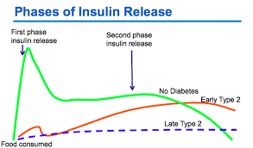
Dietary strategies could influence the underlying
pathophysiology of T2D beyond caloric restriction
remission of T2D via diet can be achieved contingent on:
(1) the return of the first-phase insulin response, which itself is reliant on achieving and sustaining significant weight loss
(2) T2D being of relatively short duration
A key aspect of beta-cell function, called the first-phase insulin response
This marked post-meal insulin spike is critical physiologically to suppress hepatic glucose output and lipolysis of peripheral adipose tissue, and to promote the uptake of glucose and fatty acids into skeletal muscle
The first-phase insulin response declines over the course of T2D, and data from lifestyle trials and bariatric surgery consistently show an inverse relationship between duration of T2D and likelihood of remission
Nicola D Guess, Could Dietary Modification Independent of Energy Balance Influence the Underlying Pathophysiology of Type 2 Diabetes? Implications for Type 2 Diabetes Remission, Diabetes Ther, 2022 , March 10th

Slide 32
Effects of dietary components on glucose and the physiological drivers underlying glucose concentrations in T2D independent of calorie restriction
Nicola D Guess, Could Dietary Modification Independent of Energy Balance Influence the Underlying Pathophysiology of Type 2 Diabetes? Implications for Type 2 Diabetes Remission, Diabetes Ther, 2022 , March 10th

Slide 33
PROTEINS
To date, five well-controlled studies by two independent research groups have shown that increasing the protein content of the diet from 15% to 30% kcal lowers blood glucose in T2D.
glucose- stimulated insulin secretion declines
markedly as T2D progresses,
amino acid-stimulated insulin secretion appears to remain relatively intact
In fact, the insulinotrophic effect of protein may be greater in people with T2D than in people with normal glucose
tolerance.
Given that a potent prandial insulin response is necessary for optimal control of post-prandial glucose concentrations and that the glucose-stimulated insulin response declines in T2D, this raises the question of whether increasing the amount of protein in the diet could help lower blood glucose concentrations, independent of weight loss.
potentiate the insulin response to a carbohydrate load,
such that increasing the amount of protein in a meal acutely can more than double the amount of insulin produced, and lead to a
reduction in post-prandial glucose concentrations
This insulinogenic response likely occurs via direct stimulation of amino acids on the beta-cell and an enhanced
incretin effect
Nicola D Guess, Could Dietary Modification Independent of Energy Balance Influence the Underlying Pathophysiology of Type 2 Diabetes? Implications for Type 2 Diabetes Remission, Diabetes Ther, 2022 , March 10th

Slide 34
Nevertheless, there is scientific data available which provide insight into the potential role of carbohydrate restriction per se on glycaemia, and this will now be reviewed.
While moderate carbohydrate restriction— independent of protein or weight loss—may not alter glucose concentrations in T2D
there is evidence that reducing the carbohydrate intake to levels likely to increase ketogenesis does have weight-independent effects on glucose
dietary approaches which could suppress endogenous glucose production independent
of caloric balance may help enhance durable glycaemic control, and this may be particularly critical as the patient moves from weight loss to weight maintenance
Nicola D Guess, Could Dietary Modification Independent of Energy Balance Influence the Underlying Pathophysiology of Type 2 Diabetes? Implications for Type 2 Diabetes Remission, Diabetes Ther, 2022 , March 10th

Slide 35
Mechanisms – dietary strategies and diabetes remission
Nicola D Guess, Could Dietary Modification Independent of Energy Balance Influence the Underlying Pathophysiology of Type 2 Diabetes? Implications for Type 2 Diabetes Remission, Diabetes Ther, 2022 , March 10th

Slide 36
WHOLE FOOD, PLANT BASED DIET
It is unlikely that any single element of a plant-based diet can lower glucose on its own to a magnitude which could influence the achievement of remission.
However, here it is important to note that some of the proposed mechanisms of effect of the glycaemic index, soluble and fermentable fibres, polyphenolic compounds and unsaturated:saturated fat ratio on glucose homeostasis are distinct.
Thus, it might be reasonable to expect that the effects of these foods combined on any given outcome would be additive.
If each approach lowers glucose by approximately 0.7 mmol/L, the overall effect of a diet high in plant-based foods independent of weight change could theoretically reach3 mmol/L
FIBERS
FERMENTABILITY
Nicola D Guess, Could Dietary Modification Independent of Energy Balance Influence the Underlying Pathophysiology of Type 2 Diabetes? Implications for Type 2 Diabetes Remission, Diabetes Ther, 2022 , March 10th

Slide 37
Could Dietary Modification Independent of Energy Balance Influence the Underlying Pathophysiology of Type 2 Diabetes? Implications for Type 2 Diabetes Remission
There is evidence that elements of diets can meaningfully influence blood glucose and T2D management independent of their effect on body weight.
These changes could help more people achieve remission of their T2D, both as an adjunct to traditional weight loss programmes and even as stand-alone glucose-lowering approaches.
Given the incidence of weight regain following weight loss interventions, leveraging the weight-neutral effects of diet on T2D is a pragmatic approach to mitigate the pathophysiological consequences of weight regain.
A greater understanding of how diet influences blood glucose can help us devise personalised diets that exploit these mechanistic effect of nutrients while meeting the tastes, preferences and needs of the patient.
Nicola D Guess, Could Dietary Modification Independent of Energy Balance Influence the Underlying Pathophysiology of Type 2 Diabetes? Implications for Type 2 Diabetes Remission, Diabetes Ther, 2022 , March 10th

Slide 38
Bariatric surgery and diabetes remission
This Photo by Unknown Author is licensed under CC BY-ND

Slide 39
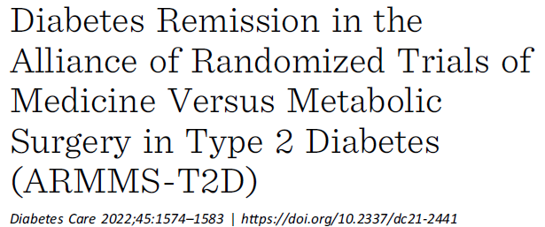
OBJECTIVE
The overall aim of the Alliance of Randomized Trials of Medicine versus Metabolic
Surgery in Type 2 Diabetes (ARMMS-T2D) consortium is to assess the durability and
longer-term effectiveness of metabolic surgery compared with medical/lifestyle
management in patients with type 2 diabetes NCT02328599
RESEARCH DESIGN AND METHODS
A total of 316 patients with type 2 diabetes previously randomly assigned to
surgery (N 5 195) or medical/lifestyle therapy (N 5 121) in the STAMPEDE,
TRIABETES, SLIMM-T2D, and CROSSROADS trials were enrolled into this prospective observational cohort.
The primary outcome was the rate of diabetes remission
(hemoglobin A1c [HbA1c] #6.5% for 3 months without usual glucose lowering
therapy) at 3 years.
Secondary outcomes included glycemic control,body weight, biomarkers, and comorbidity reduction

Slide 40
Results
Three-year data were available for 256 patients with mean 50 ± 8.3 years of age,
BMI 36.5 ± 3.6 kg/m2, and duration of diabetes 8.8 ± 5.7 years.
Diabetes remission was achieved in more participants following surgery than medical/lifestyle intervention (60 of 160 [37.5%] vs. 2 of 76 [2.6%], respectively;
P < 0.001).
Reductions in HbA1c (D 5 21.9 ± 2.0 vs. 20.1 ± 2.0%; P < 0.001), fasting plasma glucose (D 5 252 [2105, 25] vs. 212 [248, 26] mg/dL; P < 0.001), and
BMI (D 5 28.0 ± 3.6 vs. 21.8 ± 2.9 kg/m2; P < 0.001) were also greater after surgery. The percentages of patients using medications to control diabetes, hypertension, and dyslipidemia were all lower after surgery (P < 0.001).
Three-year follow-up of the largest cohort of randomized patients followed to
date demonstrates that metabolic/bariatric surgery is more effective and durable
than medical/lifestyle intervention in remission of type 2 diabetes, including
among individuals with class I obesity, for whom surgery is not widely used
Diabetes Care 2022;45:1574–1583 https://doi.org/10.2337/dc21-2441

Slide 41
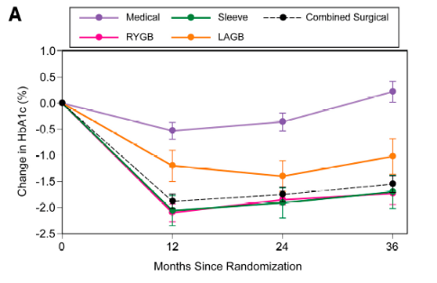
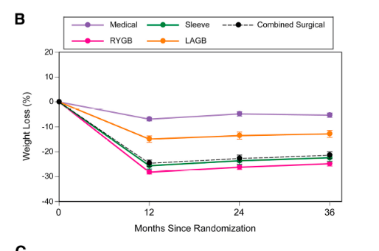
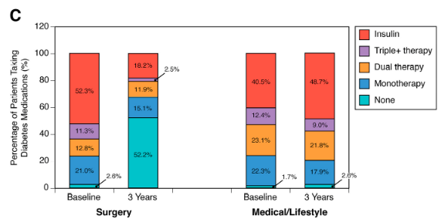
Change in HbA1c. A: Change in HbA1c (%) from baseline to 12, 24, and 36 months following randomization to medical/lifestyle, RYGB, SG,or AGB. Least-squares means and corresponding SEs from a repeated-measures model are plotted. Black dotted line with black circles indicates combined effects of surgical intervention. Surgery lowered HbA1c to a greater extent than medical/lifestyle intervention. B: Percent change in body weight from baseline to 12, 24, and 36 months following randomization to medical/lifestyle, RYGB, SG, or AGB. Least-squares means and corresponding SEs from a repeated-measures model are plotted. Black dotted line with black circles indicates combined effects of surgical intervention.Surgery lowered body weight to a greater extent than medical/lifestyle intervention. C: Percentage of patients taking diabetes medication at baseline and 3 years following surgery or medical/lifestyle intervention. LAGB, laparoscopic AGB.

Slide 42
DIADEM study
This Photo by Unknown Author is licensed under CC BY-ND

Slide 43
DIADEM I
This open-label, parallel-group, randomised controlled trial (DIADEM-I), done in primary care and community settings in Qatar, compared the effects of an intensive lifestyle intervention with usual medical care on weight loss and glycaemic outcomes in individuals with type 2 diabetes, aged 18–50 years, with a short diabetes duration (≤3 years), had a BMI of 27·0 kg/m² or more, and who were from the Middle East and north Africa region.
The intensive lifestyle intervention comprised a total diet replacement phase, in which participants were given formula low-energy diet meal replacement products followed by gradual food reintroduction combined with physical activity support, and a weight-loss maintenance phase, involving structured lifestyle support.
Participants in the control group received usual diabetes care, which was based on clinical guidelines. The primary outcome was weight loss at 12 months after receiving the assigned intervention. Our analysis was based on the intention-to-treat principle. Key secondary outcomes included diabetes control and remission
Effect of intensive lifestyle intervention on bodyweight and glycaemia in early type 2 diabetes (DIADEM-I): an open-label, parallel-group, randomised controlled trial Prof Shahrad Taheri, MBBS Hadeel Zaghloul, MBBCh †Odette Chagoury, PhD †Sara Elhadad, MDS,Salma Hayder Ahmed, BSc,Neda El Khatib, BSc, THE LANCET, Diabetes & Endocrinology,ARTICLES| VOLUME 8, ISSUE 6, P477-489, JUNE 2020, https://doi.org/10.1016/S2213-8587(20)30117-0

Slide 44
The type of lifestyle intervention is important, intensive lifestyle intervention required for diabetes remission
DIADEM I
147 participants (70 in the intervention group and 77 in the control group) were included in the final ITT analysis population.
Between baseline and 12 months, the mean bodyweight of participants in the intervention group reduced by 11·98 kg (95% CI 9·72 to 14·23) compared with 3·98 kg (2·78 to 5·18) in the control group (adjusted mean difference −6·08 kg [95% CI −8·37 to −3·79], p<0·0001).
In the intervention group, 21% of participants achieved more than 15% weight loss between baseline and 12 months compared with 1% of participants in the control group (p<0·0001).
Diabetes remission occurred in 61% of participants in the intervention group compared with 12% of those in the control group (odds ratio [OR] 12·03 [95% CI 5·17 to 28·03], p<0·0001).
33% of participants in the intervention group had normoglycaemia compared with 4% of participants in the control group (OR 12·07 [3·43 to 42·45], p<0·0001).
21% weight loss of more than 15%
61% diabetes remission
Effect of intensive lifestyle intervention on bodyweight and glycaemia in early type 2 diabetes (DIADEM-I): an open-label, parallel-group, randomised controlled trial Prof Shahrad Taheri, MBBS Hadeel Zaghloul, MBBCh †Odette Chagoury, PhD †Sara Elhadad, MDS,Salma Hayder Ahmed, BSc,Neda El Khatib, BSc, THE LANCET, Diabetes & Endocrinology,ARTICLES| VOLUME 8, ISSUE 6, P477-489, JUNE 2020, https://doi.org/10.1016/S2213-8587(20)30117-0

Slide 45
ACLM position
This Photo by Unknown Author is licensed under CC BY-ND

Slide 46
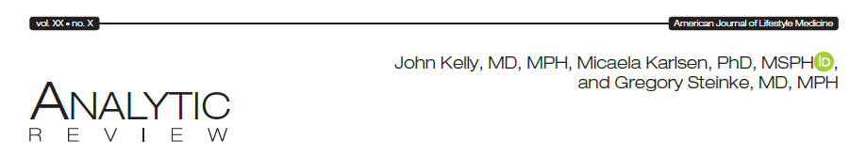

Slide 47
OFFICIAL POSITION OF AMERICAN COLLEGE of LIFESTYLE MEDICINE
The position of the ACLM, informed by current best research evidence, is that
sufficiently intensive lifestyle modifications are capable of producing significant clinical improvements in patients with T2D and
(2) that the optimal treatment to bring about remission (defined below) includes a whole food, plant-based (WFPB) dietary pattern coupled with moderate exercise.
A WFPB diet emphasizes fruits and vegetables, legumes, and whole grains, and includes nuts and seeds while eliminating or minimizing animal foods such as red and white meat, poultry, fish, eggs, and dairy, as well as refined foods that include added sugars and oils.
ACLM is in agreement with the position stated by the group who conducted the Counterpoint Study on the reversibility of T2D
“Diabetes reversal should be [the] goal in the management of Type 2 diabetes
Modificarile stilului de viata pot sa produca ameliorarea clinica semnificativa la pacientii cu DZ tip 2

Slide 48
For persons with T2DM and obesity
Significant weight reduction MAY lead to T2DM REMISSION
INTENSICE LIFESTYLE INTERVENTION is the first STEP in obtaining DIABETES REMISSION
PHARMACOLOGICAL approach may help
Favorable FACTORS – short term diabetes duration, no complications or associated diseases

Slide 49

Lifestyle medicine for diabetes remission applied in practice
This Photo by Unknown Author is licensed under CC BY-ND

Slide 50


“BETTER ME” by MedLife
The first lifestyle medicine network in Romania
President of Scientific Council: Prof Jeffrey Mechanick, Mount Sinai, New York

Slide 51


Lifestyle medicine Network 2023
Bucharest, Cluj-Napoca, Timisoara
Anca Hâncu, MD, PhD
MedLife Lifestyle medicine network coordinator
Medical Association for prevention through lifestyle, president

Slide 52








Bucuresti
Cluj-Napoca
Timisoara

