Slide 1
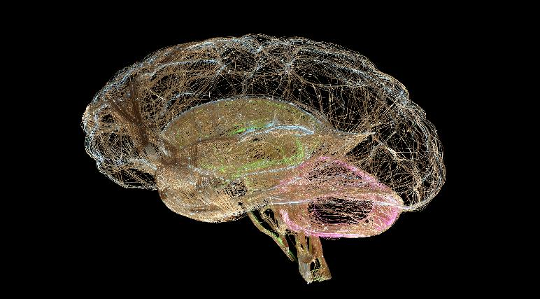
Brain Health/Aging through LSM across Lifespan
Aleksandra Pikula MD, PhD, DipABPN, DipABLM (USA), FAHA, ELMOc
Jay & Sari Sonshine Chair in Stroke Prevention and Cerebrovascular Brain Health at UHN/UofT
Director, Stroke Neurology Research Program, Krembil Brain Institute, UHN
Director, Stroke in Young Adults (SiYA) Program, TWH/UHN
Clinician-Investigator, Krembil Brain Institute, UHN
Associate Professor of Medicine (Neurology/Stroke), University of Toronto
Co-Director, Women’s Neurology Fellowship, U of T
ELMO Congress Nov 11, 2023

Slide 2
Disclosures
When I meet a new patient, I share that lifestyle
medicine is the foundation of my personal &
professional philosophy as a vascular neurologist.
***
This way, I get reminded that I treat people, not a diseases.

Slide 3
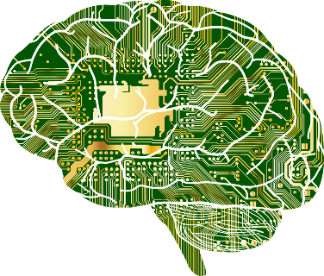
OUTLINE
Definitions
- Brain Health/Optimization/Brain Care
Brain Health/Aging seen through the lifespan
- The highest window of opportunity for prevention
Global Burden of Neurological Disease
- Shared Risks for Stroke & VCID (Dementia) & Depression
What works for brain health?
U of T - The Sonshine Stroke Prevention/Brain Health Centre:
How this can be implemented at the public level through mixed methods patient-driven research & patient-centric approach

Slide 4
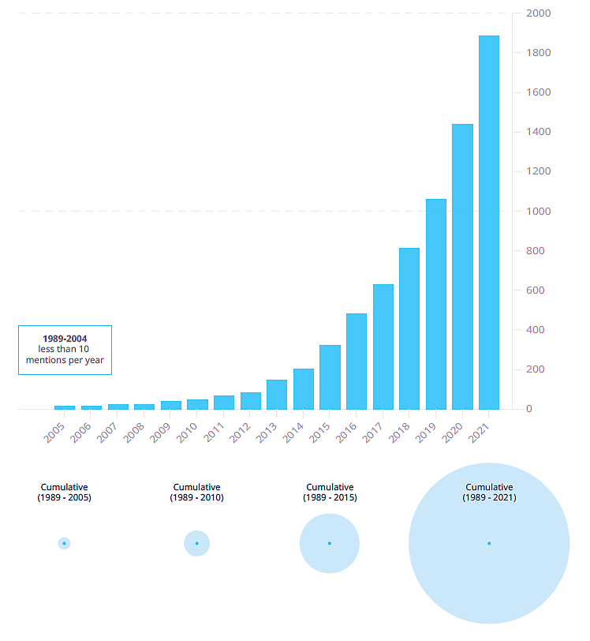
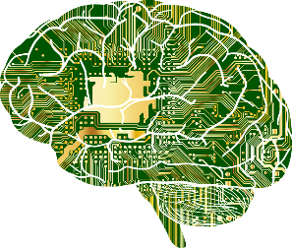
Brain health is an evolving concept that has emerged in the
academic literature in recent decades and has become increasingly
popular within science, journalism and the public

Slide 5
The Brain Health Imperative in the 21st Century—A Call to Action
The AAN Brain Health Platform and Position Statement
The WHO (2021) - as the state of brain functioning across cognitive, sensory, social-emotional, behavioral & motor domains allowing a person to realize their full potential over the life course irrespective of the presence or absence of a disorder
Numerous interconnected SDOH - influence the way our brain develops, adapts, responds to stress & adversity, giving way to strategies for both promotion and prevention across the lifespan, and some can be addressed through the pillars of Lifestyle Medicine
AAN & BCS Consortium (2022): Optimizing brain health through brain care by addressing these determinants not only improves mental and physical health but also empowers self-management towards better brain/body/mind health in people with or without neurological conditions.
Both definitions (and many others) “mental health (well being) & brain health (structural/function) are two separate but closely related concepts”
Brain health is an important determinant of mental health across the life course.
Notes:
AP

Slide 6
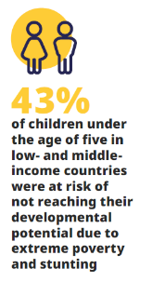

Slide 7
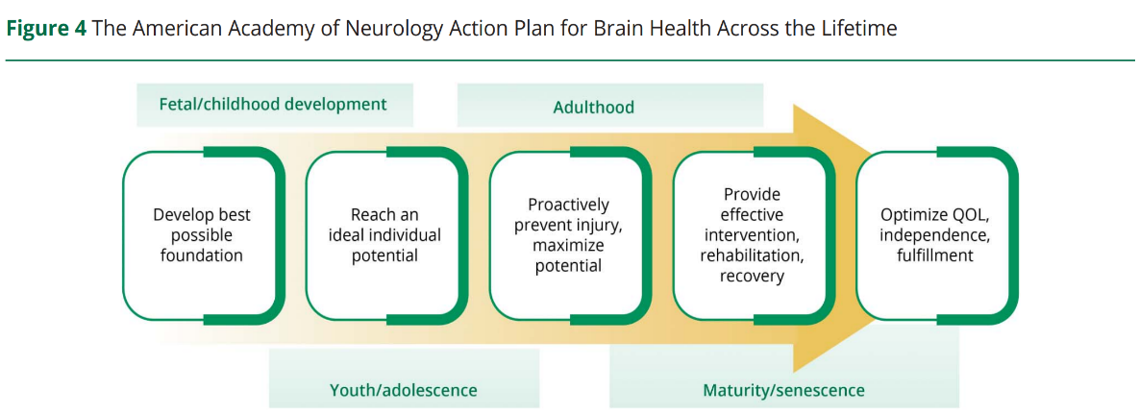
Optimizing brain health = Brain care
- preserves & improves brain structure and function, reduces the risk of developing CNS disorders,
- promotes overall health & supports continuous interactions between a person’s genetics, environment and circumstances
September 26, 2023; 101 (13) SPECIAL ARTICLE
The Brain Health Imperative in the 21st Century—A Call to Action
The AAN Brain Health Platform and Position Statement

Slide 8
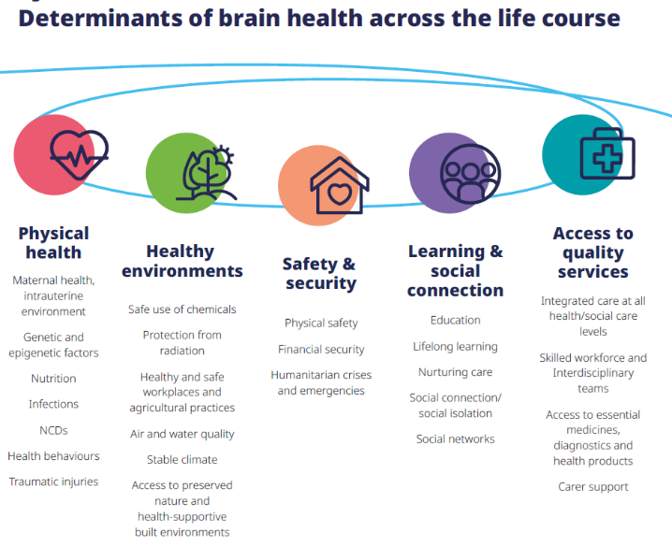
Disclosures

Slide 9
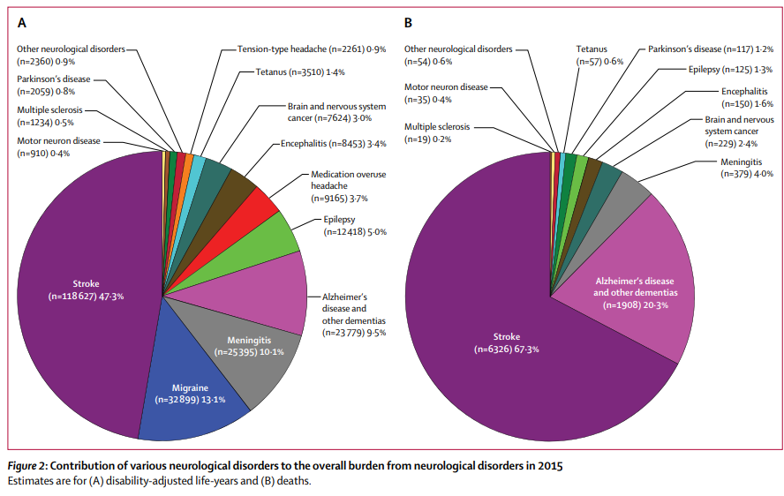
The burden of neurological disorders substantially increased over 25yrs
1st cause of disability – stroke remains the largest contributor (A)
2nd leading cause of death - despite substantial decreases in mortality rates from stroke (B)

Slide 10
1 stroke every 3 seconds
For comparison:
50 million prevalent epilepsy
44 million prevalent dementia (likely many undiagnosed, but ~50-60% cerebrovascular disease related)

Slide 11
Stroke & VCID are major global public health challenges
1 in 4 persons (>25years-old) will have a stroke in their lifetime
- with HTN being the highest single burden

Slide 12
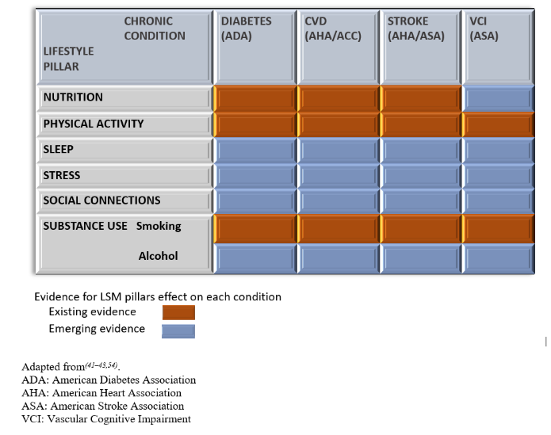
Pikula A. et al. Mayo Proceedings, Accepted 2024

Slide 13
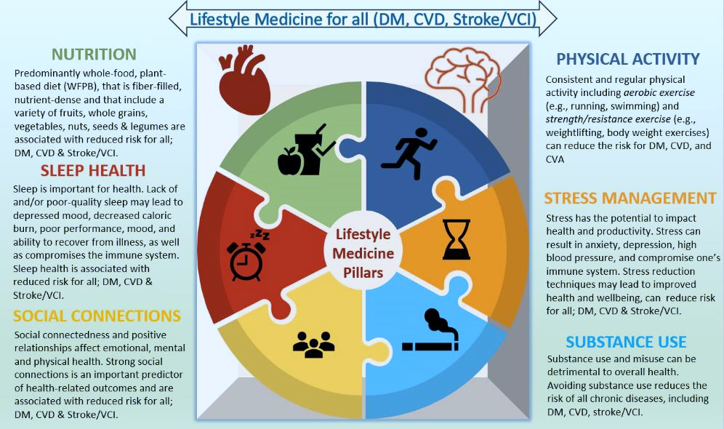
Pikula A. et al. Mayo Proceedings, Accepted 2024
Pikula A et al. Nutrition and Stroke, for W. Willett - Harvard School of Medicine Textbook 2023 in print
3 common diets associated with cognitive & stroke protection: by 30%
DASH, MEDI, MIND
Low PA -20%
Moderate PA ~ 30%
Higher levels of PA-43% stroke risk reduction, compared to inactivity
<6h or >9h – higher risk
OSA- higher risk by 30%
Prolonged naps
Prolonged Insomnia
Interrupted sleep
Stress strongly linked with higher risk of HTN, stroke, cognitive impairment, dementia/AD
Loneliness & social isolation = increased risk of stroke, recurrence, dementia (~40%)
Middle aged smoking = higher risk of cognitive impairment later in life

Slide 14
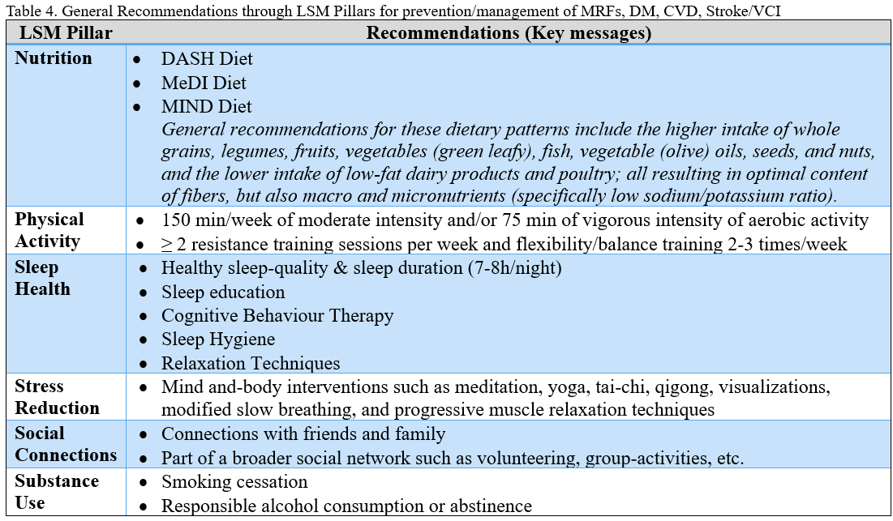
Pikula A. et al. Mayo Proceedings, Accepted 2024

Slide 15
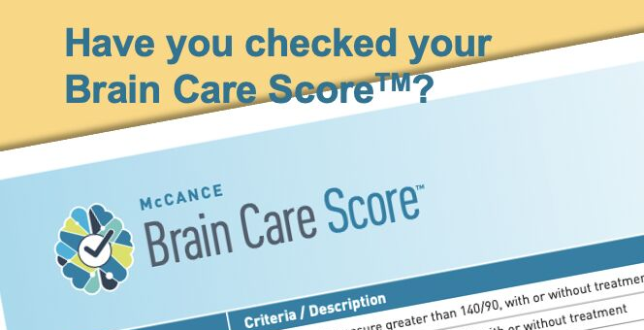

Slide 16
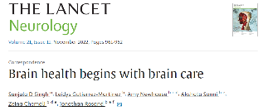
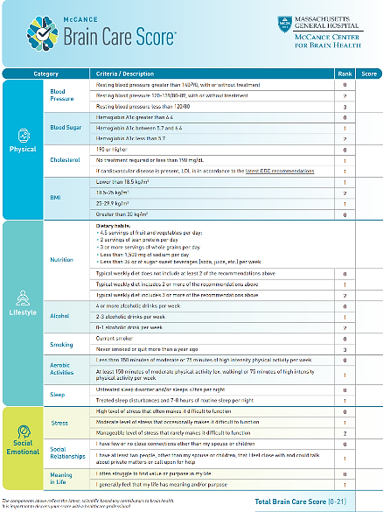
The 21-point Brain Care Score (BCS) is a novel tool derived through a modified Delphi process (forecasting modeling), in partnership with practitioners and patients to promote behavior changes and lifestyle choices to sustainably reduce the risk of dementia and stroke
- a crucial first step to motivate those who do not have brain disease as well as those who do—to take the steps that physicians worldwide generally agree will help to prevent brain diseases.
- facilitates discussions on what an individual is already doing and on identifying additional ways to enhance brain care.

Slide 17
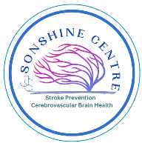
Brain Care Score Consortium – Boston 2023
HOW?
This prototype Brain Care Score is just that: a prototype. It will no doubt require refinement as investigators pursue essential research to answer questions such as the following: does improvement in the Brain Care Score over time lead to a reduction in disease risk?

Slide 18
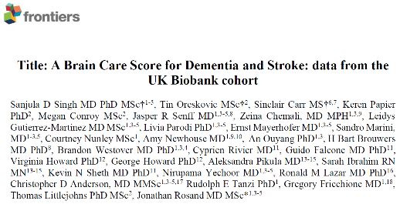
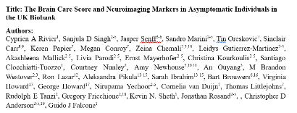
The BCS (median: 12; IQR:11–14) N= 398,990 UKB participants (mean age: 57; F: 54%)
5,354 incident cases of dementia & 7,259 incident cases of stroke median FU 12.5 years
A 5-point higher BCS at baseline associated with
~60% risk of dementia, depression & 50% risk of all stroke for age <50
32% dementia, 25% depression & ~50% stroke for age 51-59
8% dementia 10% depression & 33% stroke for >59 years
Better MRI neuroimaging markers: higher brain volume, less WMH

Slide 19
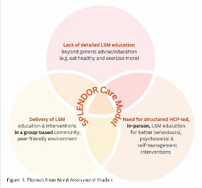
Developing an Innovative Stroke Prevention LSM Programmed Education and Coaching Group Visit Model of Care (SPLENDOR Care Model)
Bio Data
Imaging Data
HCP Satisfaction Data
Economic Data

Slide 20
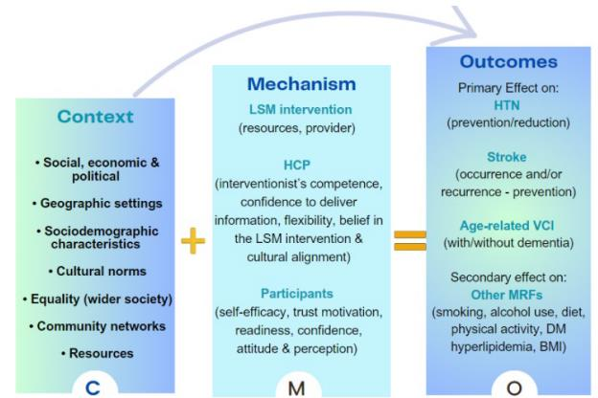
How, why, for whom and in what context LSM interventions

Slide 21
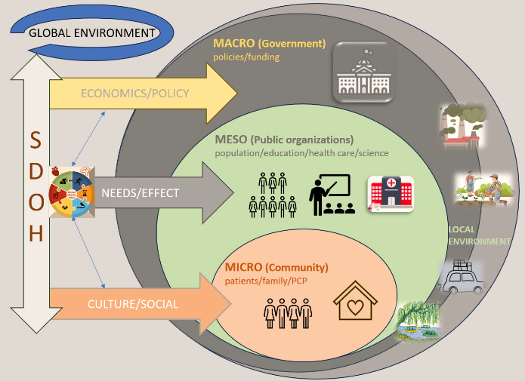
Community-Engaged Lifestyle Medicine (CELM) an evidence-based framework for promoting health equity through multi-stakeholder, multi-level, collaborative, community-engaged, culturally responsive and intersectoral approaches for structurally marginalized populations.
Using community-based participatory research (CBPR)
Advocating for public policy change
government subsidies to healthier foods; supporting access to food
Improving the physical and social conditions of underdeveloped and under-resourced neighborhoods and communities;
integrating LSM in medical education (e.g. all health care providers);
integrating SDOH within guidelines and recommendations.

Slide 22
Thank you! @WomensBrain_MD Aleksandra.Pikula@uhn.ca

