Slide 1

The effect of migration
on lifestyle intervention
Elizaveta Kuznetsova
MD, PHD, Cardiologist
Subotica, Serbia 2023
Notes:
The effect of migration on lifestyle intervention

Slide 2
Disclosure
I have no conflicts of interest to disclose.
Notes:
I have no conflict of interests

Slide 3
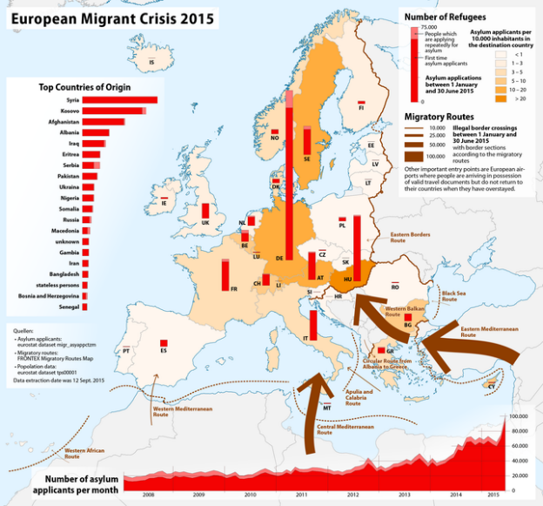
Migration is a movement of a person either across an international border, or within a state for more than one year irrespectively of the causes
Due to many reasons it is continuous process
https://home-affairs.ec.europa.eu/networks/european-migration-network-emn/emn-asylum-and-migration-glossary/glossary/migration_en
Notes:
Due to Eurocomission definition (that a little bit differs from traditional one) In the global context, movement of a person either across an international border (international migration), or within a state (internal migration) for more than one year irrespective of the causes, voluntary or involuntary, and the means, regular or irregular, used to migrate.
Migration is historically determined continuous process. According to publication activity, more attention have been payed to this problem from 2015 after one of the first modern migration crisis.
Last decade it become more intensive and caused many economical problems.

Slide 4
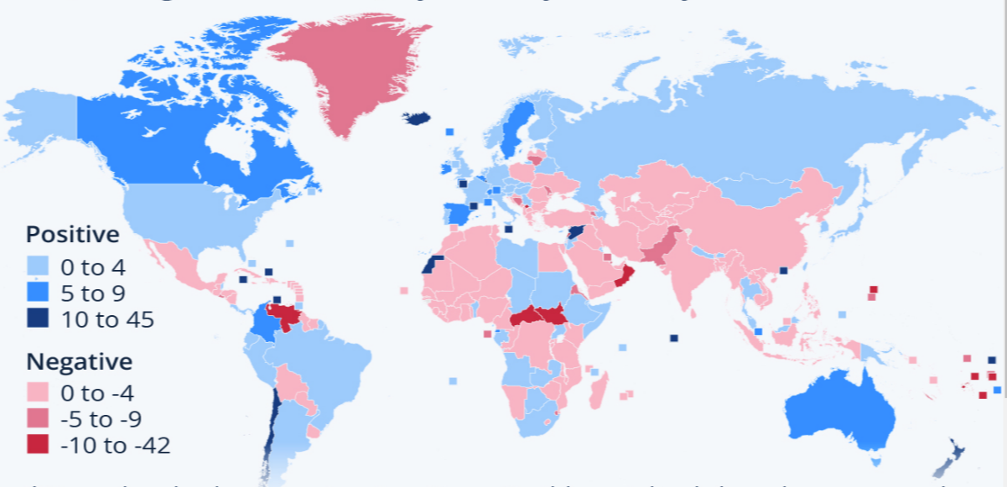
Migration processes: Net annual migration per 1,000 (average 2017-2021), by country/territory
https://www.statista.com/chart/28351/global-net-per-capita-migration-by-country/
Notes:
From about 2015-2016 first studies let’s say in pubmed, started discovered reasons and medical issues due to this process. Now we could see the most frequent migration destinations

Slide 5
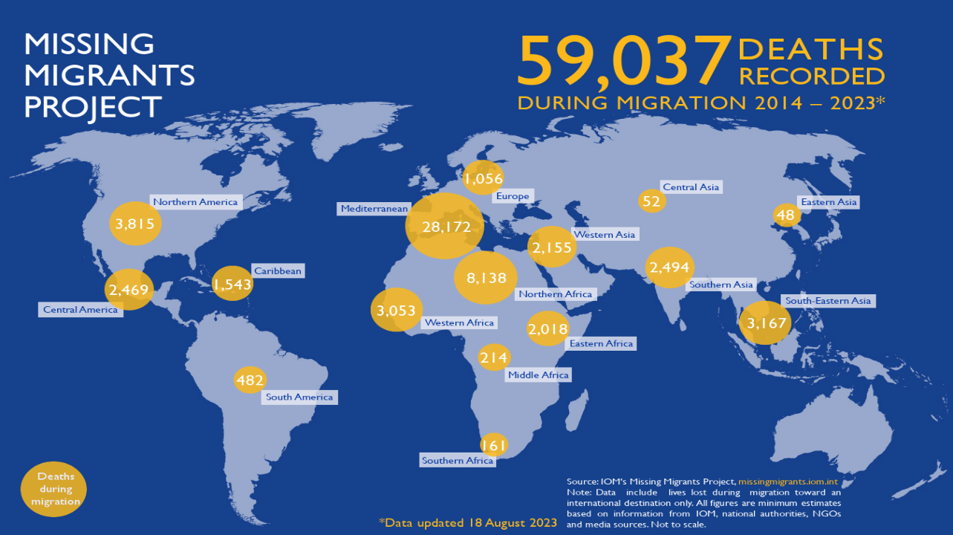
Notes:
I think that despite of mugration death rate, we will find other mostly lifestyle related problems that already influence on European health and health insurance system as well as on NCD (non-communicable statistics), I will explain it soon.

Slide 6
Migration processes
Escape
Emergency process
No plan
No funds
Re-location
Planned process
Usually due to a job
Some savings
STEP 1
Humanitarian assessment required
Notes:
First, I would like to simplified migration process in 2 types: escape (so extremely fast migration without any preparation). It requires humanitarian assessment. There are many European programs to help people.
Let’s call second type of migration - re-location is more planned process and seems like they do not need any help. But it isn’t so.

Slide 7

Migration processes
Escape
Emergency process
No plan
No funds
Re-location
Planned process
Usually due to a job
Some savings
STEP 2
Lifestyle intervention
Notes:
I would say that both groups need help. And it is a place of application lifestyle intervention.
Why I am so confident?
Let’s look at the studies.

Slide 8
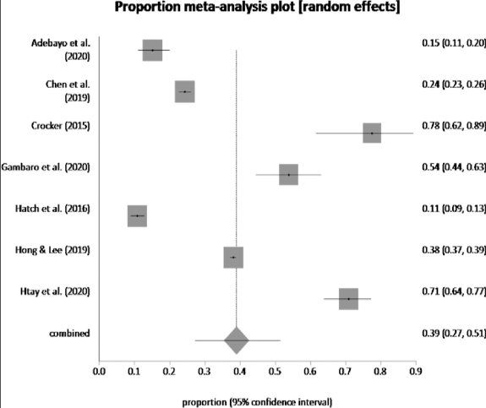
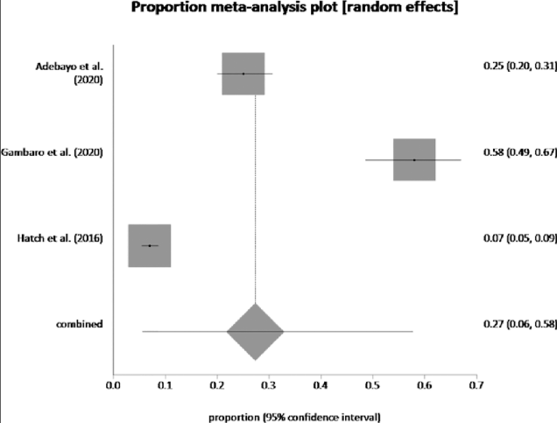
Prevalence of common mental health issues among migrant workers:
A systematic review and meta-analysis (2021)
depression by random effects
meta-analysis is 38.99%
anxiety by random effects
meta-analysis is 27.31%
https://doi.org/10.1371/journal.pone.0260221
Notes:
Meta-analyses 2021
Prevalence of common mental health issues among migrant workers: A systematic review and meta-analysis
Pooled prevalence of depression by random effects meta-analysis is 38.99%
Pooled prevalence of anxiety by random effects meta-analysis is 27.31%. https://doi.org/10.1371/journal.pone.0260221
Prevalence of common mental health issues among migrant workers: A systematic review and meta-analysis
Siti Idayu Hasan, Anne Yee, Ariyani Rinaldi, Adlina Aisya Azham, Farizah Mohd Hairi, Amer Siddiq Amer Nordin
Other mental problem related to stress,
PTSD disorder Epub 2016 Sep 29. (The epidemiology of PTSD and depression in refugee minors who have resettled in developed countries
James Reavell ¹, Qulsom Fazil ¹ Affiliations expand, PMID: 27684305, DOI: 10.1080/09638237.2016.1222065)
In discussion it is mentioned, that root for this result is environment.
And globalization processes could influence on epigenetics as well
(The environmental roots of non-communicable diseases (NCDs) and the epigenetic impacts of globalization Environmental Research Volume 133, August 2014, Pages 424-430 Paolo Vineis ª ^{b}, Silvia Stringhini ^{c}, Miquel Porta)
https://doi.org/10.1016/j.envres.2014.02.002

Slide 9
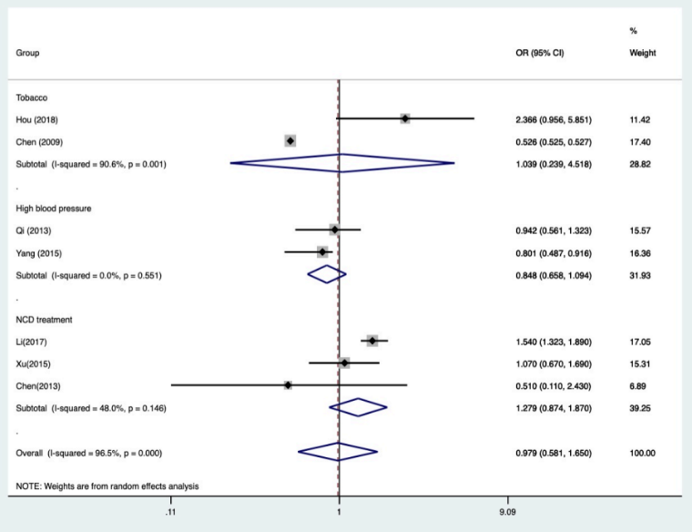
NCD risk factors among internal migrants in China: SR and MA
Tobacco use
Alcohol consumption
Unhealthy diet
Physical inactivity
Overweight
Raised waist circumference
Obesity
Raised blood sugar
Raised blood pressure
Raised blood lipids
Qian CX, et al. BMJ Global Health 2021;6:e003324. doi:10.1136/bmjgh-2020-003324
Notes:
Figure 2 Forest plot of prevalence of NCD risk factors or outcomes (migrants vs urban residents (urban as reference group)). NCD, non-communicable disease.
Tobacco use
Additionally parental migration influence on chidren’s health ans NCD risks among kids rises.
As well as mantal health disorders and sexually dangerous behavior and suicides level

Slide 10
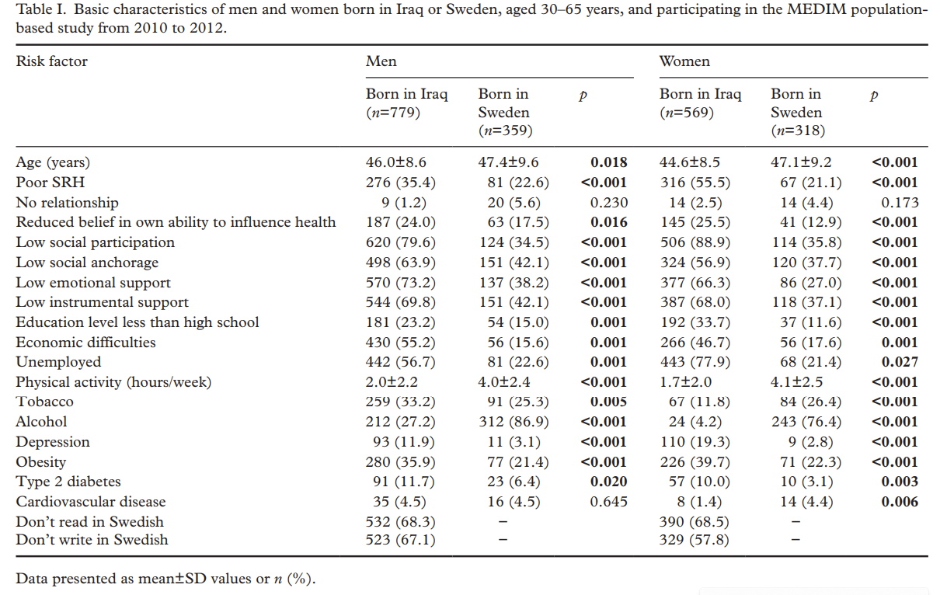
MEDIM Study Self-rated health and social capital in Iraqi immigrants to Sweden
doi:10.1177/1403494817730997

Slide 11
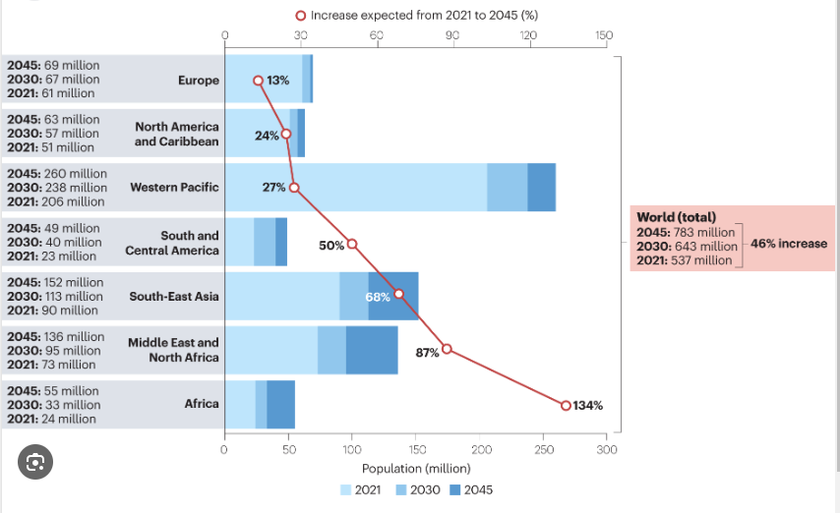
Non-communicable disease burden by 2045 (prognosis)
Nathan D. Wong and Naveed Sattar Cardiovascular risk in diabetes mellitus: epidemiology, assessment and prevention
Nature Reviews Cardiology volume 20, pages685–695 (2023)
Notes:
There are increasing risks of NCD.
For example
Cardiovascular disease (CVD) is a leading cause of death both in the EU and globally. In 2021, 20.5 million people worldwide died of CVD. In the EU, it is estimated that there are 63 million people living with CVD, and that CVD causes ~1.8 million deaths each year. To put that into context, CVD is responsible for ~37% of all deaths in the EU; this is considerably higher than the percentage of deaths related to the second most common cause, cancer.
1. World Heart Report 2023: Confronting the World’s Number One Killer. Geneva, Switzerland. World Heart Federation. 2023.
2. GBD Results Tool | GHDx (healthdata.org)
3. Wilkins E, Wilson L, Wickramasinghe K, Bhatnagar P, Leal J, Luengo-Fernandez R, Burns R, Rayner M, Townsend (2017). European Cardiovascular Disease Statistics 2017. European Heart Network, Brussels
4. Eurostat: https://ec.europa.eu/eurostat/statistics-explained/index.php?title=Cardiovascular_diseases_statistics

Slide 12
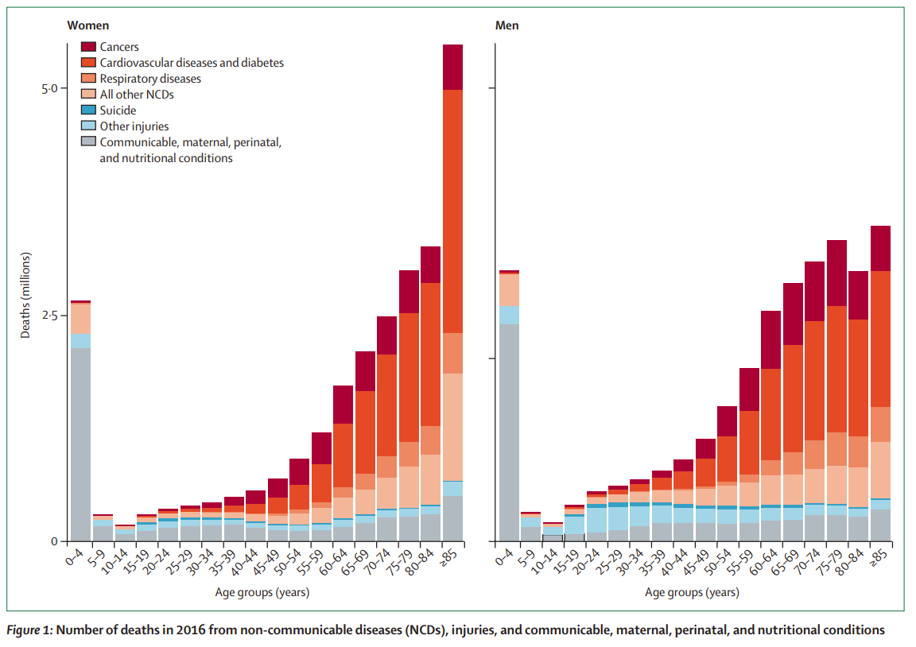
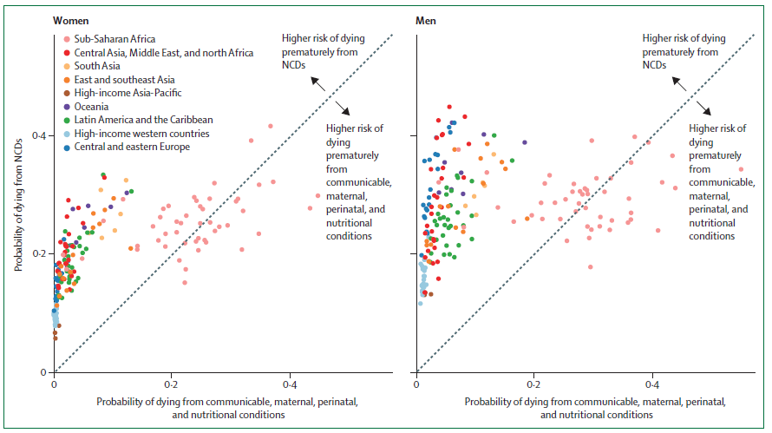
NCD Countdown 2030: worldwide trends in non-communicable diseases’ mortality and progress towards Sustainable Development Goal target 3.4
Lancet 2018; 392: 1072–88 Countdown 2030 collaboration www.thelancet.com/NCDCountdown-2030
Notes:
There are great EU initiative that is described in Lancet,
The idea is to reduce how to reduce the global NCD trend (to combine politics, health system and socio-economic systems) , this program started around 2016

Slide 13

Notes:
I am still not sure, If they include new migration waves in to statistics?

Slide 14

Migration processes
Similarities
Escape
Re-location
Long-term stress
Depression
Anxiety
Low physical activity
Unhealthy diet
Poor sleep hygiene
Low social connections
Addictions development
Sexual problems
Notes:
Going back to our 2 type migration groups.
Step one for 1 st emergency group was humanitarian help.
But an equally important step is to work with lifestyle habits with both groups and it’s important to start earlies to heat faster effect and integration this people into the local community

Slide 15





Lifestyle intervention
Nutrition
Physical activity
Sleep hygiene
Working with addictions
And sexual health
Controlling stress, reducing anxiety
And dealing with depression
Integration in community,
sharing traditions
Notes:
So, no more evidence is needed
Lifestyle intervention for this group of people couldn’t be underestimated.
Of course I am not the first person who understood this.

Slide 16
Refugee and Migrant Health Literacy Interventions in High‑Income Countries: A Systematic Review
This study demonstrates that targeted interventions can improve health literacy, behaviors, and clinical outcomes in a variety of health issues and migrant populations.
Fox, S., Kramer, E., Agrawal, P., & Aniyizhai, A. (2021). Refugee and Migrant Health Literacy Interventions in High-Income Countries: A Systematic Review. Journal of Immigrant and Minority Health. doi:10.1007/s10903-021-01152-4
Notes:
So, what intervention do we
All 23 included studies were published between 2002 and
2017, with most (N = 20) published after 2008 (Table 1).
Sixteen studies were conducted in the U.S., United States
[20–23] primarily in Washington DC (N = 5) [24–28], California
(N = 3) [29–31], and New York (N = 3) [32–34]. Three
were conducted in Europe (Denmark, Netherlands, and
Norway) [35–37], and one each in Australia [38], Canada
[39], and Taiwan [40]. One study did not report the specific
location, though it occurred somewhere within the US [41].
Mental health (N = 5) was the most commonly addressed
study objective, followed by cancer screening (N = 4), type 2
diabetes (N = 3), nutrition (N = 3), and hypertension (N = 2).
There was one study each on general health literacy, health
system navigation, childbearing, asthma, osteoporosis, and
rheumatoid arthritis. The number of participants in each
study ranged from 44 to 1044 with a combined total of
N = 5625.
Three studies used two or more intervention groups,
while the rest used a single intervention group to compare
with controls. Nine studies used individual-oriented interventions
of varying types including distributing pamphlets,
fotonovelas, access to websites, or one-on-one counseling.
Seven studies used group sessions to provide educational
experiences, primarily in the form of classes. Seven studies
used a combination of both group and individual-oriented
interventions. Only one study included a doctor’s visit as a
component of the intervention [41]. All other studies’ interventions
took place outside of a clinical encounter. Study
follow-up periods ranged from 0 to 15 months. have? Healthy literature as was shown in this SR is good initiative but for sure is not enough

Slide 17
A culturally adapted lifestyle intervention addressing a Middle Eastern immigrant population at risk of diabetes, the MEDIM (impact of Migration
and Ethnicity on Diabetes In Malmö): study protocol for a RCT
Enrollment
(over 1250 - 40% with DM T2 high risk)
30-75 years old
308 participants (born in Iraq, living in Malmö)
with high risk of DM T2
Randomization
Lifestyle intervention
Control group
10 group counseling sessions:
Diet, physical activity, behavioral change
Exercise sessions.
Cultural adaptation - gender-specific exercise sessions
Receive the information about healthy lifestyle habits provided by the primary health care center
Intervention
(over 6 months)
Primary outcome: change in fasting glucose level.
Secondary outcomes: changes in BMI, insulin sensitivity, physical activity, food habits and health-related quality of life.
Outcome
https://trialsjournal.biomedcentral.com/articles/10.1186/1745-6215-14-279
Notes:
But there is one nice study
There is one nice study protocol, designed in Malmo for people with DM risks. They proposed, that lifestyle intervention will be cost effective The aim was to design a culturally adapted lifestyle intervention for an immigrant population and to evaluate its effectiveness and cost-effectiveness.
It is Sweden study for Iraque migrants aged from 30-to 75 with DM risks
Unfortunately we still don’t have a results. Recruitment process started in October 2013.
No Study Results Posted on ClinicalTrials.gov for this Study
Unfortunately we still don’t have a results. Recruitment process started in October 2013.
This study is 6 month study mostly focused on physical activity and diet.
In this randomized controlled trial, 308 participants (born in Iraq, living in Malmö, Sweden and at high risk of type 2 diabetes) will be allocated to either a culturally adapted intervention or a control group. The intervention will consist of 10 group counseling sessions focusing on diet, physical activity and behavioral change over 6 months, and the offer of exercise sessions. Cultural adaptation includes gender-specific exercise sessions, and counseling by a health coach community member. The control group will receive the information about healthy lifestyle habits provided by the primary health care center. The primary outcome is change in fasting glucose level. Secondary outcomes are changes in body mass index, insulin sensitivity,physical activity, food habits and health-related quality of life. Measurements will be taken at baseline, after 3 and 6 months. Data will be analyzed by the intention-to-treat approach. The cost-effectiveness during the trial period and over the longer term will be assessed by simulation modeling from patient, health care and societal perspectives.
But it’s the most important things to reduce DM risks

Slide 18
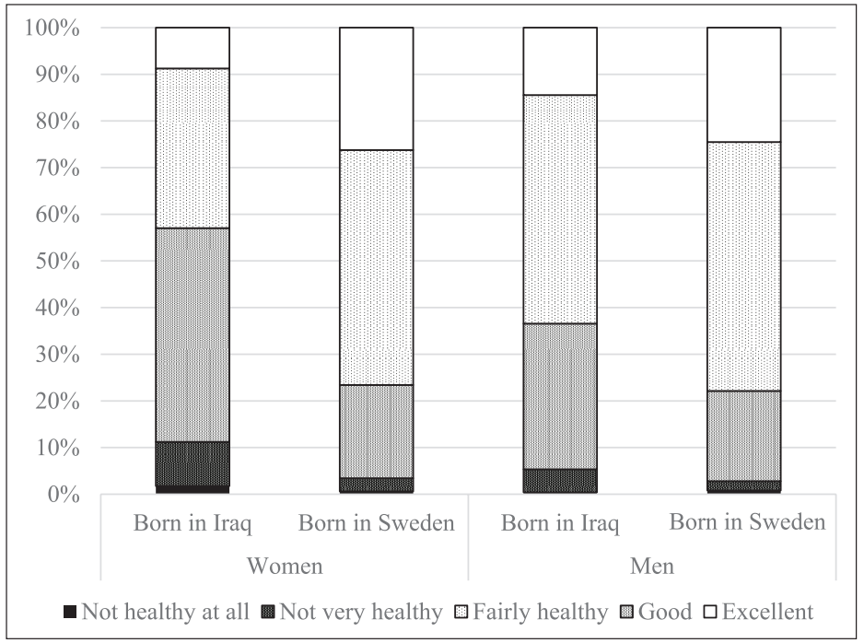
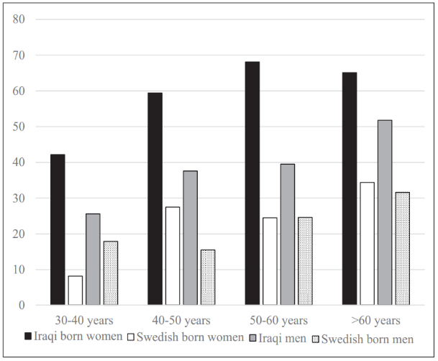
MEDIM Study Results: self-related health care
Prevalence of poor SRH in relation to age in Iraqi born
and Swedish born women/men
Distribution of SRH in Iraqi born and Swedish born women/men
Bennet, L., & Lindström, M. (2017). Self-rated health and social capital in Iraqi immigrants to Sweden: The MEDIM population-based study. Scandinavian Journal of Public Health, 46(2), 194–203. doi:10.1177/1403494817730997
Notes:
But there is one nice study
There is one nice study protocol, designed in Malmo for people with DM risks. They proposed, that lifestyle intervention will be cost effective The aim was to design a culturally adapted lifestyle intervention for an immigrant population and to evaluate its effectiveness and cost-effectiveness.
It is Sweden study for Iraque migrants aged from 30-to 75 with DM risks
Unfortunately we still don’t have a results. Recruitment process started in October 2013.
No Study Results Posted on ClinicalTrials.gov for this Study
Unfortunately we still don’t have a results. Recruitment process started in October 2013.
This study is 6 month study mostly focused on physical activity and diet.
In this randomized controlled trial, 308 participants (born in Iraq, living in Malmö, Sweden and at high risk of type 2 diabetes) will be allocated to either a culturally adapted intervention or a control group. The intervention will consist of 10 group counseling sessions focusing on diet, physical activity and behavioral change over 6 months, and the offer of exercise sessions. Cultural adaptation includes gender-specific exercise sessions, and counseling by a health coach community member. The control group will receive the information about healthy lifestyle habits provided by the primary health care center. The primary outcome is change in fasting glucose level. Secondary outcomes are changes in body mass index, insulin sensitivity,physical activity, food habits and health-related quality of life. Measurements will be taken at baseline, after 3 and 6 months. Data will be analyzed by the intention-to-treat approach. The cost-effectiveness during the trial period and over the longer term will be assessed by simulation modeling from patient, health care and societal perspectives.
But it’s the most important things to reduce DM risks

Slide 19
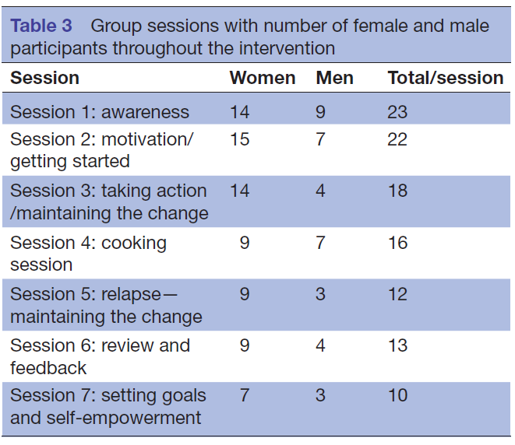
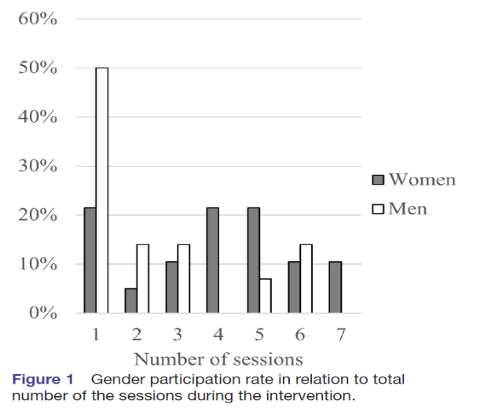
MEDIM Study Results: lifestyle intervention
Olaya-Contreras P, et al. BMJ Open 2019;9:e028076. doi:10.1136/bmjopen-2018-028076
Notes:
But there is one nice study
There is one nice study protocol, designed in Malmo for people with DM risks. They proposed, that lifestyle intervention will be cost effective The aim was to design a culturally adapted lifestyle intervention for an immigrant population and to evaluate its effectiveness and cost-effectiveness.
It is Sweden study for Iraque migrants aged from 30-to 75 with DM risks
Unfortunately we still don’t have a results. Recruitment process started in October 2013.
No Study Results Posted on ClinicalTrials.gov for this Study
Unfortunately we still don’t have a results. Recruitment process started in October 2013.
This study is 6 month study mostly focused on physical activity and diet.
In this randomized controlled trial, 308 participants (born in Iraq, living in Malmö, Sweden and at high risk of type 2 diabetes) will be allocated to either a culturally adapted intervention or a control group. The intervention will consist of 10 group counseling sessions focusing on diet, physical activity and behavioral change over 6 months, and the offer of exercise sessions. Cultural adaptation includes gender-specific exercise sessions, and counseling by a health coach community member. The control group will receive the information about healthy lifestyle habits provided by the primary health care center. The primary outcome is change in fasting glucose level. Secondary outcomes are changes in body mass index, insulin sensitivity,physical activity, food habits and health-related quality of life. Measurements will be taken at baseline, after 3 and 6 months. Data will be analyzed by the intention-to-treat approach. The cost-effectiveness during the trial period and over the longer term will be assessed by simulation modeling from patient, health care and societal perspectives.
But it’s the most important things to reduce DM risks

Slide 20
What is missing point in this studies?
process continuity
timing
workshops and practical tips
combining all parts of the lifestyle together
mental health
culture integration

Slide 21

3D lifestyle intervention model

Slide 22
3D lifestyle intervention model
Incorporate all lifestyle pillars in every day life
Through lectures, workshops and everyday practice
Culture integration via master-classes
Everyday physical activity
Mindfulness practice (or other PTSD-related practice)

Slide 23

3D lifestyle intervention model
Psychologist, PTSD therapist
MBSR, yoga teacher, and etc.
https://www. traumarelease.ru
MD, GP, Cardiologist, Medical Rehabilitation
specialist, Lifestyle medicine specialist and etc.
https://www.habitus-est.com
Notes:
We have similar experience, so we know, what we are talking about

Slide 24

Lifestyle medicine is not only Luxury

Slide 25

Lifestyle medicine is not a Luxury
it’s an opportunity for healthy living in the future for everyone
Thank you for your attention!

