Slide 1
Lifestyle Medicine, Quality of Care and Planetary Health
Prof Dr Andrée Rochfort,
Director of Quality Improvement,
Irish College of General Practitioners
Dublin
Ireland

Slide 2
Thank you
Scientific Committee
Organising Committee
Erasmus, ELMO Administrative Secretariat & Core PCO
Semmelweis University Budapest, Sponsors and Exhibitors,
All Presenters
Disclaimer – No Conflicts of Interest

Slide 3
Prof Dr Andrée Rochfort MICGP
Director Doctors Health Program &
Director of Quality Improvement
Irish College of General Practitioners
Graduated in Medicine, Trinity College Dublin
Student experience in Harvard, USA & Kenya, Africa
Family Doctor; Cardiff, Wales 1991-96, & Wexford, Ireland
PG qualifications Occupational Medicine, Medical Education, Lifestyle Medicine
Assistant Clinical Professor in Department of General Practice and Forensic & Legal Medicine, University College Dublin www.ucd.ie
Irish College of General Practitioners ICGP www.icgp.ie/doctorshealth
ICGP Director of Doctors Health in Practice Programme 2001
ICGP Director of Quality Improvement 2013
ICGP Planetary Health & Sustainability WG 2020 www.icgp.ie/planetary_health
President of EQuiP - European Society for Quality and Safety in Family Practice www.qualityfamilymedicine.eu
A network organisation in WONCA Europe www.woncaeurope.org
EFPC institutional member with ICGP https://euprimarycare.org/
Member Planetary Health European Hub https://www.planetaryhealth.eu/
ISLM Committee member www.islm.ie
ELMO Board member www.eulm.org

Slide 4
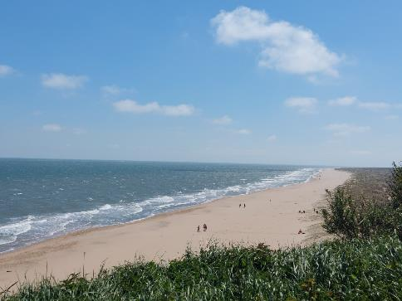
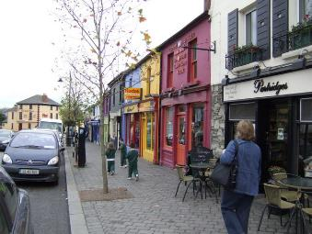
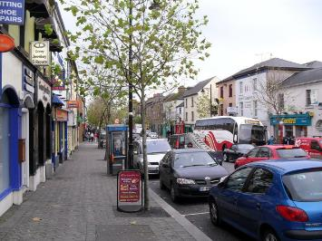

Slide 5
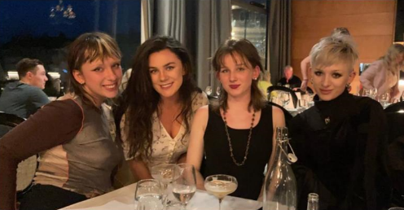

Slide 7
AGENDA
Lifestyle Medicine
Quality of Life
Quality of Care
Planetary Health, One Health, Sustainable Healthcare
Good News, More Good News
Call to Action

Slide 8
Lifestyle Medicine Definition European Lifestyle Medicine Organisation 2023*
Lifestyle medicine is a branch of medicine which has as goal to maintain optimal health and to prevent, treat and reverse chronic illness across all life stages.
The health interventions** used in lifestyle medicine include evidence-based behavioural strategies**, while considering equity and sustainability, to enhance self-management skills for optimizing nutrition, sleep hygiene, stress management, social connection, sexual health and fertility, physical activity and minimising substance use and environmental exposures. * as adopted by the ELMO Scientific Council
** Lifestyle Interventions

Slide 9
Lifestyle Medicine Definition European Lifestyle Medicine Organisation 2023*
Lifestyle medicine is a branch of medicine which has a goal to maintain optimal health and to prevent, treat and reverse chronic illness across all life stages.
The health interventions used in lifestyle medicine include evidence-based behavioural strategies**, while considering equity and sustainability, to enhance self-management skills for optimizing nutrition, sleep hygiene, stress management, social connection, sexual health and fertility, physical activity and minimising substance use and environmental exposures. * as adopted by the ELMO Scientific Council 2023
** Lifestyle Interventions

Slide 10
Lifestyle Medicine…Power to improve life for
People / Patients / Clients / The General Public / Citizens
Policy makers / Health System Decision Makers & Planners
The Planet - Co-Benefits

Slide 11
9 Dimensions of Quality of Life
Material living conditions (income, consumption)
Productive activity or main activity (work)
Health
Education
Leisure and social interactions
Security - Economic security and physical safety
Governance and basic rights
Natural and living environment
Overall experience of life
REF https://ec.europa.eu/eurostat/statistics-explained/index.php?title=Quality_of_life_indicators_-_material_living_conditions

Slide 12
9 Dimensions of Quality of Life
Material living conditions (income, consumption)
Productive activity or main activity (work)
Health
Education
Leisure and social interactions
Security - Economic security and physical safety
Governance and basic rights
Natural and living environment
Overall experience of life
REF https://ec.europa.eu/eurostat/statistics-explained/index.php?title=Quality_of_life_indicators_-_material_living_conditions

Slide 13
6 Dimensions of Quality of Health Care
safety
timeliness
effectiveness
efficiency
equity
patient-centeredness.
REF http://www.ihi.org/

Slide 14
Planetary Health, One Health, Sustainable Healthcare

Slide 15
Definitions
‘Planetary health’ is defined as the health of humans and the natural systems on which human health depends.
“ such as clean water, air and soil. All impact on plant life, food and energy systems “
WONCA Statement on Planetary Health and Sustainable Development Goals. https://www.globalfamilydoctor.com/news/planetaryhealthandsustainabledevelopmentgoals.aspx
'One Health' is an integrated, unifying approach to balance and optimize the health of all people, all animals, plants, and the environment
One Health. World Health Organization. https://www.who.int/europe/initiatives/one-health
Sustainability. Protecting the Earths natural systems are the foundation of the Sustainable Development Goals.
Sustainable Development Goals. United Nations, Department of Economic and Social Affairs https://sdgs.un.org/goals

Slide 16
Sustainability is characterized by protecting finite resources and the environment by using resources wisely while taking into account the needs of our planet’s inhabitants in the future
Ballard T. What sustainability means for primary care: primary care leads to better overall resource use and higher quality outcomes. Br J Gen Pract. 2013;63(614):457-8

Slide 17
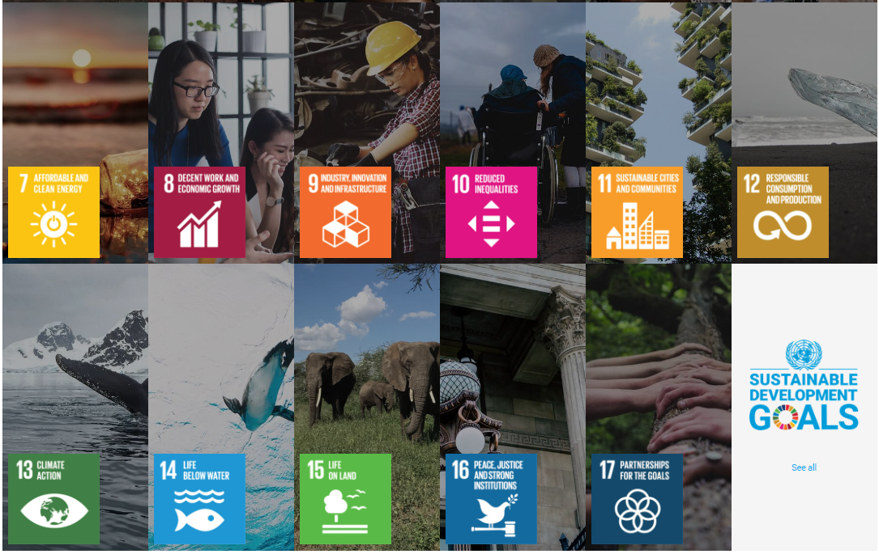

Slide 18
Good News Stories

Slide 19
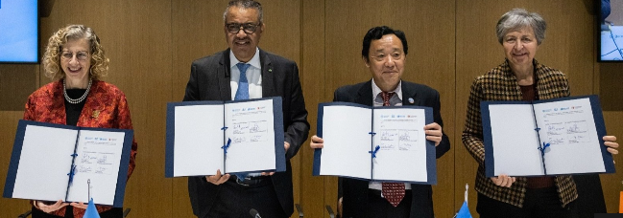
One Health Agreement
27th March 2023
The Quadripartite agreement aims to achieve together what no one sector can achieve alone, and it consists of four main agencies: the Food and Agriculture Organization of the United Nations (FAO), United Nations Environment Programme (UNEP), World Health Organization (WHO) and World Organisation for Animal Health (WOAH).
https://www.who.int/news/item/27-03-2023-quadripartite-call-to-action-for-one-health-for-a-safer-world

Slide 20
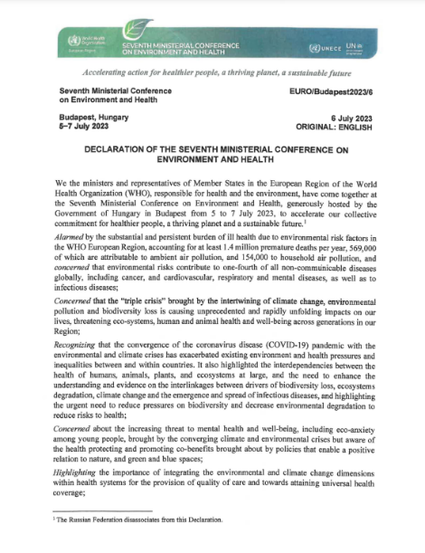
https://www.who.int/europe/publications/i/item/EURO-Budapest2023-6
https://iris.who.int/bitstream/handle/10665/371461/Budapest-decl-2023-eng.pdf?sequence=1

Slide 21
Good News Story
Demonstration of Leadership in General Practice / Family Medicine when WONCA Europe Council endorsed the 2023 Revision of the European Definition of General Practice / Family Medicine in Brussels in June 2023.
https://www.woncaeurope.org/news/view/2023-revisionof-the-definition-of-general-practice-family-medicine

Slide 22
https://www.woncaeurope.org/news/view/2023-revision-of-the-definition-of-general-practice-family-medicine

Slide 23
European Definition of Family Medicine 2011

Slide 24
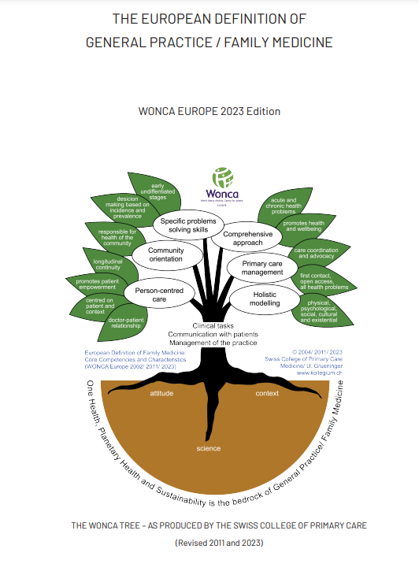
2023
https://www.woncaeurope.org/news/view/2023-revision-of-the-definition-of-general-practice-family-medicine

Slide 25
Good News Story
Multi-disciplinary leadership developments at European level involving public health and primary care with many other specialties to form the European Planetary Health Hub
https://www.planetaryhealth.eu/

Slide 26
Challenges 2023, 14(3), 33; https://doi.org/10.3390/challe14030033
Published: 14 July 2023

Slide 27
More Good News
Family doctors in Ireland are demonstrating leadership from the frontline,
with support from their academic organisation ICGP,
to help general practice teams implement the practical actions
the Glas Toolkit.
Glas = Green in Irish Language
https://www.icgp.ie/go/in_the_practice/planetary_health

Slide 28
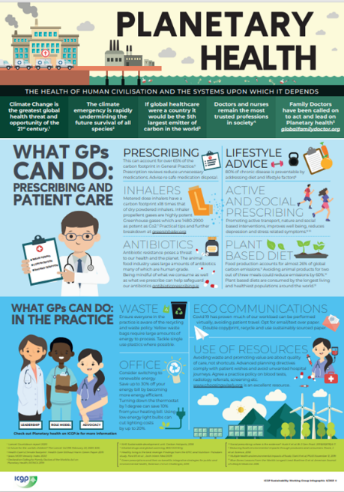
Irish College of General Practitioners
Sustainability Working Group
Infographic 2021
Aim of ICGP Sustainability WG
To raise awareness among general practitioners
of the need to consider the environment
and
the FUTURE sustainability of healthcare delivery
to patients
TODAY
https://www.icgp.ie/go/in_the_practice/planetary_health

Slide 29
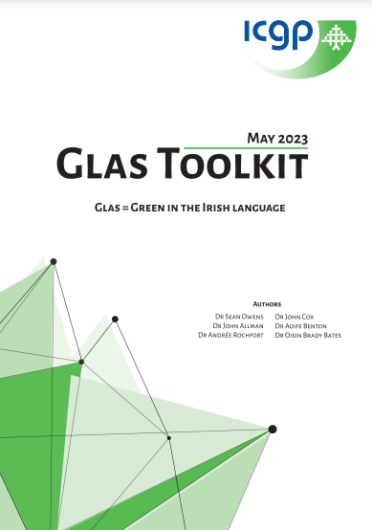
GLAS TOOLKIT

Slide 30
Ireland - Deprescribing
"Application of Stoppfrail deprescribing tool to nursing home residents across 5 GP practices In the South East of Ireland"
The project demonstrated a reduction of 31% in prescribed medication and potential savings to the Irish Health Service of 13 million euros if the result was extrapolated nationally.
Won GP Trainee Research Prize at AUDGPI (Association of University Departments of General Practice) 2022
Won ICGP GP Trainee Award for Quality and Safety in Practice. 2022
It was a multi centre project with contributions from a group of GP trainees.
Dr Ciaran Cassidy, Dr Shayan Berenjian,
Dr Damien McCarthy, Dr Martin Mroue Dr Conor Behan.

Slide 31
Clinical practice

Slide 32
Global Warning to Healthcare
“If the global health sector were a country
it would be the fifth largest emitter on the planet”
Healthcare’s Climate Footprint
https://noharm-global.org/sites/default/files/documents-files/5961/HealthCaresClimateFootprint_092319.pdf

Slide 33
https://www.revmed.ch/cobenefits/
Notes:
This extensive document is a MUST read
. Our friend Nicolas Senn in Switzerland again. What a focussed researcher and educator he is.

Slide 34
It is impossible for an unhealthy planet
to support healthy people

Slide 35
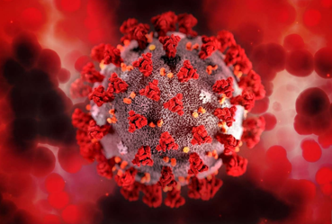
Lessons learned…
Covid-19 pandemic
Interconnectedness of how we Live our Lives

Slide 36
Call to Action

Slide 37
URGENT
Be informed
Act for better planetary health
As a citizen
As a professional

Slide 38
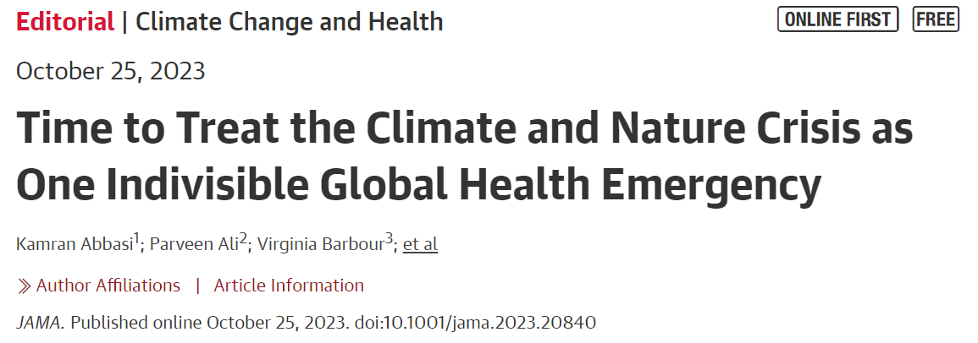
JAMA
Time to Treat the Climate and Nature Crisis as One Indivisible Global Health Emergency

Slide 39
Leadership is needed for Multidisciplinary Cooperation, Collaboration, Action and Outcomes
Notes:
I am a family doctor, a GP in the SE of Irealnd. I am a regular GP in a group practice, a teaching practice in a town of pop 10K in rural Ireland.
iam NOT an expert on sustainability or planetary health. I have a big interest in it in terms of quality and safety . Im here on behalf of EQUIP and WE to give the European perspective. Im a mother of 4 adult daughters, 2 scientists and 2 artists so lots of interesting discussions in our home on sustainability and human health. Id like to send mu husband Michael a special hello as today is our wedding anniversary!

