Slide 1
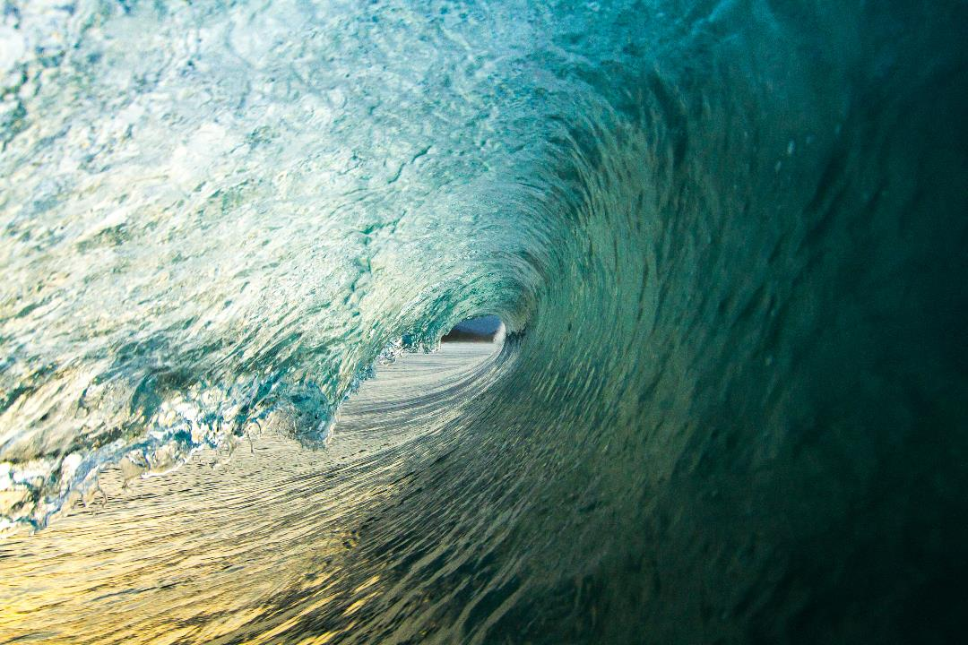
The importance of water cycles in designing a healthy and sustainable lifestyle
Eleni Prifti, PhD
5th ELMO Congress,
10-12 November 2023,
Budapest, Hungary

Slide 2
The Global Crisis of Pollution
Iceberg problem
We only know about 2% of total chemical exposure (Hulleman et al, 2023)
Main drive of
many NCDs
cancers, hormonal problems, infertility & adverse pregnancy effects, obesity
we have studied ≈500 chemicals out of ≈100,000 of chemicals (EEA, 2020)
Beyond Planetary Boundaries for Novel Entities (Persson et al, 2022)
24% of all global deaths attributed to pollution (WHO, 2023)
It keeps getting worse
EU REACH update faces huge resistance
Chemical Industry volumes are forecasted to increase
AI could speed up new chemicals production
Eleni Prifti, PhD, 5th ELMO Congress, 10-12 November 2023, Budapest, Hungary

Slide 3
Unraveling the Hydrological Cycle; Water transports chemicals
Precipitation
Runoff
Evaporation
Condensation
Eleni Prifti, PhD, 5th ELMO Congress, 10-12 November 2023, Budapest, Hungary

Slide 4
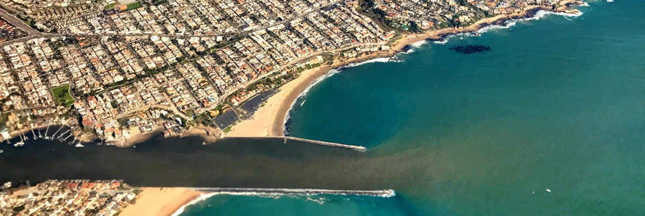
Water Cycles: Nature's Conduit for Pollution
Eleni Prifti, PhD, 5th ELMO Congress, 10-12 November 2023, Budapest, Hungary
What we can detect in water samples:
Micro/nanoplastics, fertilizers, pesticides, heavy metals, organic solvents, flame retardants, banned chemicals of the past (PCBs), dioxins, PFAS, pharmaceuticals (antidepressants, hormonal contraceptives, sedatives, antibiotics, hormonal blockers, medical imaging agents, anti-inflammatory drugs, antiseptic agents), parabens, phthalates, PAHs, triclosan, etc.
Picture: Urban Runoff by Tito Negron

Slide 5
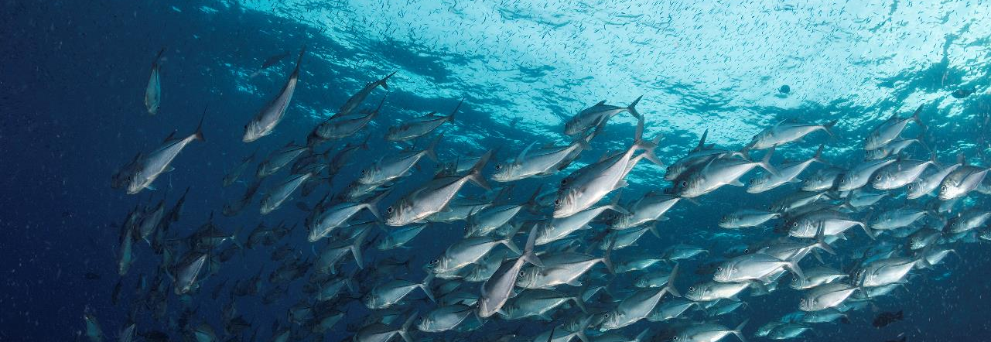
Bioaccumulation & Biomagnification
The Looming Threat of Animal-Based Diets
Eleni Prifti, PhD, 5th ELMO Congress, 10-12 November 2023, Budapest, Hungary

Slide 6
Rain doesn’t stop above organic farms
The Fantasy of Organic Produce
Eleni Prifti, PhD, 5th ELMO Congress, 10-12 November 2023, Budapest, Hungary

Slide 7
Designing a healthy & sustainable lifestyle
A three-step intervention approach
Eleni Prifti, PhD, 5th ELMO Congress, 10-12 November 2023, Budapest, Hungary

Slide 8
Step 1. A Paradigm Shift in Nutrition; Looking beyond nutrients
Covering nutritional needs
Reducing exposure to environmental chemicals
Compensating for chemical exposure
Aligning with SDGs
Eleni Prifti, PhD, 5th ELMO Congress, 10-12 November 2023, Budapest, Hungary

Slide 9
Step 2. Raising awareness about toxic chemicals in Pharmaceuticals & Personal Care Products (PPCPs)
PPCPs as emerging contaminants of high concern
Major source of endocrine disruptors
Exposure related to Social Determinants Of Health (SDOH)
Major threat to marine biodiversity (affecting fish reproduction)
If it goes to your drain it will end up in your food (limitations of WWTP)
Eleni Prifti, PhD, 5th ELMO Congress, 10-12 November 2023, Budapest, Hungary

Slide 10
Step 3. Advocating for Clean Air
98% of Europeans breathe low quality air, 400,000 deaths per year in EU (Expanse project; Guardian analysis, 2023)
4.2 millions deaths per year worldwide (WHO, 2022)
Advocating for Clean Air & Green Spaces
Indoor Air Pollution Awareness (Household VOCs)
Rain brings air pollution to our plates
Eleni Prifti, PhD, 5th ELMO Congress, 10-12 November 2023, Budapest, Hungary

Slide 11
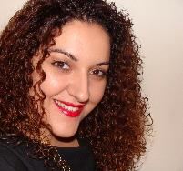
Thank you!
Eleni Prifti, PhD
Find me on

