Slide 1
Lifestyle Before Life: the role of lifestyle during the preconception period on the health of the mother and child
Dr Ourania Kolokotroni, MD, PhD
Paediatrician
Assistant Professor, School of Health Sciences
Cyprus University of Technology
ELMO Congress, Budapest, November 12th 2023

Slide 2
Key areas of Presentation
What is the association between preconception exposures and health outcomes for the mother and child?
How do preconception exposures affect biological programming?
What do we know about health around conception?
What are the gaps in knowledge about preconception health?
What are the future directions for improving lifestyle before giving life?

Slide 3
When you change the beginning of the story,
you can change the whole story
Christakis D, Media and Children, Nurturing care Framework for Early Childhood Development
Notes:
In line with nurturing care framework of WHO – investing in early years of life for better child development
A framework for helping children SURVIVE and THRIVE to TRANSFORM health and human potential

Slide 4
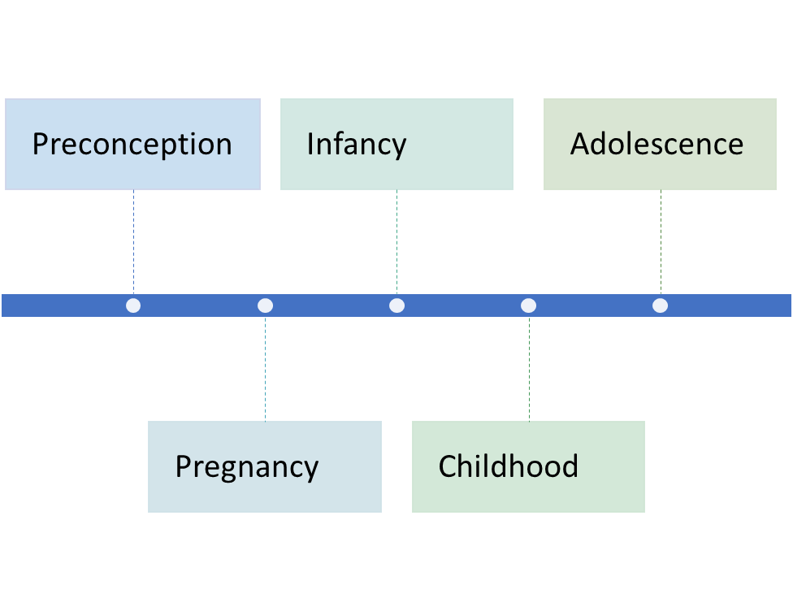
Preconception Health: A critical period of early life
Increasing evidence on the importance of early life exposures on health during critical periods of development
Birth cohorts have studied the effect of various exposures in pregnancy and infancy and provided recommendations that led to improvements in clinical practice for pregnant mothers and infants
Preconception Health, a less studied subject is now receiving increasing interest as:
the health of women and men entering pregnancy is not optimal and poses challenges for health systems
animal and human research show potential link with fertility, successful pregnancy outcomes and the heath of the mother and child and future generations
Notes:
epigenetics is the study of heritable phenotype changes that do not involve alterations in the DNA sequence
Epigenetics most often involves changes that affect gene activity and expression, but the term can also be used to describe any heritable phenotypic change. Such effects on cellular and physiological phenotypic traits may result from external or environmental factors, or be part of normal development. The standard definition of epigenetics requires these alterations to be heritable^{[3][4]} in the progeny of either cells or organisms.
The term also refers to the changes themselves: functionally relevant changes to the genome that do not involve a change in the nucleotide sequence. Examples of mechanisms that produce such changes are DNA methylation and histone modification, each of which alters how genes are expressed without altering the underlying DNA sequence. Gene expression can be controlled through the action of repressor proteins that attach to silencer regions of the DNA. These epigenetic changes may last through cell divisions for the duration of the cell's life, and may also last for multiple generations, even though they do not involve changes in the underlying DNA sequence of the organism;^{[5]} instead, non-genetic factors cause the organism's genes to behave (or "express themselves") differently

Slide 5
Preconception health The well known example of folic acid
Critical period for optimal gamete function and placental development: 3 months before and after conception
A well known example: folic acid supplementation
Folic acid supplementation during this period has been shown to:
Reduce neural tube defects by 70%
Decrease risk of pre-eclampsia
Decrease risk of miscarriage, still birth and neonatal death
Decrease risk of low birthweight and small for gestational age
Decrease risk of autism

Slide 6
Preconception Health and association with: Pregnancy, birth and postpartum outcomes
Umbrella review, Daly et al, Paediatric and Perinatal Epidemiology, 2021
Identified 53 systematic reviews of observational and interventional studies that studied 205 unique exposure-outcome interactions
Despite methodological concerns (mostly low quality data), evidence was shown for:
Maternal folic acid supplementation reduces neural tube defects
Maternal physical activity reduces risk of pre-eclampsia and gestational diabetes
Paternal age> 40, high maternal BMI and interpregnancy weight gain increase risk for various adverse pregnancy and birth outcomes such as gestational diabetes, pre-eclampsia, risk for caesarean section, large for gestational age birth

Slide 7
Preconception Health: The example of obesity
Growing number of studies looking at the association between various exposures in preconception period and maternal and child outcomes
Maternal pre-pregnancy BMI and Obesity linked to:
Infertility (inability to conceive or increased time to conceive)
Pregnancy complications (pre-eclampsia, gestational diabetes)
Adverse delivery outcomes and unsuccessful breastfeeding
Childhood obesity in early , mid and late childhood
Paternal obesity linked to:
Impaired fertility (low sperm quality and quantity)
Risk of cardiovascular disease and diabetes in offspring
Adopted from Voerman et al, PLOS Medicine, 2019
Violet – early childhood 2-5 years
Brown – mid childhood 5-10 years
Light blue – late childhood 10-18 years

Slide 8
Preconception Health: Mechanisms of Periconception Developmental conditioning
Developmental Origins of Health and Disease (Barker, 2003) :
based on Barker hypothesis and the idea of biological programming
Suggests that early life exposures lead to adaptive responses that affect the long-term risk of disease
Exposures in early life lead to epigenetic modifications that do not change the sequence of genetic DNA but instead produce changes in gene expression
Epigenetic changes lead to an adaptive response of the cellular environment at the start of development which continues through subsequent cell divisions and leads the process of biological programming – EARLY LIFE PLASTICITY (or periconceptional life plasticity when referring to pre-conception)
The epigenetic changes are transmitted across generations leading to transgenerational effects
Notes:
EPIGENETIC MODIFICATIONS DUE TO DNA METHYLATION

Slide 9
Preconception Health: Mechanisms of Periconception Developmental conditioning
Adopted from Moholdt et al, Trends in Endocrinology and Metabolism, 2020
Notes:
Note the circle – lifecourse model

Slide 10
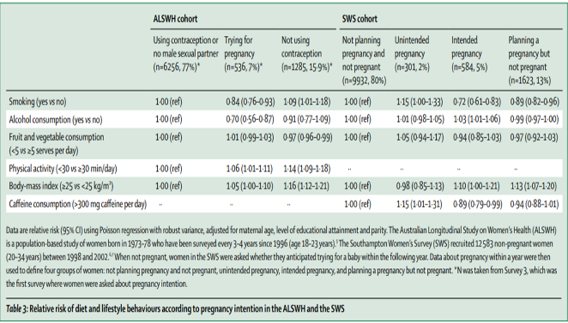
Preconception Health: What do we actually know about health around conception?
Intention to pregnancy has variable effects on health behaviours
Despite evidence of high motivation of pregnant women to change unhealthy habits, it is too little and too late to initiate lifestyle changes in pregnancy
Adopted from Stephenson et al, Lancet 2018
Notes:
Pregnancy is a teachable moment
Our analysis of new data from two preconception cohort studies5–7 shows mixed health behaviours reported in relation to pregnancy planning. Women trying for pregnancy when compared with those who were using contraception or not planning to become pregnant within the next year, were less likely to report smoking or drinking alcohol, reported lower amounts of caffeine consumption, had a higher BMI, reported lower amounts of physical activity, but had similar fruit and vegetable intake

Slide 11
Preconception Health: What do we actually know about health around conception?
Variable times to achieve benefits before conception
It takes less time to achieve adequate folic acid levels, stop smoking and lower alcohol consumption
It takes much longer to loose weight and establish new dietary habits
Adopted from Stephenson et al, Lancet 2018

Slide 12
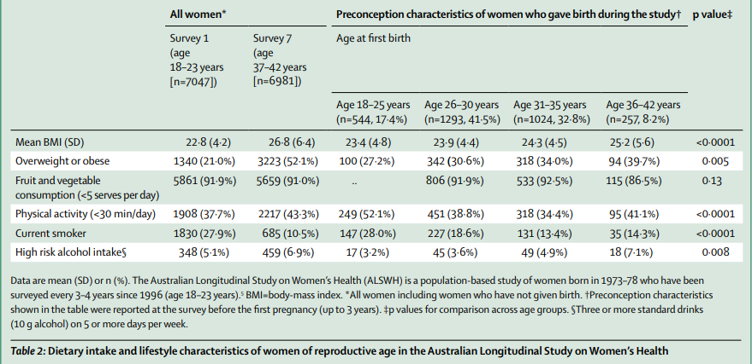
Preconception Health: what do we actually know about health around conception?
Many pregnancies are unplanned
Health behaviours/habits of people of Reproductive Age are not optimal
Adopted from Stephenson et al, Lancet 2018
Notes:
Pregnancy is a teachable moment
Our analysis of new data from two preconception cohort studies5–7 shows mixed health behaviours reported in relation to pregnancy planning. Women trying for pregnancy when compared with those who were using contraception or not planning to become pregnant within the next year, were less likely to report smoking or drinking alcohol, reported lower amounts of caffeine consumption, had a higher BMI, reported lower amounts of physical activity, but had similar fruit and vegetable intake

Slide 13
Life course model to lower risk of disease
Dual Strategy to improve preconception health by tackling:
women planning for pregnancy and thinking to conceive
women of reproductive age

Slide 14
Preconception Health: What next? What is a preconception population?
Considering the challenges to optimize health before conception, it is important to:
Recognize the value of understanding preconception populations beyond those actively seeking a pregnancy
Define the different groups of preconception populations
Explore the health profile and needs of each group and develop interventions tailored to the needs of each group
Adopted from Hill et al, 2020)

Slide 15
Preconception Health: What next? What else do we need to know?
Research to focus on important gaps in knowledge:
Health behaviours:
lack of studies on health behaviours like sleep, social connectivity/support or exposures to adverse health determinants in the environment
Behavioural intentions
intentions to change as well as other important psychological variables such as readiness, motivation to change and self-efficacy, behavioural control
Adopted from Toivonen et al, Preventive Medicine, 2017
Notes:
Developing interventions, we need to understand more the facilitators and barriers of changing behaviours in all precoception populations

Slide 16
PrePARE for LIFE study Preconception Profiling Assessment and Risk factor Evaluation of/for LIFEstyle
Cohort study of Student Nurses and Partners
Aims to:
Assess a wide variety of lifestyle habits, health behaviours and intentions in individuals of reproductive age
Evaluate the interlinked effects and potential interrelations of the various health behaviours and intentions on current and future health
Explore barriers and facilitators to optimizing health and health behaviours before conception
Create a data and biological bank in order to investigate over time the role of various preconception factors in the development of chronic diseases in parents and offsprings

Slide 17
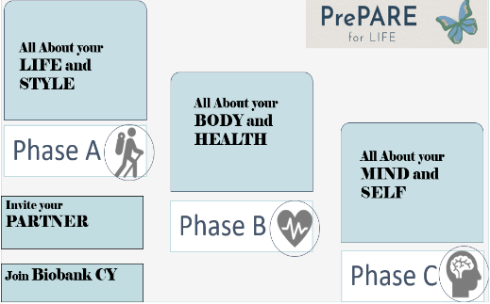
PrePARE for LIFE study Preconception Profiling Assessment and Risk factor Evaluation of/for LIFEstyle
Baseline Questionnaire Data Collection in Three Phases (within 8 months)
Phase A: Lifestyle factors/behaviours
dietary habits, physical activity levels, sleep patterns, social support, use of risky substances
Phase B: Mental, Reproductive and Sexual health
stress, depression, anxiety, menstrual history, sexual history
Phase C: Health intentions/Psychological variables
self-efficacy, motivation for change, happiness, resilience, personality traits, health locus of control, knowledge on preconception health
Anthropometric measurements
Biological specimens (biobank)
Follow up every 3 years there after

Slide 18
Preconception Health: lifestyle before life matters
Increasing evidence on the role of preconception exposures to the future health
Fertility and pregnancy outcomes
Chronic disease outcomes for mother and child
Challenges to improving exposures in preconception period
Many pregnancies unplanned – preconception period not known
Intention to pregnancy has variable effects on health habits
Variable Time needed to change lifestyle habits
Future directions in improving lifestyle before giving life
Define preconception populations and explore health profiles and needs
Research gaps in knowledge on the role of health behaviours and intentions during this critical period
Design evidence based interventions to improve preconception health - dual strategy

Slide 19
References
De-Regil LM, Peña-Rosas JP, Fernández-Gaxiola AC, Rayco-Solon P. Effects and safety of periconceptional oral folate supplementation for preventing birth defects. Cochrane Database Syst Rev 2015; 12: CD007950.
Mastroiacovo P, Leoncini E. More folic acid, the five questions: why, who, when, how much, and how. Biofactors 2011; 37: 272–79.
Hodgetts VA, Morris RK, Francis A, Gardosi J, Ismail KM. Effectiveness of folic acid supplementation in pregnancy on reducing the risk of small-for-gestational age neonates: a population study, systematic review and meta-analysis. BJOG 2015; 122: 478–90.
Gao Y, Sheng C, Xie RH, et al. New perspective on impact of folic acid supplementation during pregnancy on neurodevelopment/ autism in the offspring children—a systematic review. PLoS One 2016; 11: e0165626.
He Y, Pan A, Hu FB, Ma X. Folic acid supplementation, birth defects, and adverse pregnancy outcomes in Chinese women:a population-based mega-cohort study. Lancet 2016; 388: S91.
Voerman E, Santos S, Inskip H, Amiano P, Barros H, Charles M-A, et al. Association of gestational weight gain with adverse maternal and infant outcomes 2019;321:1702–15
Poston L, Caleyachetty R, Cnattingius S, et al. Preconceptional and maternal obesity: epidemiology and health consequences. Lancet Diabetes Endocrinol 2016; 4: 1025–36.
Gesink Law DC, Maclehose RF, Longnecker MP. Obesity and time to pregnancy. Hum Reprod 2007; 22: 414–20.
Marchi J, Berg M, Dencker A, Olander EK, Begley C. Risks associated with obesity in pregnancy, for the mother and baby: a systematic review of reviews. Obes Rev 2015; 16: 621–38.
urcksin R, Bel S, Galjaard S, Devlieger R. Maternal obesity and breastfeeding intention, initiation, intensity and duration: a systematic review. Matern Child Nutr 2014; 10: 166–83.
Kort HI, Massey JB, Elsner CW, et al. Impact of body mass index values on sperm quantity and quality. J Androl 2006; 27: 450–52.
Kaati G, Bygren LO, Edvinsson S. Cardiovascular and diabetes mortality determined by nutrition during parents’ and grandparents’ slow growth period. Eur J Hum Genet 2002; 10: 682–88
Hanson M and, Gluckman PD. Early developmental conditioning of later health and disease: physiology or pathophysiology? 2014
Hill B, Hall J, Skouteris H, Currie S. Defining preconception: exploring the concept of a preconception population 2020;20:1–11.

Slide 20
Thank you for your attention
Notes:
In line with nurturing care framework of WHO – investing in early years of life for better child development
A framework for helping children SURVIVE and THRIVE to TRANSFORM health and human potential

Slide 21
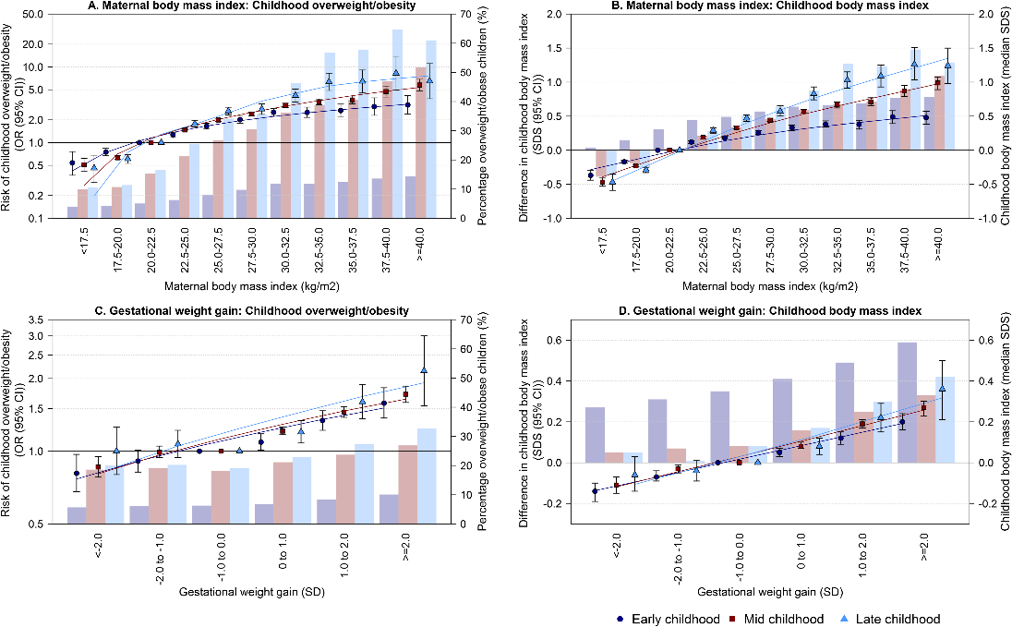
Notes:
The circles, squares and triangles represent odds ratios (ORs) (A and C) or regression coefficients (B and D) (95% confidence intervals) obtained from multilevel binary logistic or linear regression models that reflect the risk of overweight/obesity or differences in early, mid, and late childhood BMI standard deviation score (SDS) in the different maternal pre-pregnancy BMI or gestational weight gain groups, as compared to the reference group (20.0–22.5 kg/m² for maternal BMI, -1.0 to 0.0 SD for gestational weight gain [largest groups], primary y-axis). The lines are trendlines through the estimates. The models are adjusted for maternal age, education level, ethnicity, parity, and smoking during pregnancy. The bars represent the percentage overweight/obese children (A and C) or the median childhood BMI SDS (B and D) in early (2.0–5.0 years, violet bars), mid (5.0–10.0 years, brown bars), and late childhood (10.0–18.0 years, light blue bars) in the study population (secondary y-axis).
https://doi.org/10.1371/journal.pmed.1002744.g002

