Slide 1

the European lifestyle medicine certificate
IOAN HANES, MD
DIRECTOR OF THE EUROPEAN LIFESTYLE MEDICINE CERTIFICATE
VICE-PRESIDENT OF ELMO

Slide 2
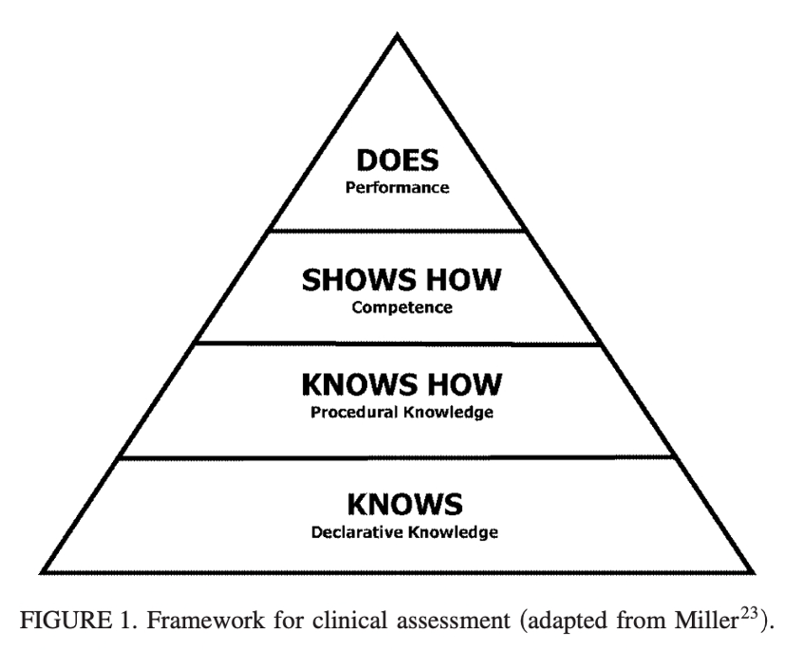

Slide 3
10- 2019

Slide 4
why?

Slide 5
who?

Slide 6
guest speakers

Slide 7
networking

Slide 8
380- 2023

Slide 9
6+2

Slide 10
scientific events

Slide 11
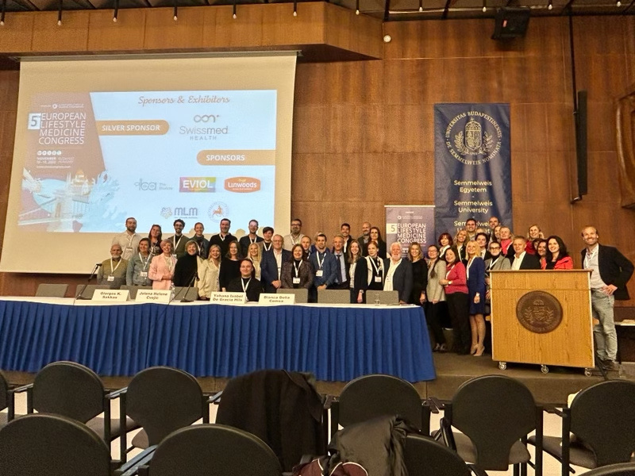
Thank you very much!

