Slide 1
Future of Medical Education: Impact of Lifestyle Medicine in Brazil and Latin America
Gustavo Hirt, MD
General Director – FP Academy
ELMO Certified in Lifestyle Medicine
Emerging Leader – UnitedHealth Group (2022)

Slide 2
Why did you go to medical school?

Slide 3
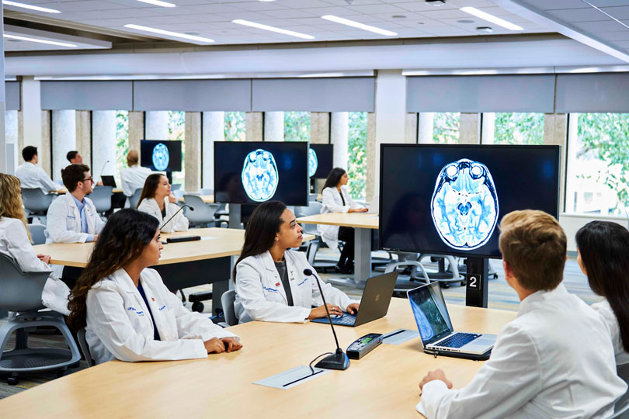
Why did you go to medical school?

Slide 8
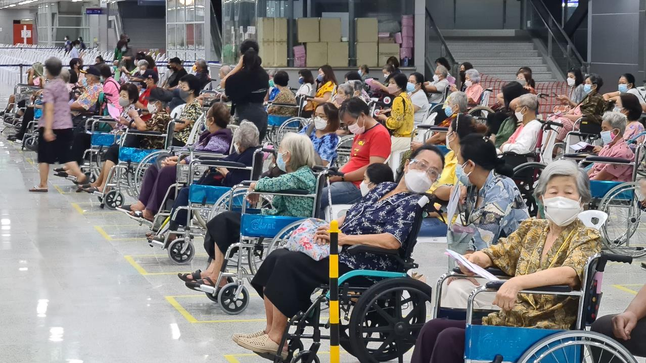

Slide 9
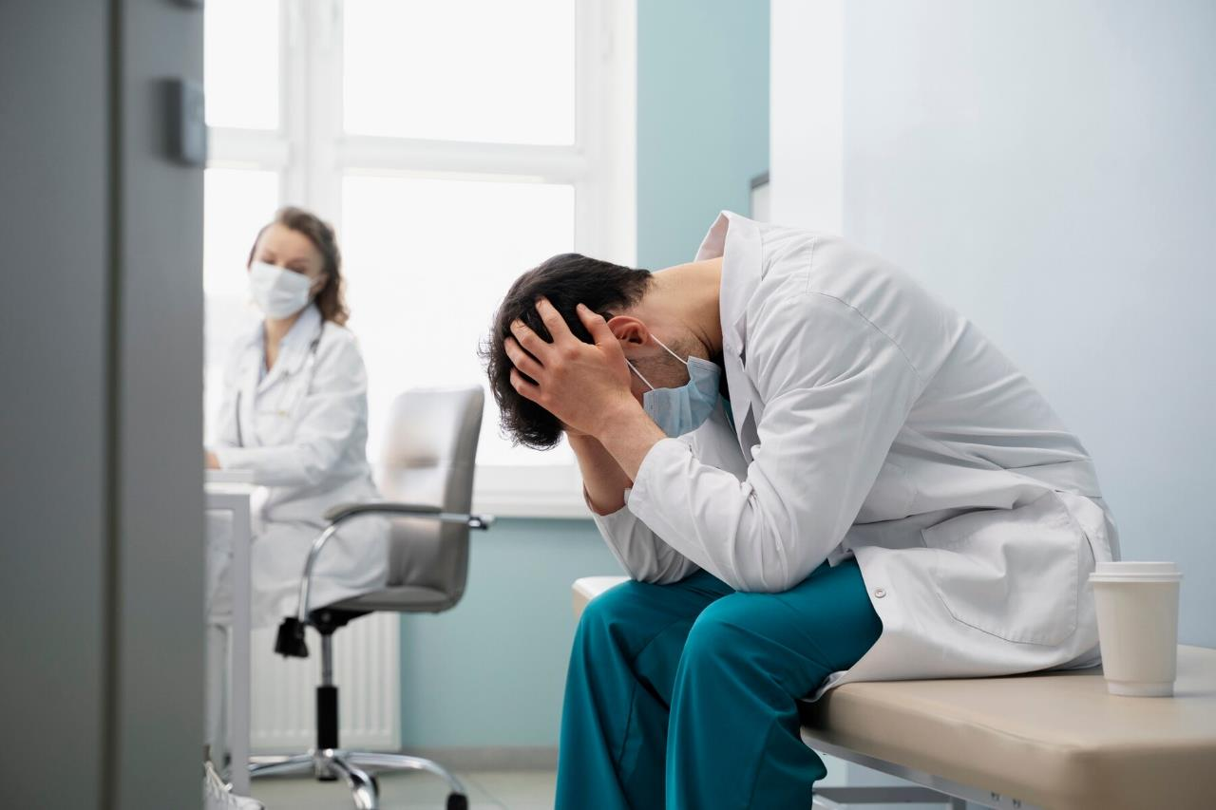

Slide 10
Lifestyle Medicine

Slide 14
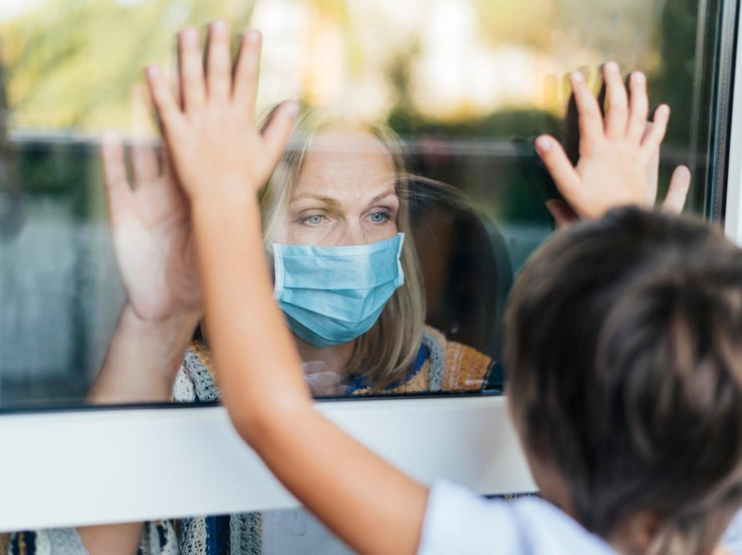

Slide 24
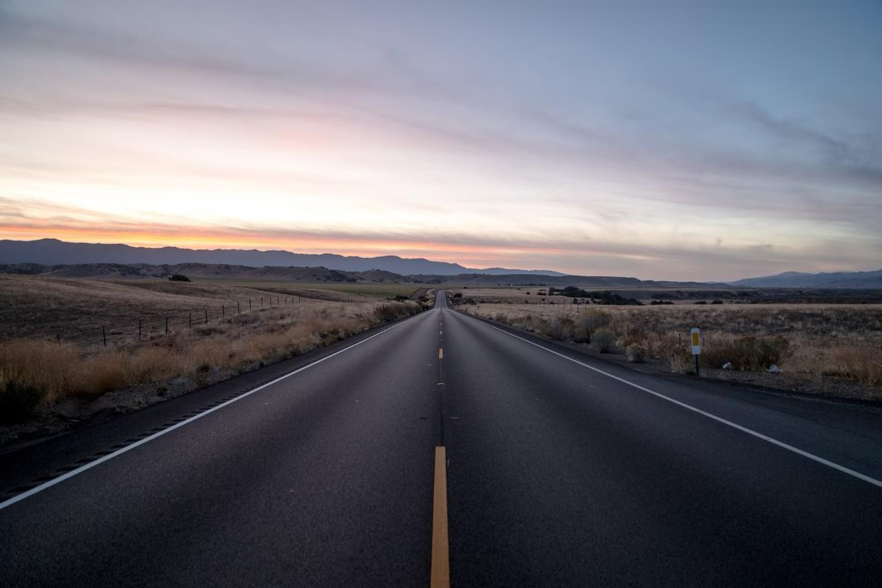

Slide 26
Why did you go to medical school?

Slide 27
Thank you!
Gustavo Hirt, MD
+55 54 999-606-084 | ghirt@abmedicina.com
@abmed.br | @abaedu.br

